Slide 1
Gesture interfaces with depth sensors
Erhardt Barth
Institute for Neuro- and Bioinformatics
University of Lübeck
Ein Gedi, March 2014
Notes:
I will base my talk on the experience with our startup company gestigon (www.gestigon.de). But do not worry, this will not be any kind of commercial. Rather, the startup endeavor tells you in a clear way, which can hurt, what the current limitations of the technology are and what future developments are required. If you need to track all degrees of freedom of two hands with very little hardware, if you need to do that through windows, in bright sunlight, and in cars, you are faced with a number of challenges, for example to (i) invent simple and robust algorithms, (ii) talk to the users and define use cases, (iii) talk to the camera people and jointly optimize hardware and algorithm design. I will briefly sketch our approach to hand- and body-skeleton tracking and discuss the main challenges. In addition to those mentioned above, one of the main technical challenges is to obtain a tight coupling between the user and the application. On top of that you need to understand user intent and a basic alphabet of gestures. It seems worth discussing how such an alphabet could be defined. It would be nice if we could set up an interdisciplinary, international interest group for TOF-based gesture technology.
1

Slide 2
Motto: show me your hardware and I show you my software!
This workshop is more about hardware but hardware alone is useless, as is software alone.

Slide 3
Overview of presentation
Why ToF?
Gesture interfaces, hand tracking
A few words about gestigon
Alternative technologies
Multi-modal interfaces
Applications

Slide 4
Future user interfaces
Computers and other electronic devices shrink and the need for a human interface remains.
This generates a tremendous interest in alternative interfaces such as touch-less gesture interfaces, which can create a large, generic interface with a small piece of hardware.
Quote from:
Foti Coleca, Thomas Martinetz, and Erhardt Barth: Gesture Interfaces with Depth Sensors. Grzegorzek et al. (Eds.): Time-of-Flight and Depth Imaging, LNCS 8200, pp. 207–227, Springer-Verlag Berlin Heidelberg, 2013.

Slide 5
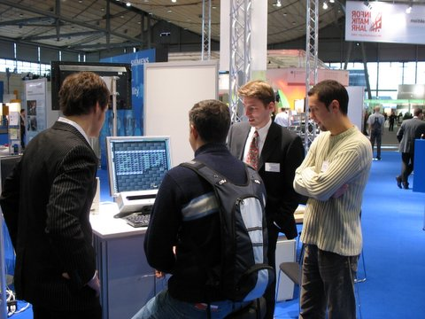
Future user interfaces
We want a more natural, more intuitive interface (NUI)
Use human-body radiation
  e.g. brain-computer interface
Use ambient radiation
  e.g. RGB cameras working with ambient light
Use active radiation (BYOL)
In general terms, we want to increase the bandwidth of man-machine communication.
CeBit 2006

Slide 6
Light sensors and active illumination
2D cameras plus IR light
  Single cam
  Single or multiple cams plus spatially structured light
  Multiple cams with uniform IR, e.g. stereo
ToF cameras
  The only reason for not using temporally structured light may be the cost of it
  One benefit of structuring light in time, is that time does not take up space

Slide 7
Why ToF and not structured light?
Easier to adapt the light pattern to a working range
Illumination hardware is simpler
Simpler calculation of depth values
Smaller baseline and thus size
Usable amplitude image
Less shadows in the depth map due to nearby lens and illumination

Slide 8
Why ToF and not stereo?
Stereo provides depth in structured regions only (edges, texture)
Stereo matching brings computational load; much simpler calculation of depth values with ToF
Less shadows in the depth map due to nearby lens and illumination
No problems with repetitive patterns such as the fingers of an open hand
Smaller size; no baseline required

Slide 9
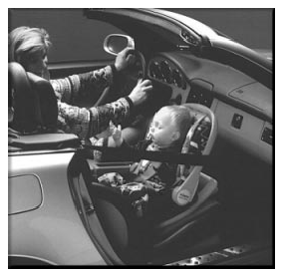
Intelligent airbags
Problems:
Deployment with kids and OoP (harm)
Useless deployment (cost)
Solutions back then, i.e. 2000+:
  Stereo (TRW, Bosch)
  ToF (IEE, Siemens)
First large application for ToF sensors (that did not happen after all)
OoP: Out of Position

Slide 10

The ARTTS project
ARTTS (Action Recognition and Tracking based on Time-of-Flight Sensors) has been an European project (2006-2009) with the following main highlights:
ARTTS camera, the world’s smallest ToF camera
2D/3D fusion camera, world’s first and only HDTV+ToF camera
Algorithms that improve the cameras and enable applications
  Improvements of both the ToF and the intensity signal
  Geometric and sparse range and intensity features optimized for ToF cameras
  Fusion of ToF signals with high-resolution video and stereo
  Face detection, nose tracker, and deictic gestures for HCI
  Robust pose estimation and tracking (SOM body tracker, model-based hand tracker)
  Gesture and activity recognition
  Respiration monitoring and detection of sleep apnea
  Gait analysis using articulated human models
Further information at www.artts.eu

Slide 11
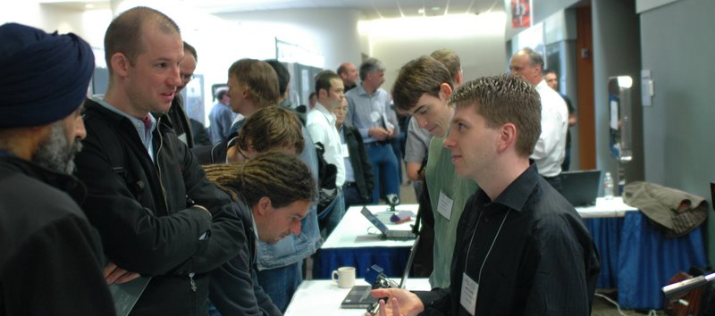
CVPR ToF workshop 2008, Alaska with MESA, PMD, Canesta, 3DV, and Melexis/Optrima exhibiting

Slide 12
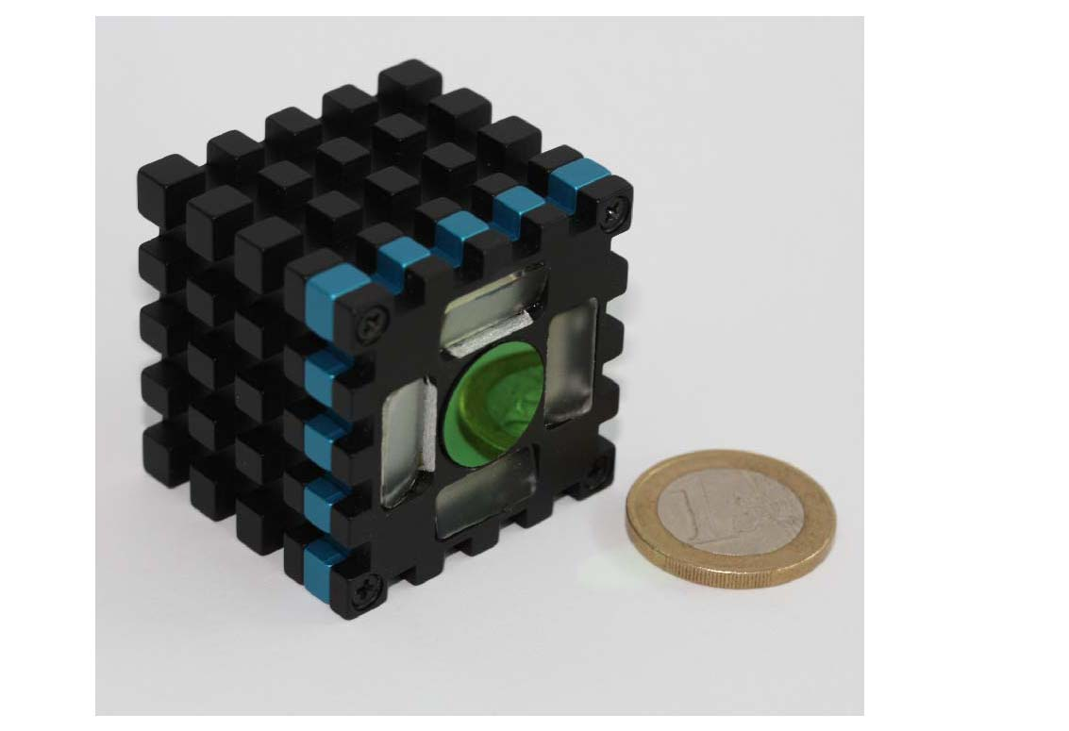
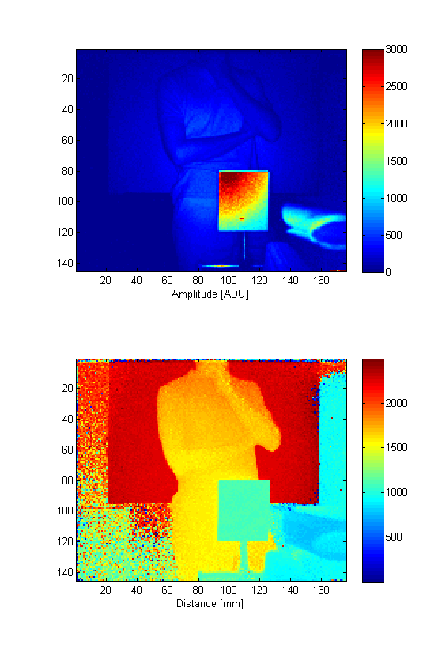
ARTTS ToF camera *
Main highlights
  First ToF camera powered by USB only
  At that time, world’s smallest ToF camera
  (38 mm x 38 mm x 35.4 mm)
  Distance standard deviation around 1%
* Developed by CSEM and MESA Imaging

Slide 13
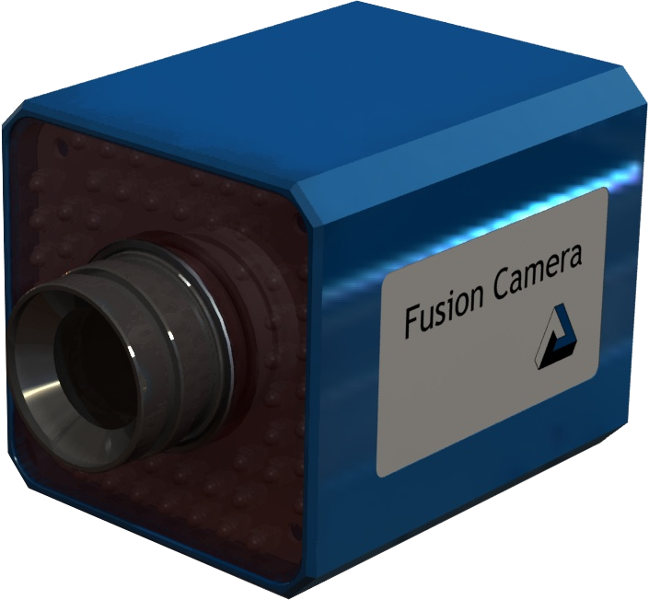
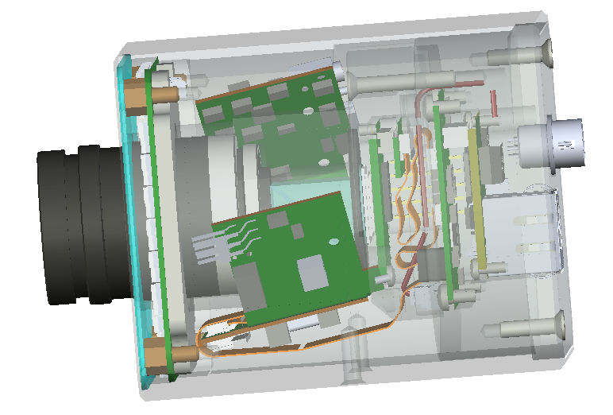
2D-3D fusion camera *
World’s first and then only hybrid HDTV/ToF camera
  Very compact
  Gigabit Ethernet interface
  Perfect alignment of 2D and 3D images
  Built-in noise filters
  * Developed by SMI and CSEM

Slide 14
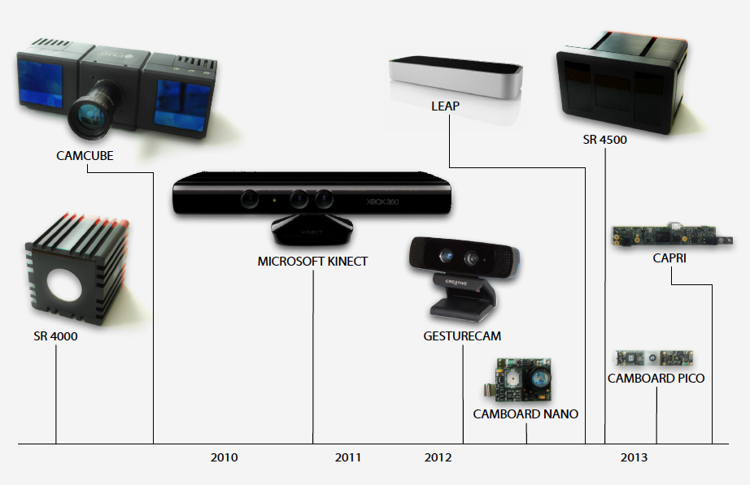
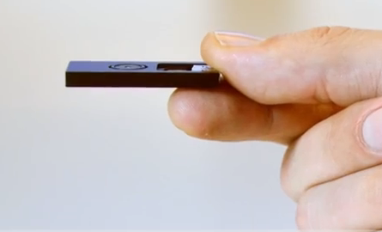
Evolution of 3D cameras
PMD CamBoard pico XS

Slide 15
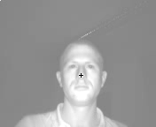
A facial feature tracker for human-computer interaction (the "NOUSE")
Use tracker as head mouse to control alternative text entry tool Dasher.
Martin can easily “type” with 12 words per minute.
Detector based on geometric features

Slide 16
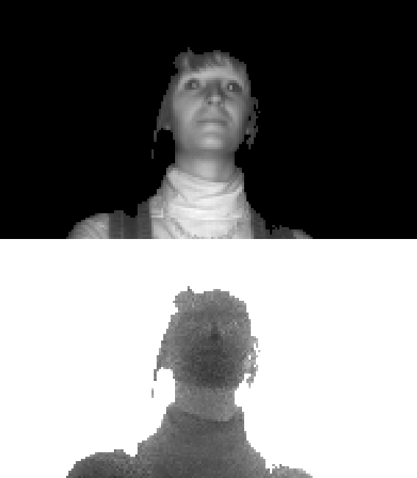
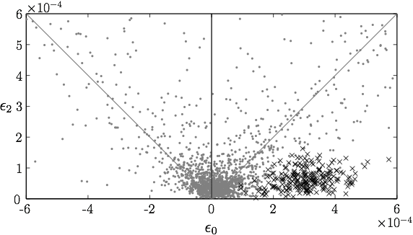

Nose Detection

Slide 17
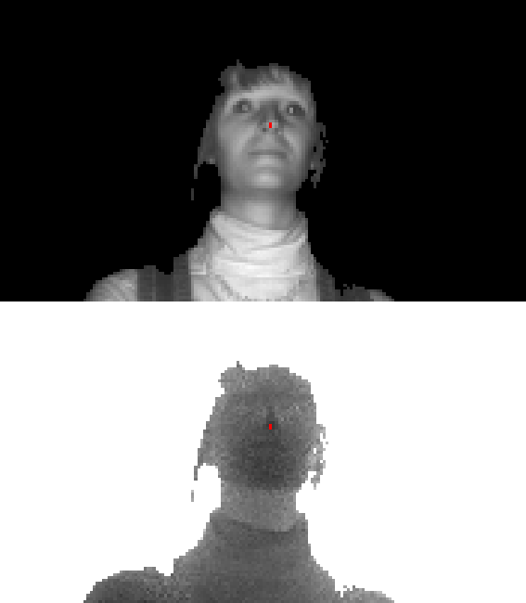
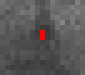
Nose Detection

Slide 18
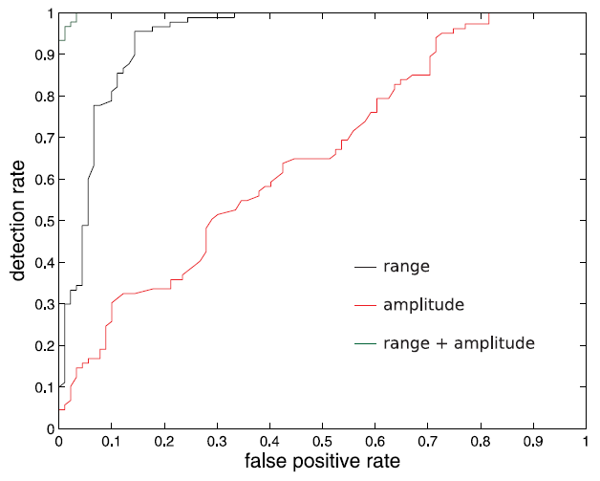
Facial feature tracker: results

Slide 19
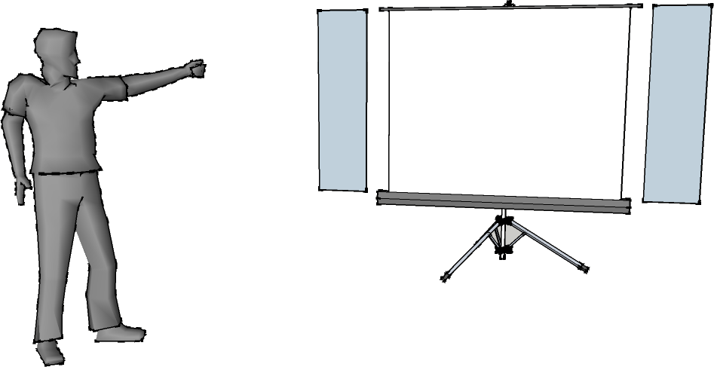
Deictic gestures
prev
next
User can point on the screen and select slides
M. Haker, M. Böhme, T. Martinetz, and E. Barth. Deictic gestures with a time-of-flight camera. International Gesture Workshop GW 2009, volume 5934 of LNAI, pages 110-121. Springer, 2009.

Slide 20
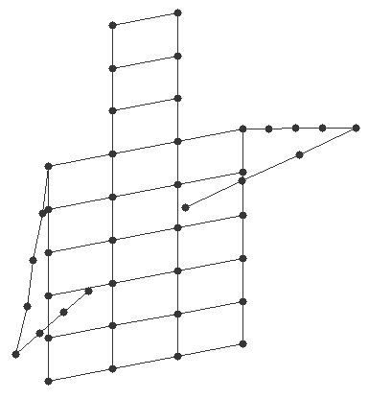
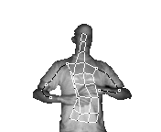
SOM pose estimation
Fit simple model of human
body to visible surface in 3D
Based on self-organizing maps (SOMs)

Slide 21
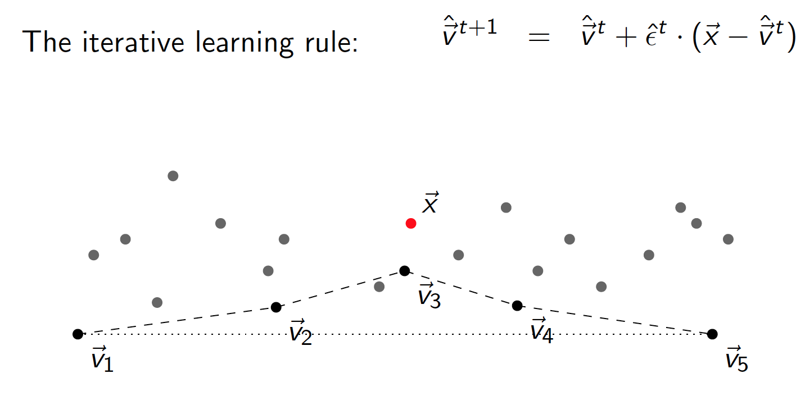
SOM pose estimation

Slide 22
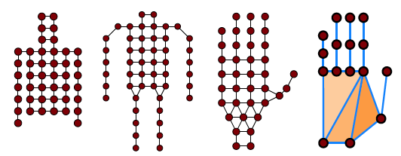
SOM topologies
From left to right: 3 different topologies of the SOM, and the hand topology of the extended SOM.

Slide 23
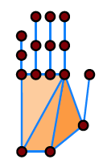
Extended SOM
Uses 1D and 2D network segments instead of just nodes
The 1D-segments are the lines between pairs of connected nodes
The 2D-segments are the triangles determined by triples of connected nodes
1D-segments better represent fingers, and the 2D-segments the palm

Slide 24
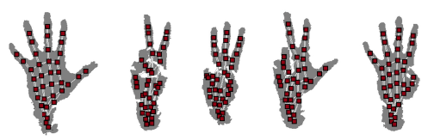
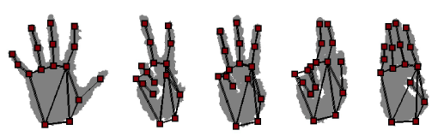
Comparison of the two SOMs

Slide 25
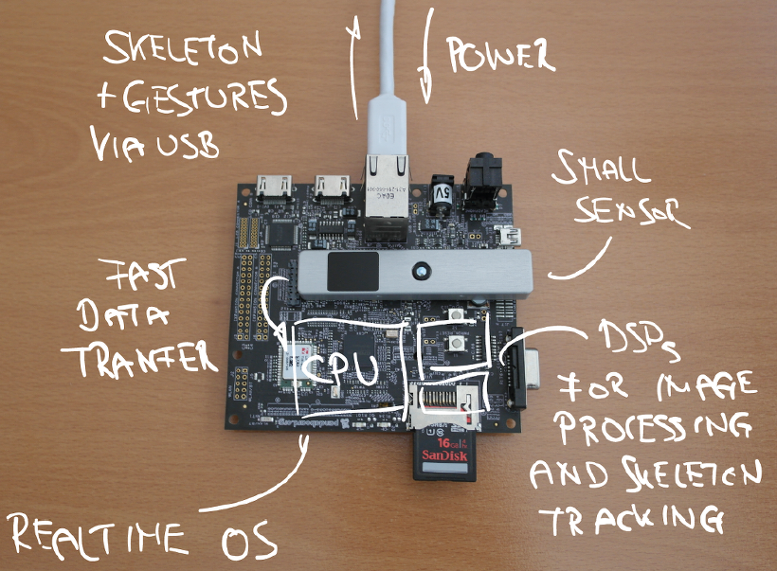
Pose estimation on ARM processor
The SOM algorithm is of low complexity and its performance scales nicely with computational power when varying the number of 3D points that are used for the update of the nodes.
Runs in realtime on an ARM processor (ARM Cortex-9, 1 GHz, dual core).

Slide 26
Current research topics
Antropometric constraints on the SOM
Fusion of 3D and 2D, e.g. for finger-tip detection
Enhancing 3D SOM with 2D information, e.g. finger-tip detection
Combining gestures and gaze

Slide 27
Alternative approaches
Simplified interfaces with more limited use
  only simple features such as finger tips and blobs
  no pose estimation
More complex, generative and/or discriminative models
  better accuracy but higher computational load

Slide 28
Remaining challenges
Data quality and environment limitations: ToF cameras are getting better but some environments (e.g. sunny outdoors) are still problematic
Data rate and latency: the hand is capable of very quick and sudden movements
Ergonomic limitations: interfaces have to be designed around human anatomy and capabilities

Slide 29
Remaining challenges
Unintentional user movements; possible solutions:
  Define active area in which gestures are performed
  Use modal interfaces – a „clutch“ gesture indicates intent (e.g. waving)
  Dwell time – hold for a specific time, after which the action is performed (e.g. hold hand on hyperlink)
  Multi-modal interaction – use alternative input, like vocal commands

Slide 30
Commercial solutions for 3D hand interfaces
Microsoft (ToF)
Softkinetic / Creative / Intel (ToF)
Omek / Intel (?)
Leap (stereo)
3Gear (camera agnostic, mainly PrimeSense)
gestigon (camera agnostic, currently mainly ToF)
others like PointGrab, EyeSight are using only 2D

Slide 31

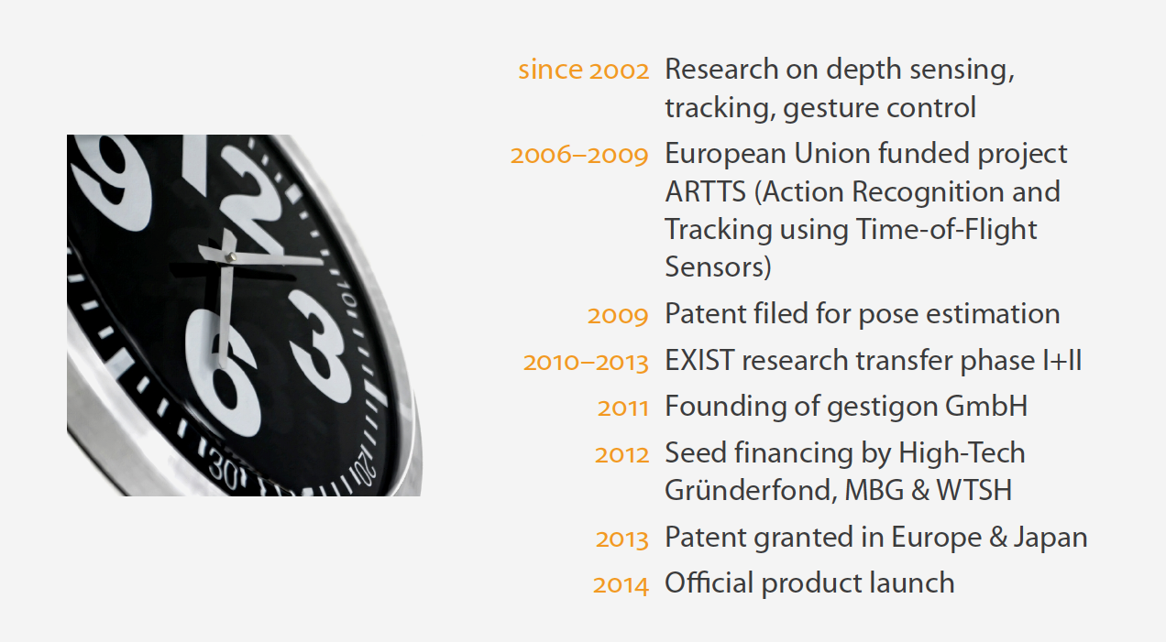

gestigon brief history

Slide 32
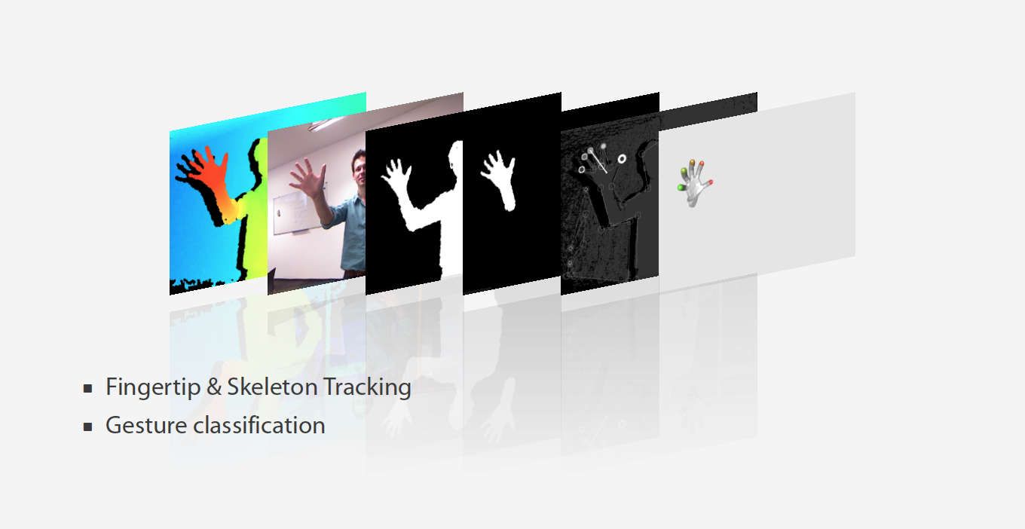
gestigon technology

Slide 33
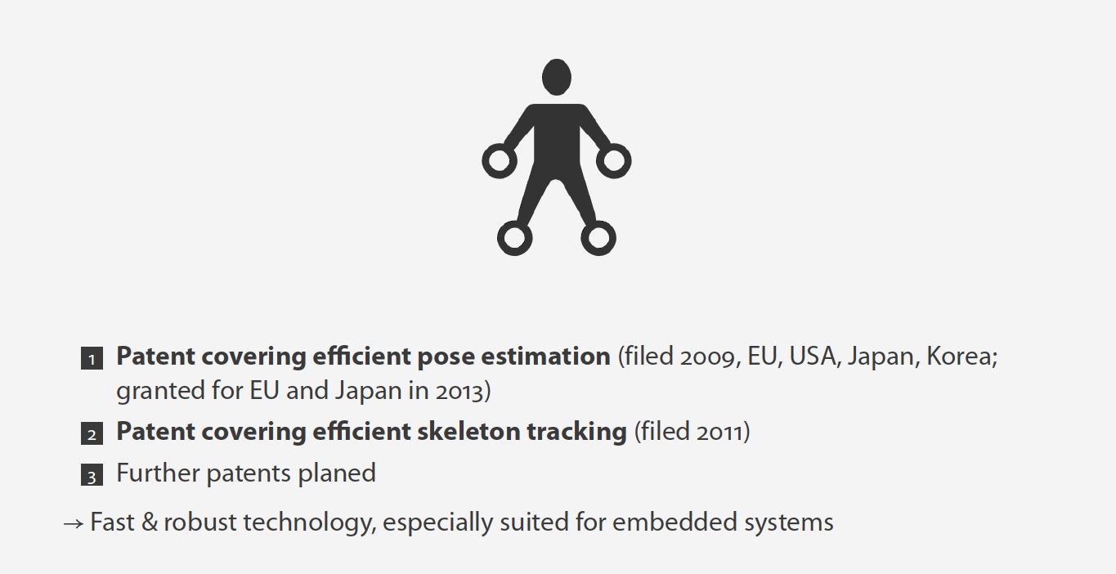
gestigon IP

Slide 34
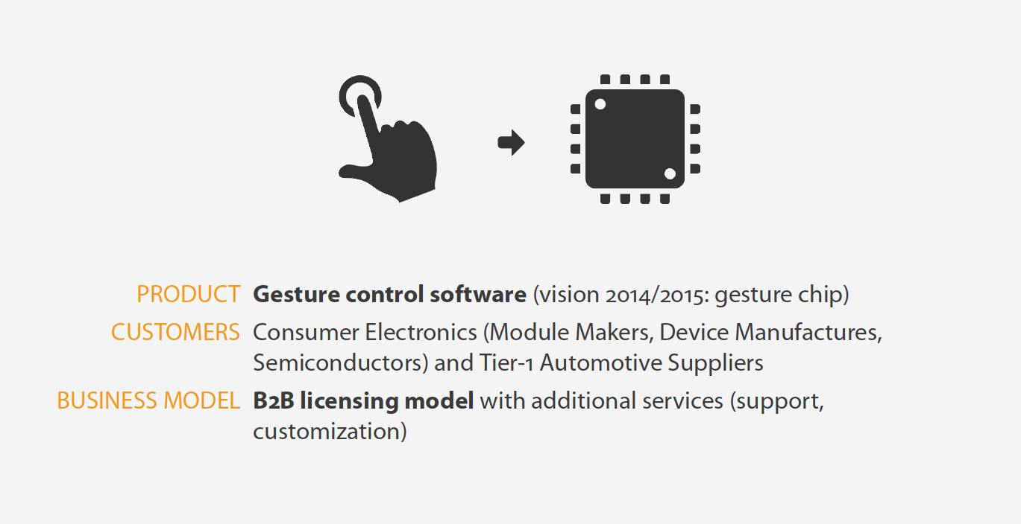
gestigon products and services

Slide 35
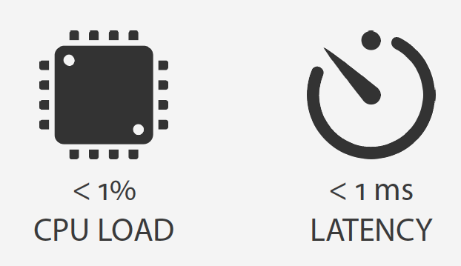
gestigon USPs

Slide 36
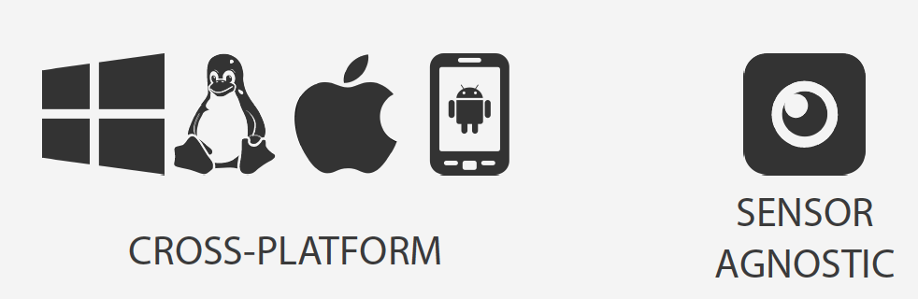
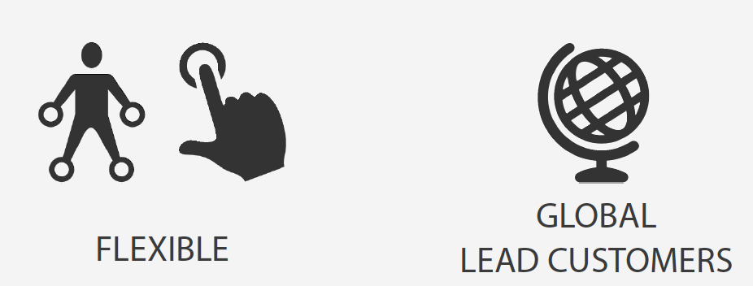
gestigon USPs

Slide 37
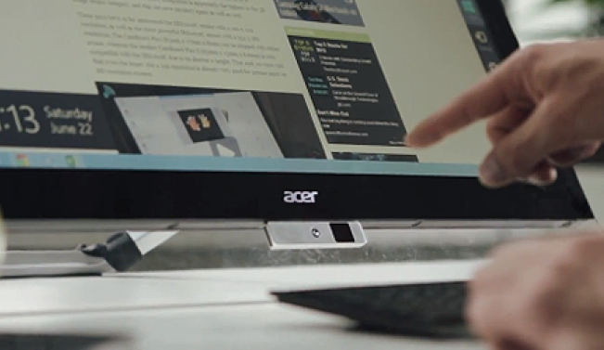
Current focus at gestigon
License current technology to Module Makers, ODMs, OEMs
Turn embedded solution into a gesture chip
Consumer electronics, automotive, and digital-signage partnerships
See demo on Wednesday

Slide 38
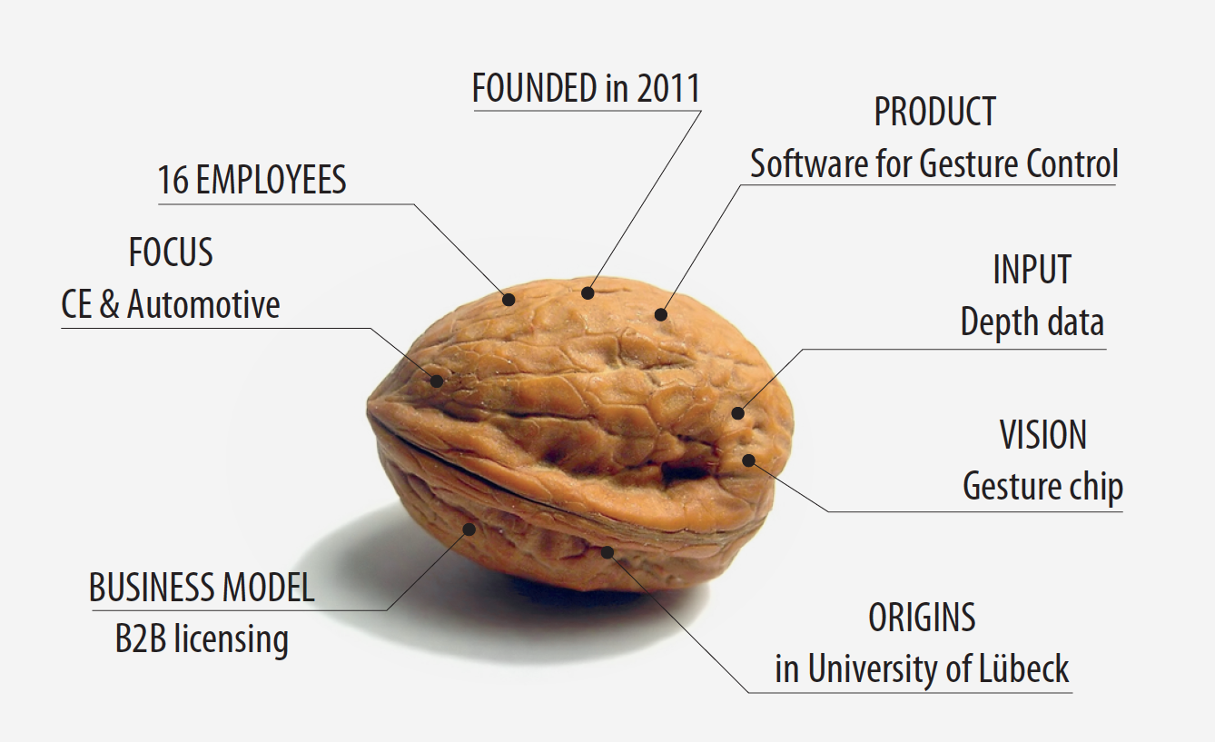

Slide 39
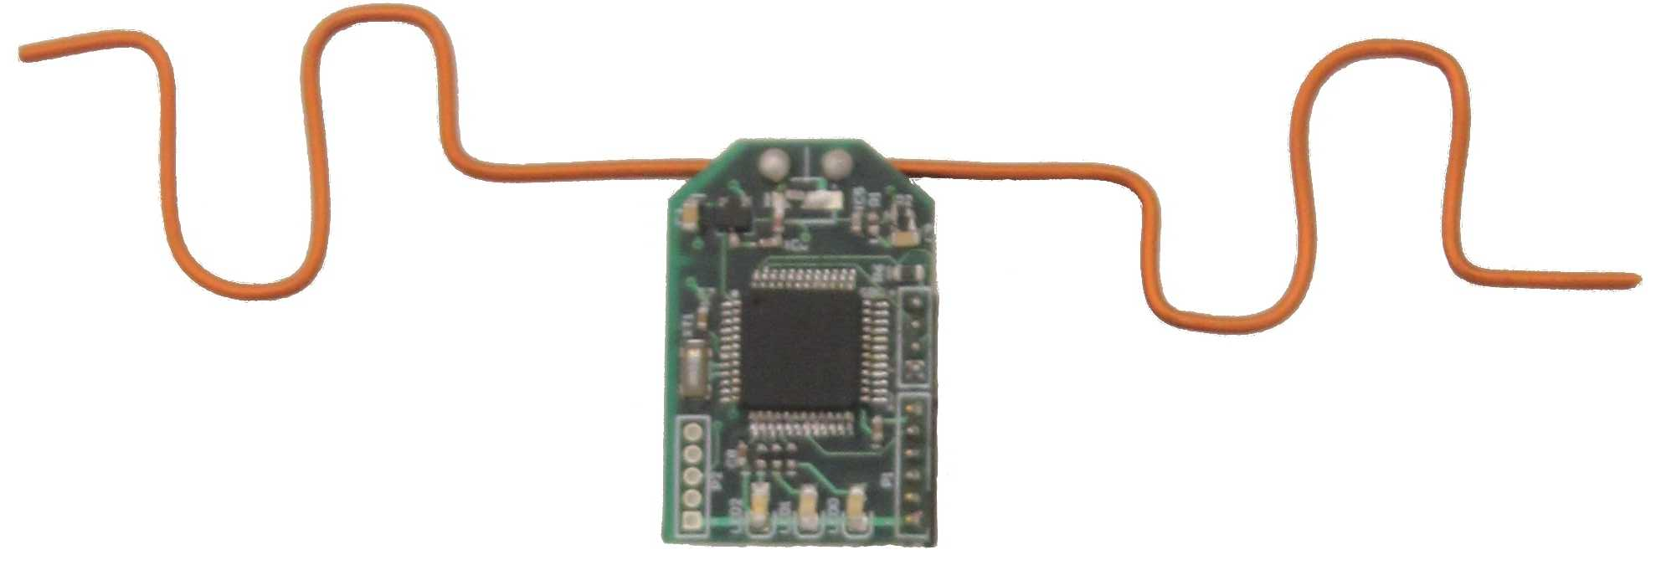
Alternative technologies
WiSee and AllSee (University of Washington)
Uses Doppler shift in wireless signal to detect and classify gestures
+ Leverages existing wireless transceivers
+ Does not require free view
+ Low power requirements
Requires vigorous motion
No pointing, no subtle gestures

Slide 40
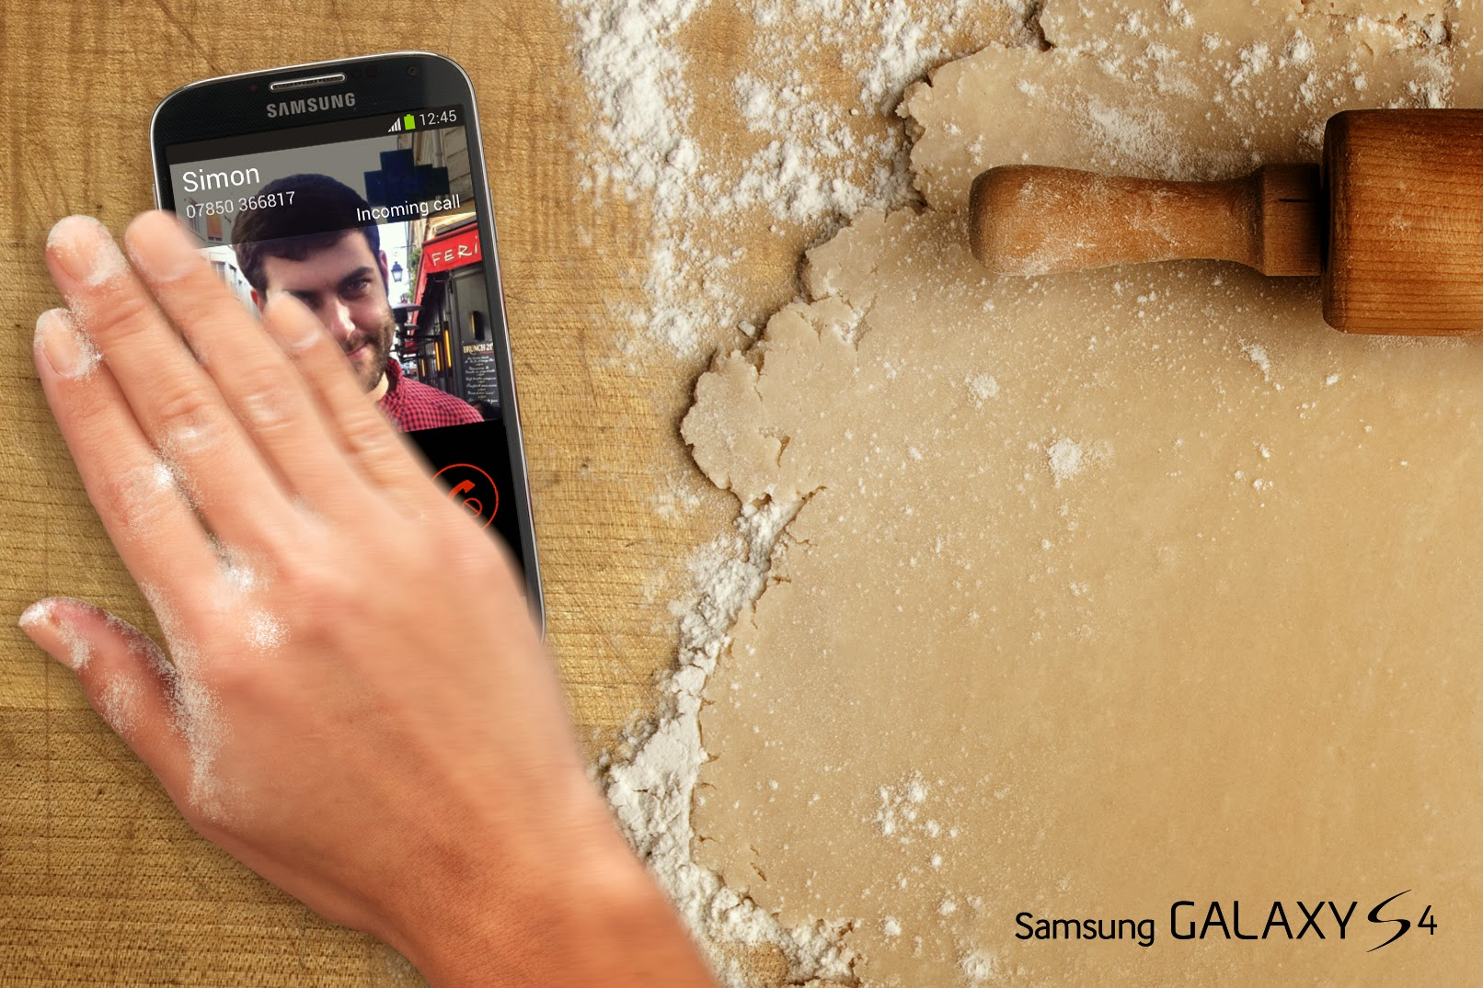
Alternative technologies
Samsung Air Gestures
+ Leverages proximity sensor of smartphones
- Simple gestures only
- Requires hand to be
in close proximity to
the screen

Slide 41
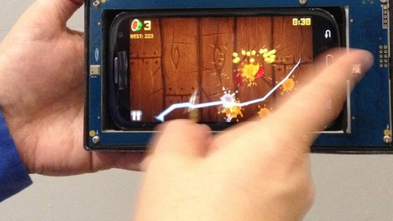
Alternative technologies
Elliptic Labs
Ultrasonic sensors for gesture recognition

Slide 42
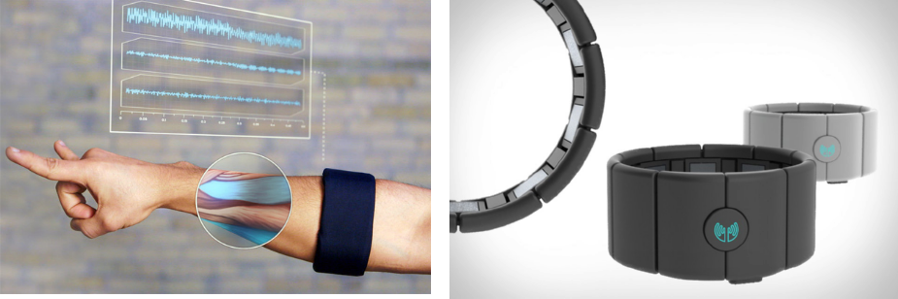
Alternative technologies
Thalmic Labs Myo Armband
EMG muscle activity sensors for gesture recognition
Haptic feedback

Slide 43
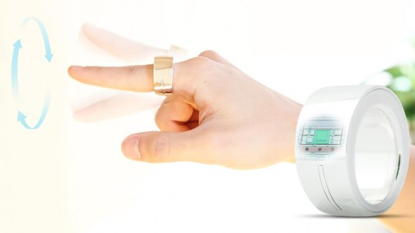
Alternative technologies
Logbar Ring
has motion and touch sensors
vibrates for feedback

Slide 44
Multi-modal interfaces
Combining gestures and speech/sound
Combining gestures and gaze
Combining everything

Slide 45
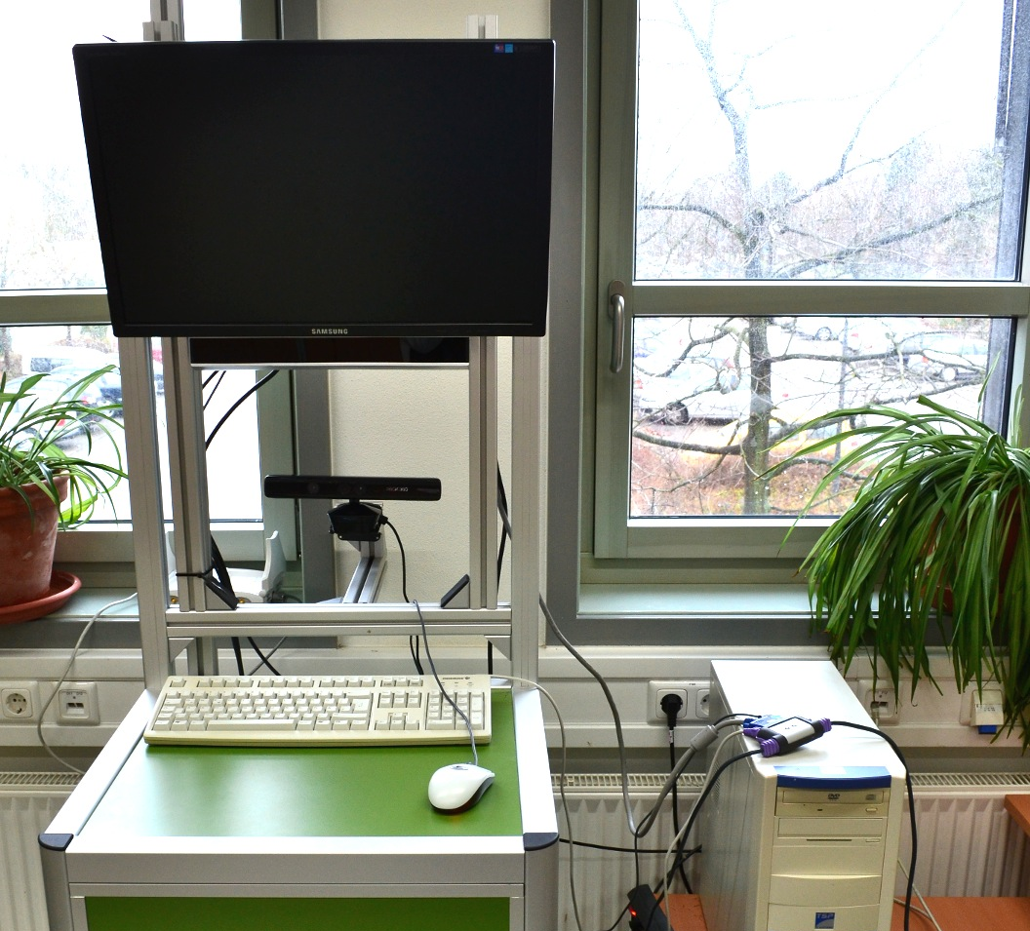
Gestures & gaze 2011*
SMI RED + Kinect
Evaluation of 3 tasks:
point to an icon (either by gaze, hand, or mouse)
activate an icon (push, or click)
activate a series of icons
Conclusion: the multimodal interface (pointing by gaze and activating by hand-push gesture) is faster – < 2s - than pointing and pushing by hand – > 3s - (but still slower than mouse clicks – 1s - however, this is mainly due to technological limitations of the experimental setup).
* Eike von Tils, Eciency of Eyetracking in Combination with Gesture Recognition, INB BSc thesis, 2011.

Slide 46
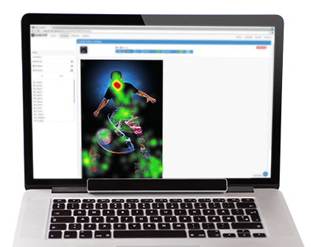
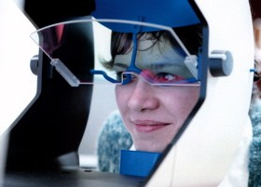
Eye-tracking (ET) technology
Evolution of hardware similar to ToF
Expectations similar to gesture-based NUI
Mass-market applications are still a vision
Problem: ET does not work for everybody (e.g. due to some glasses)
www.gazecom.eu

Slide 47
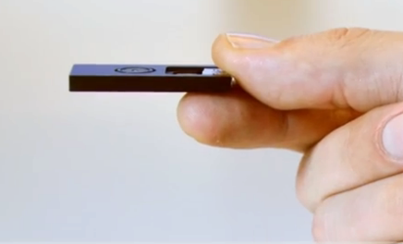
Applications of gesture interfaces
Sensors are finally small
Interface software is getting there
Remaining problem: what are the applications and who is developing them?
PMD pico XS

Slide 48
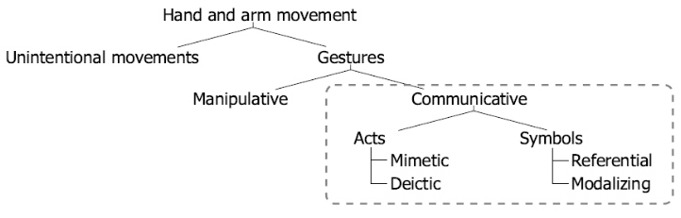
What is a gesture
V. Pavlovic et al. - Visual interpretation of hand gestures for human-computer interaction: a review. IEEE TRANSACTIONS ON PATTERN ANALYSIS AND MACHINE INTELLIGENCE, VOL. 19, NO. 7, JULY 1997

Slide 49
Gesture taxonomy
Unintentional movements – the bane of gesture recognition
Manipulative – working with physical objects (pushing a button)
Mimetic – imitating actions (air guitar!, swipe left to turn page)
Deictic – pointing to something (look at that!, move cursor to location)
Referential – gestures linked to meanings (thumbs up!, spread hand to zoom in)
Modalizing – changing the meaning of communication (shrugging shoulders)

Slide 50
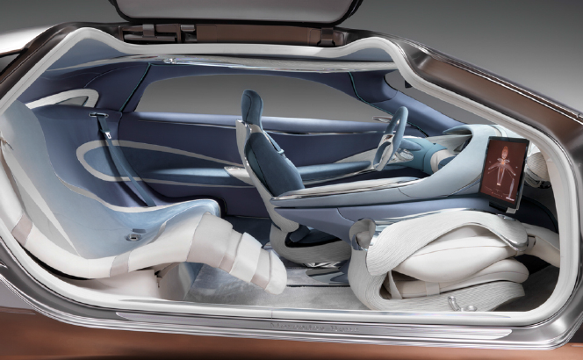
Automotive applications
Interface space in the car is expensive
Car makers seem to hate buttons
They are all looking into ToF-based gesture interfaces

Slide 51
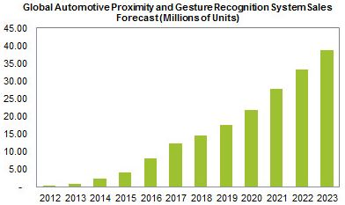
Automotive applications
First proximity recognition systems used by Cadillac and Volkswagen in 2012
IHS predicts fast growth of gesture solutions
High-resolution gesture systems to appear by 2017
Source: IHS Inc. September 2013
http://press.ihs.com/press-release/design-supply-chain-media/sales-automotive-proximity-and-gesture-recognition-systems-s

Slide 52
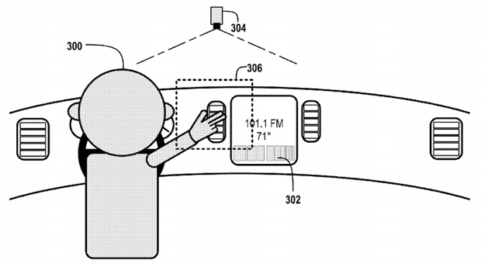
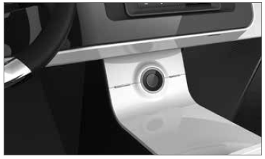
Automotive applications
Google patent application for gesture control in cars (2013)
gesture control interface at CES 2014: Kia, Visteon

Slide 53
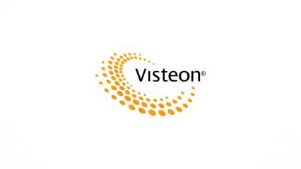
Automotive applications: multi-modal interface developed by Visteon & gestigon

Slide 54
Human-computer interface
Apps like photo browsers, maps, music, etc. can gain from a more natural interface
Gaming can be more fun

Slide 55
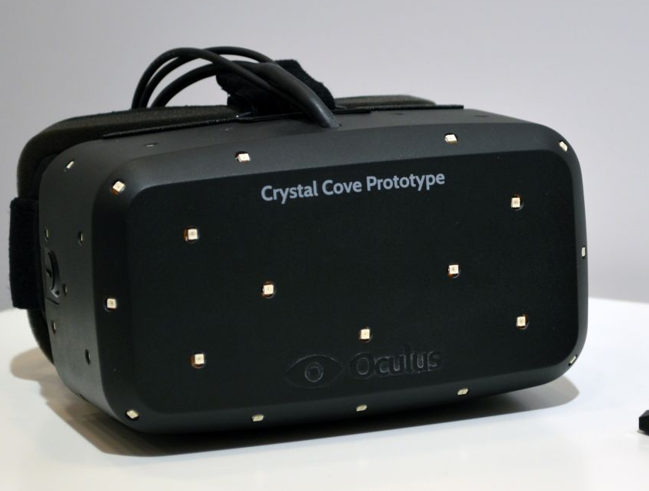
Augmented reality - Oculus Rift
Virtual-reality platform, currently needs extra wearable hardware for positional tracking and action recognition
-> good platform for 3D cameras
(mounted on device or external)
Pose estimation
Gesture recognition
3D body/hand 'avatar' for better immersion

Slide 56
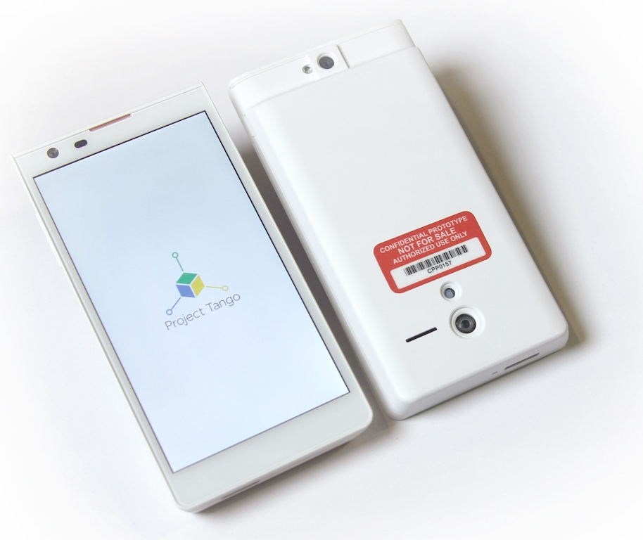
Google Tango
Mobile phone with ‘powerful computer vision processors’
- IR depth camera (Structured light, Capri?, pulsed ToF ?)
- and one 4MP RGB-IR and one high-speed VGA sensor
Focus seems to be on augmented reality and SLAM (Simultaneous localization and mapping), not interaction, but
‘Possibilities are endless and the future is awesome‘.

Slide 57




Acknowledgements
Martin Böhme, Martin Haker, Thomas Martinetz
Foti Coleca, Sascha Klement

Slide 58
Conclusions
3D sensing has gained increased visibility worldwide
Hardware and software are maturing
A growing number of applications seem possible; many involve 3D gestures and aim at more natural user interfaces (NUIs)
Still some question marks regarding applications and their volumes

