Slide 1
Time Resolved imaging
Micha Feigin – MIT
ITOF Workshop - Ein Gedi 2014

Slide 2
Overview
Femto photography
Pose estimation through diffuser
Microwave camera

Slide 3
Femto Photography

Slide 4
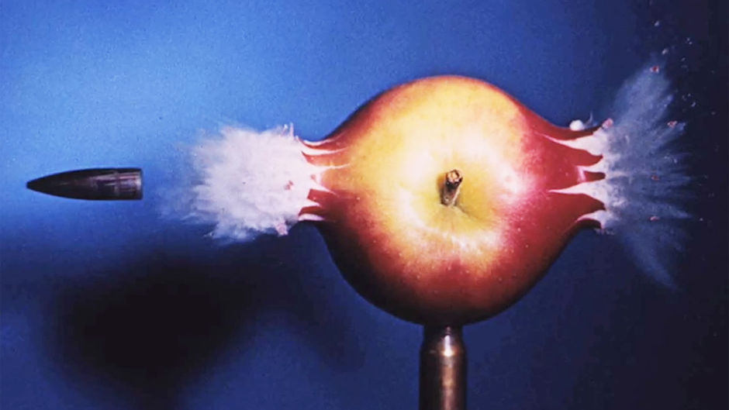
1964 - Harold E. Edgerton
834 m/s

Slide 5
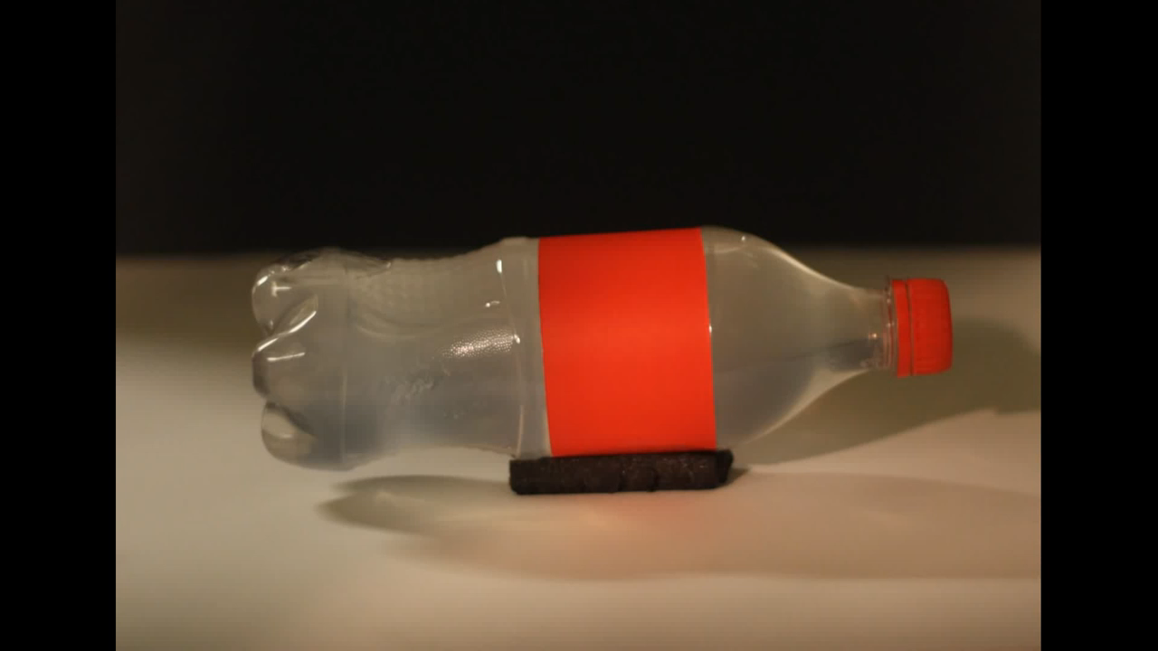

2011 – Velten et al.
$$3∗{10}^{9} m/s$$

Slide 6
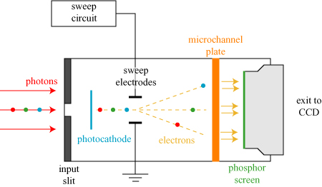
The Streak camera

Slide 7
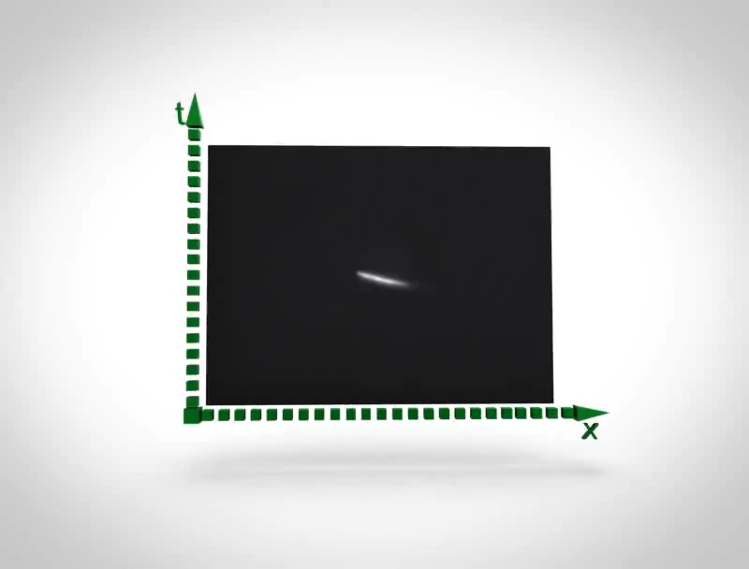
The Streak Camera

Slide 8
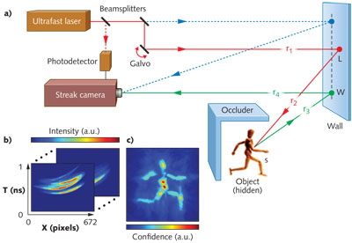
Application : Looking around the corner

Slide 9
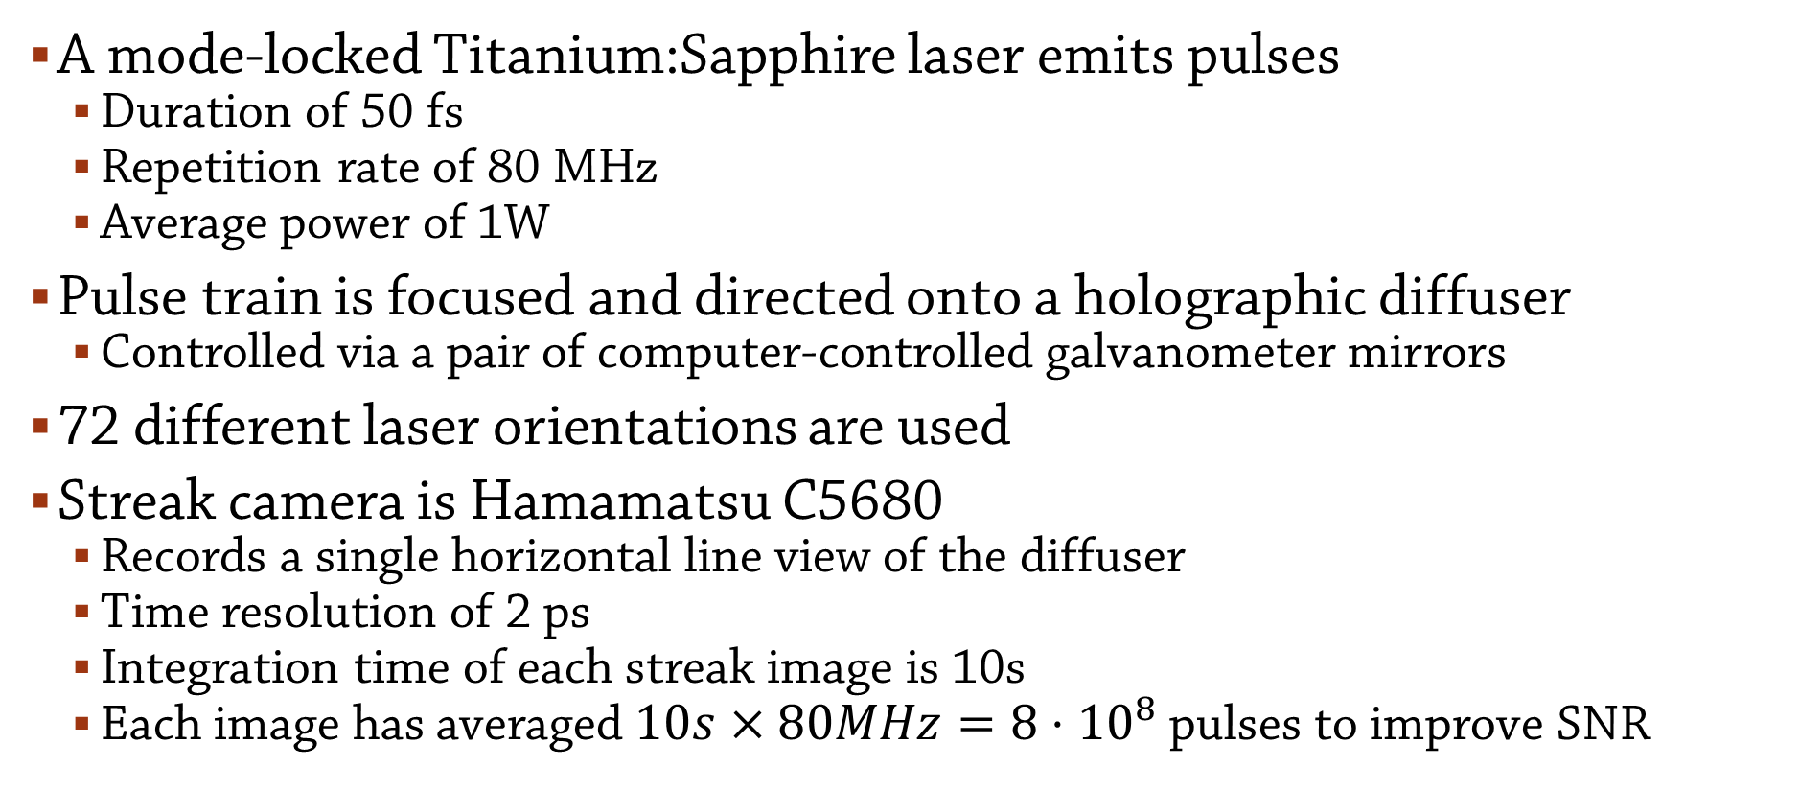
Experimental Setup
A mode-locked Titanium:Sapphire laser emits pulses
  Duration of 50 fs
  Repetition rate of 80 MHz
  Average power of 1W
Pulse train is focused and directed onto a holographic diffuser
  Controlled via a pair of computer-controlled galvanometer mirrors
72 different laser orientations are used
Streak camera is Hamamatsu C5680
  Records a single horizontal line view of the diffuser
  Time resolution of 2 ps
  Integration time of each streak image is 10s
  Each image has averaged $10s×80MHz=8⋅{10}^{8}$ pulses to improve SNR

Slide 10
The streak camera model
Can be modelled as a single bounce
Virtual light source mapped to laser point on wall
Virtual (lens less) sensor by mapping camera to wall
Virtual pixel
Lambertian wall
Virtual light source
camera
Lambertian object
Laser

Slide 11
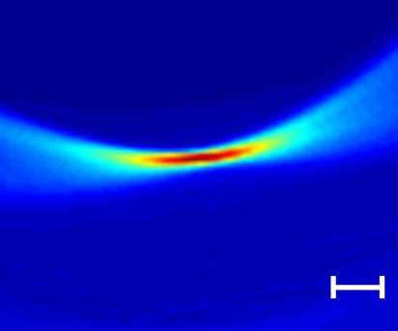
The streak camera model
Virtual pixel
Lambertian wall
Virtual light source
t
camera
Lambertian object
Laser
x

Slide 12
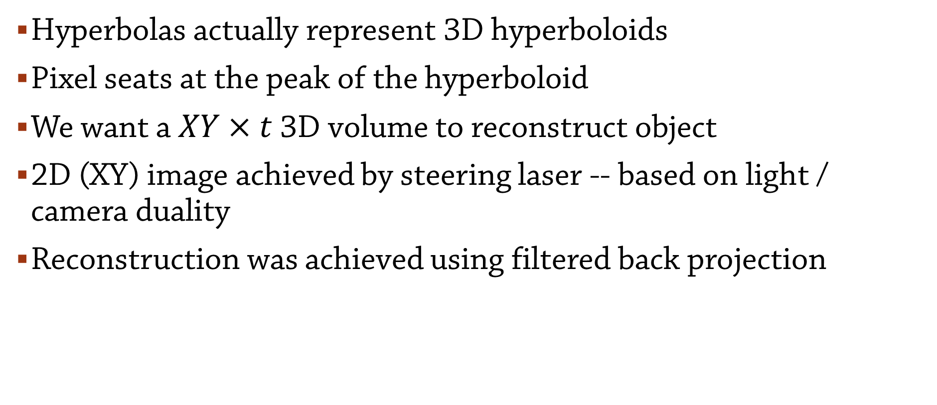
Looking around the corner
Hyperbolas actually represent 3D hyperboloids
Pixel seats at the peak of the hyperboloid
We want a $XY×t$ 3D volume to reconstruct object
2D (XY) image achieved by steering laser -- based on light / camera duality
Reconstruction was achieved using filtered back projection

Slide 13
pose estimation from scattered TOF data given shape priors
With Dan Raviv and Christopher Barsi

Slide 14
The Setup

Slide 15
Experimental Setup
Pulse train is focused and directed onto a holographic diffuser
  Controlled via a pair of computer-controlled galvanometer mirrors
  Gaussian diffuser of size 10cm by 10cm and STD of 8.8 (Edmund Optics, 65-886)
Ground truth is recorded with a FARO digitizer arm

Slide 16
Pose estimation behind diffuser
One of several problems in subsurface imaging
A large number of samples is not feasible in many cases
Q: how much information can be reconstructed using few or single spatial measurement

Slide 17
Pose estimation behind diffuser
Instead of imaging an unknown geometry
  Recover only spatial and angular position of an object
  Assume a prior on the geometry:
    Search for Humans in hazardous environments
    Track organs or tumors over time
    Surgical tool tracking
These techniques may also be used to extend super resolution flouro-microscopy to thick media

Slide 18
Forward light model

Slide 19
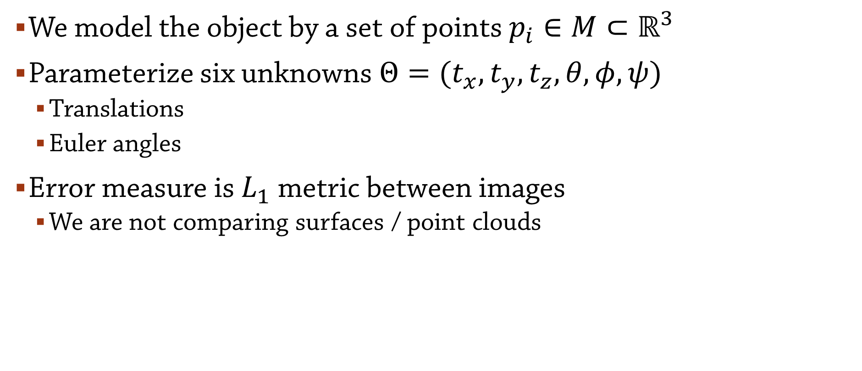
Cross modality ICP
We model the object by a set of points $p_{i}∈M⊂ℝ^{3}$
Parameterize six unknowns $Θ=(t_{x},t_{y},t_{z},θ,φ,ψ)$
  Translations
  Euler angles
Error measure is $L_{1}$ metric between images
  We are not comparing surfaces / point clouds

Slide 20
Experimental Results

Slide 21
Microwave Pinhole Camera
With Gregory Charvatt, Andrew Temme and Ayush Bhandari

Slide 22
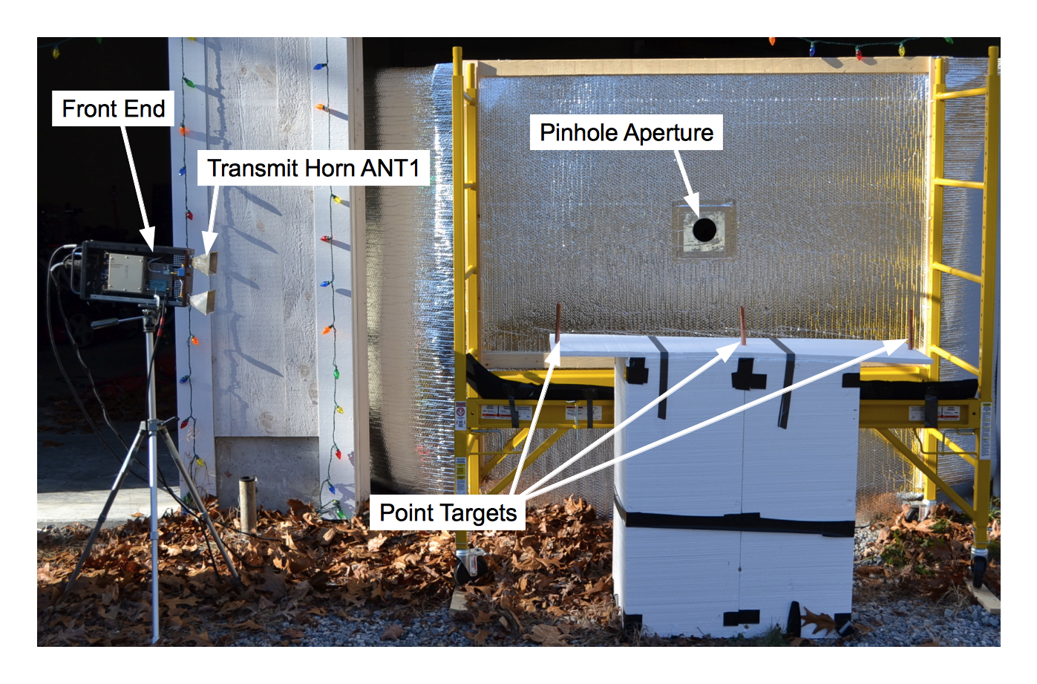
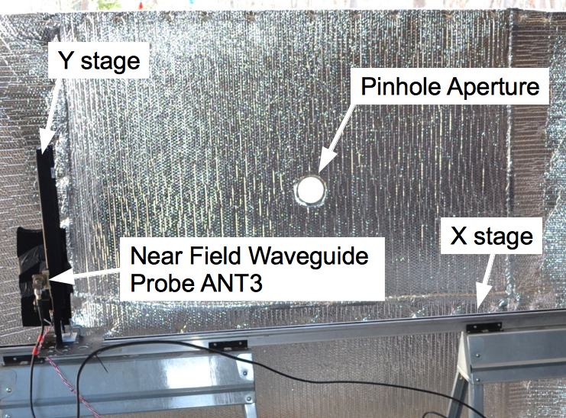

The Setup
Wavelength is $\sim 3cm$ (at 10 GHz)
Aperture size set to 9.5cm ($\sim 3.2λ$)

Slide 23
Background
Problem:
Dielectric optics at 10GHz are expensive and difficult to build
On the other hand:
Antennas and electronics are relatively simple
Modulation frequencies and codes that are difficult to produce with a ToF camera
Real, time resolved imaging at low digitization rates
  Processing is done by emitting a chirp signal
  Multiplication done in hardware
  Time domain signal recovered by inverse Fourier transform

Slide 24
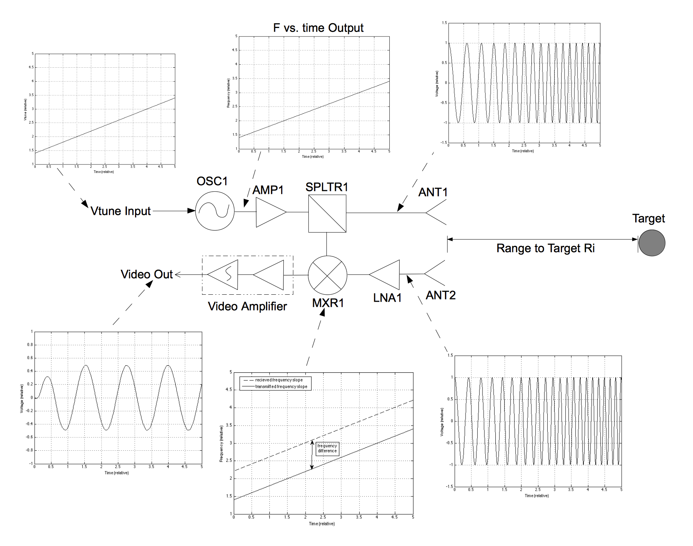
FMCW Radar

Slide 25
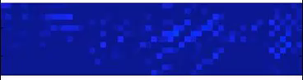
Time resolved video of cylinders

Slide 26
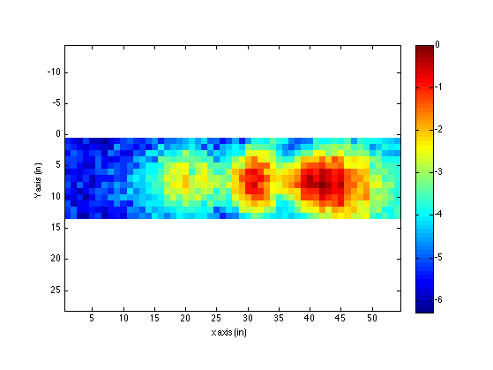
Integration image of cylinders

Slide 27
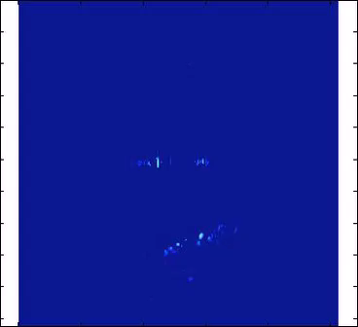
Time resolved (Max Response) of Bike

Slide 28
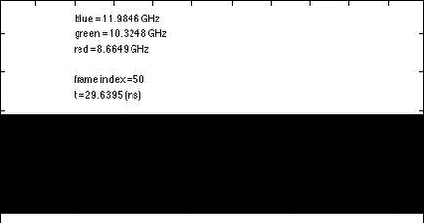
Multi spectral time resolved video of cylinders

Slide 29
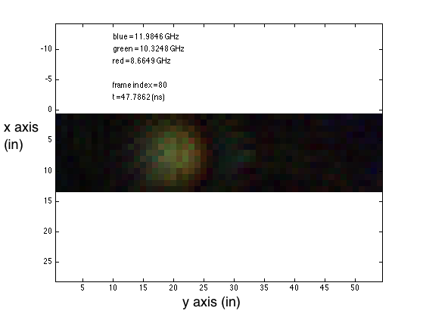
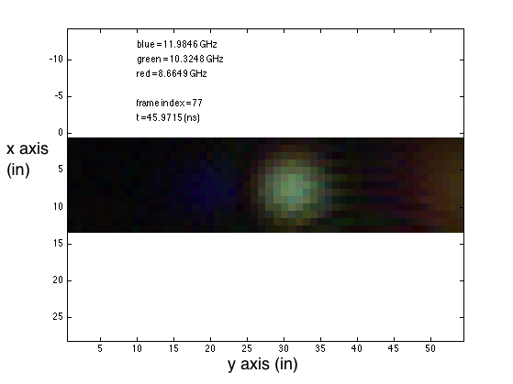
Multi spectral time resolved video of cylinders

Slide 30

Resolution limit
At 10GHz, highly diffraction limited
  Spot size $2g=a\frac{p+q}{p}\sim 10cm to 20cm$
  (depends on distance to object)
More appropriate to mm wave and
THz imaging

Slide 31
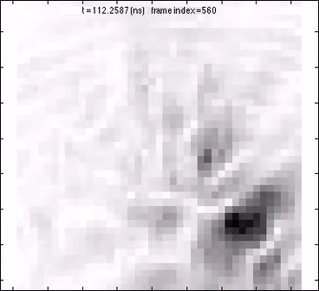
The next stage – Time resolved video of push pins

Slide 32
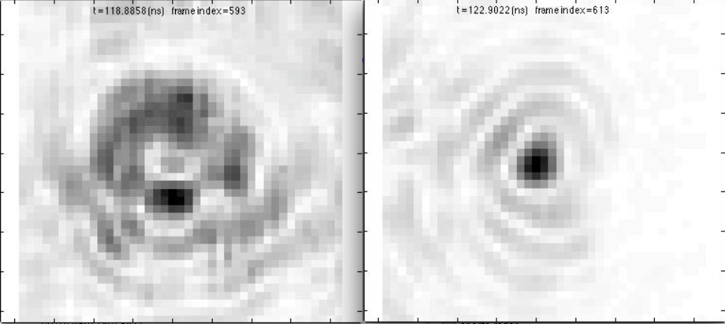
Spheres behind a drywall
Back illumination
Direct illumination

