Slide 1
From Pose to Affordance
Juergen Gall

Slide 2
Tutorial on applications of RGB-D cameras (CVPR’14)
Towards solving real-world vision problems with RGB-D cameras
Organizers: Juergen Gall (University of Bonn), Xiaofeng Ren (Amazon), Pushmeet Kohli (Microsoft Research Cambridge)
Date: 28 June 2014 in conjunction with CVPR’14
Location: Columbus, Ohio, US

Slide 3
Tutorial on applications of RGB-D cameras (CVPR’14)
Speakers from CVPR’13:
Liefeng Bo (Intel Labs)
Juergen Gall (University of Bonn)
Pushmeet Kohli (Microsoft Research Cambridge)
Jamie Shotton (Microsoft Research Cambridge)
Alisson Sol (Microsoft)
Xintian Wu (Intel)
Topics:
Introduction to RGB-D cameras
Pose estimation of humans and cameras
Recognition and scene understanding
Face analysis
Action recognition
Commercial SDKs and APIs

Slide 4
Workshop on RGB-D cameras (ECCV’14)
4th Consumer Depth Cameras for Computer Vision
Organizers: Andrea Fossati (ETH Zurich), Juergen Gall (University of Bonn), Miles Hansard (Queen Mary University London)
Date: 6-12 September 2014 in conjunction with ECCV’14 (date not fixed yet)
Location: Zurich, Switzerland
Submission deadline: End of June/Beginning of July (not fixed yet)
Impact: Citations of top 3 publications:
  3D with Kinect (131)
  RGBD-HuDaAct: A Color-Depth Video Database For Human Daily Activity Recognition (74)
  Real Time Hand Pose Estimation using Depth Sensors (63)

Slide 5

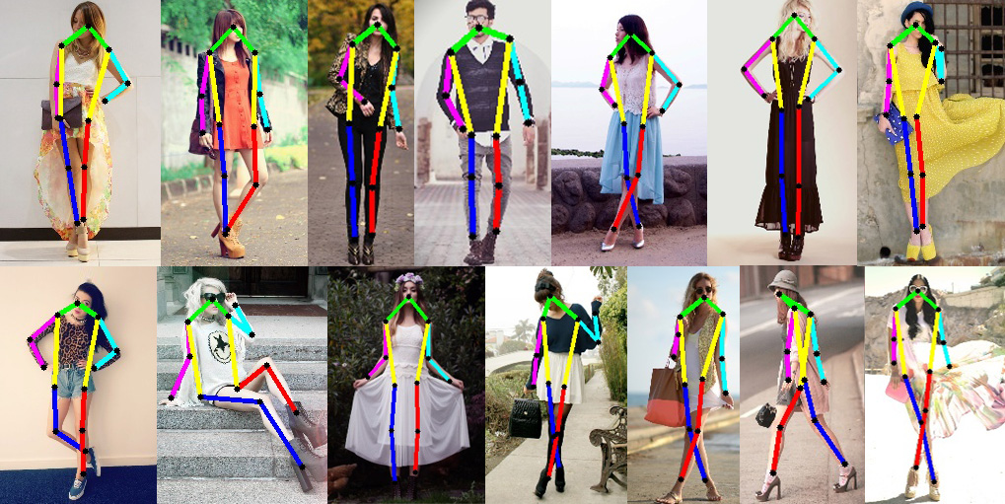
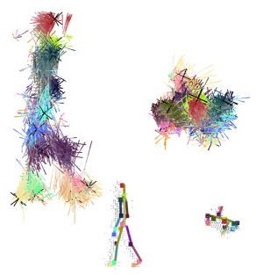
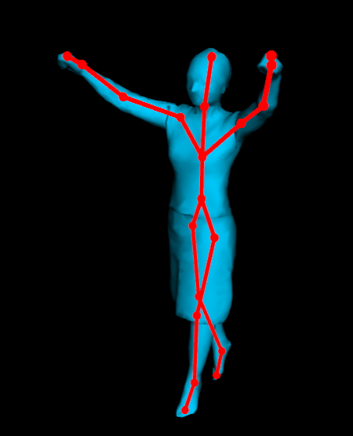
Human pose estimation
Bounding box
2d pose
3d pose
Detailed 3d geometry

Slide 6
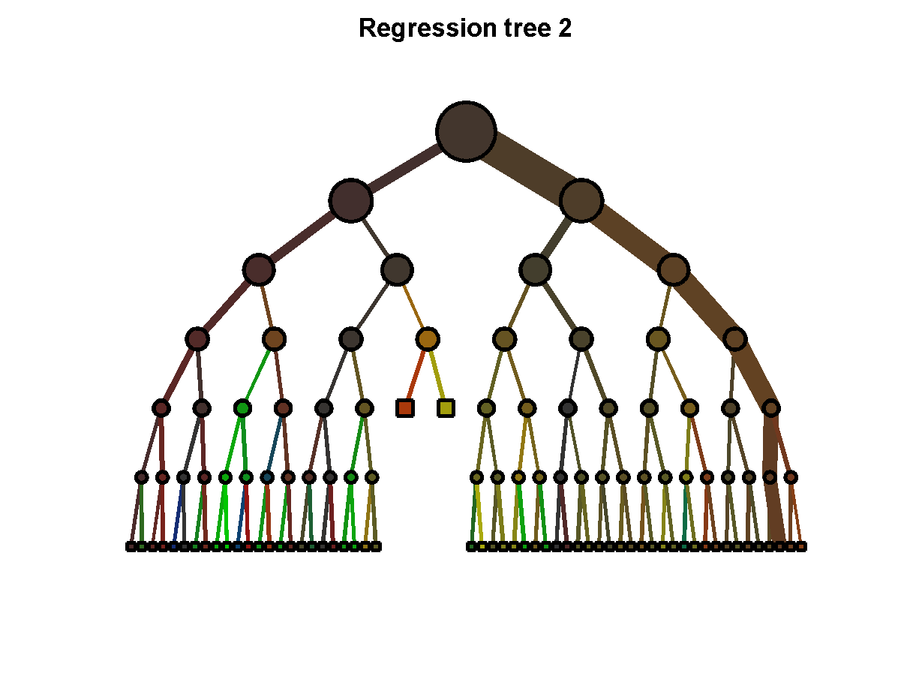
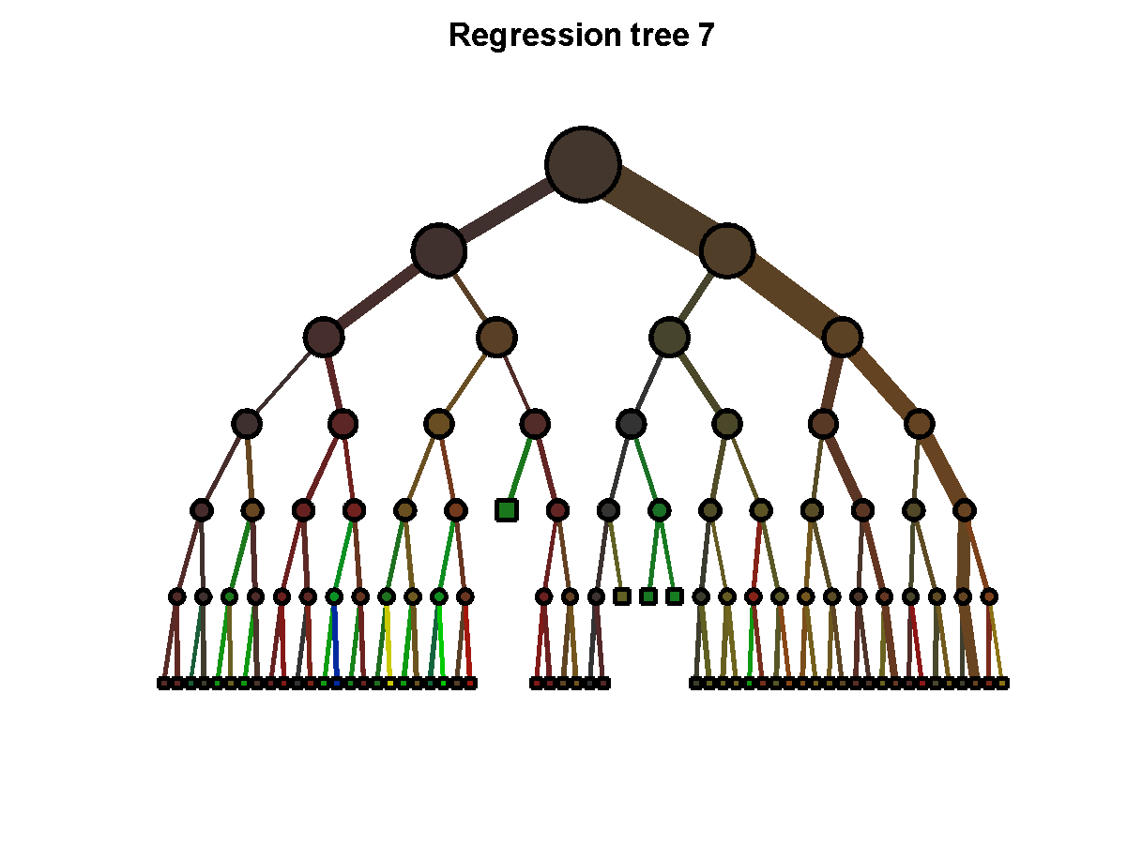
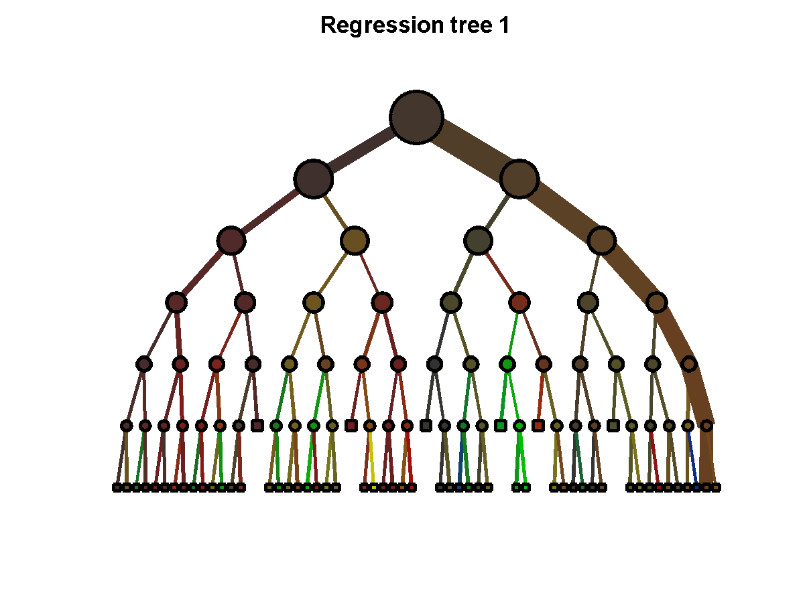
Random Forests
…
[ L. Breiman, J. Friedman, C.J. Stone, and R.A. Olshen. Classification and Regression Trees (CART). 1984 ]
[T. Ho. Random Decision Forests. 1995]
[ Y. Amit and D. Geman. Shape quantization and recognition with randomized trees. 1997 ]
[ L. Breiman. Random forests. 2001 ]
[ A. Criminisi and J. Shotton. Decision Forests in Computer Vision and Medical Image Analysis. 2013 ]

Slide 7

Body part classification
right hand
left
shoulder
neck
right
elbow
[ J. Shotton et al. Real-Time Human Pose Recognition in Parts from a Single Depth Image. CVPR 2011 ]

Slide 8
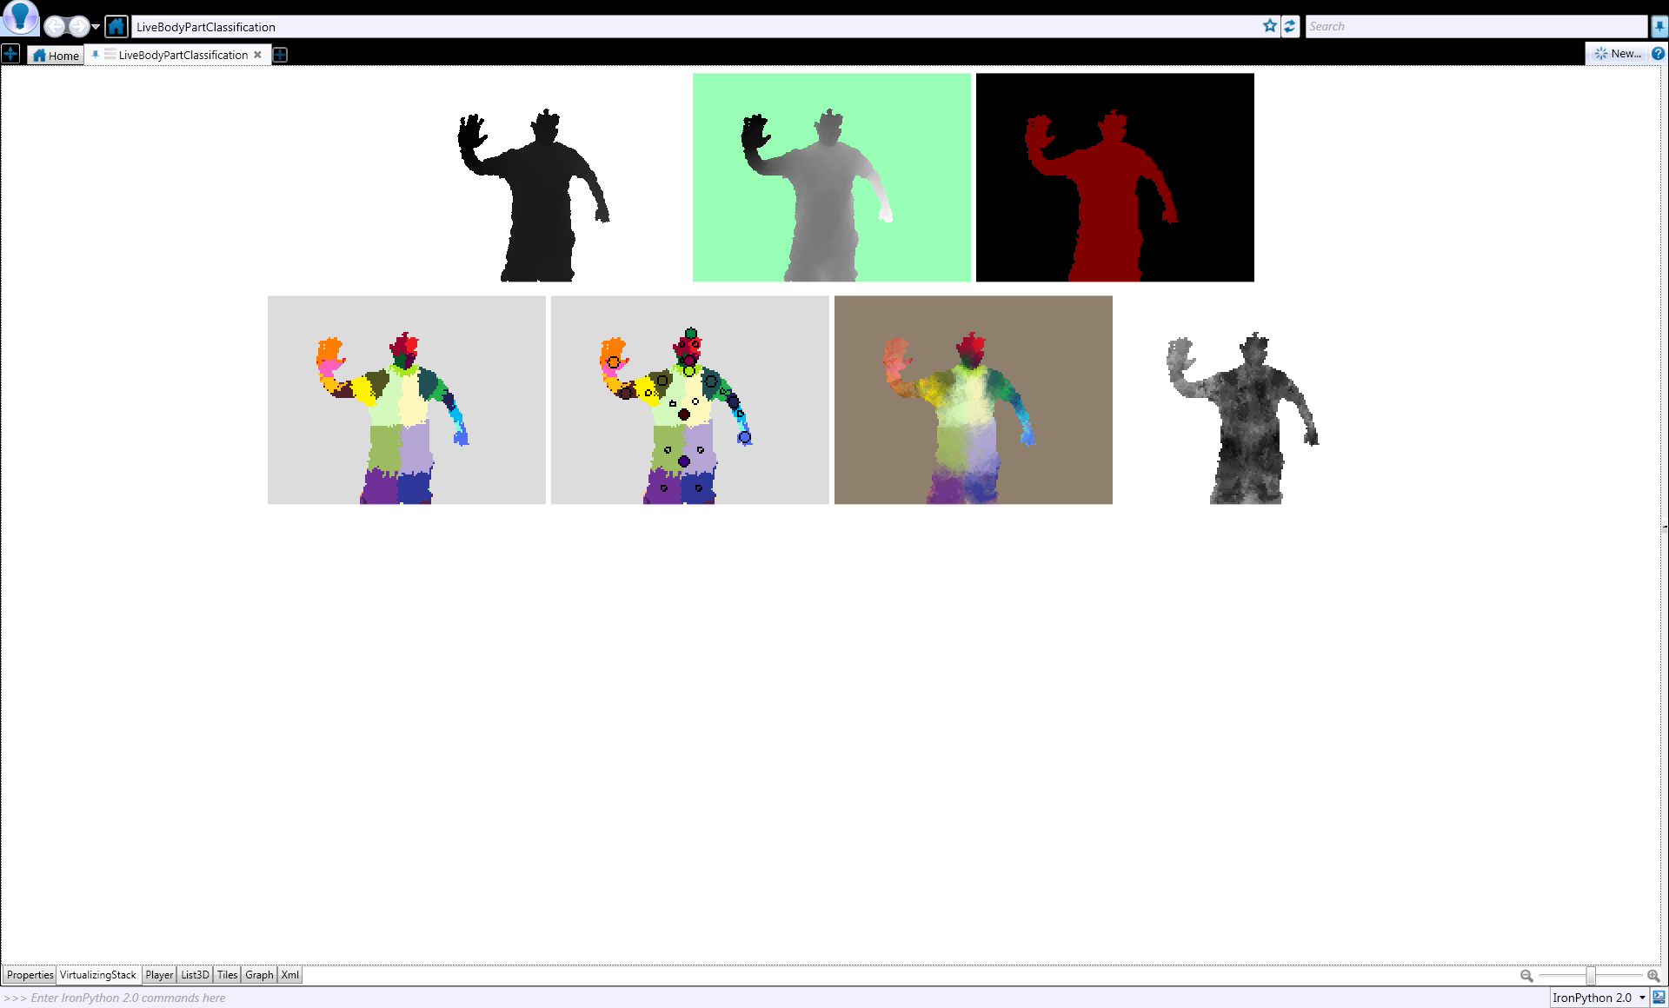


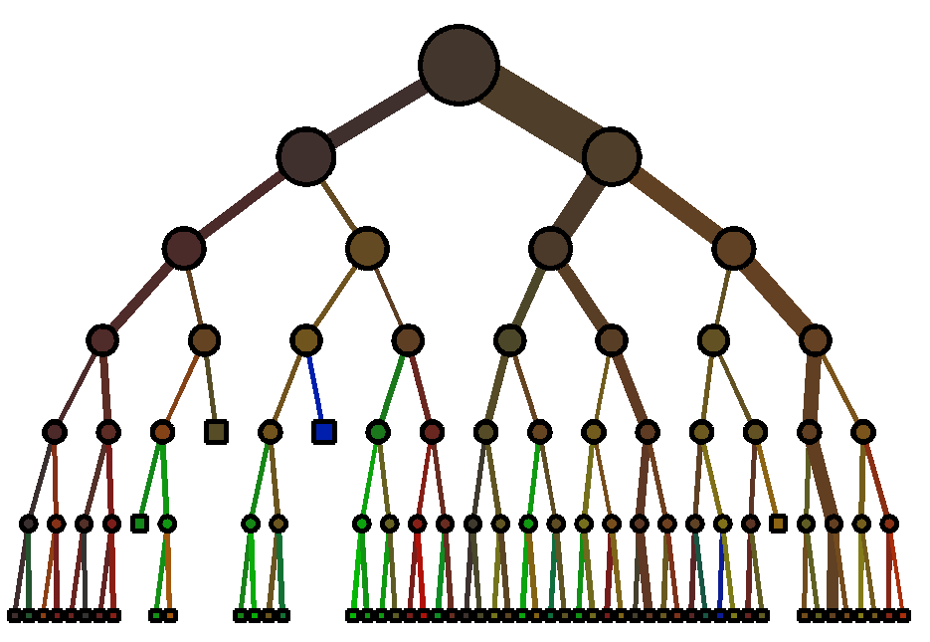






Classification
Input: Labeled training data
Tree: Separate data based on class label

Slide 9
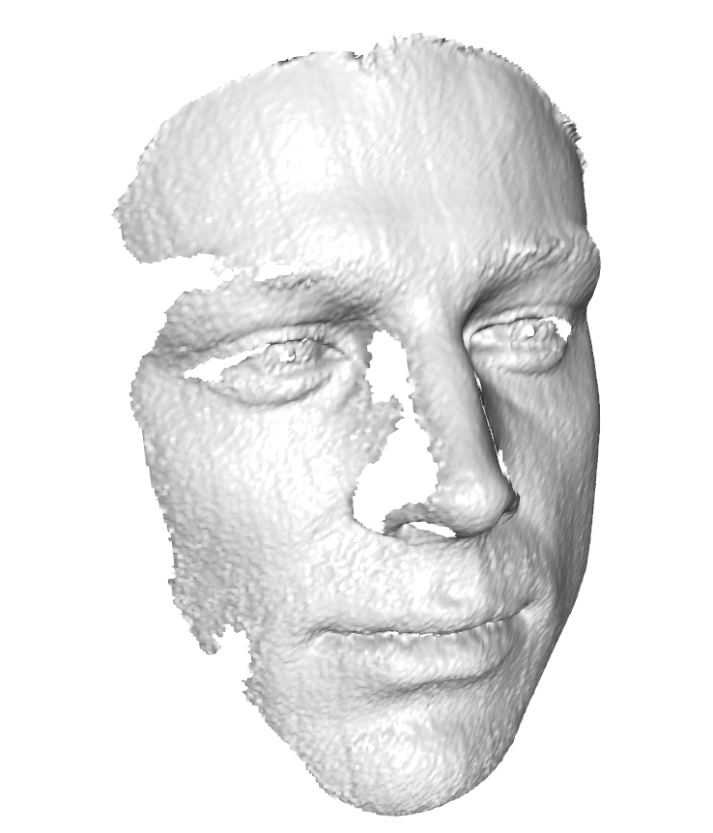
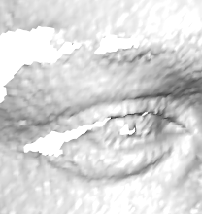
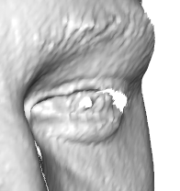
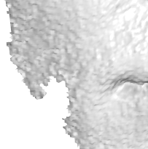
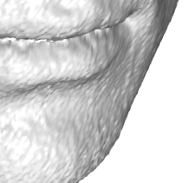
Head pose estimation - Regression
[ G. Fanelli et al. Random Forests for Real Time 3D Face Analysis. IJCV 2013 ]
Notes:
Popular idea in computer vision, especially object detection
Generalized Hough transform
I learn the mapping using a random forest

Slide 10
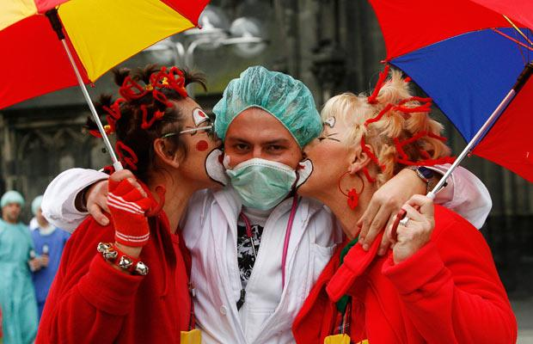
Carnival Cologne

Slide 11
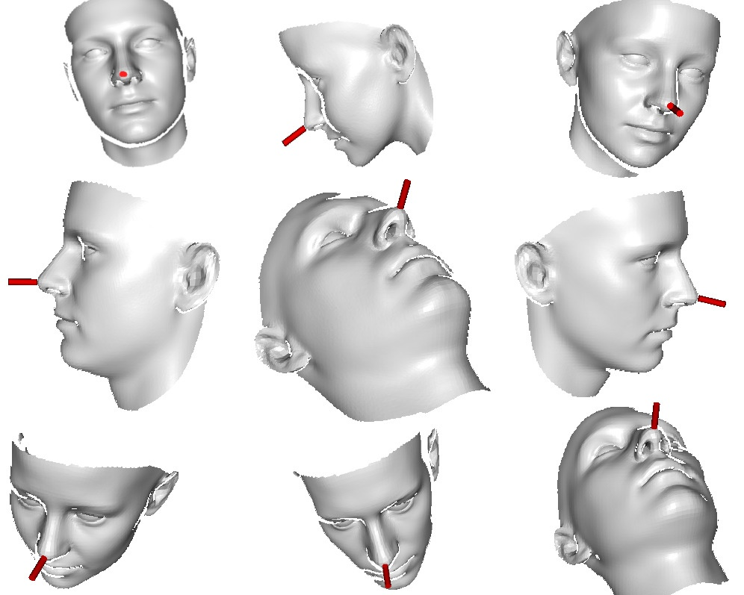
Training
Synthetic renderings of a 3D face model
[Paysan et al. A 3D Face Model for Pose and Illumination Invariant Face Recognition. AVSS 2009 available at http://faces.cs.unibas.ch/bfm ]
50K depth images
  ± 90° Yaw
  ± 50° Pitch
  ± 20° Roll
  Identity variations
  (not expression)

Slide 12
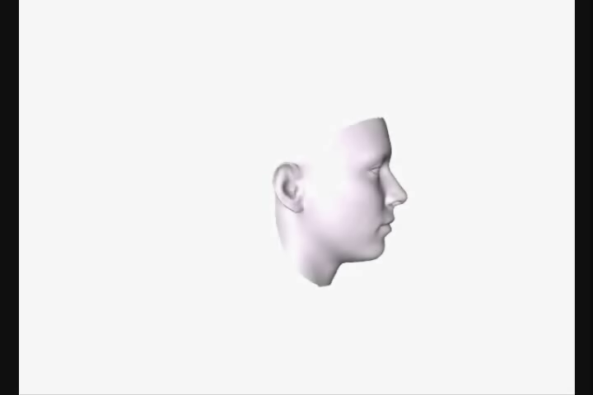
Synthetic training data

Slide 13
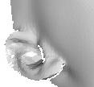





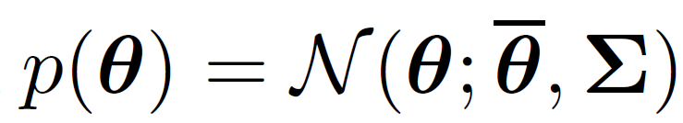
Training
…
…
.
.
.

Slide 14

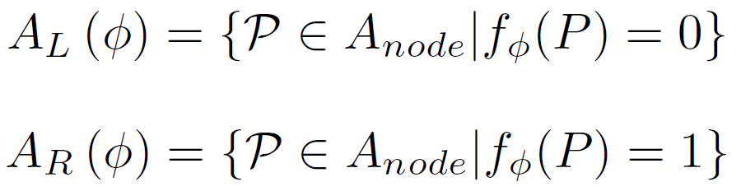
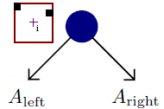
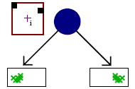
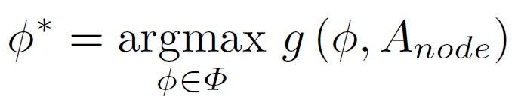
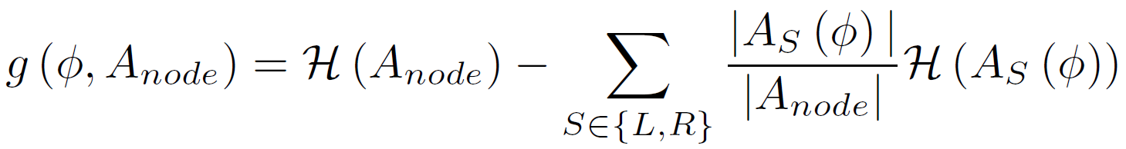
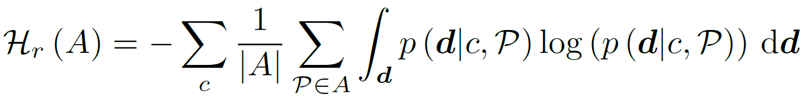
Optimal test - Regression
Generate random set of tests:
Take best test based in information gain:

Slide 15
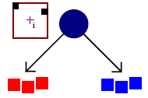
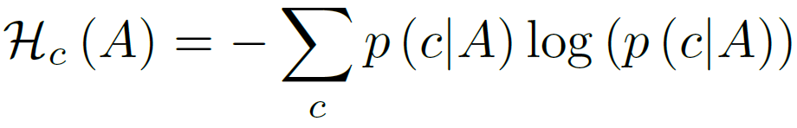
Classification and Regression
Take best test based in information gain:
Combination:
  Interleaved (random)
  Weighted:
[ J. Gall and V. Lempitsky. Class-Specific Hough Forests for Object Detection. CVPR 2009 ]

Slide 16
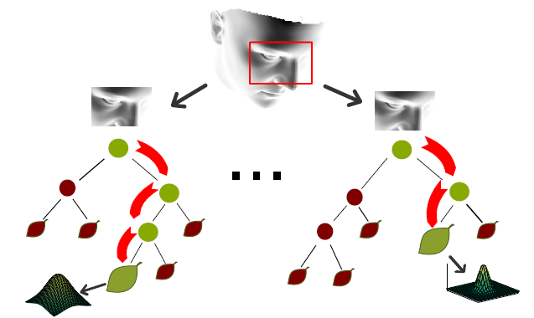
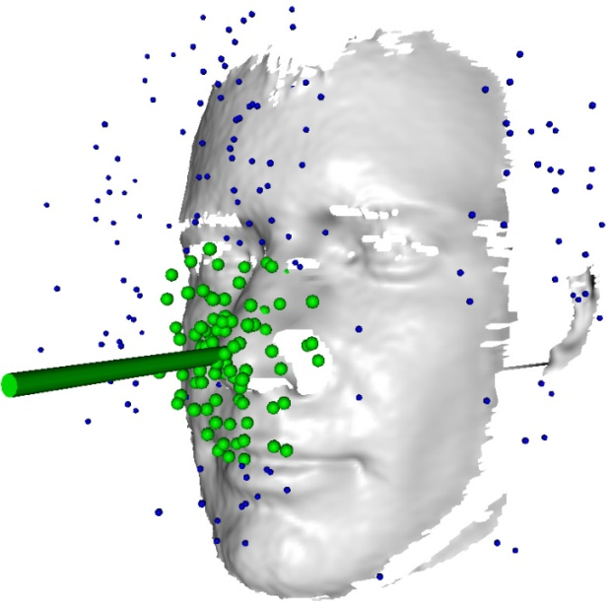
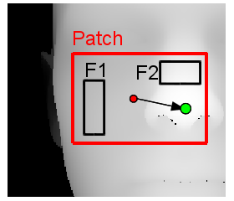
Head pose estimation
Split Nodes: Binary tests
Leave Nodes: multivariate Gaussian distributions of head pose
Mean shift

Slide 17
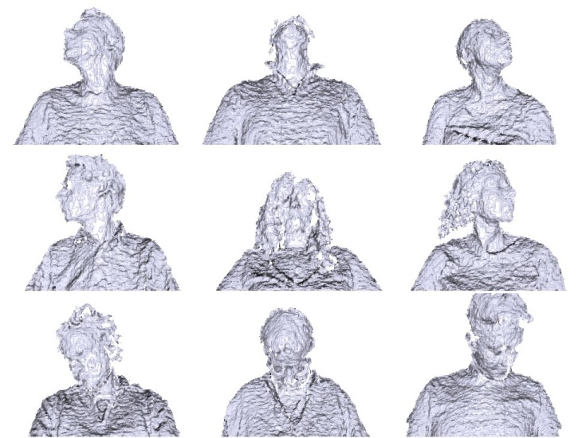
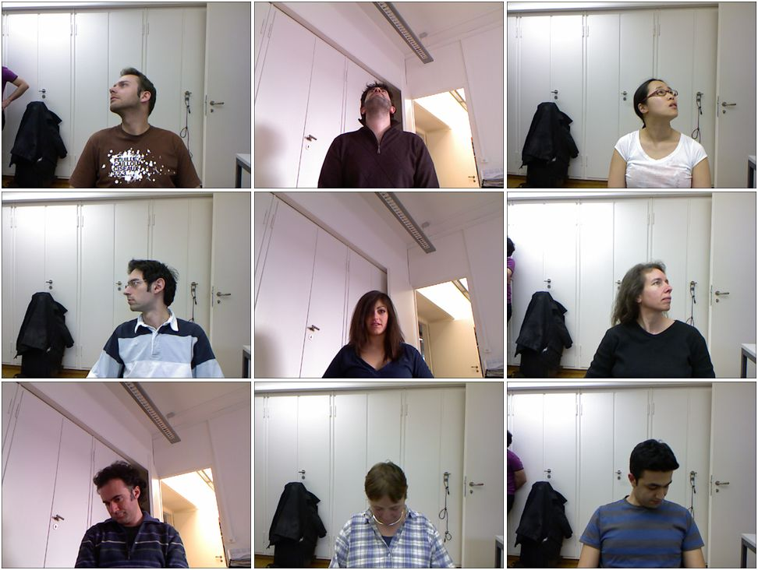
Biwi Kinect head pose database
20 people
  6 females and 14 males
  >15K Depth + RGB images
Large rotations
  ± 75° yaw
  ± 60° pitch
[ G. Fanelli et al. Random Forests for Real Time 3D Face Analysis. IJCV 2013 available at http://www.vision.ee.ethz.ch/~gfanelli/head_pose/head_forest.html ]

Slide 18
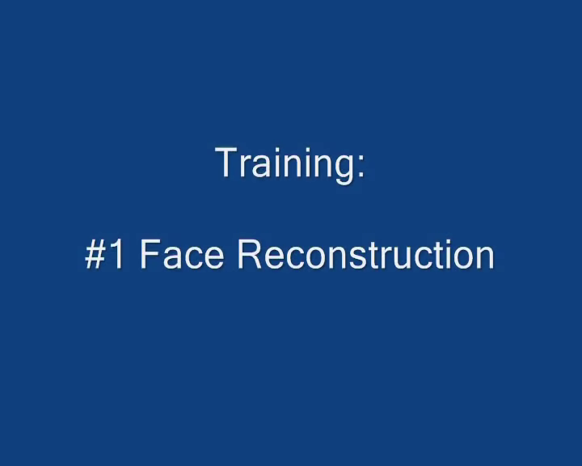
Database Automatic Annotation
[T. Weise et al. Realtime Performance-Based Facial Animation. SIGGRAPH 2011 ]

Slide 19
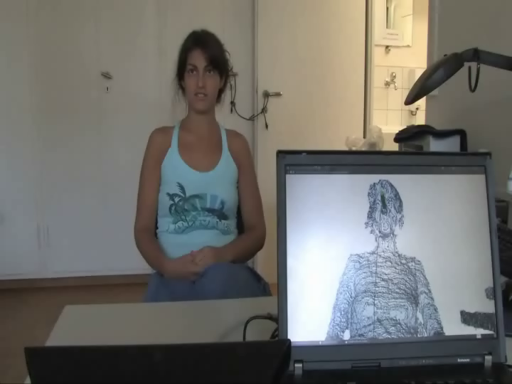
Results
[ G. Fanelli et al. Random Forests for Real Time 3D Face Analysis. IJCV 2013
available at http://www.vision.ee.ethz.ch/~gfanelli/head_pose/head_forest.html ]

Slide 20

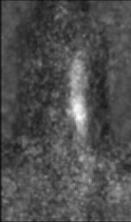
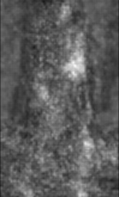
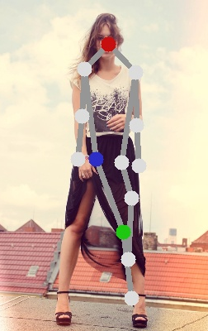
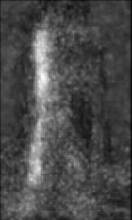
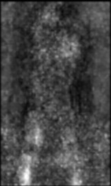
Human Pose Estimation
Independent Part Detectors
Notes:
Some of these problems can be solved by the binary potentials,

Slide 21
Human Pose Estimation
Independent Part Detectors
Notes:
Here we can see some typical failure cases of the pictorial structure framework.
The missing arm and the
Doublecounting fo the leg.

Slide 22
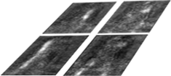
Dependent Part Detectors
[ M. Dantone et al. Human Pose Estimation using Body Parts Dependent Joint Regressors. CVPR 2013 ]

Slide 23
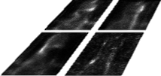
Dependent Part Detectors
[ M. Dantone et al. Human Pose Estimation using Body Parts Dependent Joint Regressors. CVPR 2013 ]

Slide 24
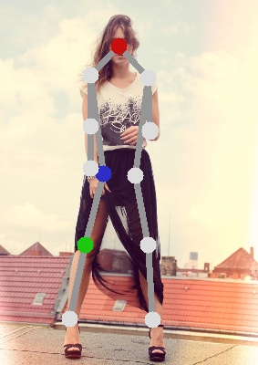
Dependent Part Detectors
[ M. Dantone et al. Human Pose Estimation using Body Parts Dependent Joint Regressors. CVPR 2013 ]

Slide 25
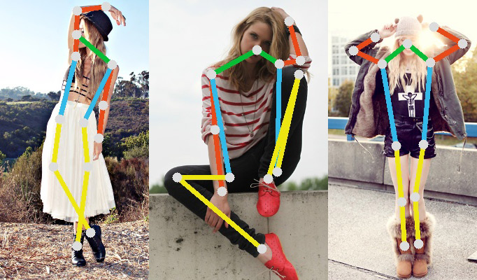
FashionPose dataset
7,543 accurate annotated images
Downloaded from fashionblog ( lookbook.nu )
Large variation of dressing style and poses

Slide 26
FashionPose

Slide 27
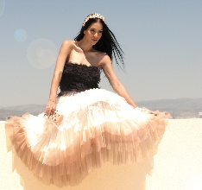
Failure Cases

Slide 28
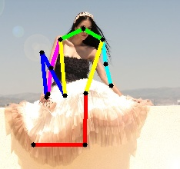
Failure Cases

Slide 29
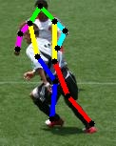

Failure Cases

Slide 30
Failure Cases

Slide 31
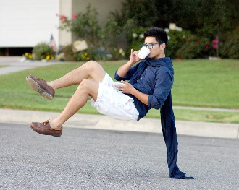
Failure Cases

Slide 32
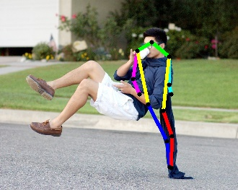
Failure Cases

Slide 33
Object Discovery by Human Motion Capture
Infer similarity of objects from human-object interaction
[ J. Gall et al. Functional Categorization of Objects using Real-time Markerless Motion Capture. CVPR 2011 ]

Slide 34
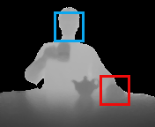
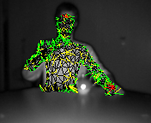
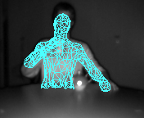


Video segmentation
Real-time pose extraction
Use pose as feature for segmenting video and clustering the segments
Face and hand
detector
3d correspondences
3d pose

Slide 35

Object Discovery by Human Motion Capture

Slide 36
Categorized Objects
Cluster1 Cluster2 Cluster3 Cluster4 Cluster5 Cluster6 Cluster7 Cluster8

Slide 37

Object discovery from weakly labelled videos

Slide 38

Object discovery from weakly labelled videos

Slide 39

Object discovery from weakly labelled videos

Slide 40






Functionality as Property
Human categorization has been evolved over 1000 years:
  chair: PIE base *sed- (to sit) → Latin sedentarius (sitting, remaining in one place) → sedentary (meaning “not in the habit of exercise”) → cathedral → chair. http://www.etymonline.com
Appearance-based similarity is sometimes difficult to learn:
Affordance: Relation between functionality and (local) appearance J. Gibson, The Ecological Approach to Visual Perception, 1979. Stark and Bowyer, TPAMI, 1991.

Slide 41


Chairs
Observe human-object interaction
[ H. Grabner et al. What makes a chair a chair? CVPR 2011 ]

Slide 42





Geometric Human-Object Relation
Probability of a sitting pose T for a given 3d scene M
  Closest 3d distances to chairs for vertex V:
  Intersections with chairs for
  triangle T:
  Model:

Slide 43
Where can I sit?

Slide 44


Real world example
3d reconstruction: Zach et al. ICCV’07

Slide 45

Google 3D Warehouse

Slide 46


Google 3D Warehouse
Training on chairs, testing on chairs (left) and objects to sit down (right)

Slide 47


Is human pose an important cue for scene understanding?
No general answer yet, but encouraging results
Humans have shaped the world
Bounding boxes or segments ≠ objects
Evaluations protocols often prefer bounding boxes or segments
≠

Slide 48
Workshop on Affordances (RSS’14)
Affordances in Vision for Cognitive Robotics
Organizers: Karthik Mahesh Varadarajan (Technical University of Vienna), Markus Vincze (Technical University of Vienna), Trevor Darrell (University of California, Berkeley), Juergen Gall (University of Bonn)
Date: 12-16 July 2014 in conjunction with RSS’14 (date not fixed yet)
Location: University of California, Berkeley
Submission:
  Conceptual papers (1 page)
  Design or experimental papers (3 pages)
  Full papers (5 pages)
Submission deadline (not fixed yet)
Speakers from Robotics, Vision, Psychophysics, Neuroscience

