Slide 1
From Pose to Affordance
Juergen Gall

Slide 2
Tutorial on applications of RGB-D cameras (CVPR’14)
Towards solving real-world vision problems with RGB-D cameras
Organizers: Juergen Gall (University of Bonn), Xiaofeng Ren (Amazon), Pushmeet Kohli (Microsoft Research Cambridge)
Date: 28 June 2014 in conjunction with CVPR’14
Location: Columbus, Ohio, US

Slide 3
Tutorial on applications of RGB-D cameras (CVPR’14)
Speakers from CVPR’13:
Liefeng Bo (Intel Labs)
Juergen Gall (University of Bonn)
Pushmeet Kohli (Microsoft Research Cambridge)
Jamie Shotton (Microsoft Research Cambridge)
Alisson Sol (Microsoft)
Xintian Wu (Intel)
Topics:
Introduction to RGB-D cameras
Pose estimation of humans and cameras
Recognition and scene understanding
Face analysis
Action recognition
Commercial SDKs and APIs

Slide 4
Workshop on RGB-D cameras (ECCV’14)
4th Consumer Depth Cameras for Computer Vision
Organizers: Andrea Fossati (ETH Zurich), Juergen Gall (University of Bonn), Miles Hansard (Queen Mary University London)
Date: 6-12 September 2014 in conjunction with ECCV’14 (date not fixed yet)
Location: Zurich, Switzerland
Submission deadline: End of June/Beginning of July (not fixed yet)
Impact: Citations of top 3 publications:
  3D with Kinect (131)
  RGBD-HuDaAct: A Color-Depth Video Database For Human Daily Activity Recognition (74)
  Real Time Hand Pose Estimation using Depth Sensors (63)

Slide 5

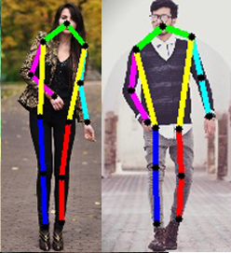
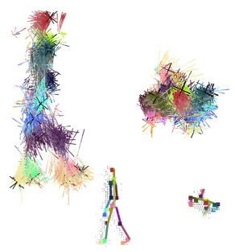
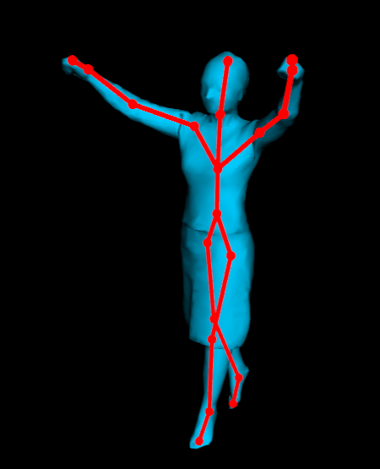
Human pose estimation
Bounding box
2d pose
3d pose
Detailed 3d geometry

Slide 6
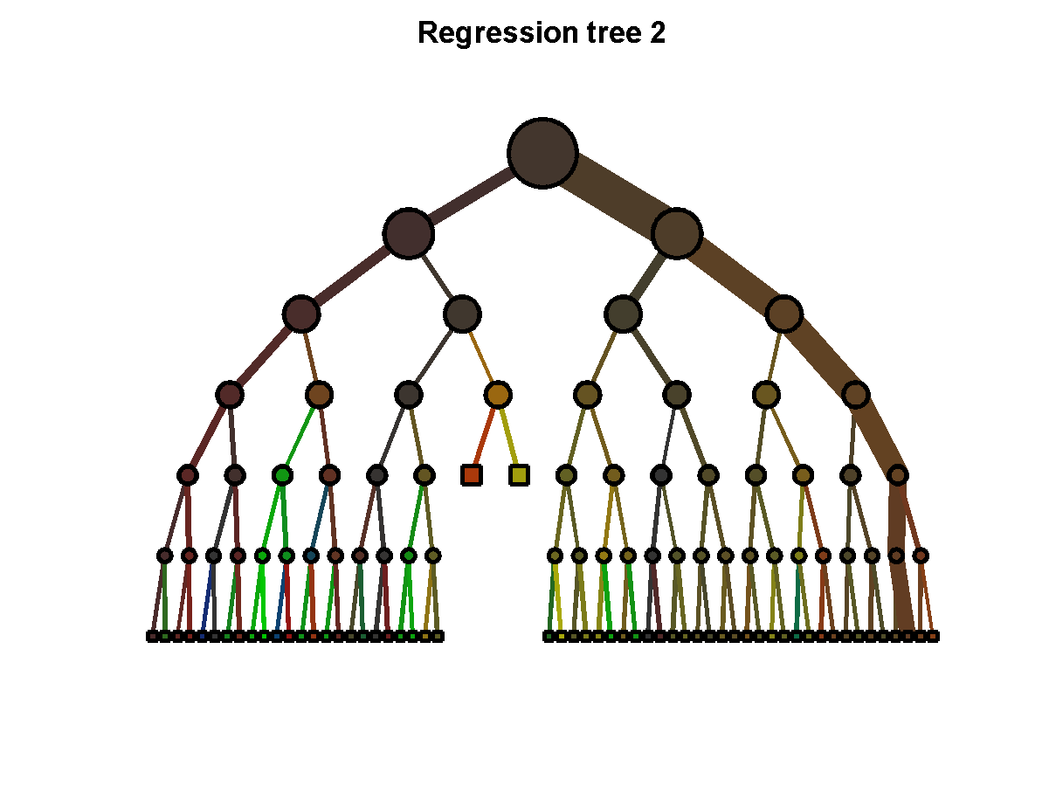
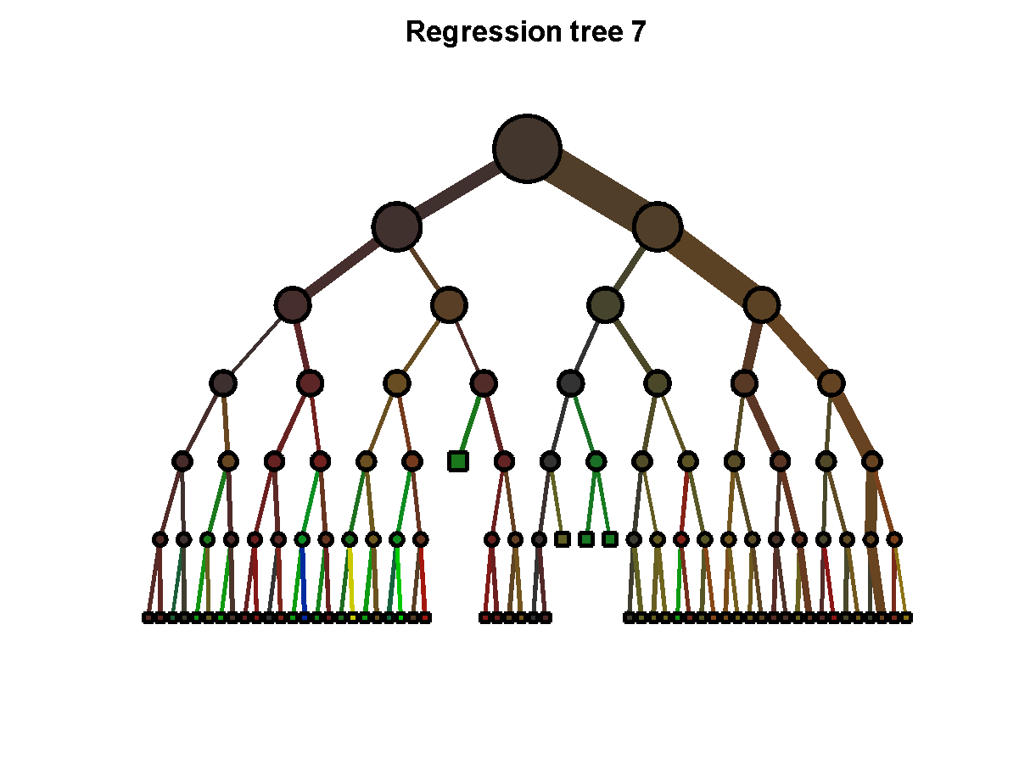
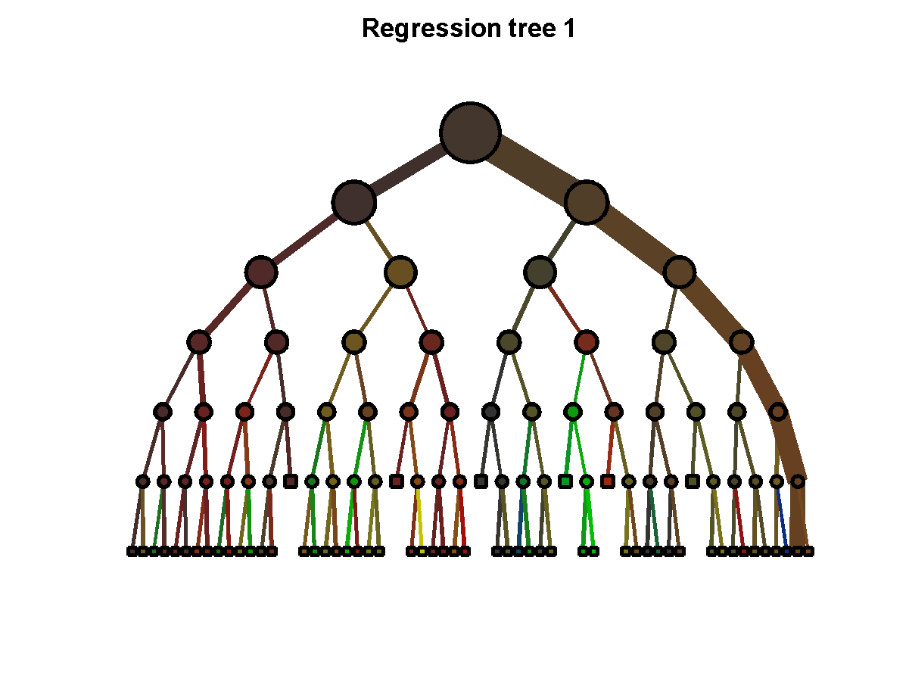
Random Forests
…
[ L. Breiman, J. Friedman, C.J. Stone, and R.A. Olshen. Classification and Regression Trees (CART). 1984 ]
[T. Ho. Random Decision Forests. 1995]
[ Y. Amit and D. Geman. Shape quantization and recognition with randomized trees. 1997 ]
[ L. Breiman. Random forests. 2001 ]
[ A. Criminisi and J. Shotton. Decision Forests in Computer Vision and Medical Image Analysis. 2013 ]

Slide 7

Body part classification
right hand
left
shoulder
neck
right
elbow
[ J. Shotton et al. Real-Time Human Pose Recognition in Parts from a Single Depth Image. CVPR 2011 ]

Slide 8
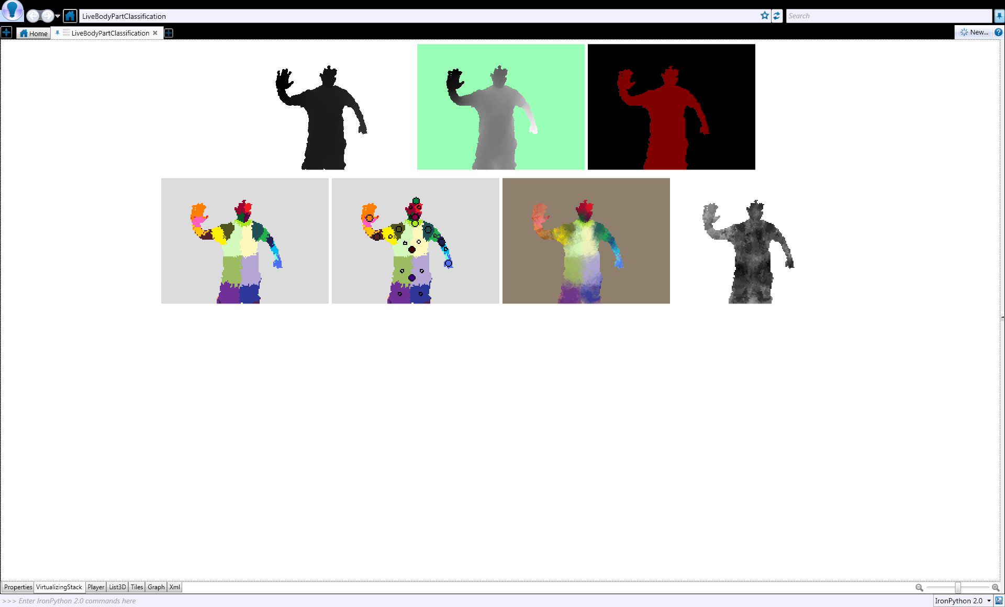


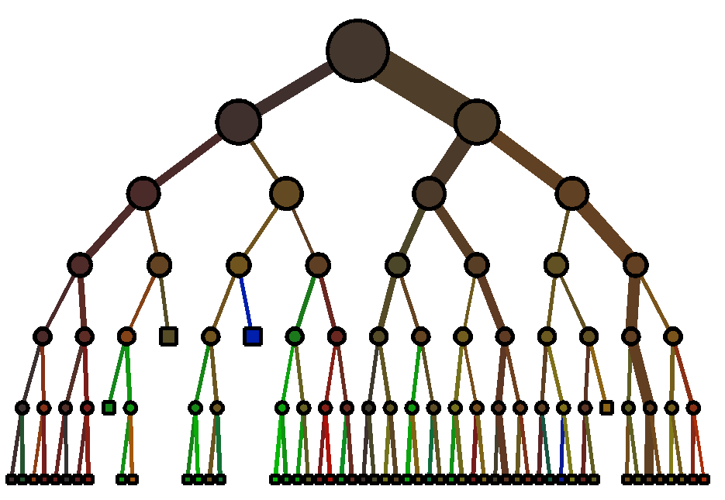






Classification
Input: Labeled training data
Tree: Separate data based on class label

Slide 9
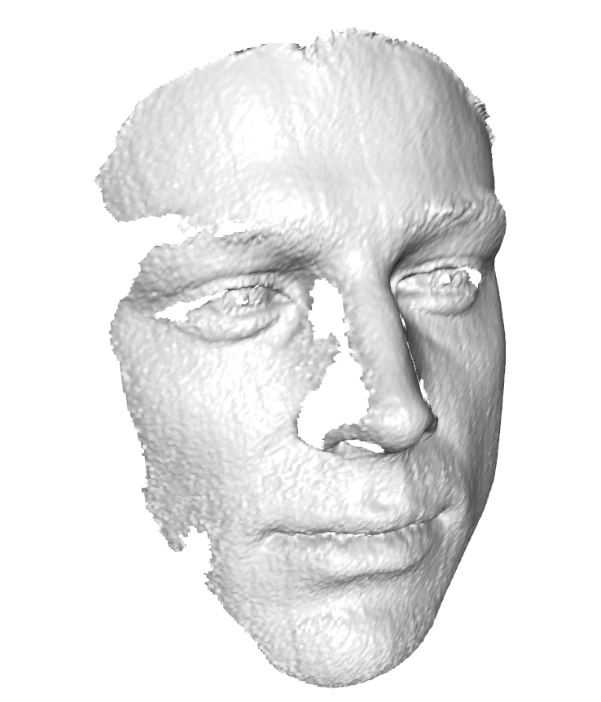
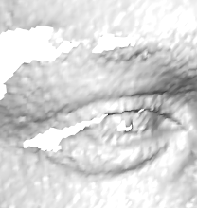
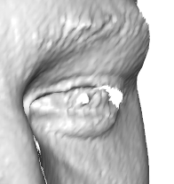
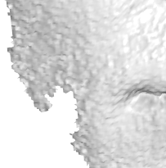
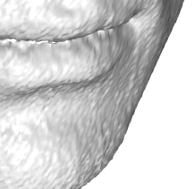
Head pose estimation - Regression
[ G. Fanelli et al. Random Forests for Real Time 3D Face Analysis. IJCV 2013 ]
Notes:
Popular idea in computer vision, especially object detection
Generalized Hough transform
I learn the mapping using a random forest

Slide 10
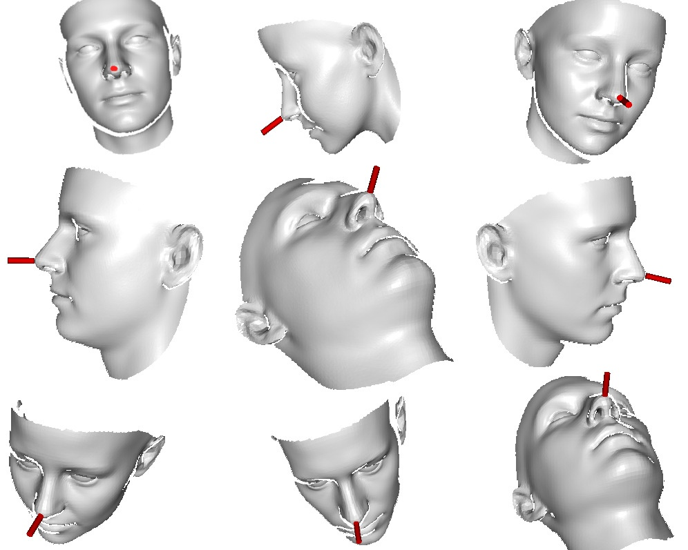
Training
Synthetic renderings of a 3D face model
[Paysan et al. A 3D Face Model for Pose and Illumination Invariant Face Recognition. AVSS 2009 available at http://faces.cs.unibas.ch/bfm ]
50K depth images
  ± 90° Yaw
  ± 50° Pitch
  ± 20° Roll
  Identity variations
  (not expression)

Slide 11
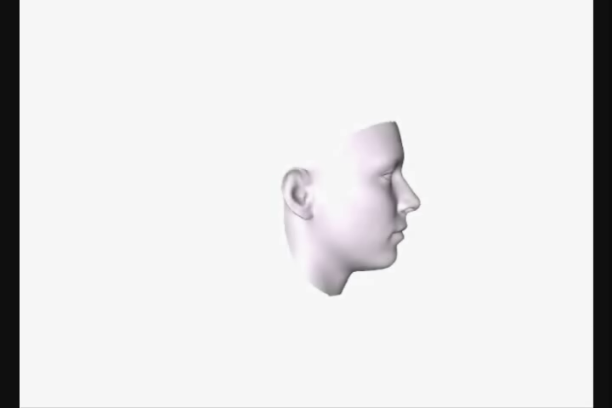
Synthetic training data

Slide 12
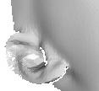





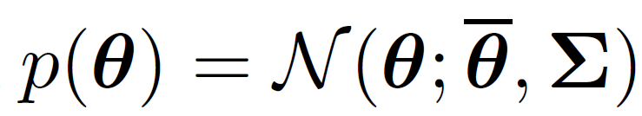
Training
…
…
.
.
.

Slide 13

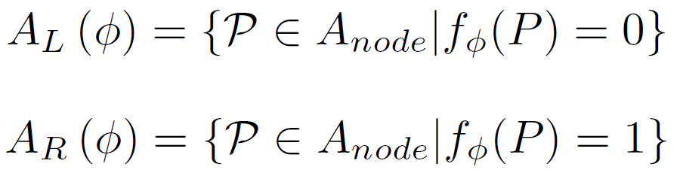
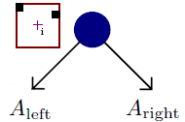
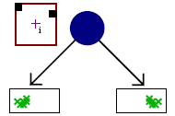
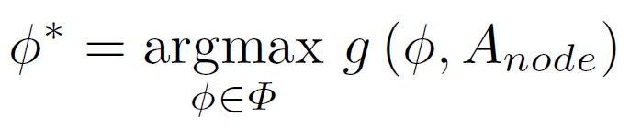
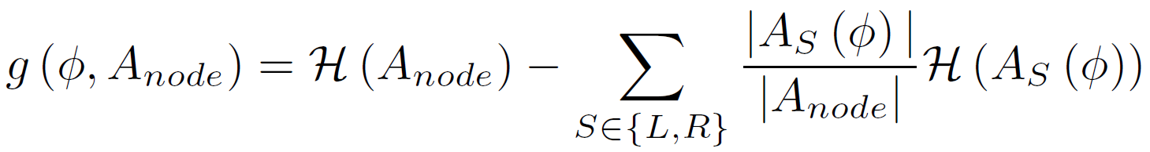
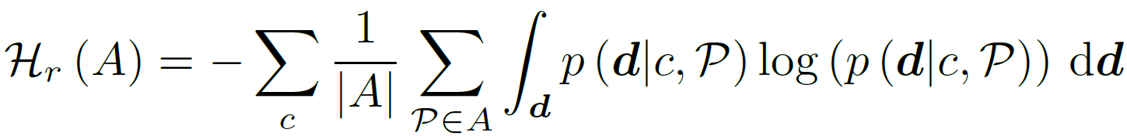
Optimal test - Regression
Generate random set of tests:
Take best test based in information gain:

Slide 14
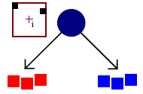
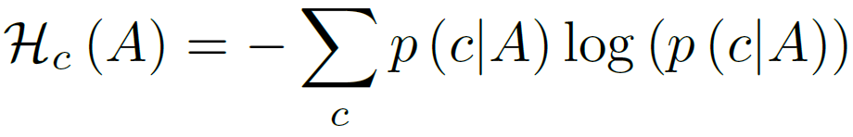
Classification and Regression
Take best test based in information gain:
Combination:
  Interleaved (random)
  Weighted:
[ J. Gall and V. Lempitsky. Class-Specific Hough Forests for Object Detection. CVPR 2009 ]

Slide 15
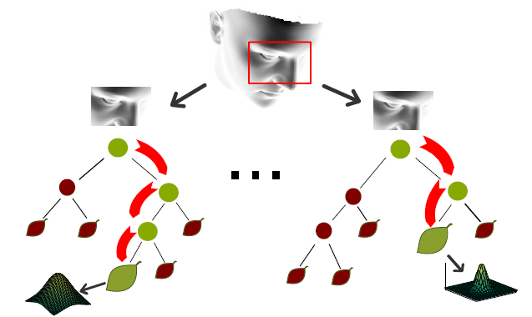
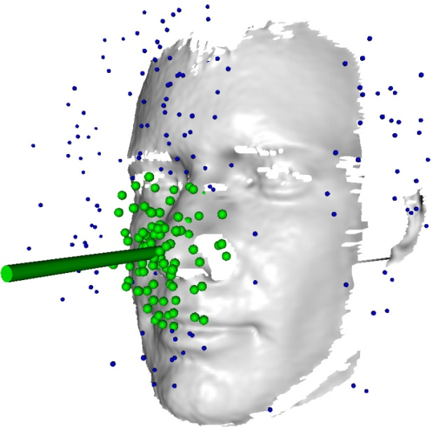
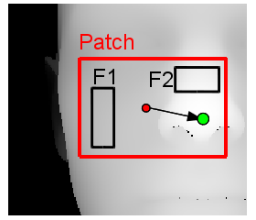
Head pose estimation
Split Nodes: Binary tests
Leave Nodes: multivariate Gaussian distributions of head pose
Mean shift

Slide 16
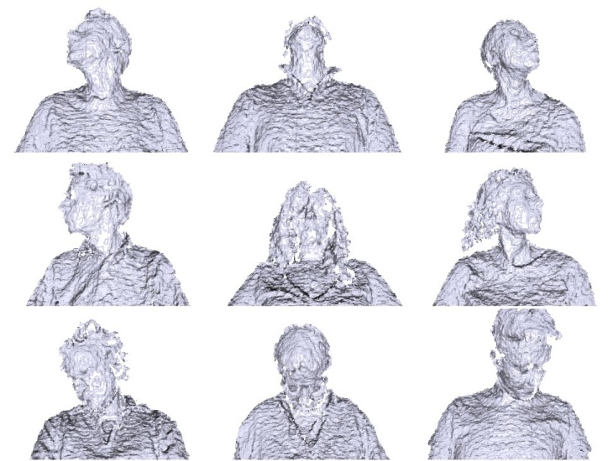
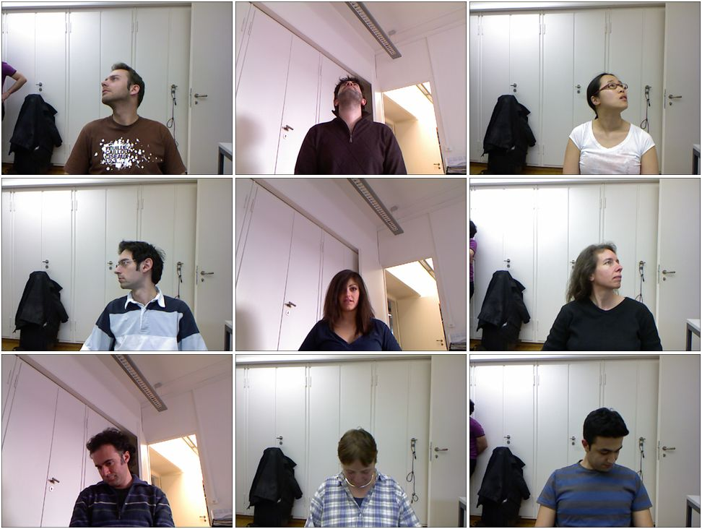
Biwi Kinect head pose database
20 people
  6 females and 14 males
  >15K Depth + RGB images
Large rotations
  ± 75° yaw
  ± 60° pitch
[ G. Fanelli et al. Random Forests for Real Time 3D Face Analysis. IJCV 2013 available at http://www.vision.ee.ethz.ch/~gfanelli/head_pose/head_forest.html ]

Slide 17
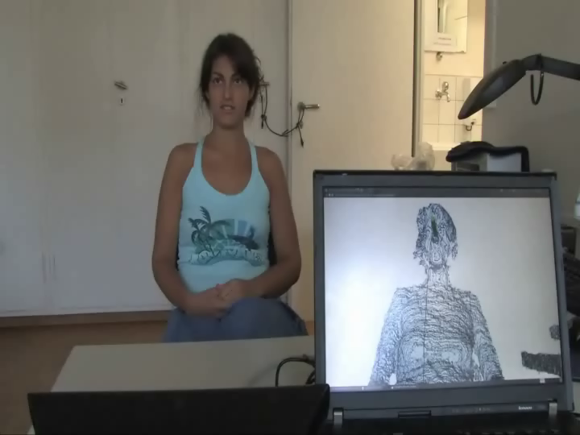
Results
[ G. Fanelli et al. Random Forests for Real Time 3D Face Analysis. IJCV 2013
available at http://www.vision.ee.ethz.ch/~gfanelli/head_pose/head_forest.html ]

Slide 18

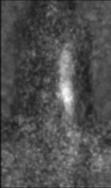
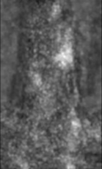
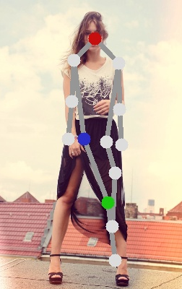
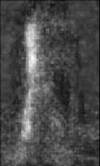
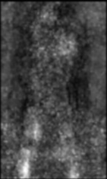
Human Pose Estimation
Independent Part Detectors
Notes:
Some of these problems can be solved by the binary potentials,

Slide 19
Human Pose Estimation
Independent Part Detectors
Notes:
Here we can see some typical failure cases of the pictorial structure framework.
The missing arm and the
Doublecounting fo the leg.

Slide 20
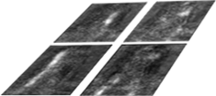
Dependent Part Detectors
[ M. Dantone et al. Human Pose Estimation using Body Parts Dependent Joint Regressors. CVPR 2013 ]

Slide 21
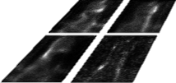
Dependent Part Detectors
[ M. Dantone et al. Human Pose Estimation using Body Parts Dependent Joint Regressors. CVPR 2013 ]

Slide 22
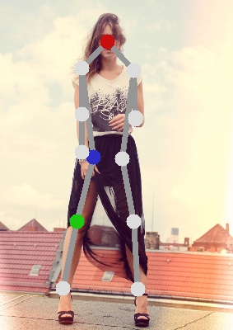
Dependent Part Detectors
[ M. Dantone et al. Human Pose Estimation using Body Parts Dependent Joint Regressors. CVPR 2013 ]

Slide 23
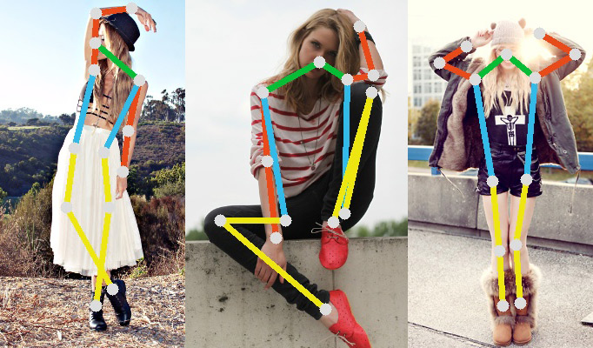
FashionPose dataset
7,543 accurate annotated images
Downloaded from fashionblog ( lookbook.nu )
Large variation of dressing style and poses

Slide 24
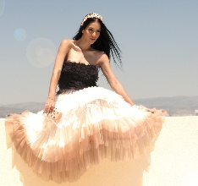
Failure Cases

Slide 25
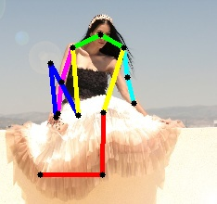
Failure Cases

Slide 26
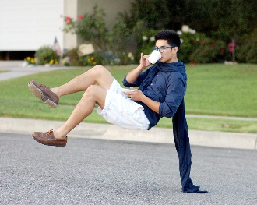
Failure Cases

Slide 27
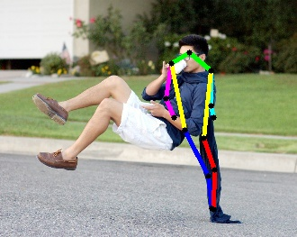
Failure Cases

Slide 28
Object Discovery by Human Motion Capture
Infer similarity of objects from human-object interaction
[ J. Gall et al. Functional Categorization of Objects using Real-time Markerless Motion Capture. CVPR 2011 ]

Slide 29
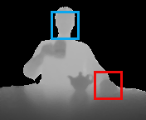
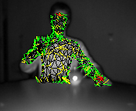
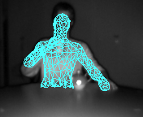
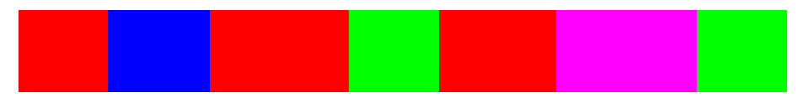
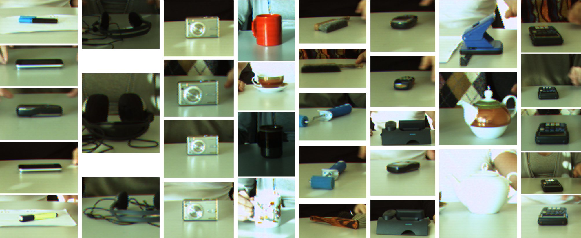
Video segmentation
Real-time pose extraction
Use pose as feature for segmenting video and clustering the segments
Face and hand
detector
3d correspondences
3d pose

Slide 30

Object Discovery by Human Motion Capture

Slide 31
Categorized Objects
Cluster1 Cluster2 Cluster3 Cluster4 Cluster5 Cluster6 Cluster7 Cluster8

Slide 32




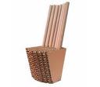

Functionality as Property
Human categorization has been evolved over 1000 years:
  chair: PIE base *sed- (to sit) → Latin sedentarius (sitting, remaining in one place) → sedentary (meaning “not in the habit of exercise”) → cathedral → chair. http://www.etymonline.com
Appearance-based similarity is sometimes difficult to learn:
Affordance: Relation between functionality and (local) appearance J. Gibson, The Ecological Approach to Visual Perception, 1979. Stark and Bowyer, TPAMI, 1991.

Slide 33


Chairs
Observe human-object interaction
[ H. Grabner et al. What makes a chair a chair? CVPR 2011 ]

Slide 34





Geometric Human-Object Relation
Probability of a sitting pose T for a given 3d scene M
  Closest 3d distances to chairs for vertex V:
  Intersections with chairs for
  triangle T:
  Model:

Slide 35
Where can I sit?

Slide 36


Real world example
3d reconstruction: Zach et al. ICCV’07

Slide 37

Google 3D Warehouse

Slide 38
Workshop on Affordances (RSS’14)
Affordances in Vision for Cognitive Robotics
Organizers: Karthik Mahesh Varadarajan (Technical University of Vienna), Markus Vincze (Technical University of Vienna), Trevor Darrell (University of California, Berkeley), Juergen Gall (University of Bonn)
Date: 12-16 July 2014 in conjunction with RSS’14 (date not fixed yet)
Location: University of California, Berkeley
Submission:
  Conceptual papers (1 page)
  Design or experimental papers (3 pages)
  Full papers (5 pages)
Submission deadline (not fixed yet)
Speakers from Robotics, Vision, Psychophysics, Neuroscience

