Slide 1
International Time of Flight Imaging Workshop
A Review for Global Shutter Image Sensor
March 10, 2014
University of Hyogo, Shizuoka University
Nobukazu Teranishi
Notes:
Good afternoon, ladies and gentlemen.
It is great honor to do keynote speech, here.
My talk is about global shutter, which is important technology for ToF.
CCD image sensors have GS function, which is very well know.
So, I would like to focus this talk on GS CMOS image sensors.

Slide 2
Contents
１. Motivation of GS (Global Shutter)
２. Various Schemes
2.Supplement. Definition of Shutter Efficiency
2.1. 5Tr Scheme
2.2. 8Tr Scheme
2.3. 2-Stage Transfer Scheme
2.4. Pixel-wise CDS
2.5. Pixel-wise ADC
3. Cross Talk Reduction
4. Summary
Notes:
This is contents of my talk.
After motivation of GS, various schemes, cross talk reduction will be explained.

Slide 3
1. Motivations
(1) No deformation of moving object
(2) Correspond to modulated light,
(3) No flash band
(4) Electronic shutter
Notes:
These are motivations for global shutter image sensors.
(1) No deformation of moving object
(2) Correspond to modulated light,
(3) No flash band
(4) Electronic shutter
I would like to explain one by one.

Slide 4

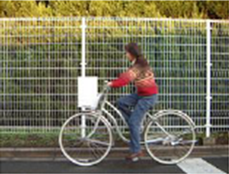
1.1 Motivation --- No deformation of moving object
Rolling Shutter
(b) Global Shutter
（Tetsuo Yamada, “Image Sensors and Camera”, 2012)
Exposure Period
1Frame
1Frame
Notes:
As is well known, rolling shutter suffers from deformation of moving object.
The wheals are deformed.
This is because exposure period for each row is offset row by row.
Global shutter does not have such deformation.

Slide 5

1.2.1 Motivation ---Correspond to modulated light
・ Exposure should be synchronized with modulated light.
Examples :
・ Chronologically modulated light
・ Spatially and chronologically
modulated light
ToF
Excitation Light:
Structured Light
Florescence Light:
time
Florescence Imaging
Notes:
Next, modulated light needs global shutter, because exposure should be synchronized with modulated light.
For example, ToF and florescence imaging use chronologically modulated light.
Some structured light method uses spatially and chronologically modulated light.

Slide 6
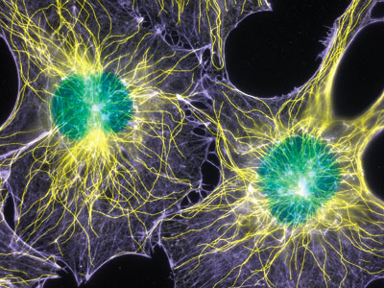
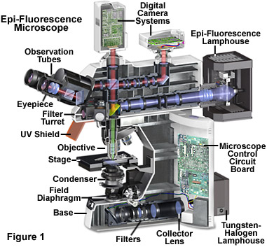
1.2.2. Motivation ---Correspond to modulated light
・ Low noise, high sensitivity and GS are needed.
Filamentous actin and microtubules
(structural proteins) in mouse fibroblasts (cells)
(1000x)
(Torsten Wittmann, Nikon Small World, 2003)
Fluorescence Microscope
(Nikon HP)
Notes:
This shows fluorescence microscope of biological application.
Low noise, high sensitivity and GS are needed in this application.
This beautiful photo shows mouse fibroblasts.
Filamentous: 繊維状の フィラメント状の
Actin:アクチン◆筋肉の収縮にかかわるタンパク質の一種
Microtubules; 微小管
Fibroblasts: 線維芽細胞

Slide 7
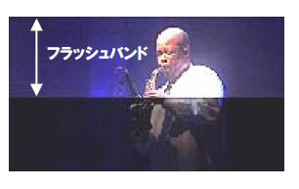
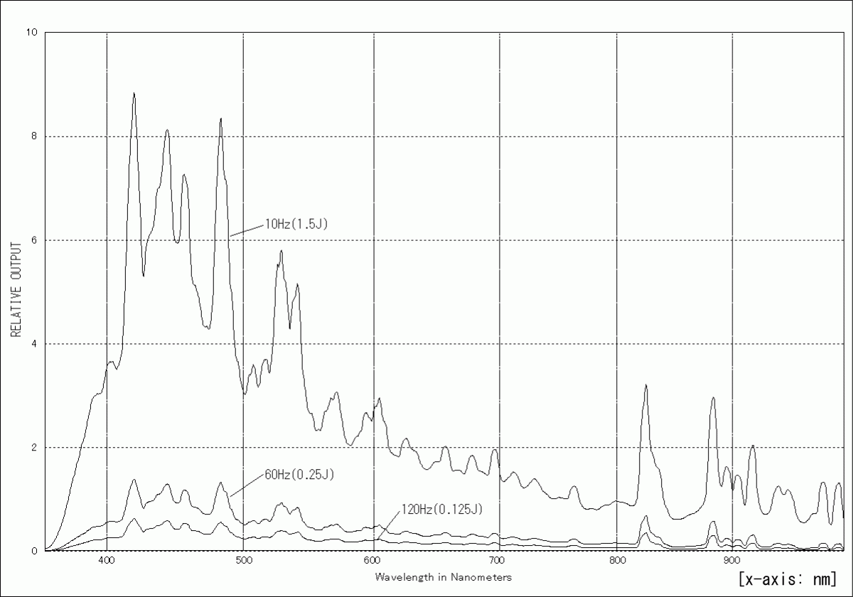
1.3. Motivation ---No Flash Band
・ RS (Rolling Shutter) suffers from flash band.
i-th frame
i+1-th frame
1
2
3
4
N-1
N
Flash
Light
Intensity
400
500
600
700
800
900
i-th frame
i+1-th frame
Wavelength (nm)
(Sugawara Laboratory)
Spectrum of Xenon Strobe Light
Notes:
Thirdly, RS suffers from flash band as this photo.
It is because if flash light is lid here, part of rows receive the flash light, while others do not within one frame.
So, part of the image is blight and remainder is dark.
This is spectrum of Xenon strobe light.
We should take note that Xenon strobe light has rather large intensity even over 800nm.
Most ToF systems use these wavelength, therefore, strobe light might jam ToF.

Slide 8
1.4.1. Motivation --- Electronic shutter
Shutter Functions
1. Exposure Control
2. Time Resolution Control
Electronic Shutter’s Merits
- Electronic shutter has more time-resolution than mechanical shutter
because of little shutter lag, or shutter blur.
- If rolling shutter (RS) is used for short electronic shutter,
deformation of moving object becomes bigger & more noticeable.
Notes:
Forth is electronic shutter.
Shutter has 2 functions, exposure control and time resolution control.
Electronic shutter has more time-resolution than mechanical shutter,
because there is little shutter lag or blur.
If rolling shutter (RS) is used for short electronic shutter,
deformation of moving object becomes bigger & more noticeable.

Slide 9
1.4.2 Motivation --- Electronic shutter
Mechanical Focal Plane Shutter
Electronic Shutter
100% Aperture
100% Aperture
100
100
Aperture
Aperture
0
0
Time
Time
1st Curtain
DSLR
・Cover glass
・Optical low-pass filter
・IR-cut filter
・Dust reduction system
Image Sensor
2nd Curtain
Gap
Gap between image sensor and curtain
⇒ Shutter efficiency is less than 100%.
Notes:
This viewgraph compares electronic shutter with mechanical shutter.
In mechanical focal plane shutter, since there is a gap between image sensor and curtain,
shutter efficiency is less than 100%, while shutter efficiency of electronic shutter is 100%.
For example, DSLR needs cover-glass, optical low-pass filter, IR cut filter, and dust reduction system in the gap.
So, the gap is bigger than that of film SLR.

Slide 10


1.4.3 Motivation --- Electronic shutter
(a) Mechanical Shutter
Nikon D200
AF Nikkor 180mm F2.8D
ISO 400
F2.8
1/8,000
(b) Electronic Shutter
Nikon D20
AF Nikkor 180mm F2.8D
ISO 400
F2.8
1/8,000
(Kenji Toyoda, 2008)
Notes:
These photos are taken by mechanical shutter and electronic shutter, respectively.
Both have the same lens and same exposure time as 1/8,000.
How do you feel?

Slide 11


1.4.4 Motivation --- Electronic shutter
Enlargement
(a) Mechanical Shutter
(b) Electronic Shutter
(Kenji Toyoda, 2008)
・ Bubbles and sprays are clearer in electronic shutter case.
・ Electronic shutter has more time-resolution than mechanical shutter.
Notes:
These are enlargements, respectively.
Kenji Toyoda, who took these photos and designed those cameras in Nikon, says bubbles and sprays are clearer in electronic shutter case.
I think so too.
Electronic shutter has more time-resolution than mechanical shutter.

Slide 12
Contents
１. Motivation of GS
２．Various Schemes
2.Supplement. Definition of Shutter Efficiency
2.1. 5Tr Scheme
2.2. 8Tr Scheme
2.3. 2-Stage Transfer Scheme
2.4. Pixel-wise CDS
2.5. Pixel-wise ADC
3. Cross Talk Reduction
4. Summary
Notes:
Next, we would like to explain various schemes for GS.
After definition of shutter efficiency,
5 Tr scheme, 8 Tr scheme, 2-stage transfer scheme, pixel-wise CDS and pixel-wise ADC are explained.

Slide 13
2 Various Schemes
Challenge：
- Dark current at storage region
- Cross talk to storage region (Shutter efficiency)
Artifact appears ahead of moving real image
unnaturally
- Noise reduction of storage reset
- PD area increase despite storage area
- Current reduction, if all source follower amplifiers are
operated during GS operation.
Schemes :
(1) 5Tr Scheme
(2) 8Tr Scheme (Charge gain at pixel)
(3) 2-stage Transfer Scheme (CCD-like Scheme)
(4) Pixel-wise CDS
(5) Pixel-wise ADC
Real image
Artifact by
crosstalk
Notes:
GS needs storage for each pixel.
It brings challenges;
- Dark current at storage region
- Cross talk to storage region (Shutter efficiency)
Artifact by cross talk appears ahead of moving real image.
This phenomenon is unnatural.
- Noise reduction of storage reset
- PD area increase despite storage area and additional transistors.
- Large current, if all source follower amplifiers are operated during GS operation.
Various schemes are proposed to overcome those challenges.
I would like to explain these schemes using following slides.
.

Slide 14

2.Supplement. Definition of Shutter Efficiency
There are two components of “Shutter Efficiency”.
・ Shutter Lag ⇒
・ Cross Talk ⇒ 1 -
Actual Sensitivity within t_{e}
x 100 (%)
Ideal Sensitivity
Cross talk
x 100 (%)
Actual Sensitivity
+
Ideal Sensitivity
Actual Sensitivity
(Shutter Lag)
Crosstalk
(Parasitic Light Sensitivity)
Sensitivity
Exposure time, t_{e}
Storage time, t_{s}
Time
Accumulated at PD
Stored at storage
・ For ToF, both are important because exposure time is very short.
Notes:
This viewgraph shows that there are two components of “Shutter Efficiency”.
One is shutter lag, and the other is cross talk.
At this figure, horizontal axis denotes time, while vertical axis denotes sensitivity.
At first stage, signal electrons are accumulated at PD, and at second stage, signal electrons are stored at storage.
Ideally, sensitivity rises up and falls down without time loss.
But, actually, there is a shutter lag. even using electronic shutter.
Shutter efficiency by shutter lag is defined by this ratio.
Storage has cross talk or parasitic light sensitivity.
Shutter efficiency by cross talk is defined by this expression.
For usual GS image sensor, cross talk is mainly discussed.
But, for ToF, both are important, because exposure time is very short.

Slide 15
2.1.1. 5Tr Scheme
Structure:
・4Tr RS Scheme + Global Reset Gate (Overflow Gate) = 5Tr Scheme
・ FD is used for storage.
Good Point：
- Simple pixel structure
Bad Point：
(1) Dark current at FD
Can not use pinned PD.
(2) Cross talk
(3) Reset noise
When C_{FD}=4fF, N_{n}=25e.
ref) 4 Tr RS: ≲ 2e
Source Follower
(SF)
Reset Gate (RG)
Transfer Gate
(TG)
Global Reset
Gate (GR)
PD
Select Gate
(SEL)
Column
Circuit
Floating Diffusion(FD)
5Tr Scheme
Notes:
5 Tr scheme is explained first.
Global Reset Gate is added to 4 Tr rolling shutter scheme.
FD is used for storage.
Good point is simple pixel structure.
So, 5 Tr scheme are produced a lot.
Bad points are dark current at FD, because it can not use pinned PD structure,
cross talk and reset noise.
When CFD is 4 fF, reset noise is 25 electrons,
while 4 Tr RS image sensors, using CDS, have less than 2electrons noise.

Slide 16
2.1.2 External CDS for 5Tr Scheme
Readout Sequence
Reset level, V_{r}(n) , and signal level, V_{s}(n) , are read out separately.
GR
Good Point:
- Reset noise (kTC noise)
is eliminated.
- ～ 10e noise is realized.
Bad Points:
- Non-correlated noises,
1/f noise at SF, increase
by a factor of √2．
- Frame memory is needed.
TG
SEL
RG
Accumulation
Period
V_{s} (n-1)
V_{r}(n)
V_{s} (n)
V_{r}(n+1)
Signal + Reset
Image
Sensor
+
Frame Memory
for Resets
-
External CDS Diagram
Notes:
This viewgraph explains external CDS for 5 Tr. Scheme.
At 5 Tr scheme, reset level, V_{r}(n) , and signal level, V_{s}(n) , are read out separately, in other word, at different frame.
So, to do CDS, external frame memory for resets is needed.
Good point is that reset noise is eliminated.
Around 10 electrons random noise is realized.
Bad points are that Non-correlated noise, 1/f noise at SF, increases by a factor of √2．
Frame memory is needed externally.

Slide 17

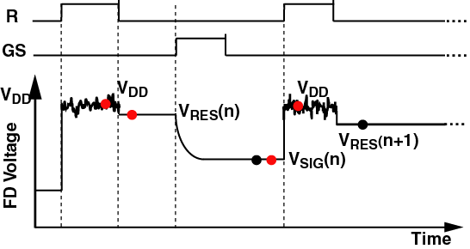
2.1.2 External Memory + CQS for 5Tr Scheme
RG
(B. Fowler et al.
(Fairchild Imaging),
Proc. of SPIE,
vol. 7536, 07, 2010)
TG
CQS: Correlated
Quadruple
Sampling
V_{DD}
V_{DD}
V_{r} (n)
V_{r} (n+1)
V_{s} (n)
(V_{S}(n) – V_{DD}) – (V_{r}(n) – V_{DD}) = V_{S}(n) – V_{r}(n)
Realize
2.54 e noise
Eliminate 1/f noise
at column.
Eliminate reset noise
at external.
Good Point: ・ Both reset noise and 1/f noise are eliminated.
Bad Point: ・ Frame rate decreases half.
・ External frame memory is needed.
Notes:
To reduce both reset noise and 1/f noise, Boyd Fowler of Fairchild Imaging proposes External memory + CQS for 5Tr Scheme.
CQS stands for Correlated Quadruple Sampling.
They use VDD during reset period as reference.
These subtractions eliminate 1/f noise at column, because they have correlation.
And, this subtraction eliminates reset noise at external.
Good point is both reset noise and 1/f noise are eliminated.
They realize 2.54 electrons random noise.
Bad points are that frame rate decreases half.
External frame memory is needed.

Slide 18
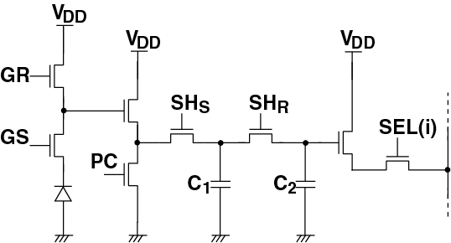
2.2. 8 Tr Scheme
Features: ・ Charge gain in pixel
・ Two S/H capacitances for reset and signal.
(X. Wang, et al. (CMOSIS),
Proc. of SPIE,
vol. 7536, Jan., 2010)
SF
C_{FD}
Parasitic Sensitivity
Good Point: ・ Reset noise of C_{FD} is eliminated. Random noise is 10e.
・ Good shutter efficiency, 99.998%.
Bad Point: ・ Large power consumption during SFs are ON.
・ Conversion gain decreases half.
・ kTC noises by C1 and C2
Notes:
CMOSIS proposes 8 Tr scheme, to improve both random noise and shutter efficiency.
There are two distinct features.
First is charge gain in pixel.
If charge gain is 10, parasitic sensitivity decreases 1/10 in input reference, and kTC noises by storage reset also decrease 1/10 in input reference.
Second is two S/H capacitances for reset and signal.
Then, CDS can be done at column circuit.
Good points are that reset noise of CFD is eliminated, and random noise becomes 10 electrons.
Good shutter efficiency, 99.998%, is realized because of 2 reasons.
One is charge gain in pixel.
The other is because 2 storage capacitances have similar parasitic sensitivity, and they are cancelled at CDS.
Bad points are large power consumption during SFs are ON.
Conversion gain decreases half.
kTC noises by C1 and C2 are remained.
This scheme is very popular among industrial application, now.

Slide 19
2.3. 2-Stage Transfer Scheme
V_{DD}
Feature: Storage (ST) between PD & FD.
Variation of ST:
・ Pinned PD structure
・ Surface channel CCD
・ Buried channel CCD
Good Points:
・ Low noise by real CDS.
2.7 e random noise is obtained.
・ Low dark current if pinning structure
is used at ST.
RG(i)
SF
GR
GTG
TG(i)
V_{DD}
PD
ST
FD
N⁺
P⁺
P⁺
N⁺
N
N
SEL(i)
(1) Charge
Transfer
Globally
(2) Charge
Transfer
Row by
Row
ST: Storage
RG(i): Reset Gate for i-th Row
(K. Yasutomi et al.(Shizuoka Univ.), ISSCC 2010)
Notes:
To eliminate both reset noises of storage and FD, 2-stage transfer scheme is proposed.,
As shown in this figure, storage, ST, is located between PD and FD.
Signal electrons are transferred from PD to ST globally.
Then, they are transferred from ST to FD row by row.
Both charge transfer should be complete transfers.
Then, reset noise of ST is not occurred, and reset noise of FD is eliminated by CDS.
There are variations of ST;
Pinned PD structure, as this figure, is proposed by Yasutomi-san of Shizuoka Univ.. Yasutomi-san is here.
Surface channel CCD structure and buried channel CCD structure are reported, also.
Good points are that low noise by real CDS.
2.7 electrons random noise is obtained by Yasutomi-san.
Low dark current is realized if pinning structure is used at ST.
I think 2-stage transfer scheme is promising method.

Slide 20
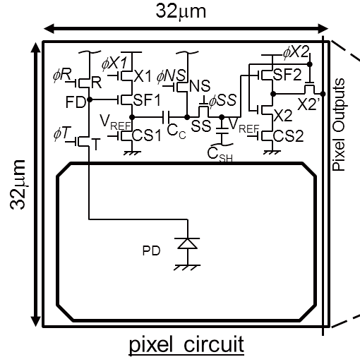
2.4. Pixel-wise CDS
Feature: S/H circuit for CDS in pixel.
Good Points:
・ Low noise by true CDS.
Noise: 4.8 e at 10 Mfps
・ High frame rate because of
- Pixel parallel
- No need to send reset level.
Bad Points:
・ Large power consumption while
SFs are globally operated.
・ Many transistors in pixel.
eg. 11 tr + 2 capacitance
Pixel Schematic
(T. Tochigi et al.(Tohoku Univ., ISSCC 2012)
Notes:
Pixel-wise CDS is used for high frame rate image sensor by Tochigi of Tohoku University.
In this scheme, S/H circuit for CDS is located in pixel.
Good points are that low noise realized by true CDS.
4.8 ele noise is obtained even at 10 Mfps.
High frame rate is possible because of the pixel parallel and no need to send reset level.
Bad points are large power consumption while SFs are globally operated,
and many Trs in pixel.

Slide 21
2.5. Pixel-wise ADC
Feature: Small circuit size and low power consumption ADC in pixel.
Good Points:
・ High frame rate because of pixel
parallel.
・ No dark current and no cross talk
at storage.
・ Digital processing in pixel.
Example: Wide DR.
Bad Points:
・ Large power consumption while
ADC are globally operated.
・ Many transistors in pixel. Stacking (3D Assemble) is awaited.
V_{DD}
V_{C}
Reset
RG
Inv.
Delay
Counter
Output
(F. Andoh et al.)
In-pixel ADC
(B. Fowler et al., ISSCC 1994.)
(F. Andoh et al., ITE Technical Report, vol. 23, no. 40, pp. 71-76, June 1999.)
Notes:
This viewgraph shows pixel-wise ADC.
Small circuit size and low power consumption ADCs are embedded in a pixel.
Good points are high frame rate because of pixel parallel.
No dark current and no cross talk at storage.
Digital processing in pixel can be possible.
Bad points are large power consumption while ADC are globally operated.
Many transistors in pixel.
To overcome the many transistor problem, stacking, or 3D assemble, is awaited.

Slide 22
Contents
１. Motivation of GS
２．Various Schemes
3. Cross Talk Reduction
3.1. Cross Talk mechanism
3.2. Charge Diffusion Reduction
3.3. Photoshield Material
3.4. Photoshield Shape
3.5. On-chip Optics --Lightpipe—
4. Summary
Notes:
Thirdly, I would like to explain cross talk reduction.

Slide 23
3.1. Cross Talk Mechanism
Multi-reflection
Transmission of
Photoshield
Oblique
Incident
Light
Photoshield
FD
GTG
GTG
ST
TG
ST
TG
N
P⁺
N
P⁺
PD
N
PD
N
e
Charge Diffusion
Cross Talk Mechanism
(Buried channel, CCD 2-stage transfer scheme)
Notes:
This figure shows 4 mechanisms of cross talk to ST using buried channel CCD, 2-stage transfer scheme.
From viewpoint of optics, oblique incident light, multi-reflection, and transmission of photoshield are causes.
From viewpoint of device physics, charge diffusion is a main cause.
Following viewgraphs explain how to prevent these mechanisms.

Slide 24
3.2.1. Charge Diffusion Reduction (1)
P⁺-Barrier Layer
ST
ST
ST
P⁺
N
P⁺
N
P⁺
N
PD
N
PD
N
PD
N
P⁺
P⁻Epi.
P-Well
Potential
Barrier.
e
x
P⁺Sub.
e
N-Sub.
e
Lifetime is short.
P-Sub.
Potential
Barrier.
P⁺-Barrier Layer
P⁻/P⁺ Wafer
P-Well/N-Substrate
・ Only one additional
process step
・ No process change
・ Limited performance
・ Sensitivity non-
uniformity
・ Good performance
for deep electrons
・ Longer process
Notes:
This viewgraph shows 3 methods to prevent charge diffusion mechanism.
P⁻/P⁺ wafer is used because minority carrier life time is short in P+ substrate.
Most electrons, generated in P+ region, are annihilated.
Good point is that no process change is needed.
Bad point is limited performance and sensitivity non-uniformity.
P-well/N-substrate structure achieves good performance for deep electrons because the potential barrier is enough high.
But, longer process is needed.
P+ barrier layer just under ST forms potential barrier by Fermi level difference because of impurity concentration difference.
Good point is that only one additional process step is needed.

Slide 25
3.2.1. Charge Diffusion Reduction (1)
P⁺-Barrier Layer
ST
ST
ST
P⁺
N
P⁺
N
P⁺
N
PD
N
PD
N
e
PD
N
P⁺
e
P⁻Epi.
P-Well
Potential
Barrier.
e
x
P⁺Sub.
e
N-Sub.
e
Lifetime is short.
P-Sub.
Potential
Barrier.
P⁺-Barrier Layer
P⁻/P⁺ Wafer
P-Well/N-Substrate
・ Only one additional
process step
・ Effective for shallow
and deep electrons
・ Limited performance
・ No process change
・ Limited performance
・ Sensitivity non-
uniformity
・ Good performance
for deep electrons
・ Longer process
Notes:
While these method are not effective for shallow electrons, P+ barrier layer is effective for both shallow electrons and deep electrons.
But, the barrier height is around 100 mV, so the performance is limited.

Slide 26
3.2.2. Charge Diffusion Reduction (2)
ST
P⁺
N
PD
N
P⁺
e
P-Well
e
N-Sub.
Potential
Barrier.
P-Well/N-Substrate + P⁺-Barrier Layer
・ Good performance
・ Longer process
Notes:
The combination of P-well/N-substrate + P⁺-barrier layer shows good performance for both shallow electrons and deep electrons.
But, longer process is needed.
Most CCD image sensors use this structure to reduce cross talk, or smear.

Slide 27
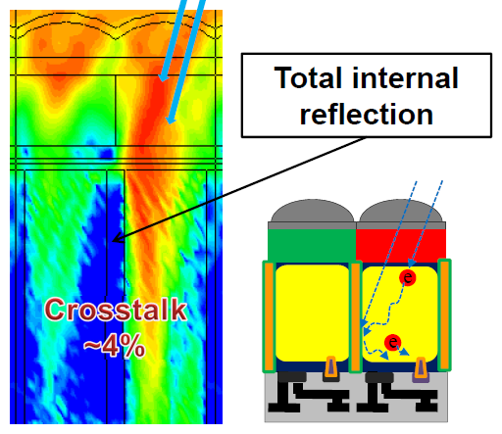
3.2.3. Charge Diffusion Reduction (3)
・ DTI (Deep Trench Isolation) tech.
is reported for 1.12um BSI (Back
Side Illumination) RS 4 Tr scheme
image sensor.
・ DTI protects both charge diffusion
and oblique incident light to reduce
cross talk between pixels.
DTI
Silicon
(3～4
um)
(JC. Ann et al (Samsung), ISSCC 2014.)
・ DTI may not be adopted to GS image sensor with no change.
- 8 Tr scheme and pixel-wise CDS scheme can use DTI structure,
and need good pixel design.
- In case of 5 Tr scheme and 2-stage transfer scheme, DTI can not put
between PD and ST.
Notes:
CMOS image sensors for mobile phone cameras have small pixel size, 1.12um.
Cross talk between pixels is one of the important challenges even for RS.
DTI, deep trench isolation technology is reported for 1.12um BSI, back side illumination, rolling shutter CMOS image sensor at ISSCC 2014 by Ann of Samsung.
Since the silicon thickness is only 3 or 4 um, DTI is formed from the front surface to the back surface.
Then, DTI effectively protects both charge diffusion and oblique incident light to reduce cross talk between pixels.
But, DTI may not be adopted to GS image sensor with no change.
8 Tr scheme and pixel-wise CDS scheme can use DTI structure, but need good pixel design.
In case of 5 Tr scheme and 2-stage transfer scheme, DTI can not put between PD and ST,
because there needs signal electron transfer from PD to ST.
Near IR needs thick silicon.
It is another challenge for DTI.

Slide 28
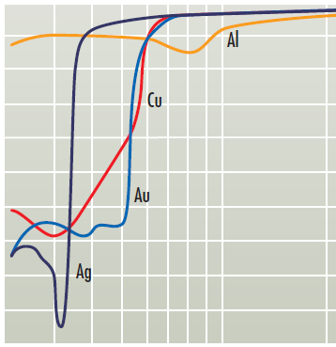
3.3. Photoshield Material
・ Tungsten is best material for photoshield among various metals.
100
 | Al | W
Light Blocking (Transmissivity) | ○ | ○
Low Reflectivity | × | ○
Edge Uniformity (Grain Size) | × | ○
Migration Free | × | ○
Pin Hole Free (No Nodule) | × | ○
Heat Tolerance | × | ○
90
80
70
60
50
Reflectivity (%)
40
30
W
20
10
0
.2
.3
.4
.5
.6
.7
.8
.9
1
2
Wavelength (um)
(http://optica.cocolog-nifty.com/blog/2011/11/post-97a0.html
+ A. Toyota, et al. (NEC), IEEE T-ED, 1991.)
Notes:
Photoshield material is an important factor to reduce cross talk.
We can use various metals at Si process line.
Tungsten is best material among various metals.
This table compares tungsten with aluminum.
Both have enough low transmissivity.
Tungsten has lower reflectivity for wide wavelength as shown in this figure.
It has good edge uniformity because of smaller grain size.
Tungsten also has migration free, pin hole free, and higher heat tolerance.
Tungsten is used as photoshield at CCD image sensor to reduce cross talk.

Slide 29
3.4. Photoshield Shape
・ Distance, t, between photoshield
and Si substrate should be smaller.
λ: Wavelength,
n : Refractive Index
(Cutoff condition for waveguide)
If λ=850nm, n = 1.45, t_{c}=290nm.
・ Special process is needed to
realize this condition.
・ Local wiring is a candidate.
Crosstalk
Al
x
t
ST
PD
・ Photoshield edge position from PD,
x, should be larger.
(N. Teranishi, et al. (NEC), IEEE T-ED, 1987.)
Notes:
Photoshield shape also much affects cross talk.
This figure shows cross sectional view of test image senosr and
cross talk dependence of photoshield edge position ,x.
The parameter is the distance, t, between photoshield and Si substrate.
As this figure, t should be smaller to reduce cross talk.
According to cutoff condition of waveguide theory, t should be smaller than λ/2n.
For example, if λ=850nm, refractive index ,n, is 1.45 for silicon dioxide, tc is 290nm.
Special process is needed to realize this condition.
In case of CCD image sensors, tungsten photoshield satisfies this condition .
In CMOS process, local wiring is a candidate.
Photoshield edge position from PD, x, should be larger.
But, this has tradeoff against sensitivity.

Slide 30
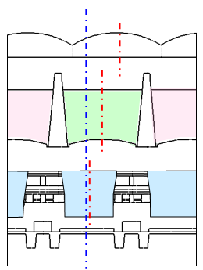
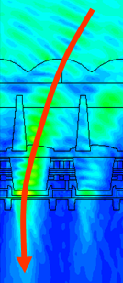
3.5. On-chip Optics --Lightpipe--
Microlens
・ On-chip optics, microlens,
lightpipe, are effective to
reduce cross talk.
・ Microlens increases fill factor.
Light pipe turns oblique light
into normal.
Separation wall
Color filter
Lower
lightpipe, SiN
Photo shield
Silicon
Aperture
・Powerful lightpipe
- Color filter becomes lightpipe.
- High refractive index SiN
- Bended lightpipe.
- Large aperture by fine technology.
・Oblique light is turned into normal.
FDTD
(Finite-difference
time-domain method
(N. Teranishi, et al. (Panasonic), IEEE IEDM, 2012.)
Notes:
On-chip optics, such as microlens, light pipe, are effective to reduce cross talk as well as to increase sensitivity.
Roughly speaking, while microlens increase effective fill factor, lightpipe turns oblique light into normal.
I would like to explain powerful light pipe reported by Panasonic.
Color filter becomes lightpipe since low refractive index separation wall is located between color filters.
High refractive index SiN is used as lower lightpipe core.
Bended lightpipe is structured by different shifted ratios of microlens, color filter and lower lightpipe.
Large aperture is realized by fine technology.
According to FDTD simulation, oblique light is turned into normal.

Slide 31
Contents
１. Motivation of GS
２．Various Schemes
3. Cross Talk Reduction
3.1. Charge Diffusion Reduction
3.2. Photoshield Material
3.3. Photoshield Shape
3.5. On-chip Optics --Lightpipe—
4. Summary
Notes:
Summary.

Slide 32
4. Summary
GS is needed because of
・ No deformation of moving object
・ Correspond to modulated light
・ No flash band
・ Electronic shutter
２．Challenges
・ Dark current at storage
・ Crosstalk （Shutter Efficiency)
・ Noise reduction
・ PD area increase
３．To overcome challenges, various methods are proposed.
・ 8 Tr scheme , ・ 2 stage transfer scheme
・ Pixel-wise CDS, ・ Pixel-wise ADC
４．To reduce crosstalk, optical structure is important as well as
charge diffusion.

