Slide 1
Novel Methods of Resolving Multi-path in Time of Flight Cameras
Refael Whyte, Lee Streeter, Michael Cree, Adrian Dorrington.
The University of Waikato, New Zealand.

Slide 2
New Zealand

Slide 3
Time-of-Flight Background
Illuminate the scene, reflected light
$$s\left(t\right)=\frac{a}{2}\cos\left(ω_{l}t+φ\right)+b$$
Returning light correlated with reference signal
$$g\left(t\right)=\cos\left(ω_{l}t\right)$$
Cross-correlation is
$$h\left(τ\right)=s\left(t\right)⨂g\left(t\right)=\frac{a}{2}cos\left(ω_{l}τ+φ\right)+b$$
S$hift τ$ to recover 3 unknowns, so 3 samples required.
Can represent data as a complex variable
$$ζ=a\exp\left(−jφ\right)$$

Slide 4
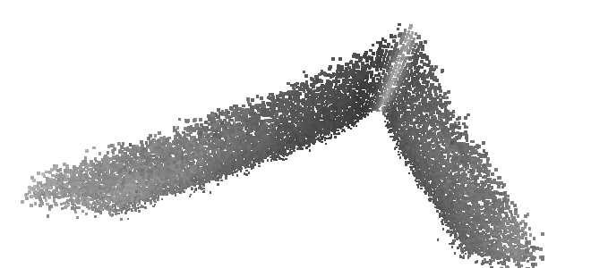
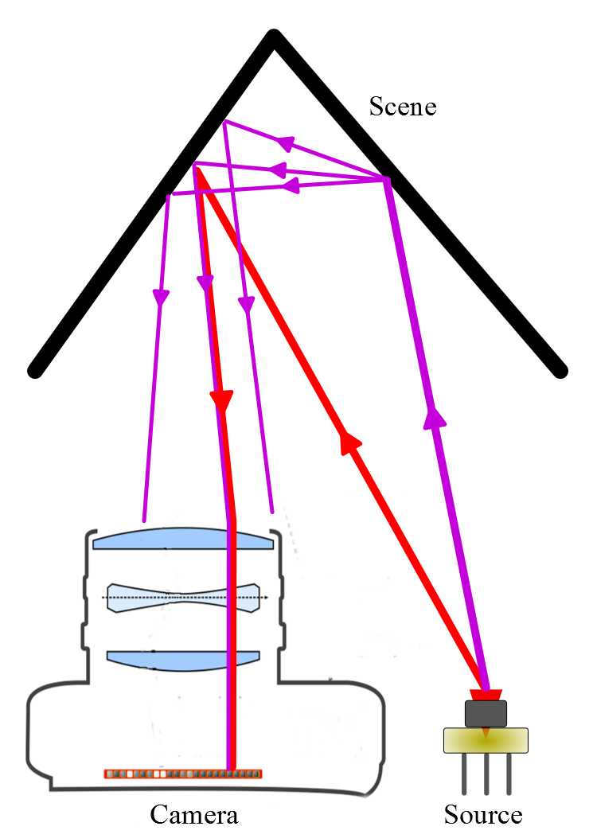
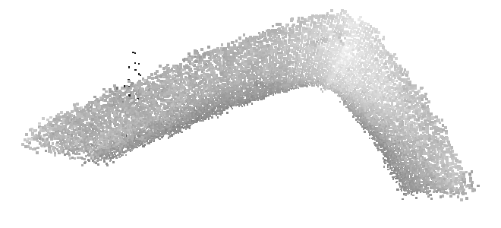
Multi-Path Interference
Actual Corner
Corner Correct
Corner Measured
Multi-path is caused by inter-reflections, subsurface scattering, mixed pixels and volumetric scattering
Measured Corner

Slide 5
Multi-path Interference
Can’t resolve using current measurements.
Multi-path adds on complex plane.
$$a_{2}e^{−jφ_{2}}$$
Img
$$a_{m}e^{−jφ_{m}}$$
$$a_{1}e^{−jφ_{1}}$$
Real

Slide 6
Direct and Global Separation
Separate returns
$L=L_{d}+L_{g}$
Illuminate scene with checkerboard, and inverted checkerboard.
$$\frac{1}{2}L_{g}$$
$$L_{d}+ \frac{1}{2}L_{g}$$
$$L_{d}+ \frac{1}{2}L_{g}$$
$$\frac{1}{2}L_{g}$$

Slide 7
Direct Global Separation Cont
The measured values are
$$L_{min}=\frac{1}{2}L_{g}$$
$$L_{max}=L_{d}+\frac{1}{2}L_{g}$$
In reality 25 frames used. 5 shifts in x, and 5 shifts in y for each x.

Slide 8
Complex Direct Global Separation
Same principle, but using complex variables. Multi-path can be expressed as
$$L=a_{d}\exp\left(−jφ_{d}\right)+a_{g}\exp\left(−jφ_{g}\right)$$
Complex vectors add on complex plane.
Maximum and minimum become
$$L_{min}≈\left|L_{min}\right|,$$
$$L_{max}≈|L_{max}|$$
$$L_{g}$$
$$L$$
$$L_{d}$$

Slide 9
Complex Direct Global Separation
Because complex additional constraints
$\left|L_{d}\right|≫\left|\frac{L_{g}}{2}\right|$, or $φ_{d}−φ_{g}<\frac{π}{2}$
$$\frac{L_{g}}{2}$$
$$L_{min}≠\frac{L_{g}}{2}$$
Will fail assumptions.
$$L$$
$$L_{d}$$

Slide 10
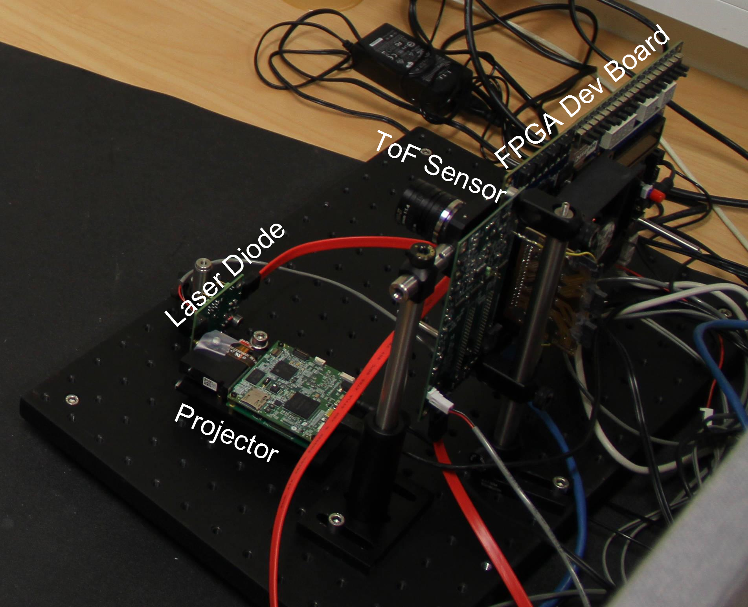
Equipment setup
Custom ToF camera attached to DMD based projector.
PMD19k3 Sensor, 120x160

Slide 11
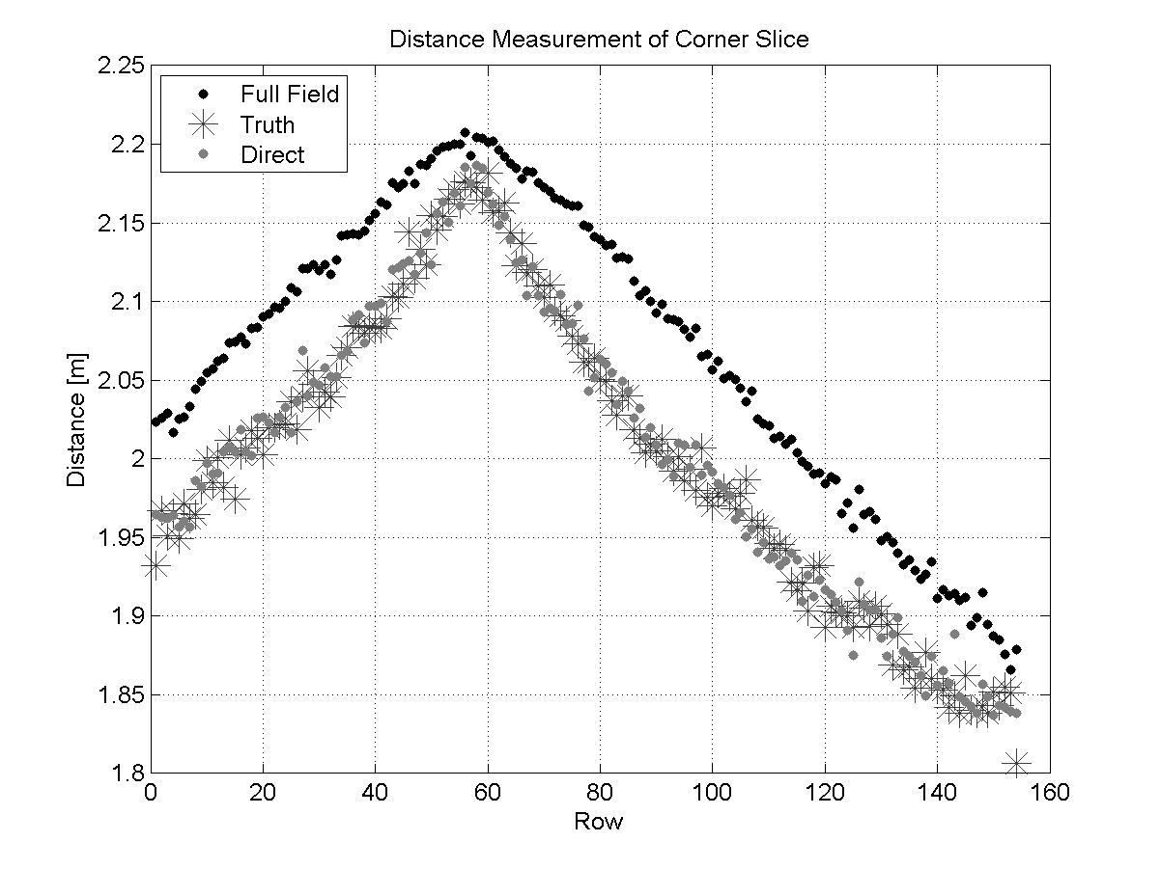
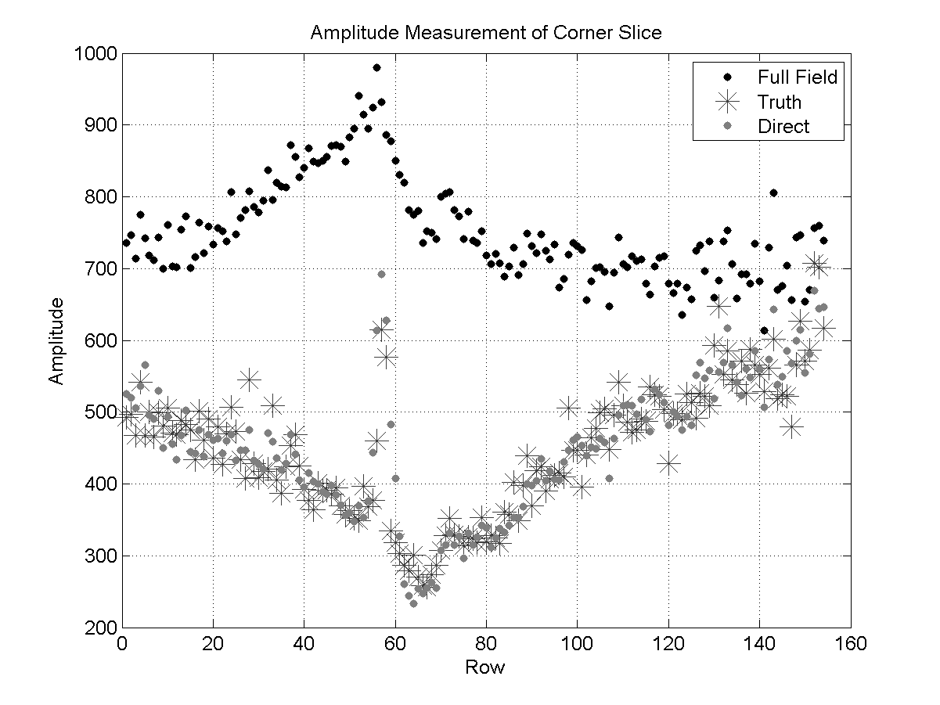
Results – Corner

Slide 12
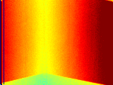
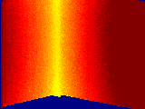
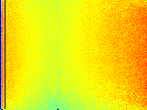
Results - Corner
Amplitude
Direct Amplitude
Global Amplitude
Phase
Direct Phase
Global Phase

Slide 13
Direct Global Sinusoidal Pattern
Illuminate the scene with high frequency sinusoidal.
Light seen at each pixel over time is
$L\left(t\right)=\frac{A\left(1+\sin\left(ω_{p}t+θ\right)\right)}{2}$
$$t_{0}=$$
$$t_{1}=$$
$$t_{2}=$$

Slide 14
Direct Global Sinusoidal Pattern
DC
The measured radiance is
$$I\left(t\right)=\frac{L_{d}}{2}\sin\left(ω_{p}t+θ\right)+\frac{L_{d}+L_{g}}{2}$$
Can find the unknowns with a discrete Fourier Transform.
1st Frequency

Slide 15
Direct Global Complex
The general formula is
$$I\left(t,τ\right)=h_{d}\left(τ\right)L\left(t\right)+\frac{h_{g}\left(τ\right)}{2}$$
Correlation function $h\left(τ\right)$ is a sinusoid
Can do frequency mixing
$L\left(t\right)=\frac{1+\cos\left(3ω_{l}τ+θ\right)}{2}$
Resulting is mixing between 3 and 1.

Slide 16
Direct Global Complex
The new correlation function between projector and time of flight, the mixing results in the following
$I\left(τ\right)=\frac{a_{d}}{4}\left(\cos\left(\left(3−1\right)ω_{l}τ+θ−φ_{d}\right)+\cos\left(\left(3+1\right)ω_{l}τ+θ+φ_{d}\right)\right)+\frac{a_{d}\cos\left(ω_{l}τ+φ_{d}\right)+a_{g}\cos\left(ω_{l}τ+φ_{g}\right)}{2}$
$I\left(τ\right)=\frac{a_{d}}{4}\left(\cos\left(2ω_{l}τ+θ−φ_{d}\right)+\cos\left(4ω_{l}τ+θ+φ_{d}\right)\right)+\frac{a_{d}\cos\left(ω_{l}τ+φ_{d}\right)+a_{g}\cos\left(ω_{l}τ+φ_{g}\right)}{2}$
End up with direct at frequency 2 and 4.
Using the Discrete Fourier transform the unknowns can be solved.
$$2ω_{l}$$
$$4ω_{l}$$
$$1ω_{l}$$

Slide 17
Direct Global Complex
The equations for the unknowns are
$$θ=\frac{φ_{2}+ φ_{4}}{2}$$
$$φ_{d}=\frac{φ_{2}− φ_{4}}{2}$$
$$a_{d}=2\left(α_{2}+ α_{4}\right)$$
$$\frac{a_{g}}{2}\exp\left(−jφ_{g}\right)= α_{1}\exp\left(−jφ_{1}\right)−\frac{a_{d}}{2}\exp\left(−jφ_{d}\right)$$
Only require 9 samples

Slide 18
Direct Global Complex
Only require 9 samples
Projector pattern and phase step changes between each frame.
Mixing the pattern shift frequency with the correlation shift frequency.

Slide 19
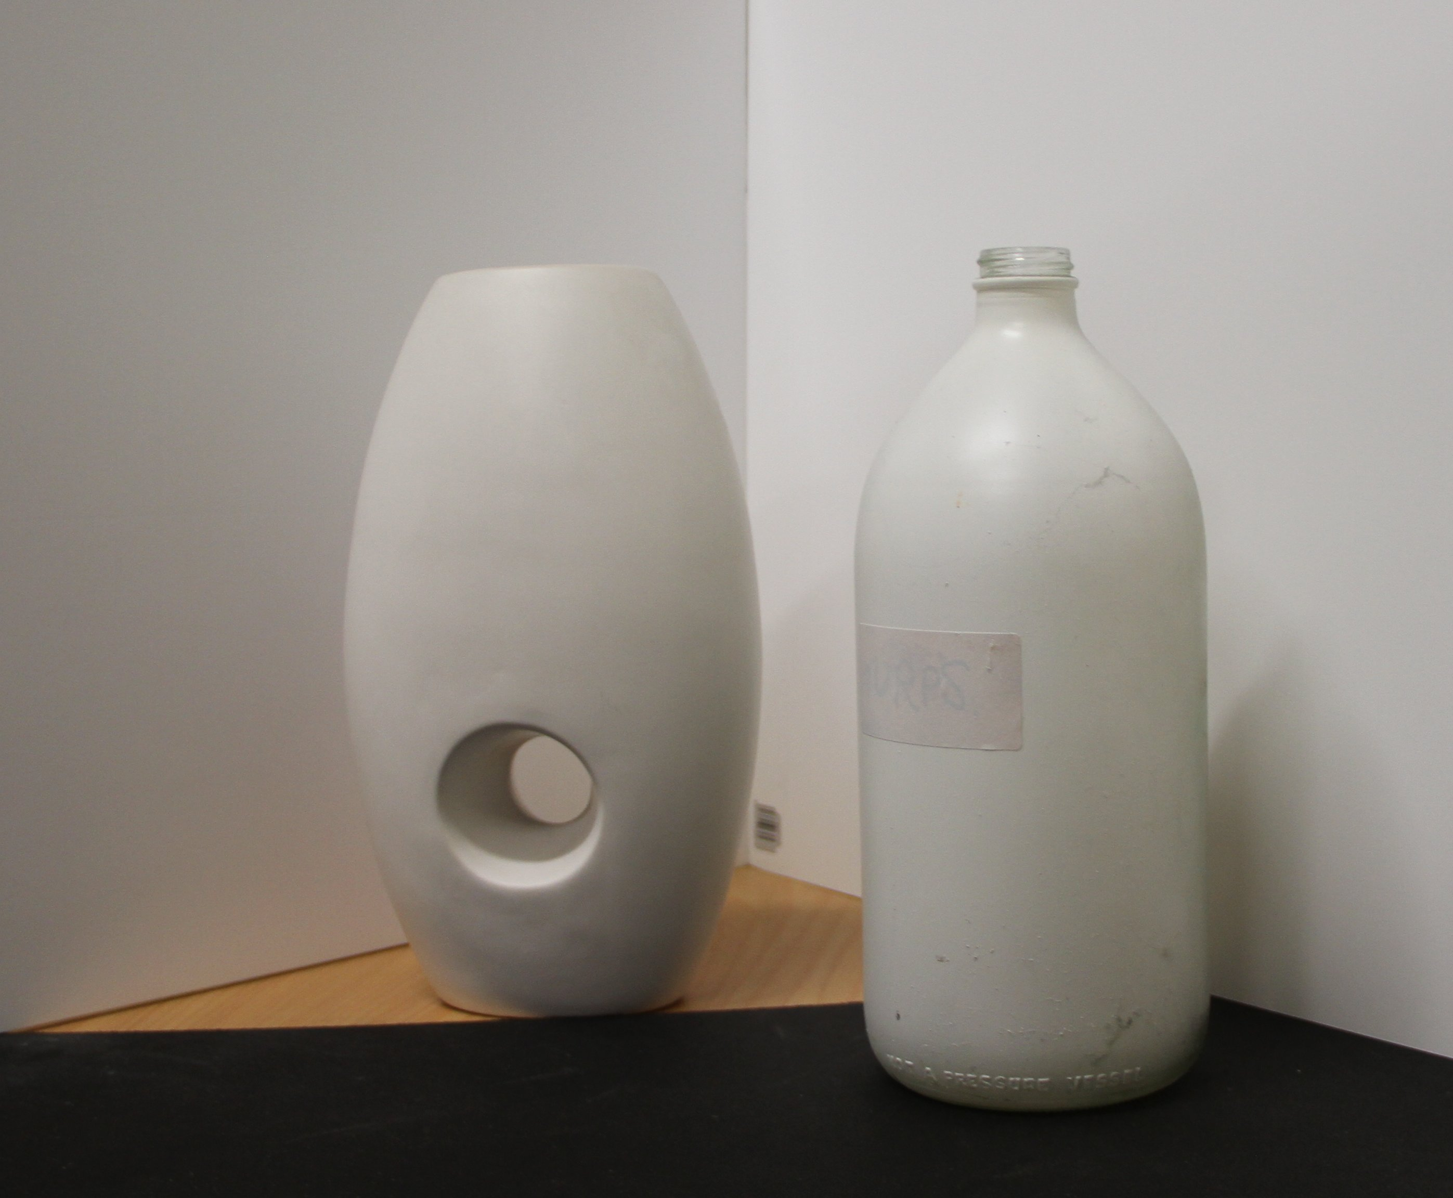
Direct Global Complex - Data
Scene Photo
ToF Raw Frames
Projector Pattern
Combination

Slide 20
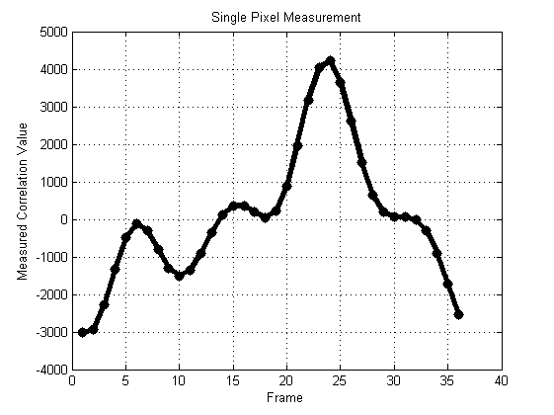
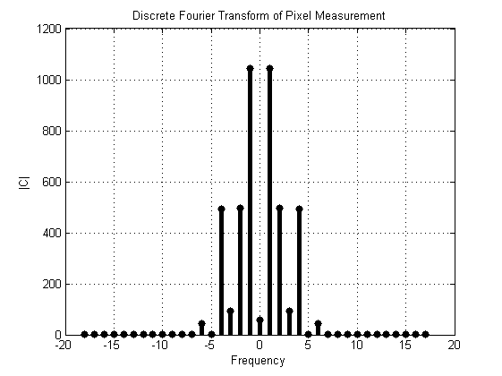
Single Pixel Measurement

Slide 21
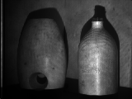
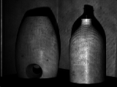
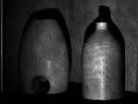
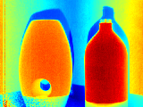
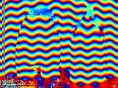
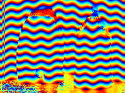
Entire Image
$$α_{1}$$
$$α_{2}$$
$$α_{4}$$
$$φ_{1}$$
$$φ_{2}$$
$$φ_{4}$$
$$I\left(τ\right)=\frac{a_{d}}{4}\left(\cos\left(2ω_{l}τ+θ−φ_{d}\right)+\cos\left(4ω_{l}τ+θ+φ_{d}\right)\right)+\frac{a_{d}\cos\left(ω_{l}τ+φ_{d}\right)+a_{g}\cos\left(ω_{l}τ+φ_{g}\right)}{2}$$

Slide 22
Entire Image
$$θ=\frac{φ_{2}+ φ_{4}}{2}$$
$$a_{d}=2\left(α_{2}+ α_{4}\right)$$
$$φ_{d}=\frac{φ_{2}− φ_{4}}{2}$$

Slide 23
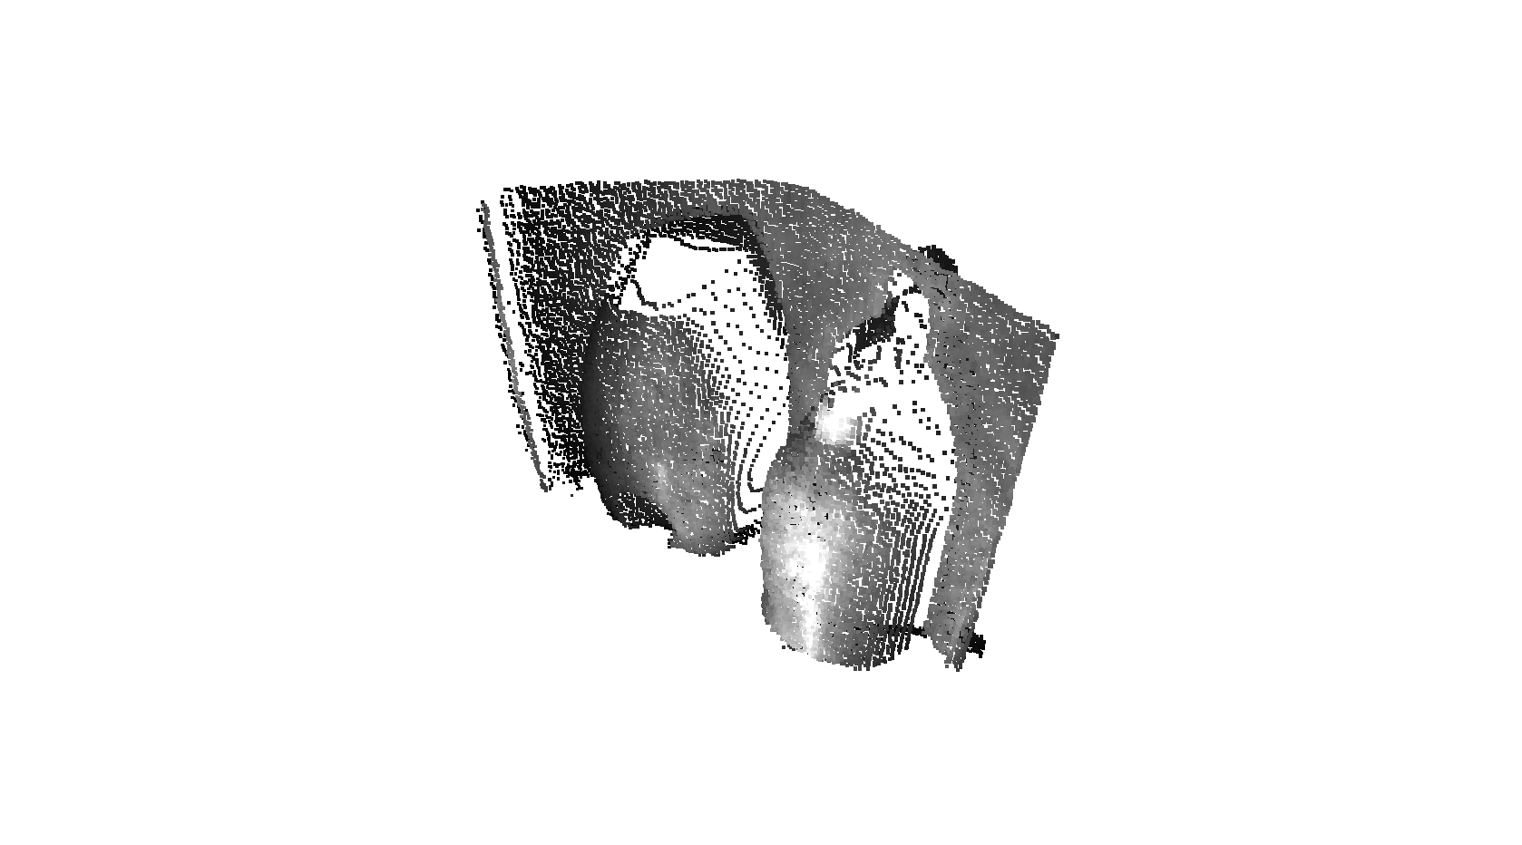
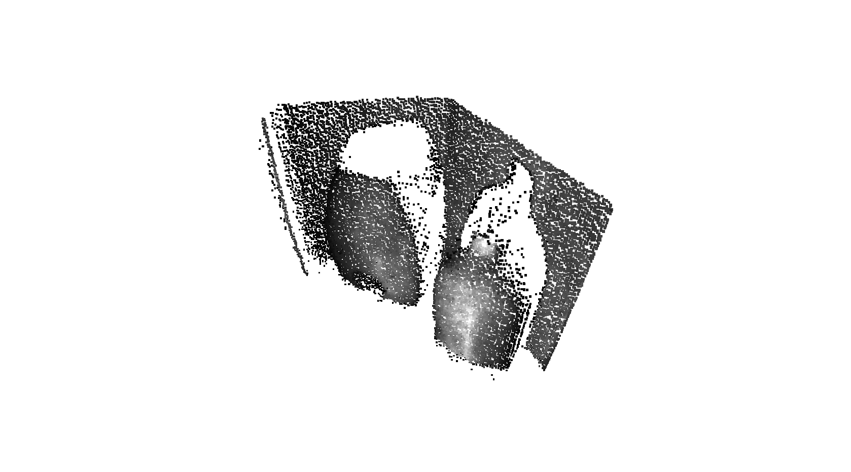
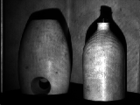
Results 9Images – Bottles Corner
Shadow
Amplitude

Slide 24
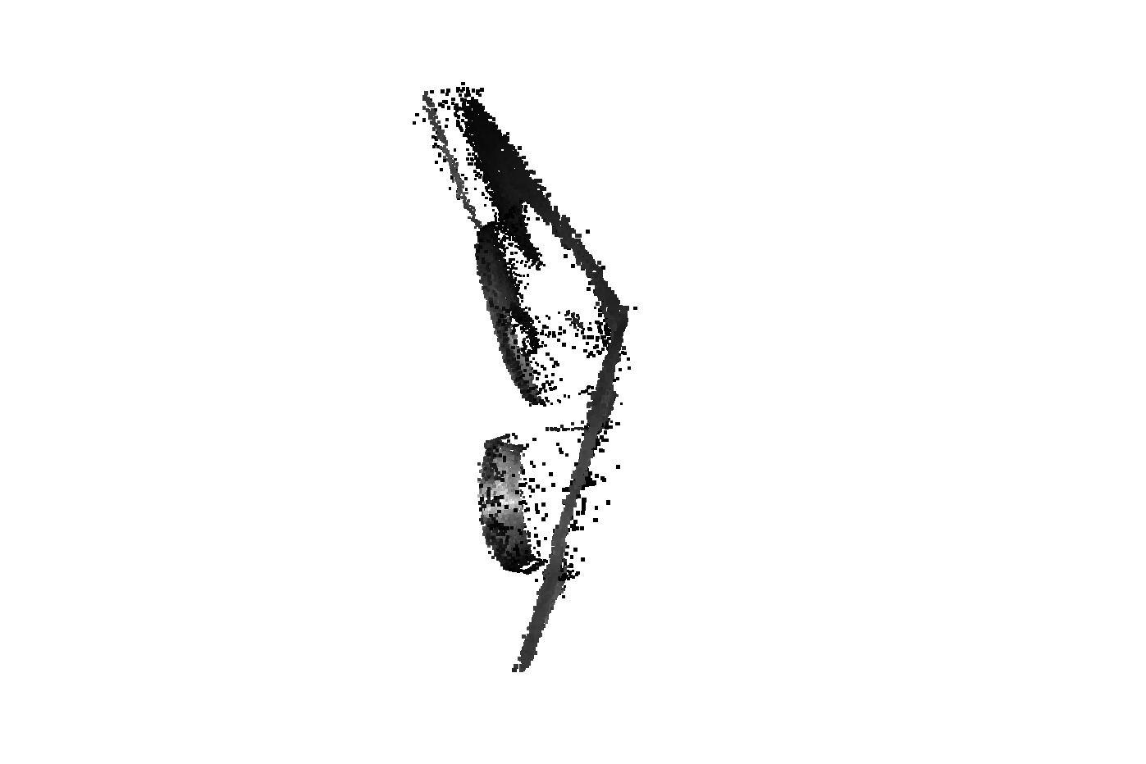
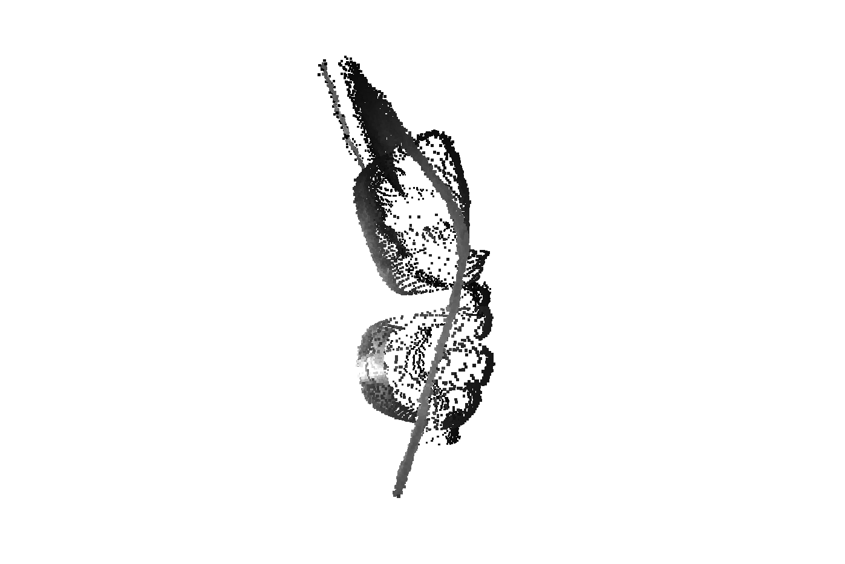
Results – Bottles Corner

Slide 25
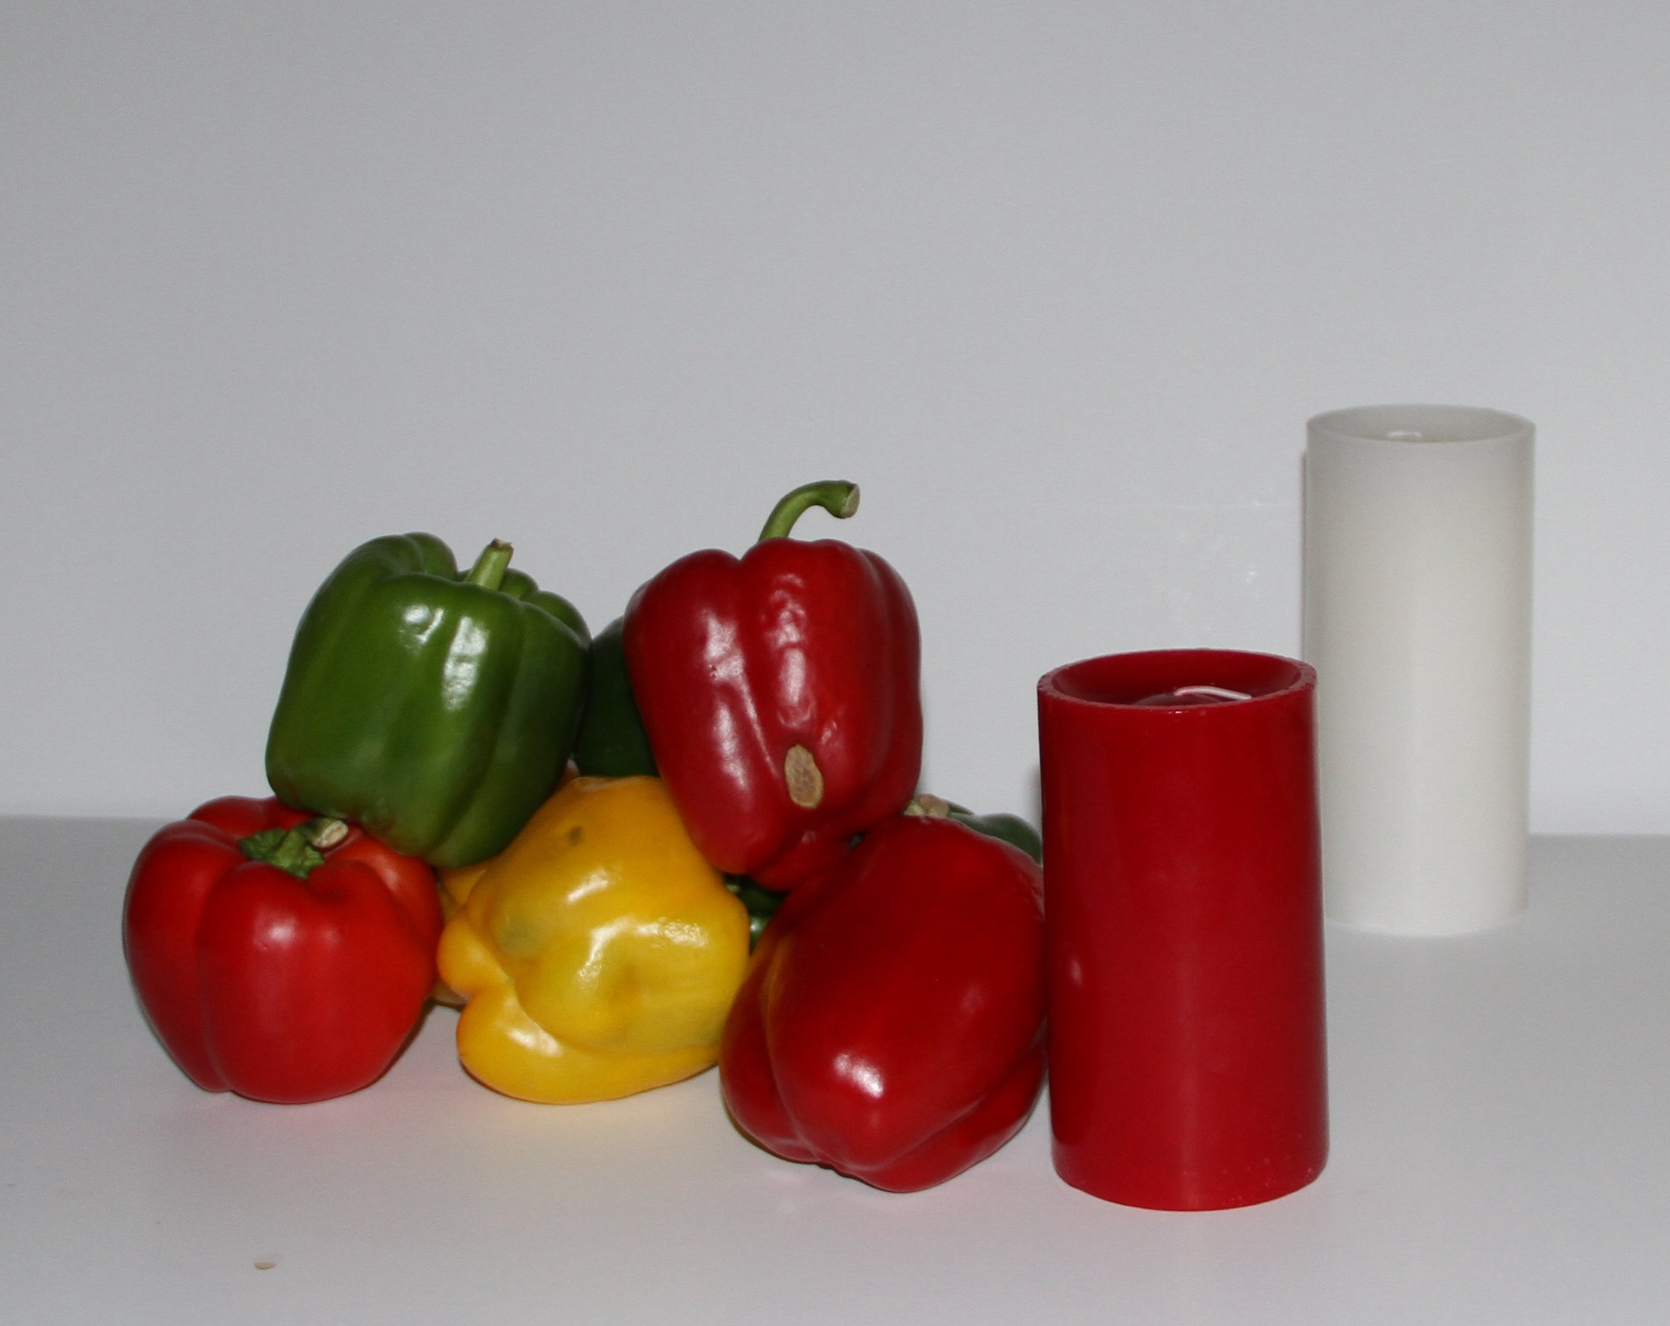
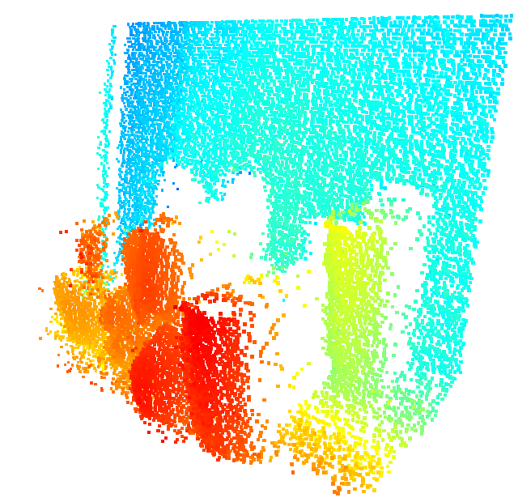
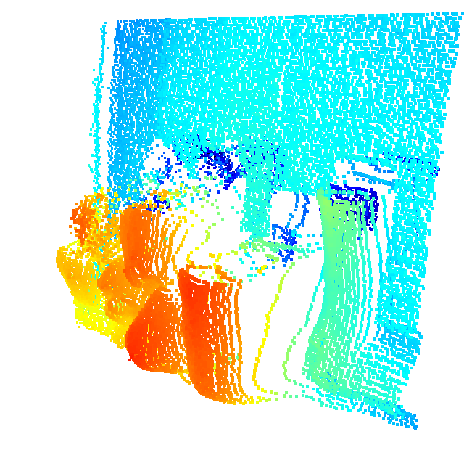
Results – Subsurface Scattering

Slide 26
Issues
Odd harmonics in correlation function caused by using square waves.
3rd Harmonic is not an issues, 5th and higher orders are.
Linear response of projector. Non-linear introduces spurious harmonics.
Projector FoV and Camera FoV are different.
Specular reflections fail.

Slide 27
Conclusion
Resolved errors due to multipath in time of flight cameras using direct global separation methods.
Requires 9 frames.
Does not resolve specular reflections.
Thanks to the MIT Media Lab.

