Slide 1
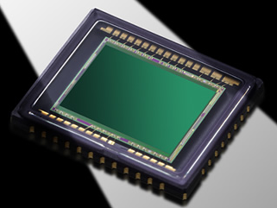
Pixel Design and Technologies for Time-of-Flight Sensors
Tohru Yamada, Takuya Asano
Image Sensor Division
Semiconductor Business Division
Automotive & Industrial Systems Company
Panasonic Corporation
10 March 2014
Notes:
Thank you, Mr. Chairman. Good afternoon, ladies and gentlemen. I am Tohru Yamada from Kyoto, Japan.
Thank you for the opportunity to present to you, today.
I work in the Image Sensor Division of the Semiconductor Business Division of Panasonic’s Automotive and Industrial Systems Company.
Sorry about the long and complicated department name.
Before we get into the presentation, let me briefly introduce my credentials.
I have some 20 years’ experience in image sensor field.
Currently, I am responsible for steering development and mass-production of image sensor products including ToF sensors.
My area of expertise is design and development of Image sensor pixels.
Today, I want to outline state-of-the-art design and technologies for enhancing pixel performance in ToF sensors.
I believe that our new technologies will help to revolutionize TOF sensor design and performance and realize prospective new applications and new markets.

Slide 2


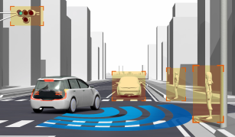

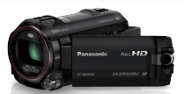
Market Trends of Image Sensors
Entry of 3D imagers to Gaming market creates new applications
for Consumer, Industrial and Automotive markets.
Before
After
Market demands
Picture Viewing, Recording, sharing
Object Recognition
Classification
Requirements for IS
High-quality 2D Visible Imaging
Accurate 3D Imaging
(Depth, Shape, Color)
Applications
Visible light
Visible light and Infrared (IR) light
DSC, DVC, Smartphone
Consumer
Industry
Automobile
Picture Shooting
and Recording
@Microsoft XBOX
@KIVA Systems
Autonomous
Driving
Natural U/I
Robotic vision
3D imaging technologies will become as pervasive as 2D-DSCs
Notes:
Let's start with the background to our ToF sensor development activity.
This slide shows market trends of the image sensor industry.
To date, our main market for image sensors has been DSCs, DVCs and smart phone cameras for picture shooting and recording.
These applications require high-quality 2D visible pictures and it is through pursuit of this quality that IS technologies have progressed dynamically over about a decade.
However, added value for achieving high-quality pictures has reached satisfaction level and new added value applications are being eagerly sought by the IS industry.
Entery of 3D imagers to the gaming market, in such forms as natural user interfaces, leads to creation of new applications not only in the consumer market but also in the industrial and automotive markets for development of robotic vision, autonomous driving, and so on.
In these applications, accurate 3D imaging is required for IS in order to implement object recognition and classification.
I believe that, in the near future, 3D imaging will become as pervasive a range of technologies as conventional 2D applications and the ToF sensor is a strong candidate for 3D imaging.

Slide 3
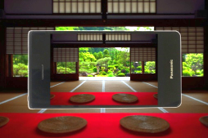

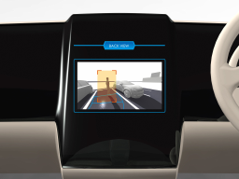
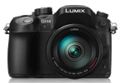

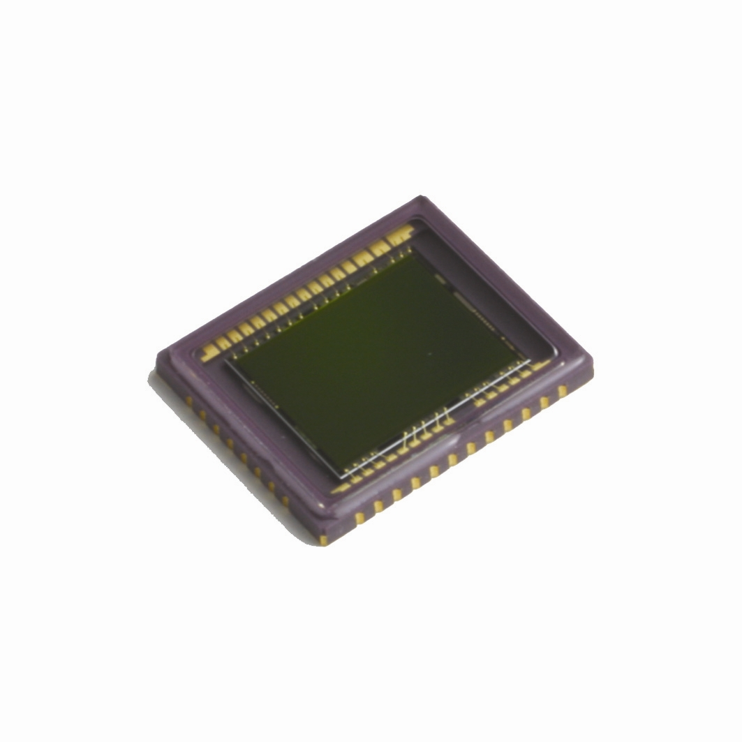
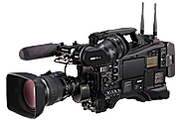
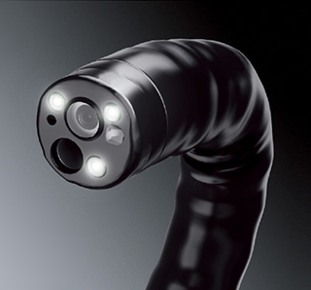
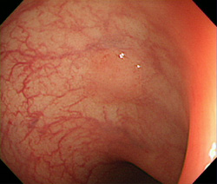
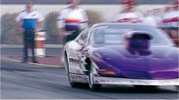
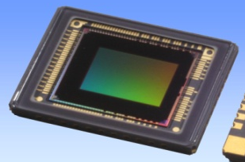
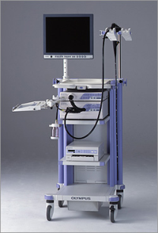
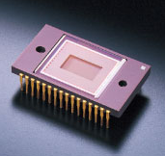
Panasonic Image Sensors
Digital AV
Security/Automotive
IT-CCD*
Small Pixel
High Sensitivity
High IR Sensitivity
Wide Dynamic Range
*Interline Transfer CCD
Broadcast
CMOS (CIS)
Image Sensor
Medical
νMaicovicon®
SmartFSI®
Global Shutter
Low Smear
Color Reproducibility
Small Die Size
Enhancing 2D imaging technologies will make further progress on ToF sensors
Notes:
Now, let me introduce Panasonic image sensors.
The Automotive and Industrial Systems Company is a unique business which has developed both CCDs and CISs.
We have more than 30 years’ experience in the IS field and have developed a number of IS products and technologies for various applications.
These applications have required us to achieve high performance levels in such areas as small pixels and high sensitivity for digital AV, high IR sensitivity and [a ]wide dynamic range for security and automotive applications, global shutter and low smear for professional broadcast cameras, and good color reproducibility and small die size for medical endoscope.
We have been able to satisfy these requirements by developing a number of standout technologies, which we believe will help us make further progress in ToF sensor development.

Slide 4
Basic Principle of Pulsed ToF
IR Pulse
Projection
Global Shutter
IR
light
Projection
Light
Tp
Tp
t
TOF
sensor
Reflection
Δｔ
Δｔ
Reflection
Light
S0
S1
Distance Z
t
Depth Calculation
S0 exposure
S1 exposure
Δt
C
T_{P}
: Time of Flight
: Light Speed
: IR Pulse width
Requirements for Pulsed ToF Pixels
High IR Sensitivity -> Long Distance Ranging
Fast Global Shutter (GS) -> Accurate Depth Measurement
Revolutionized IT-CCD pixel will satisfy these requirements
Notes:
Now, let's take a look at the basic principle of Pulsed ToF.
In Pulsed ToF, IR pulse light is projected to the object and reflected light is captured using the global shutter of a ToF sensor.
In this operation, the ToF sensor captures two individual signals of S0 and S1 exposures.
Depth is easily calculated by dividing S1 signals by S0 signals.
The requirements for Pulsed TOF pixels are as follows:
First, reflected light intensity is inversely proportional to the square of the distance, then higher IR sensitivity is necessary for carrying out long distance ranging.
Second, a fast global shutter is very important, especially for pulsed ToF, in order to measure accurate depth.
And, our revolutionized IT-CCD pixel will satisfy these requirements.

Slide 5
Global Shutter Pixels – GS-CIS vs. IT-CCD
IT-CCD provides better performance in Sensitivity, Smear, Dark Current and Crosstalk.
 | GS-CIS (5-Tr. type*) 1/3" WVGA (752x480) 6.0um□ | Panasonic IT-CCD (MN39784) 1/3" qHD (960x540) 5.4um□
Pixel Architecture
Signal Storage Region | C_{FD} (Floating Diffusion Capacitance) | VCCD (Vertical CCD)
Overflow Control /Electronic Shutter | LOD (Lateral Overflow Drain) | VOD (Vertical Overflow Drain)
Sensitivity (@550nm) | 4.8V/lux･s ⁽¹⁾ | 6.3V/lux･s
Parasitic Sensitivity /Smear | 0.5% / -46dB ⁽²⁾ | 0.0003% / -130dB
Dark Current (@25℃) | 14mV/s ⁽¹⁾ | 0.5mV/s
Crosstalk (IR Light) | Several pixels ( p⁻-sub.) | Within one pixel ( n⁻-sub.)
*RST-Tr, SEL-Tr are not shown
Small PD Area
Large PD Area
Photo-Shield
C_{FD}
Photo-Shield
VCCD
TG
OFG
TG
AMP
PD
PD
n
AMP
PD
n
n
PD
C_{FD}
↑
Many Defects
LOD
VCCD
↑
Defect-free
p⁻
p⁻
n⁻
VOD
Pixel performances
LOD
AMP
5
Reference :(1)Data sheet (2)IIWS2005
Notes:
Before getting on to current ToF pixel technologies, let me mention global shutter pixels.
This chart shows a comparison of pixel architectures and performances between the GS-CIS and our IT-CCD.
This CIS consists of 5-Tr, TG, OFG, AMP, which are indicated in this figure, and RST and SEL, which are not shown here.
CFD works as the signal storage region. Overflow control and electronic shutter are conducted by OFG.
Even though 5-Tr. GS-CIS has the smallest number of Tr. in pixels among the other GS-CIS architectures, these plural Trs. and diffusion layers make the PD area smaller, which results in decreased photo-sensitivity.
Furthermore, poor photo-shield causes serious parasitic sensitivity in the FD, defects in the FD generate large dark current, and p-type substrate, which is often used to obtain higher IR sensitivity in ToF sensors, induces a good deal of pixel crosstalk when IR light penetrates deeply into the substrate.
In contrast, IT-CCD consists of only PD and VCCD. That's all. OFD is vertically formed by using an n-substrate and a p-well which is formed by high energy I/I.
Even though this 3D pixel design is a little difficult to achieve, IT-CCD pixel is the simplest architecture for the global shutter function.
The large PD area achieves high sensitivity at visible light, and good coverage photo-shield reduces parasitic sensitivity to a negligible level.
VCCDs work as very low dark current signal storage regions. The VOD structure can suppress bulk crosstalk of IR signals to within one pixel.

Slide 6
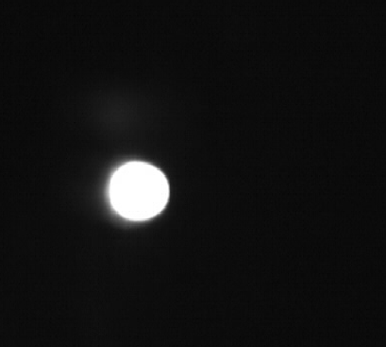
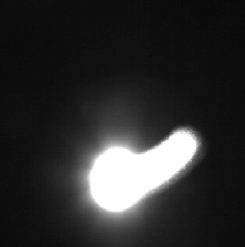
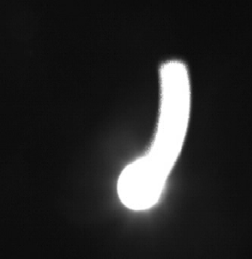
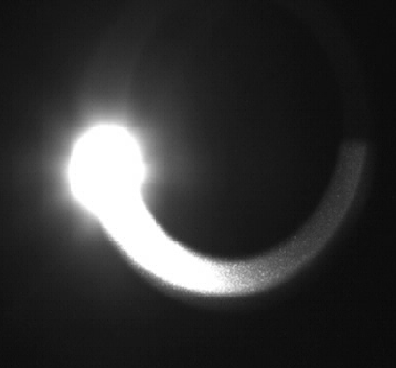
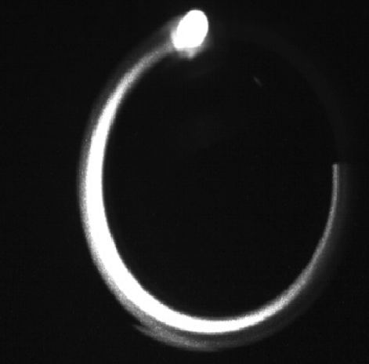
Smear (Parasitic Sensitivity) – GS-CIS vs. IT-CCD
Panasonic IT-CCD (MN39784)
1/3" qHD (960x540) 5.4um□
Good photo-shield of IT-CCD reduces parasitic sensitivity in VCCD; no image artifact caused by LED light can be seen.
60fps
0.00003%
(-130dB)
TG
Good Coverage
Electric fan blade
LED light
n
PD n
Shutter 1/2000s
VCCD
p⁻
n⁻
Poor Coverage
TG
OFG
Camera
GS-CIS 1/3" WVGA
(752x480) 6.0um□
AMP
PD
n
C_{FD}
p⁻
LOD
60fps
30fps
15fps
7.5fps
0.5%(-46dB)
6
Notes:
Now, let's take a look at some benchmark results for the GS-CIS and our IT-CCD.
The first one is smear or parasitic sensitivity.
In this comparison, an LED light is mounted on an electric fan blade and the blade is fast-rotated.
As you can see in these pictures, good photo-shield coverage in the IT-CCD can dramatically reduce parasitic sensitivity in the VCCD. No image artifacts caused by LED light can be seen in the picture.
But, with GS-CIS, poor photo-shield coverage causes significant parasitic sensitivity in the FD, which produces serious image artifacts in the direction that the LED light moves.

Slide 7
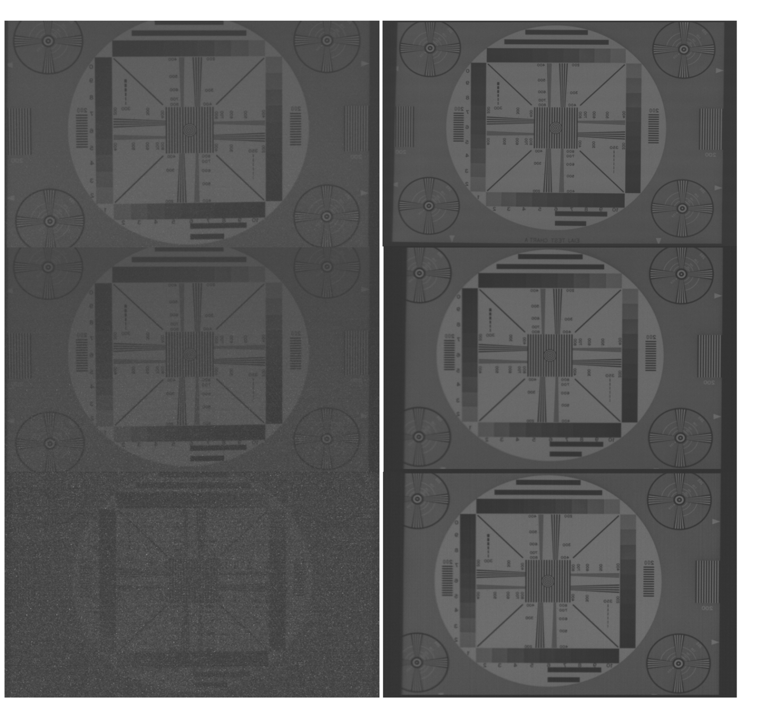
Dark Current – GS-CIS vs. IT-CCD
Sensor temperature 80 degrees; exposure time 1/10000s
Junction Defect
Readout time
GS-CIS
IT-CCD (MN39784)
AMP
GS-CIS
TG
n⁺⁺
p⁺⁺
16.7ms
(60fps)
n
C_{FD}
p⁻
PD
Bulk Defect
IT-CCD
TG
n
p⁺⁺
33ms
(30fps)
n
VCCD
p⁻
PD
n⁻
Defect-free
VCCD of IT-CCD has low doped channel and no metal junction; this can reduce surface and bulk defects, resulting in low dark current.
66.7ms
(15fps)
7
Notes:
Next, we have a dark current comparison.
Here the sensor temperature is set to 80 degrees. Three different readout time images are shown in this slide.
GS-CIS stores the signals in the FD, which has a number of junction defects due to the metal contact and a number of bulk defects due to high doped ion-implantation, which causes serious white blemishes and dark current.
While IT-CCD stores the signals in the VCCD, which has a low doped channel and no metal junction, this can reduce generation of surface and bulk defects, resulting in suppression of white blemishes and dark current.

Slide 8
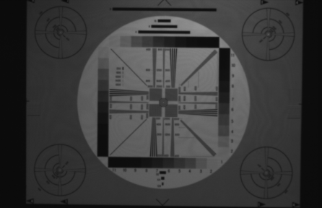
IR Image Resolution – GS-CIS vs. IT-CCD
Resolution chart of IT-CCD taken by IR light has Good Resolution.
VOD structure can suppress Bulk Crosstalk by Drift transfer of Photo-electrons.
960 pixels
IR light = 850nm
200 pixels
540 pixels
540 pixels
200 pixels
GS-CIS
6.0um□
IT-CCD (MN39784)
5.4um□
752 pixels
IR Light
Blurred Image
Good Resolution
IR Light
PD
n
PD
n
Drift
p
Diffusion
VOD Barrier
Drift
SUB (p⁻)
SUB (n⁻)
8
Notes:
Finally, here is a comparison of IR Image resolution.
Here, the wavelength of the IR light is 850nm. IR images of resolution charts are captured for both sensors.
As you can see in these enlarged pictures, a blurred image is obtained for GS-CIS. This is due to the bulk crosstalk caused by thermal diffusion of the photo-electrons generated in the deep part of the p-type substrate.
While IT-CCD pixels have VOD structure, photo-electrons generated above VOD barriers are immediately transferred to each target PD by electrical field drift, and electrons generated below the VOD barriers drain to the n-substrate. This can suppress bulk crosstalk and enable reproduction of the original resolution.

Slide 9
Pixel Design and Technologies for ToF Sensors
Advantages of IT-CCD pixels
  High Sensitivity (@Visible Light)
  Low Parasitic Sensitivity (Low Smear)
  Low Dark Current
  Low Crosstalk (@IR Light)
High Reflective-Index (HRI)
Micro-Lens
Challenges for ToF Sensor
  1. Long Distance Ranging
    High Fill-Factor
    Enhanced IR Sensitivity
  2. Accurate Depth Measurement
    Electronic Fast Shutter
Metal
Metal
VCCD
TG
TG
Deep
PD
Deep
VOD
Barrier
Deep Narrow
Isolation
(NI)
Electric Field
Enhancement
Approach
  High Reflective-Index Micro-Lens
  Deep PD w/ VOD
  Electric Field Enhancement in the Deep PD
9
Notes:
Now, I want to talk about state-of-the-art pixel design and technologies for ToF sensors.
As explained in the previous slides, the IT-CCD pixel has the advantages of high sensitivity at visible light, low parasitic sensitivity, low dark current and low crosstalk in the IR.
Despite these advantages, we need to revolutionize our IT-CCD pixels in order to address the following challenges to further progress on ToF sensors.
First, in order to achieve long distance ranging, the High Reflective-Index micro-lens and Deep PD have been developed. The resulting effective FF is 70% and the QE in the IR is 18%.
Second, Electric Field Enhancement in the Deep PD is implemented in order to realize an electronic fast shutter for accurate depth measurement. The resulting rise time and fall time of the shutter pulse are shorter than 2nsec.
Today I will introduce the last two approaches.

Slide 10
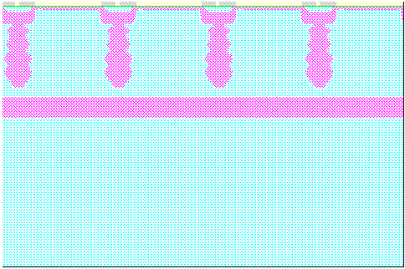
Enhanced IR Sensitivity – Deep PD w/ VOD
Light Absorptivity in Si
IR Light penetrates deeply into Si substrate.
450nm
Deep PD is necessary to obtain
higher IR sensitivity.
550nm
Light absorptivity [a.u.]
650nm
Deep PD is created by forming Deep VOD Barrier and Deep Narrow Isolation through High-Energy Ion-Implantation process.
λ=850nm (IR)
Depth of Si [um]
Quantum Efficiency (Q.E.)
Pixel Impurity Profiles
Conventional PD
Deep PD
Potential
Potential
Deep PD
Q.E. [a.u.]
PD (n)
VCCD
Deep
PD
VCCD
(p)
VOD Barrier (p)
(n)
2
Deep Narrow Isolation
x 2.8
Conventional PD
Deep VOD Barrier (p)
Wavelength [nm]
SUB (n⁻)
SUB (n⁻)
Notes:
Let me show you the new technology for enhancing IR sensitivity.
This graph shows the light absorptivity in Si. As you can see, IR light absorptivity is very low, so IR light penetrates deeply into the Si substrate.
Then, Deep PD is necessary to obtain higher IR sensitivity. The Deep PD is created by forming a deep VOD barrier and deep narrow isolation through a high-energy ion-implantation process.
The VOD barrier of the Deep PD is deepened from 3um to 5um and the resulting Q.E.@850nm is increased to 18%, or 2.8-times higher than that of the conventional PD.

Slide 11
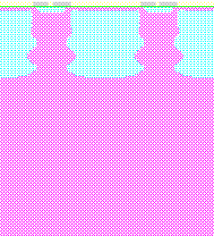
Fast Shutter Characteristics– Deep PD w/ VOD
Deep PD w/ VOD
P-sub. structure
Shutter Time (ST) :0.5nsec ~ 1000nsec
ON
TG pulse
IR pulse
TG pulse
IR pulse
TG pulse
Potential
Potential
OFF
PD
(n)
PD
(n)
ON
VCCD
1
VCCD
1
IR pulse
(850nm)
Drift
2
OFF
VOD Barrier (p)
2
1. Photo-electrons are generated in PDs and transferred to VCCDs.
Diffusion
SUB(n⁻)
SUB(p⁻)
2. After TG pulse turns off, electrons in deep regions of substrate belatedly move to PD.
Photo-Current Simulations
Fast Shutter Simulations
Shutter ON (1)
OFF (2)
ON (1)
OFF (2)
P-sub.
10nsec
500psec
@90%
16nsec
VCCD
signals
VCCD
signals
Demodulation Contrast (DC)
( VCCD sig. - PD sig. ) [a.u.]
Deep PD w/ VOD
Photo-current [a.u.]
Photo-current [a.u.]
PD signals
PD signals
Time [nsec]
Time [nsec]
Shutter Time (ST) [nsec]
Even though p-sub. obtains higher DC at ST longer than 16nsec, the DC plummets as ST becomes shorter, while Deep PD w/ VOD retains DC and 90% of it is obtained at ST of 500psec.
11
Notes:
Next, I want to discuss the fast shutter simulation results of the deep PD with VOD compared to the p-sub. structure.
These analyses are conducted using transient photo-current simulations.
In order to simplify analysis, both structures have the same VCCDs and PDs. Only the substrate type and VOD barrier of the Deep PD structure are different from those of the p-sub. structure.
For both structures, TG pulses are applied to the transfer gates from 0.5nsec to 1000nsec and 850nm IR pulses are synchronized with TG pulses .
As you can see in the photo-current simulation results for Deep PD with VOD, during the shutter-on period, photo-electrons are generated in the PD and almost all of these electrons are instantly transferred to the VCCDs through electric field drift. Then, after the TG pulse turns off, PD signals remain at negligible levels.
But, in the case of the p-sub. structure, during the shutter-on period, photo-electrons are generated and gradually transferred to the VCCDs through thermal diffusion. Even after the TG pulse turns off, electrons in deep regions of the substrate belatedly move to the PD and a significant amount of PD signals remains.
Residual PD signals degrade demodulation contrast, which is calculated by subtracting PD signals from VCCD signals.
This figure shows the simulated shutter time dependence of demodulation contrast.
The red line shows the p-sub structure and the blue line shows the Deep PD with VOD.
As you can see in this graph, even though the p-sub. structure obtains higher demodulation contrast at a shutter time longer than 16nsec, the demodulation contrast plummets as shutter time becomes shorter, while the Deep PD with VOD retains demodulation contrast and 90% of it is obtained at the shutter time of 500psec.

Slide 12
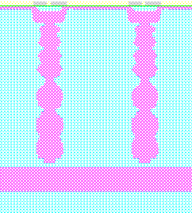
Technology for Future TOF – Double Deep PD
Deep PD
Double Deep PD
Quantum Efficiency (Q.E.)
Double Deep PD
PD (n)
VCCD
PD (n)
VCCD
(p)
(p)
Deep Narrow Isolation
Q.E. [a.u.]
Double Deep NI
Deep VOB (p)
Deep PD
x 1.6
Double Deep VOB (p)
SUB(n⁻)
SUB(n⁻)
Fast Shutter Simulations
Double Deep PD w/VOD
Wave Length [nm]
P-sub.
500nsec
Demodulation Contrast (DC)
Deep PD w/VOD
Shutter Time (ST) [nsec]
Double Deep PD realizes 1.6 times higher IR sensitivity than Deep PD. DC of this PD will surpass P-sub. at ST <500nsec.
Notes:
Let's move on to the approach for future ToF sensors.
We currently have under development Double Deep PD, using ultra high energy ion implantation and epitaxial growth technologies.
The first trial production of Double Deep PD obtains 1.6-times higher IR sensitivity than that for the Deep PD I shown in the previous slide.
Fast shutter simulations indicate that the demodulation contrast of the double deep PD will surpass that of the p-sub. structure at a shutter time shorter than 500nsec. This will be a major advantage of the Double Deep PD for longer distance ranging and accurate depth measurement.
Unfortunately slant and variation of photo-response remain in the first trial production. These could be removed through optimal pixel design.

Slide 13
Summary
Advantages of IT-CCD Pixel
  Better performance in areas of Sensitivity, Smear, Dark Current and Crosstalk.
Requirements for Pulsed ToF
  1. High IR Sensitivity -> Long Distance Ranging
  2. Fast Global Shutter -> Accurate Depth Measurement
IT-CCD pixel can satisfy
these requirements.
This work
  1-1. High Reflective-Index Micro-Lens -> High F.F.
  1-2. Deep PD w/ VOD -> High IR Q.E.
  2. Electric Field Enhancement in the Deep PD -> Fast Shutter
Next Approach to Future ToF
  Double Deep PD w/ VOD -> Higher IR Q.E.
Revolutionized IT-CCD pixel will aid further progress on ToF sensors
13
Notes:
Finally let me summarize this presentation.
As I mentioned, the IT-CCD pixel has strong advantages in terms of Sensitivity, Smear, Dark Current and Crosstalk.
Pulsed ToF requires high IR sensitivity for long distance ranging and a fast global shutter for accurate depth measurement.
Our IT-CCD pixel can satisfy these requirements.
In this work, the High Reflective Index micro-lens realizes effective Fill Factor of up to 70%@5.4um□pixels.
Deep PD increases quantum efficiency to 18%@850nm.
Electric Field enhancement in the Deep PD achieves an electronic fast shutter with rise time and fall time shorter than 2nsec.
For future ToF sensors, Double Deep PD with VOD can further enhance quantum efficiency in the IR up to 28%.
Our simulation indicates that this PD will obtain higher demodulation contrast than that for the p-sub. structure through the generally used ToF shutter time.
In conclusion, we believe that our revolutionized IT-CCD pixel will aid further progress on ToF sensors and has the potential to make it the front-runner in 3D imagers.
Thank you.

