Slide 1

High-Resolution Time-of-Flight
Range Imagers with
Lateral Electric Field Modulators
Keita Yasutomi and Shoji Kawahito
Research Institute of Electronics
Shizuoka University
Hamamatsu, Japan

Slide 2
Outline
Lateral Electric Field Modulator (LEFM)
  1-tap LEFM
  = Draining Only Modulator (DOM)
  Multi-tap LEFM
Implementation 1:
A TOF range imager with In-pixel background light cancelling (4-tap LEFM)
Implementation 2:
A sub-mm resolution TOF imager with column-wise skew calibration
(1-tap LEFM: DOM)

Slide 3
Outline
Lateral Electric Field Modulator (LEFM)
  1-tap LEFM
  = Draining Only Modulator (DOM)
  Multi-tap LEFM
Implementation 1:
A TOF range imager with In-pixel background light cancelling (4-tap LEFM)
Implementation 2:
A sub-mm resolution TOF imager with column-wise skew calibration
(1-tap LEFM: DOM)

Slide 4
Lateral Electric Field charge Modulator (LEFM)
Y
Two-tap LEFM
[S.Kawahito et.al, IISW ’13]
X
Z
E_{Z} → E_{Y} → E_{X}
E_{z2}
E_{z1}
E_{Y1}
・Fast charge modulation with
high constant electric field
・High Q. E. in short λ
・Low Noise (small scooped
electrons, trapped electrons)
・CMOS compatible
E_{Y2}
E_{x}

Slide 5
Two-tap LEFM
S. Kawahito, et al. IISW 2013
X-X’
ΔVp
ΔVp

Slide 6
1-tap LEFM: Draining-Only Modulator (DOM)
S. Kawahito et al., IISW 2009
・Large Well Capacity
(with FD node)
・For TOF Range Imagers
・Low Noise (True CDS with SD)
・Biological Applications (FLIM)

Slide 7
Outline
Lateral Electric Field Modulator (LEFM)
  1-tap LEFM
  = Draining Only Modulator (DOM)
  Multi-tap LEFM
Implementation 1:
A TOF range imager with In-pixel background light cancelling (4-tap LEFM)
Implementation 2:
A sub-mm resolution TOF imager with column-wise skew calibration
(1-tap LEFM: DOM)

Slide 8
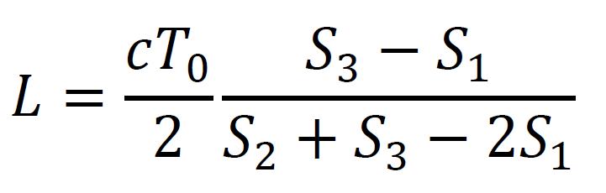
4-tap LEFM
S. Han et.al ISSCC 2014
FD2
FD3
Integration
Readout
Emitted
light
G2
G2
G3
G3
Aperture
G1
G1
GD
GD
Four different phase signals can be obtained in single frame.
→ In-pixel background
cancelling suitable for
moving object
FD1
Drain

Slide 9
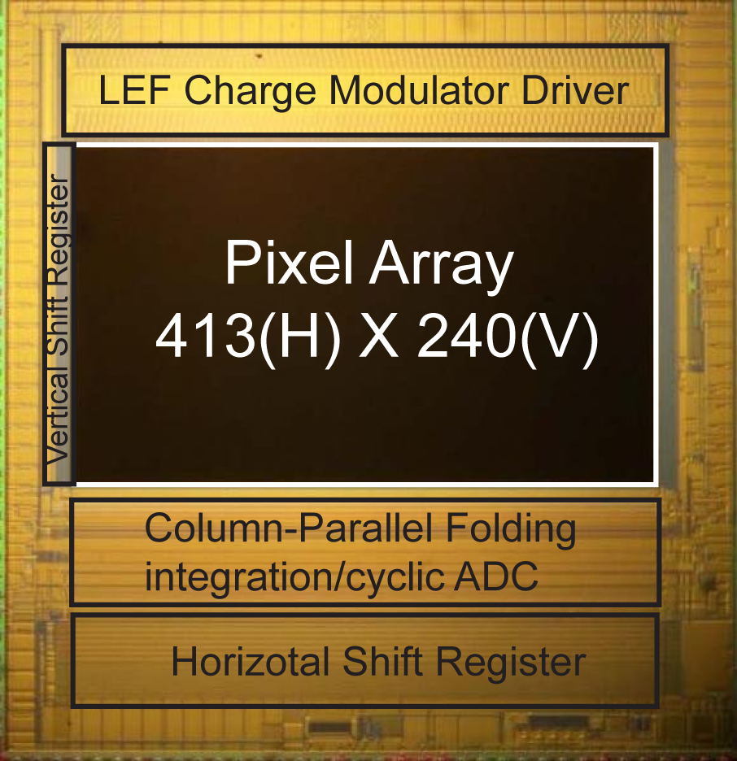
In-pixel background cancelling
Intensity image
Range resolution @1.3m
0.5cm (w/o BG)
1.5cm (w/ BG 4000lx)

Slide 10
Outline
Lateral Electric Field Modulator (LEFM)
  1-tap LEFM
  = Draining Only Modulator (DOM)
  Multi-tap LEFM
Implementation 1:
A TOF range imager with In-pixel background light cancelling (4-tap LEFM)
Implementation 2:
A sub-mm resolution TOF imager with column-wise skew calibration
(1-tap LEFM: DOM)

Slide 11
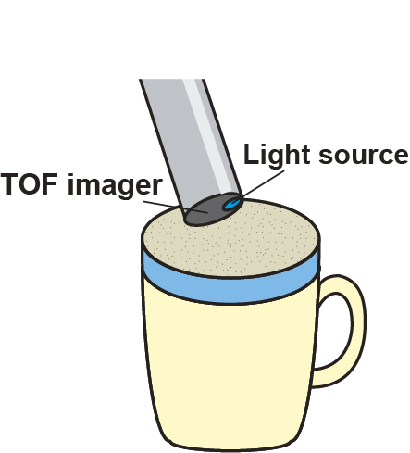
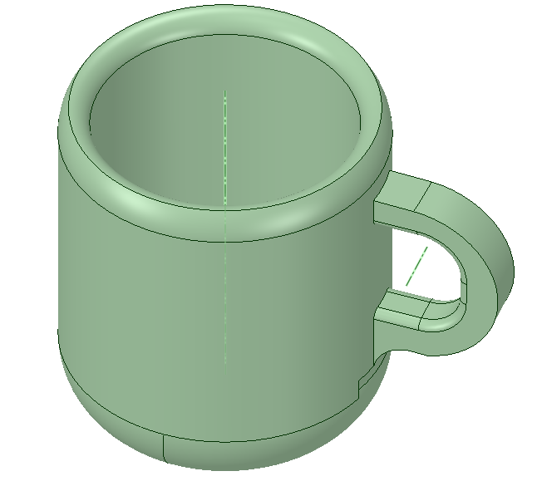
Motivation
New application for TOF range imagers
Miniature-head & High-speed 3D scanning system
Flexible scanning
Current contactless 3D scanners:
Light-section method
→ High resolution, but long base line
Challenges for sub-mm or higher range resolution
Light source: short pulse width of <1ns
→ Indirect TOF using impulsed light
High-speed modulation lock-in pixels
→ Draining-Only Modulation (DOM) pixels
Column-wise skew of gating clocks
→ Column-parallel skew calibration

Slide 12
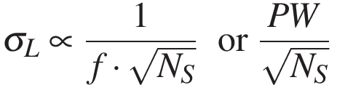
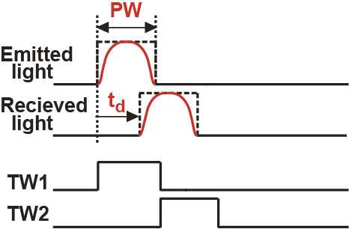
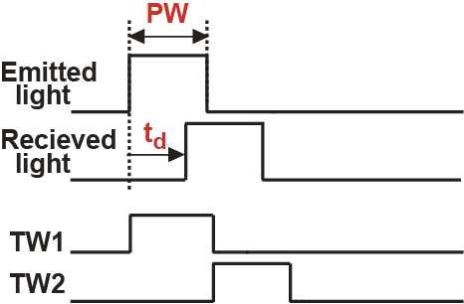
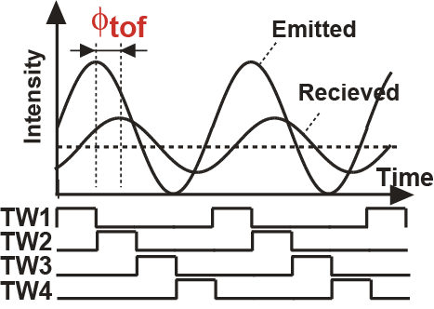
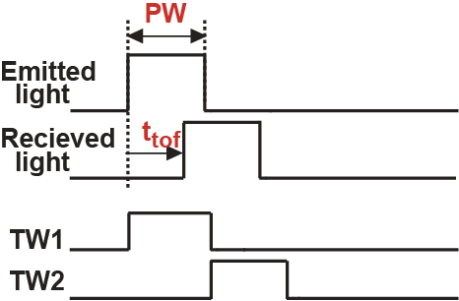
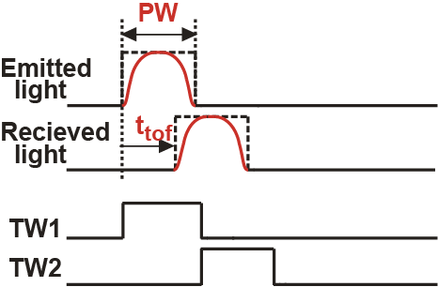
σ_{L} of Indirect TOF techniques
Resolution
- Continuous wave
- Pulsed illumination

Slide 13
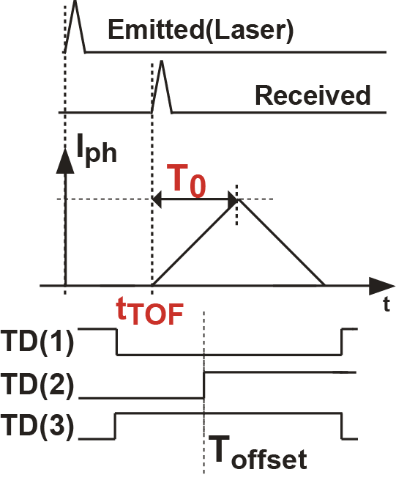
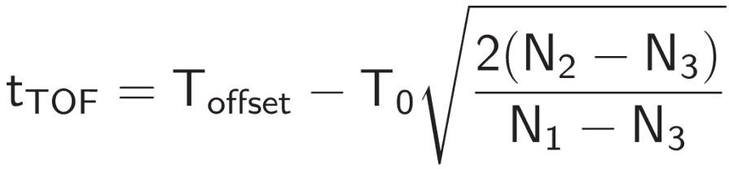
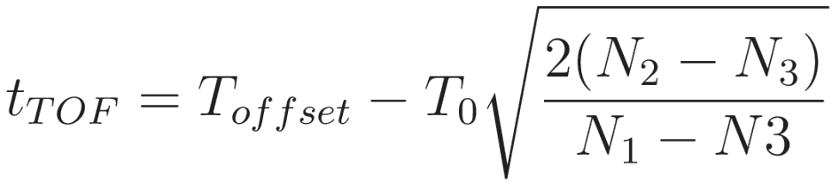
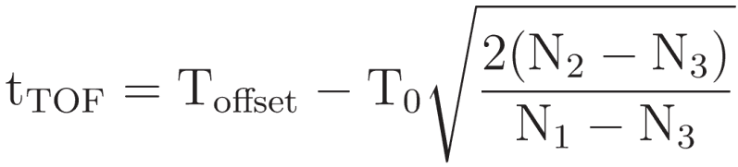
Proposed TOF Measurement Method
K.Yasutomi et al, IISW 2013
Concept: Use impulse response of photocurrent
N₁,N₂,N₃: Signal electrons
modulated by TD(1),TD(2),TD(3)
Advantages:
The photocurrent is regarded
as an impulse response
→ Distortion of light pulse is negligible.

Slide 14
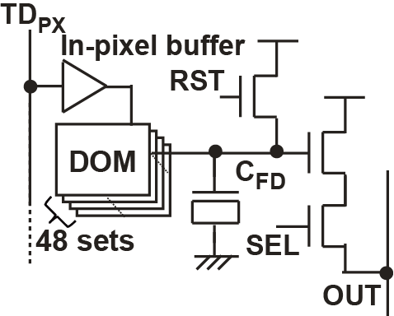
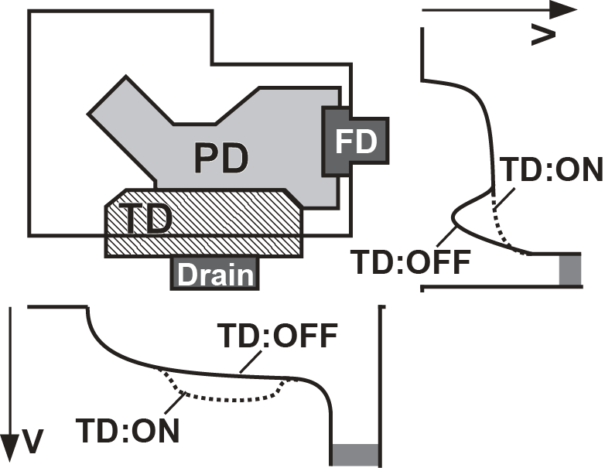
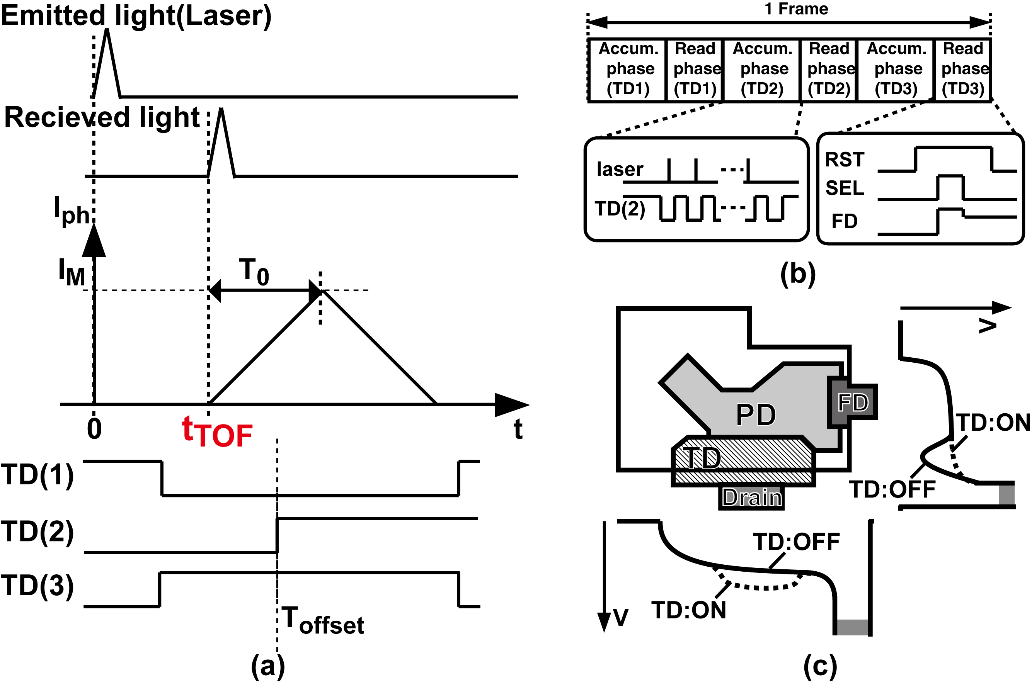
DOM Lock-in Pixel
DOM unit (2.8um□)
Pixel size 22.4um□
TD
n+
p+
n+
n
p-sub.
S,Kawahito et al. IISW 2011
K.Yasutomi et al. IISW 2013
Z. Li et al. TED 2012
Advantages:
- DOM detector → High-speed response
Loss-less repetitive accumulation
- In-pixel buffer → Pulse shaping of TD
Reduced cap. of TD_{PX} wiring

Slide 15
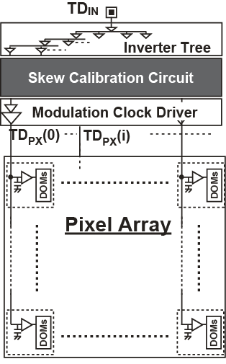
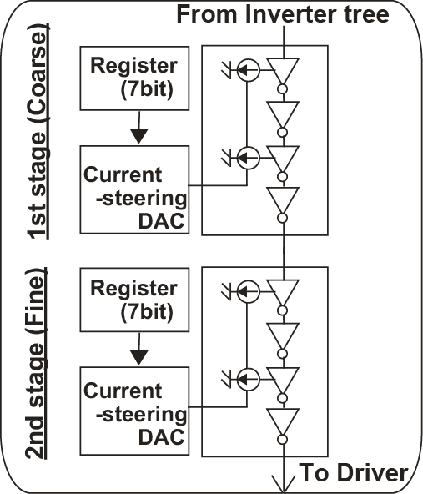
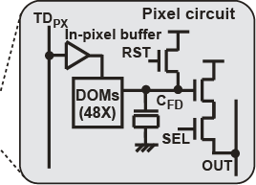
Sensor Architecture
Column-parallel skew calibration
The skew between TD_{PX}s occurs due to device mismatch & voltage drop of the power supply line
Notes:
This slide shows sensor architecture and column-parallel skew calibration circuits.
The gating clock, TDPX pass through a inverter tree, skew calibration circuit and modulation clock driver.
The different path of each column causes a different delay between TDPXs, which is identical to the skew.
In particular, the skew occurs due to device mismatch and voltage drop of the power line in the clock driver.
To calibrate these skew, two-stage voltage controlled delay lines, so called VCDL is implemented in every column.
The delay of every column can be independently controlled by the resister setting, so that the skew is cancelled out.
The 1st stage is used for coarse calibration. And the 2nd stage is used for fine calibration.

Slide 16
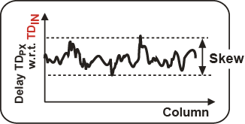
Why Skew Calibration Is Needed?
Emitted light
Received light
I_{ph}
Measurable range
≈300ps
0
t
TOF
TD
IN
TD
PX
T_{offset}(i)
Outside
Pixel
Count
Skew
T_{offset}
If the T_{offset} is outside of measurable range, the depth calculation is failed!!
Notes:
Before talking about calibration, I will explain why skew calibration is needed.
In our technique, the rising edge of TD, that is Toffset, should be inside of the measurable range, which is about 300ps.
However, Toffset are varied due to the different delay between column to column like this, which is equivalent of the skew.
Some of columns of Toffset are located outside of the measurable range.
As a result, the depth calculation is failed.
To calibrate the skew, we use column-parallel skew calibration circuit.

Slide 17
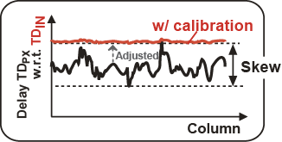
Why Skew Calibration Is Needed?
Emitted light
Received light
I_{ph}
Measurable range
≈300ps
0
t
TOF
TD
IN
Adjusted to the slowest column
TD
PX
T_{offset}(i)
Pixel
Count
After calibration
T_{offset}
After calibration, all the T_{offset} are
within the measurable range.
Notes:
To calibrate the skew, we use column-parallel skew calibration circuit.
→
The delay of column skew calibration circuit are adjusted so that all the Toffset meets the slowest Toffset.
After this calibration, all the Toffset are within the measurable range.

Slide 18
Skew Calibration Procedure
Emitted
Controlling trigger delay
Measure the skew by
controlling trigger delay.
Received
I_{ph}
Measure the delay while
changing the 1st Reg. value.
→ The 1st Reg. value is
chosen for minimized skew.
TD
PX
T_{offset}(i)
Modulation characteristic
Output
Skew
Measure the delay while
changing the 2nd Reg. value.
→ The 2nd Reg. value is
chosen for minimized skew.
Trigger delay

Slide 19
Skew Calibration Procedure
Skew measurement
Extracted from modulation characteristic
Fastest cond. (All reg. =1)
Sweep calibration cct.
Skew is measured by chanigng Reg. value
Skew measurement
Adjustment the delay
Setting 1st stage
Measure the skew by
controlling trigger delay.
Measure the delay while
changing the 1st Reg. value.
→ The 1st Reg. value is
chosen for minimized skew.
Measure the delay while
changing the 2nd Reg. value.
→ The 2nd Reg. value is
chosen for minimized skew.

Slide 20
Skew Calibration Procedure
Skew measurement
Extracted from modulation characteristic
Fastest cond. (All reg. =1)
Sweep calibration cct.
Skew is measured by chanigng Reg. value
Skew measurement
Adjustment the delay
Setting 1st stage
Measure the skew by
controlling trigger delay.
Measure the delay while
changing the 1st Reg. value.
→ The 1st Reg. value is
chosen for minimized skew.
Measure the delay while
changing the 2nd Reg. value.
→ The 2nd Reg. value is
chosen for minimized skew.

Slide 21
Chip Photograph
Technology: 0.11-um CIS
Pixel size: 22.4 x 22.4um²
K.Yasutomi et al, ISSCC 2014

Slide 22
Measured Skew w/ Calibration
850ps_{p-p}
173ps_{rms}
81ps_{p-p}
8ps_{rms}
Within the measurable range

Slide 23
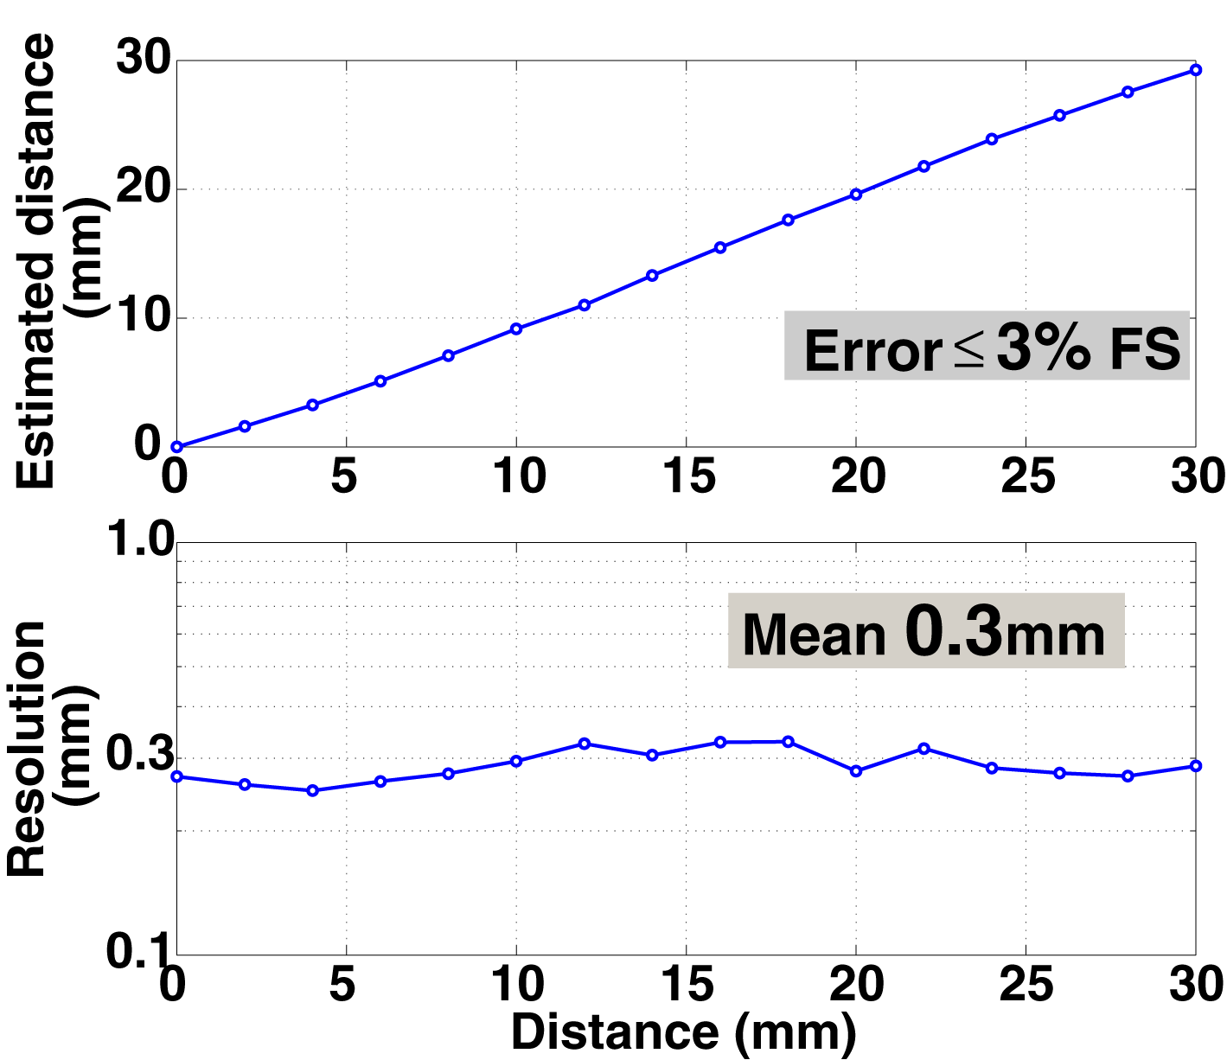
Distance Measurement
Average on all the main pixels.
Target: Mirror
Light source:
443nm laser
(pulse width 72ps)
= 2ps

Slide 24
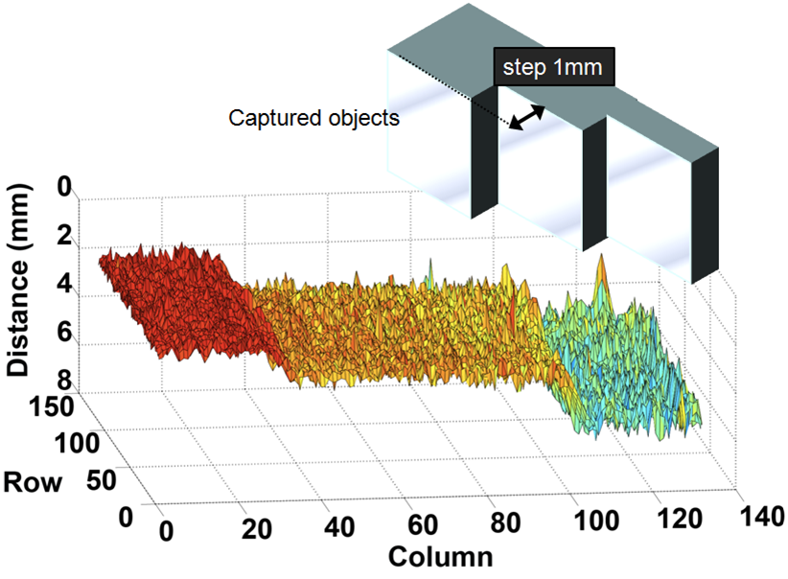
Captured 3D image
- 500 frame average
W/ digital offset calibration
Frame rate: 22fps
(Integration time: 13.3ms)
Captured object

Slide 25
Performance Summary
Technology |  | 0.11-μm CIS
Total pixels |  | 310(H) × 120(V)
Effective pixels |  | 132(H) × 120(V)
Pixel size |  | 22.4 x 22.4 μm²
Frame rate (Integration time 13.3ms/33ms ) |  | 22 fps / 9.6 fps
Repetition frequency |  | 7.5 MHz
Fill factor (without micro-lens) |  | 24 %
Emitter | Wavelength | 443 nm
 | Pulse width | 71.6 ps
 | Power | 12.5 μW/cm² at focal plane
Measurable range |  | 32 mm at error < 3% Full scale
Range resolution |  | 0.3 mm (mean in measurable range)

Slide 26
Performance Comparison
Spec. | [1] | [2] | [3] | [4] | [5] | [6] | This work [7]
Technology [um] | 0.18 | 0.11 | 0.35 | 0.13 | 0.35 | 0.35 | 0.11
Pixel no. | 80x 60 | 320x240 | 336x252 | 480x360 | 64x64 | 60x48 | 132x120
Pixel pitch [um²] | 10 | 12 | 15 | 10 | 30 | 85 | 22.4
Fill factor [%] | 24 | 34.5 | 19 | 24 | 25.75 | 0.5 | 22
Wavelength [nm] | 850 | 850 | 870 | 850 | 850 | 850 | 443
Accumulation time | 50ms | 50ms | 330ms (3fps) | 10ms | 20ms (50fps) | 45ms | 33ms
Range resolution @Measured distance | 50mm @1m | 10mm @1m | 7.4mm | 5mm @1m | 19mm @2m | 5mm @40cm | 0.3mm @32mm
[1] D.Stoppa, et al., "A Range Image Sensor Based on 0.18-um CMOS Imaging Technology," IEEE J. Solid-State Circuits, Vol.46, No.1, Jan.2011.
[2] S-J. Kim, et. al., "A CMOS Image Sensor Based on Unified Pixel Architecture With Time-Division Multiplexing Scheme for Color and Depth Image Acquisition," IEEE J. Solid-State Circuits, vol.47, no.11, pp.2834-2845, Nov. 2012.
[3] S.Kawahito, et.al. " A CMOS time-of-flight range image sensor with gates-onfield-oxide structure," IEEE Sensors J., vol. 7, no.12, pp. 1578-1586, Dec. 2007.
[4] W.Kim, et.al. "A 1.5Mpixel RGBZ CMOS Image Sensor for Simultaneous Color an Range Image Capture," ISSCC 2012, Dig. Tech. Papers. pp. 392-393, Feb. 2012.
[5] Shcherbakova, et.al, "3D Camera Based on Linear-Mode Gain-Modulated Avalanche Photodiodes," ISSCC 2013 Dig. Tech. Papers, pp.490-491, Feb. 2013.
[6] C.Niclass, et.al, "Single photon synchronous detection," IEEE J. Solid-State Circuits, vol.44, no. 7.pp. 1977-1989, Jul. 2009..
[1] D.Stoppa, et al., IEEE JSSC, 2011.
[2] S-J. Kim, et. al. IEEE JSSC, 2012.
[3] S.Kawahito, et.al. " IEEE Sensors J., 2007.
[4] W.Kim, et.al. ISSCC 2012.
[5] Shcherbakova, et.al, ISSCC 2013
[6] C.Niclass, et.al, IEEE JSSC, 2009..
[1] D.Stoppa, et al., JSSC, 2011. [2] S-J. Kim, et. al. JSSC, 2012. [3] S.Kawahito, et.al. “ Sensors J., 2007. | [4] W.Kim, et.al. ISSCC 2012. [5] Shcherbakova, et.al, ISSCC 2013 [6] C.Niclass, et.al,JSSC, 2009.. [7] K.Yasutomi, et.al, ISSCC 2014

Slide 27
Summary
Lateral Electric Field Modulator (LEFM)
  high-speed charge modulation
  loss-less repetitive accumulation
Implementation 1: 4-tap LEFM lock-in pixel
  In-pixel background light cancelling
  Sub-cm range resolution
Implementation 2: DOM lock-in pixel with column parallel skew calibration
  0.3mm resolution @ 32mm range.
  (= 2ps time resolution)
  Skew reduced from 173ps_{rms} to 8ps_{rms}

Slide 28
Acknowledgments
A part of this work was supported by Knowledge Cluster Initiative, Grant-in-Aid for Scientific Research and COI STREAM of MEXT.
The authors would like to thank
Prof. K.Kagawa, Mr. S.Han, Mr. T.Usui,
Mr. T.Akahori, and Mr. Y.Kaneko for thier contribution to imager developments and helpful discussion.

