Slide 1
Interactive Methods in Scientific Visualization

Slide 2
GPU Volume Raycasting Christof Rezk-Salama University of Siegen, Germany

Slide 3
Volume Rendering in a Nutshell
Image Plane
Eye
Data Set
Back-to-front iteration
Front-to-back iteration

Slide 4
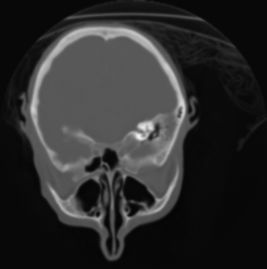
Volume Rendering
Object order approach:
Data Set
Image Plane
Eye
For each slice {
calculate contribution to the image
}

Slide 5
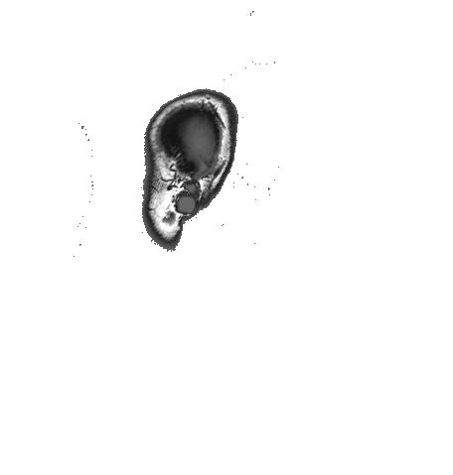
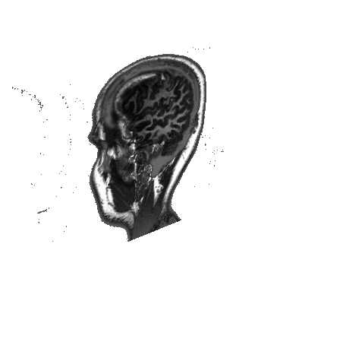
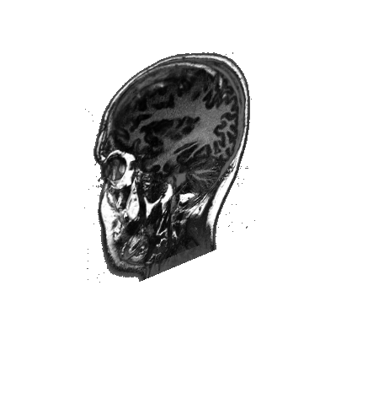
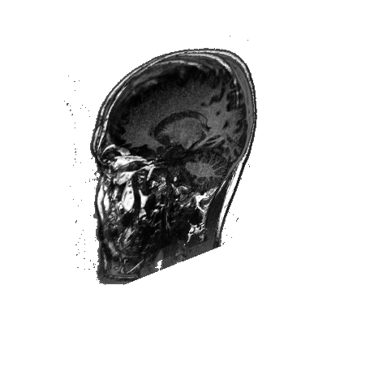
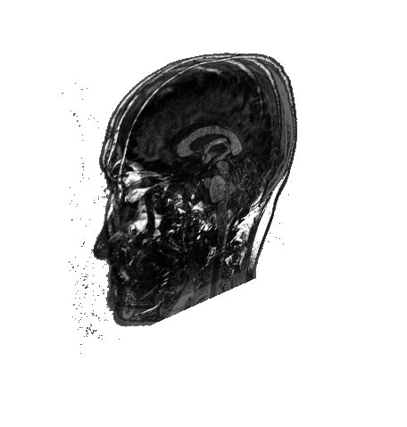
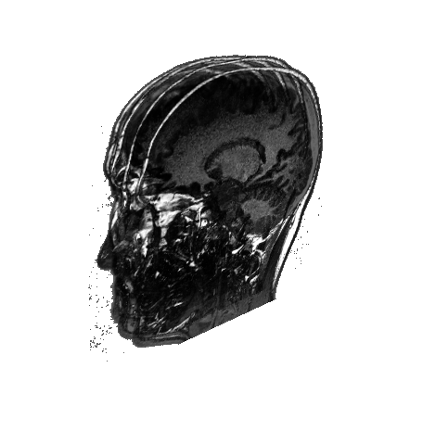
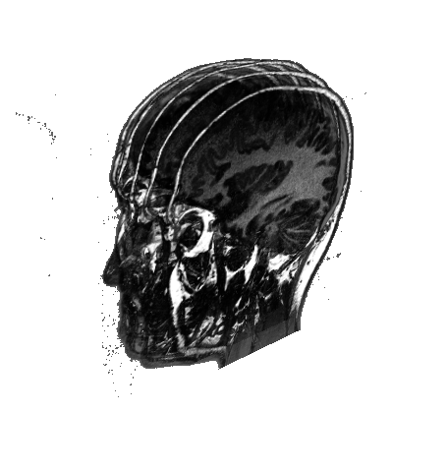
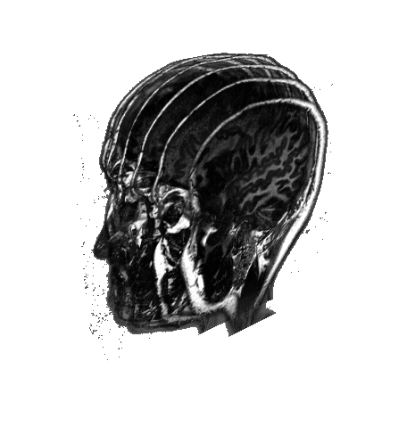
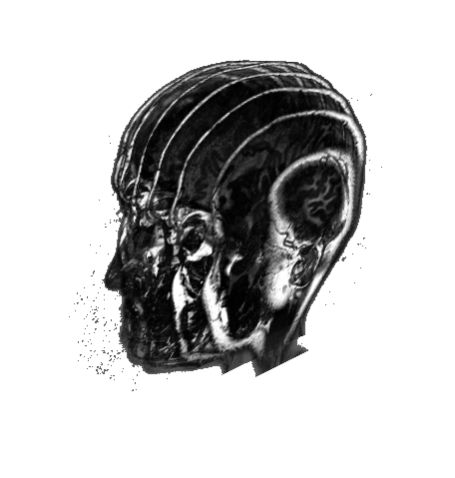
Object Order Approach
Proxy geometry (Polygonal Slices)

Slide 6
Volume Rendering
Image order approach:
Data Set
Image Plane
Eye
For each pixel {
calculate color of the pixel
}

Slide 7
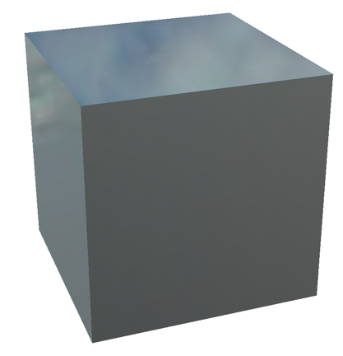
GPU Volume Raycasting
Easy to implement
Everybody knows how to draw a box:
glBegin(GL_QUADS);
{
glVertex3d(0.0,0.0,0.0);
glVertex3d(0.0,0.0,1.0);
glVertex3d(0.0,1.0,1.0);
glVertex3d(0.0,1.0,0.0);
…
}
glEnd();

Slide 8
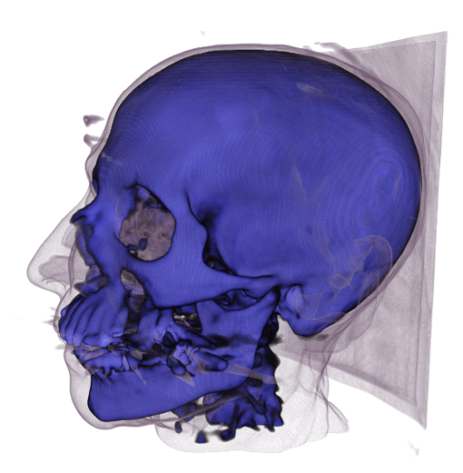
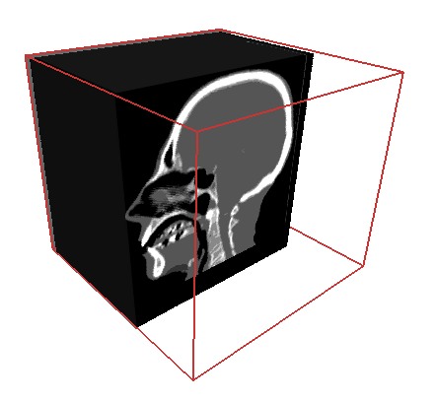
GPU Volume Raycasting
Simple Shader for Texture Mapping
float3 main( float3 worldPos : TEXCOORD0, float3 viewVec : TEXCOORD1,
uniform sampler3D volumeTex
) : COLOR
{
return color;
}
Original Vertex Position in World Space
Viewing Vector in World Space
float4 color = tex3D(volumeTex, worldPos);
float4 color = float4(0.0, 0.0, 0.0, 0.0);
for( int i = 0; i < NUM_STEPS; i++) {
}
float4 sample = tex3D(volumeTex, worldPos);
3D Texture
color += (1 - color.a) * sample;
if (color.a > 0.99) break;
worldPos += STEPSIZE * viewVec;

Slide 9
GPU Raycasting vs. Texture Slicing
GPU Raycasting is easier to impoment
and also more efficient, because:
No Alpha Blending! avoid successive read/write operations to the frame buffer
Early Ray Termination
… provided you have an up-to-date GPU

Slide 10
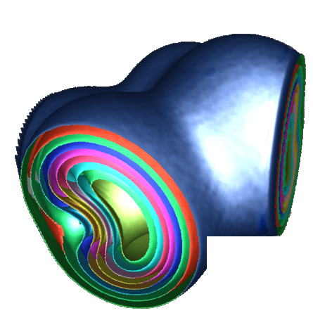
Local Illumination
Surface lighting: Light is reflected at surfaces
Volume lighting: Light is scattered at isosurfaces
Isosurface extraction not required!
We only need the normal vector
Normal vector of isosurface is equal to (normalized) gradient vector
Isosurfaces

Slide 11
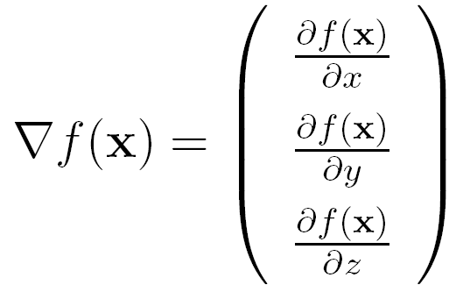
Gradient Estimation
The gradient vector is the first-order derivative of the scalar field
We can estimate the gradient vector using finite differencing schemes
partial derivative in x-direction
partial derivative in y-direction
partial derivative in z-direction

Slide 12
Finite Differences
Taylor expansion:
Forward Difference:
Backward Difference:

Slide 13
Finite Differences
Central Difference:
Gradient Approximation using Central Differences:

Slide 14
On-the-fly Gradient Estimation

Slide 15
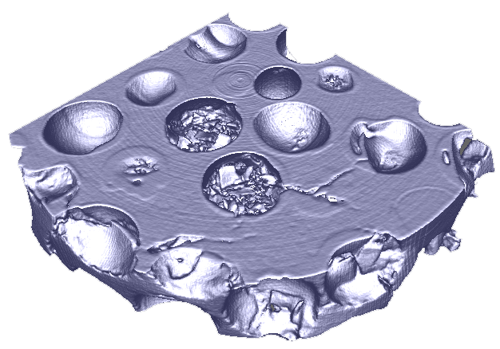
Examples Local Illumination

Slide 16
On-the-fly Gradient Estimation
Drawbacks:
Each additional texture sample is expensive!
Central Differences: 7 Texture Samples
Forward/Backward Differences: 4 Texture Samples
Advantages:
Low memory requirements
Gradient estimation at floating point precision!
Gradient estimation can be omitted in FP (using a conditional branch)

Slide 17
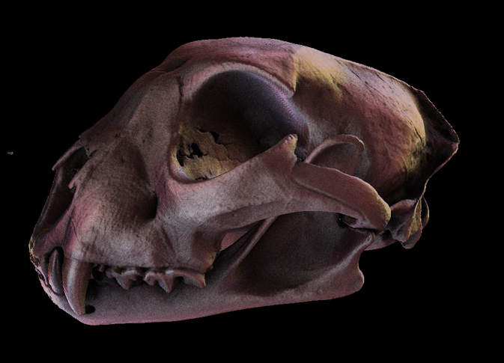
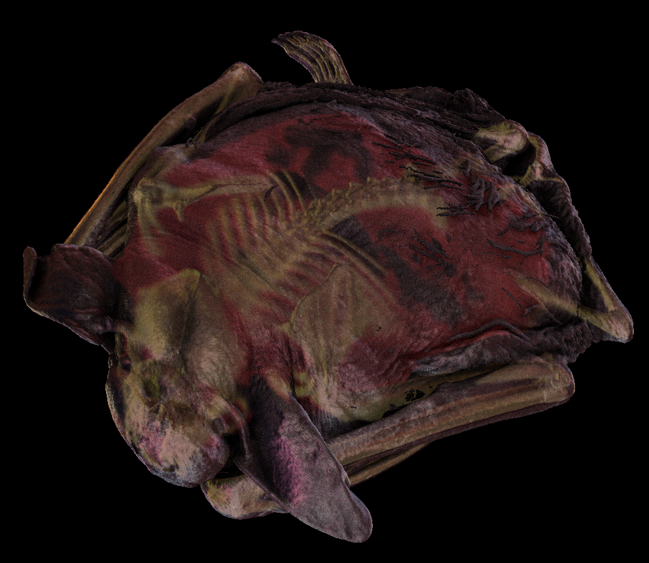
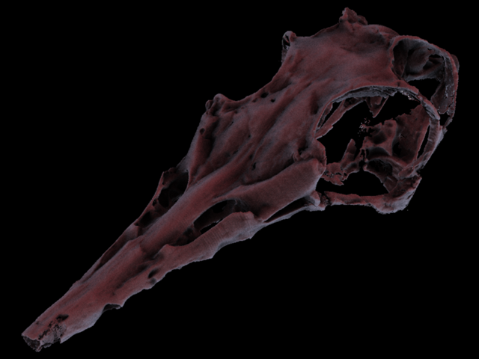
Advanced Illumination
cheetah skull
big brown bat
Data sets available at the UTCT data archive, DIGIMORPH http://utct.tacc.utexas.edu
pterosaur skull

Slide 18
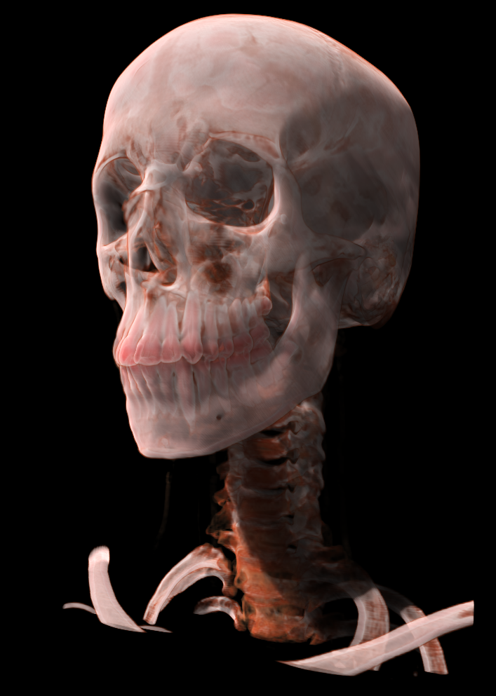
Translucency

Slide 19
Scattering Effects
When a photon hits a surface, it changes both direction and energy
Single Scattering:
Light is scattered once before it reaches the eye
Local illumination model
Multiple Scattering
Soft shadows
Translucency
Color bleeding

Slide 20
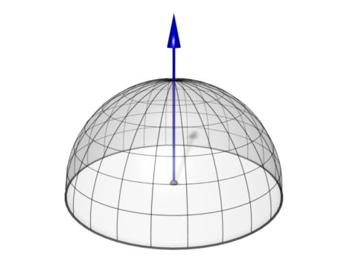
Surface-Like Reflection: The BRDF
Bidirectional Reflectance Distribution Function
Hemisphere
BRDF
Elevation Angle

Slide 21
Volume Scattering: The Phase Function
Example: Henyey Greenstein
Sphere
Phase Function
Probability of a photon changing ist direction by a given angle
Rotation invariant („no normal vector“)
Anisotropy parameter

Slide 22
The BSDF
Bidirectional Scattering Distribution Function
Sphere
BSDF
Elevation Angle
Scattering with orientation (surface-like)
Phase function notation:

Slide 23
A Practical Model
Surface-like scattering (BSDF) at high gradients
Henyey-Greenstein at low gradients

Slide 24
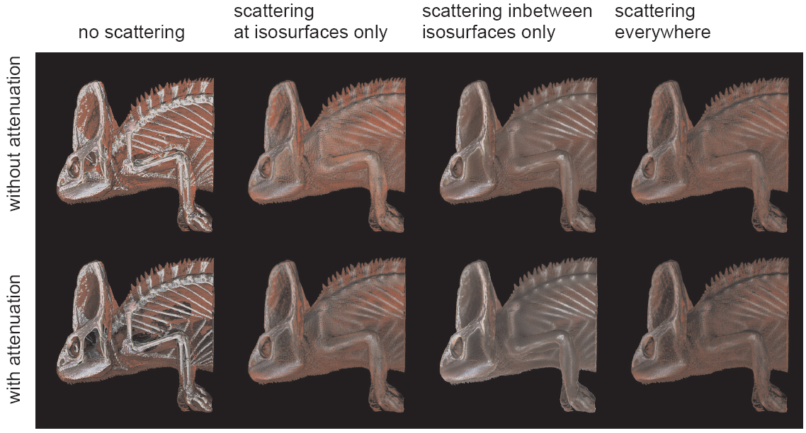
A Practical Model

Slide 25
Math Notation
Mathematical Model integrates over the entire sphere/hemisphere
Integral must be solved for every intersection point
Fredholm Equation (cannot be solved analytically)

Slide 26
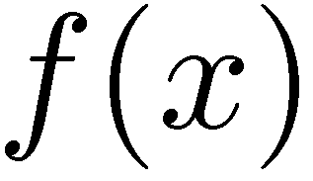
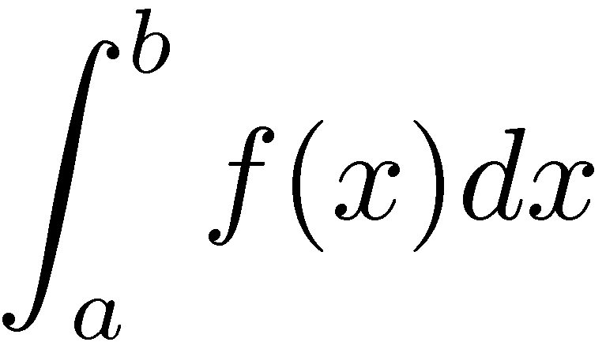
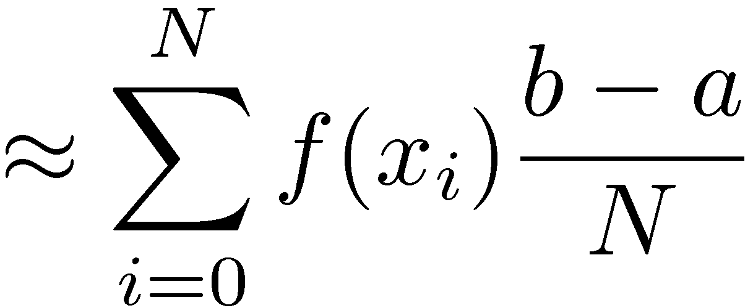
Numerical Integration
Equidistant Sampling
Approximation integral by a Riemann sum
Stochastic Sampling
Uniformly distributed samples
Approximation by sum

Slide 27
Stochastic Sampling
Cons:
Slower convergence than Riemann sum
Pros:
Better Scalability for multidimensional functions: increase number of samples in arbitrary steps
Noise instead of Aliasing
Independent of sampling grid: Clever placement of samples will improve the convergence!

Slide 28
Blind Monte-Carlo Sampling
Example: Filtering an Environment Map
Given an Environment Map
(i.e. photograph: fisheye or mirror ball)
Calculate an Irradiance Map
For each pixel of the irradiance map:
Determine n random directions on the hemisphere
Sample the Environment Map and
Average the results (incl. cos-term)
LDR Sample

Slide 29
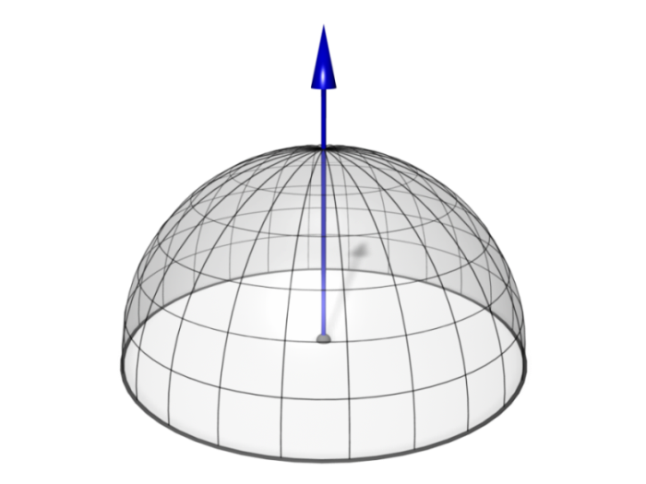
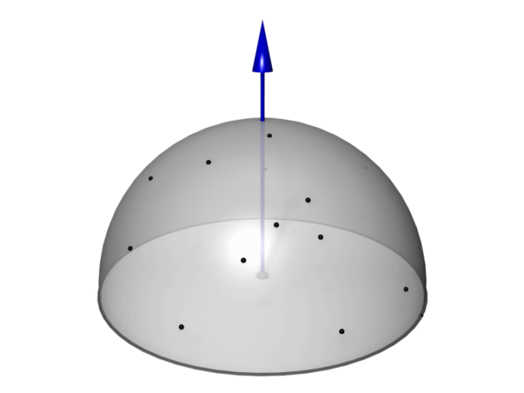
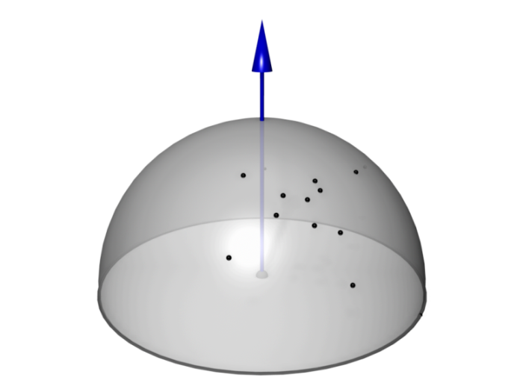
Rendering
Calculate the radiance of a point
depending on the incoming light on the sphere/hemisphere
depending on the phase function/BRDF
Deterministic
Uniform sampling of the sphere/hemisphere.
High computational load good approximation
Blind Monte-Carlo
Randomized sampling of the sphere/hemisphere.
Visually better images for fewer samples, slow convergence
Importance Sampling
Place samples where contribution is high
Faster!

Slide 30
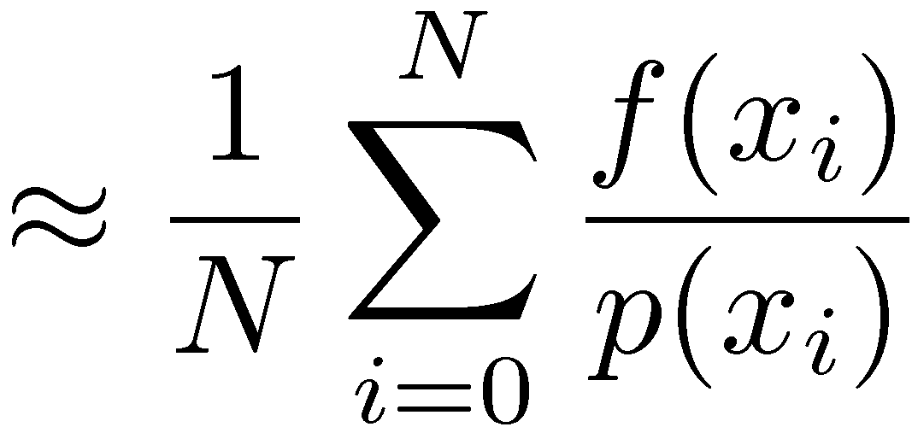
Importance Sampling
Stochastic Sampling
Non-uniformly distributed samples
Approximation by sum
Clever placement of samples
Many samples where function is high
Few samples where function is low
Probability Distribution Function (PDF)

Slide 31
Sampling a Specular Lobe
Simple Approach Specular term
Non-optimal, but easy to implement
Idea: uniform distribution of directions restricted to a cone
Precompute random unit vectors with uniform PDF
Randomly pick one vector
Negate vector, if
Blend with vector and normalize
Blend weight controls the size of the specular highlight and can be calculated from shininess

Slide 32
Importance Sampling
Literature:

Slide 33
GPU Ray-Casting
Calculate First Intersection with Isosurface
Rasterize the front faces of the bounding box
For each fragment, cast a ray
Find first intersaction point with isosurface by sampling along the ray
interval bisection
Store the intersection point in render target 0
Estimate the gradient vector using central differences
Store the gradient vector in render target 1

Slide 34
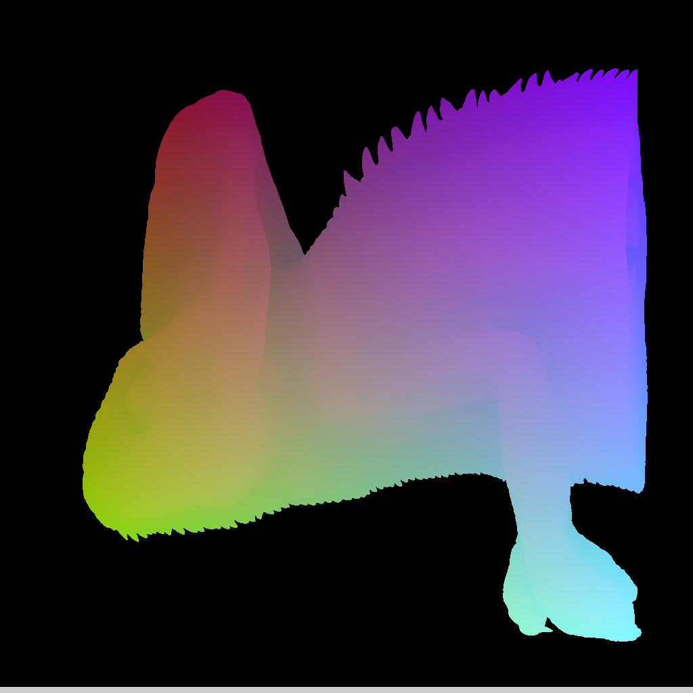
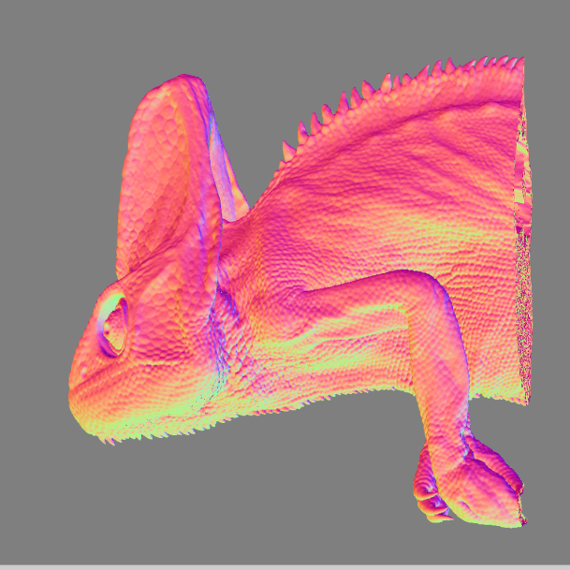
First Render Pass
MRT0: xyz-coordinates of first intersection point with isosurface
MRT1: xyz-components of gradient vector (color coded)

Slide 35
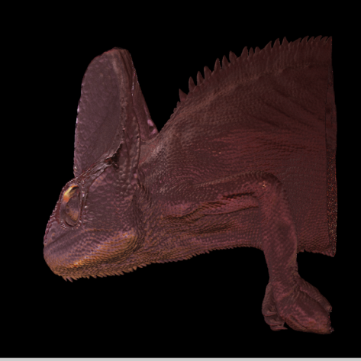
High Quality Isosurface

Slide 36
Deferred Shading
Single Scattering (no shadows)
Diffuse term:
Sample irradiance cube using gradient direction
Specular term:
Calculate random directions on the specular lobe
Sample environment cube
Weight each sample with its BRDF/phase function and its probability distribution

Slide 37
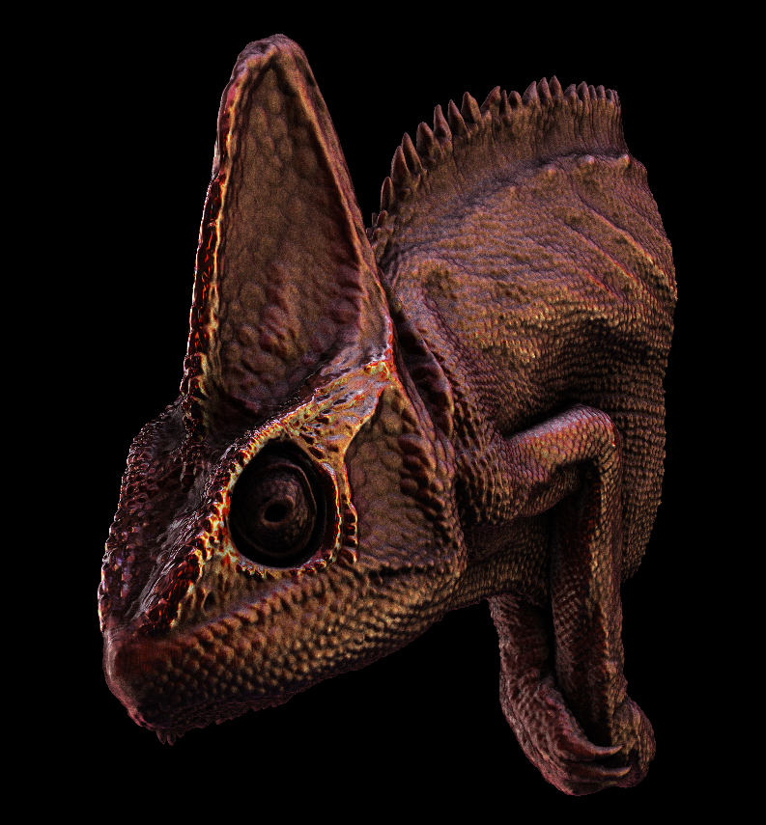
High Quality Isosurface
Why not use a pre-filtered environment map for the specular term as well?
You can, but
it only works for one specular exponent per object
Variable shininess may be used to visualize additional surface properties (e.g. gradient magnitude)

Slide 38
Ambient Occlusion
Approximate indirect light
Accessibility term:
How easy can a surface point be reached?
Ambient Occlusion:
Calculate random directions on the specular lobe
Cast a ray and sample only a few steps in each direction
Count the rays that do not intersect the isosurface again

Slide 39
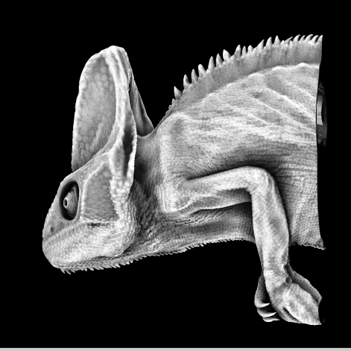
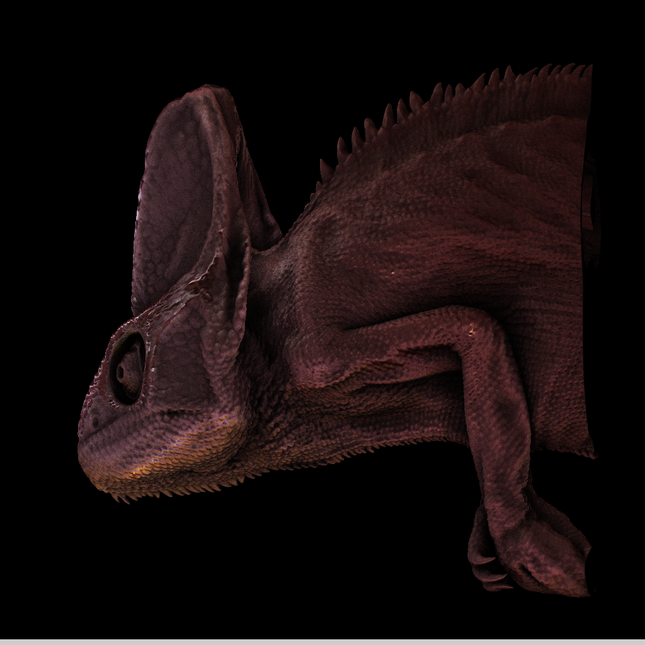
High Quality Isosurface
Single Scattering
Ambient Occlusion

Slide 40
Single Scattering Example

Slide 41
Single Scattering Example

Slide 42
Multiple Scattering
Mathematical Model integrates over the entire sphere/hemisphere
Integral must be solved for every intersection point
Fredholm Equation (cannot be solved analytically)
Numerical Solution:
Number of rays grows exponentially
Much workload spent for little contribution

Slide 43
Multiple Scattering
Mathematical Model integrates over the entire sphere/hemisphere
Quantum Optics
Trace the path of single photons
Photons are scattered randomly
Probability of scattering direction given by BRDF/phase function
Monte Carlo path tracing

Slide 44
Phase Function Model
Scattering of light at every point inside the volume
Too expensive (extremely slow convergence)
Not practicable. Controlling the visual appearance is difficult
Idea: Restrict scattering events to a fixed number of isosurfaces only.
non-refractive
refractive

Slide 45
GPU Ray-Casting
Scattering Pass
Start at first isosurface and trace inwards
Account for absorption along the rays
Proceed until next isosurface
Calculate scattering event
Sample the environment on exit

Slide 46
GPU Ray-Casting
Scattering Pass
Simplifying Assumption:
Absorption on the „way in“ is same as on the „way out“
Abort the ray inside the volume square the absorption and sample irradiance map
Not very accurate but good visual results

Slide 47
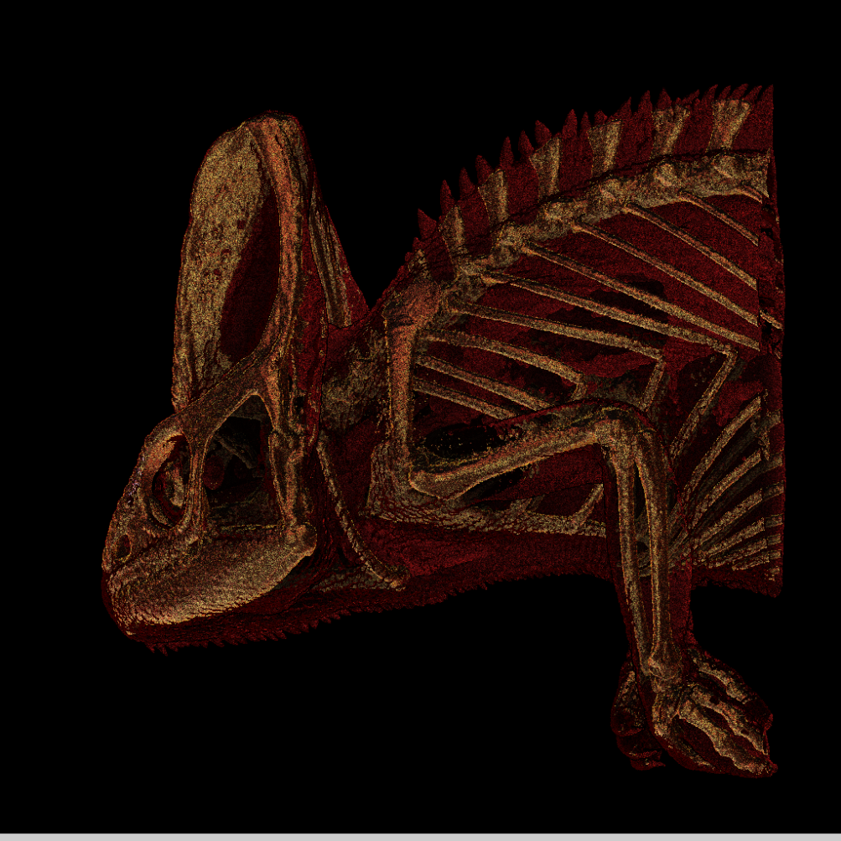
Scattering Pass
preview in real-time
final version in ½-1 seconds

Slide 48
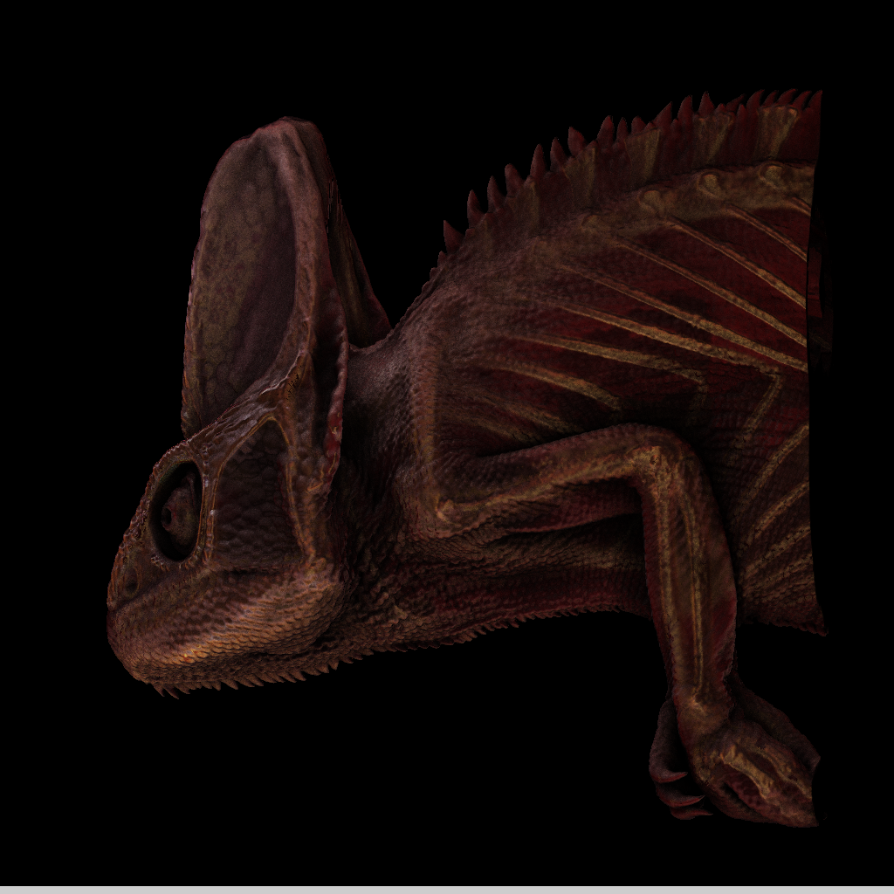
Final Composite
Multiply
Blend using Fresnel term

Slide 49
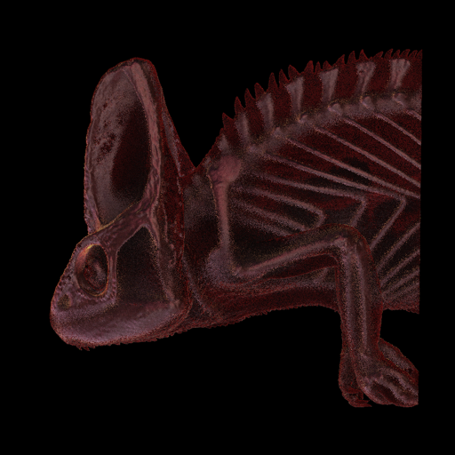
Path Tracing
Primary rays: 1 Secondary rays: 64
Primary rays: 8 Secondary rays: 8
Primary rays: 64 Secondary rays: 1

Slide 50
Examples
Different scattering cone angles for the „inward-looking“ (transmissive) Phong-lobe
refractive

