Slide 1
Advanced Illumination Techniques for GPU-Based Volume Raycasting

Slide 2
Scattering Effects

Slide 3
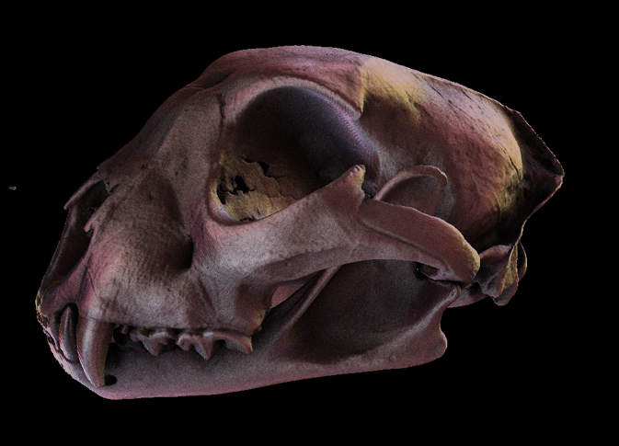
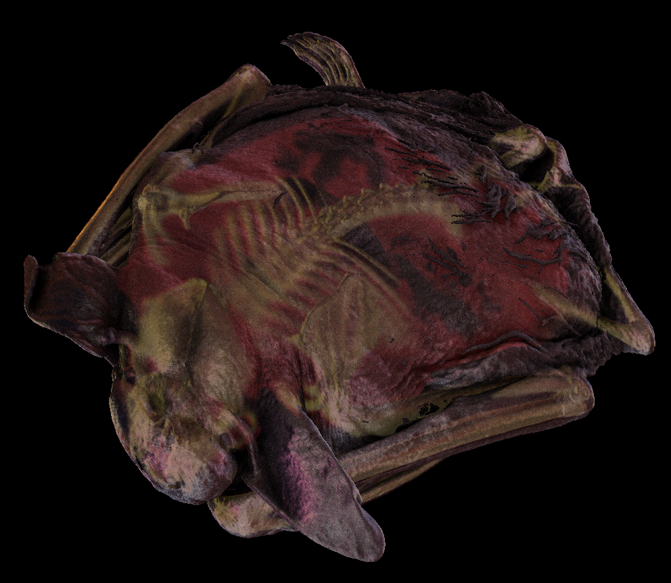
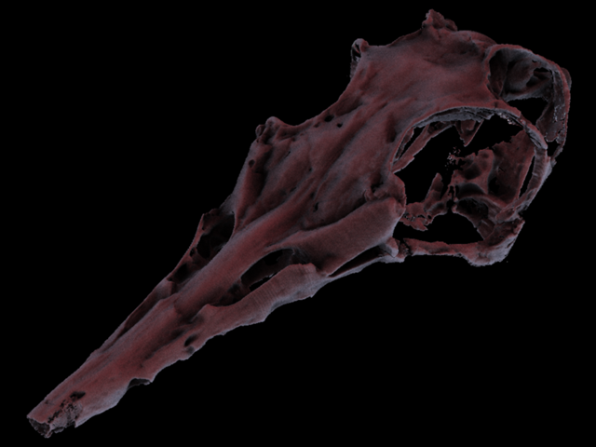
Advanced Illumination
cheetah skull
big brown bat
Data sets available at the UTCT data archive, DIGIMORPH http://utct.tacc.utexas.edu
pterosaur skull

Slide 4
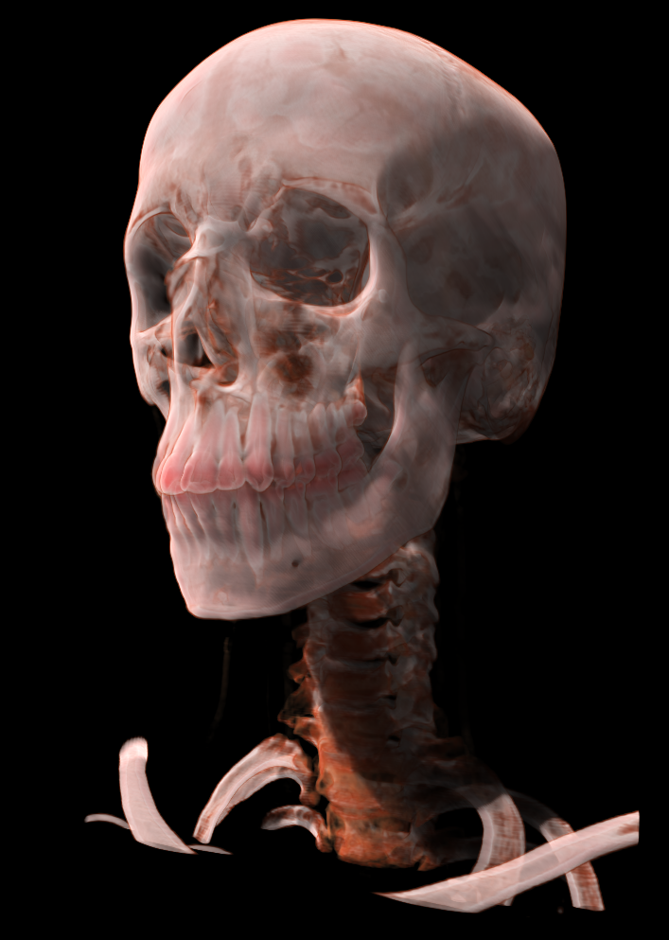
Translucency

Slide 5
Light Transport
Wave-Particle Duality
Photons
Quantum of light (the smallest possible packet of light at a given wavelength)
Photoelectric effect (van Lenard,1902)
Wave Theory (Maxwell)
Electro-magnetic wave characteristics of light
Effects such as interference and diffraction
Quantum Mechanics (Einstein)
Universal theory of light transport
probabilistic characteristics of the motions of atoms and photons (quantum optics)

Slide 6
Scattering Effects Single and Multiple Scattering

Slide 7
Scattering Effects
When a photon hits a surface, it changes both direction and energy
Single Scattering:
Light is scattered once before it reaches the eye
Local illumination model
Multiple Scattering
Soft shadows
Translucency
Color bleeding

Slide 8
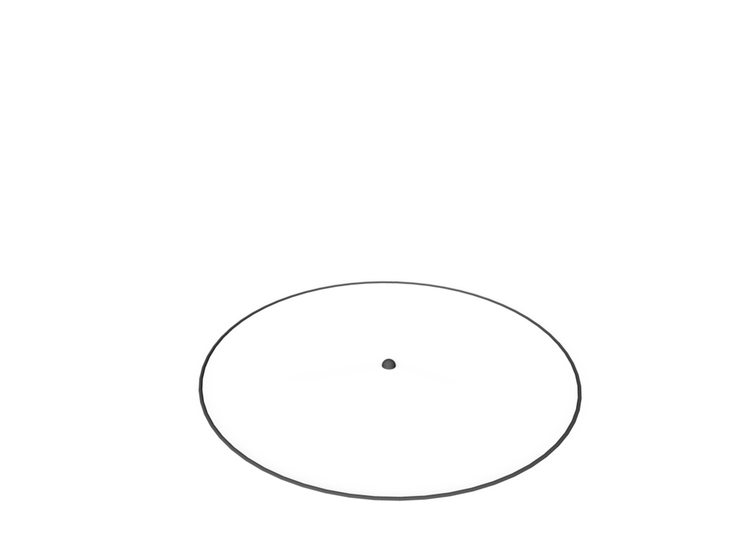
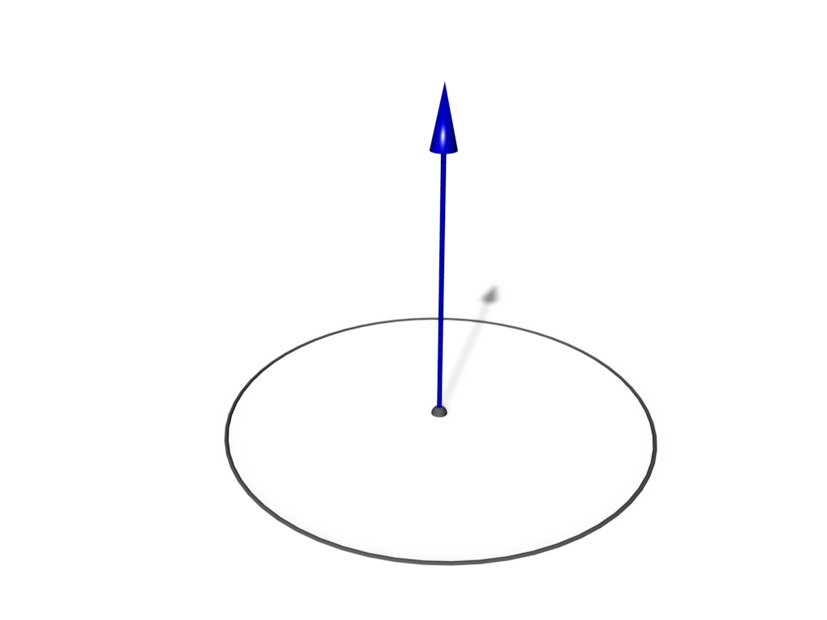
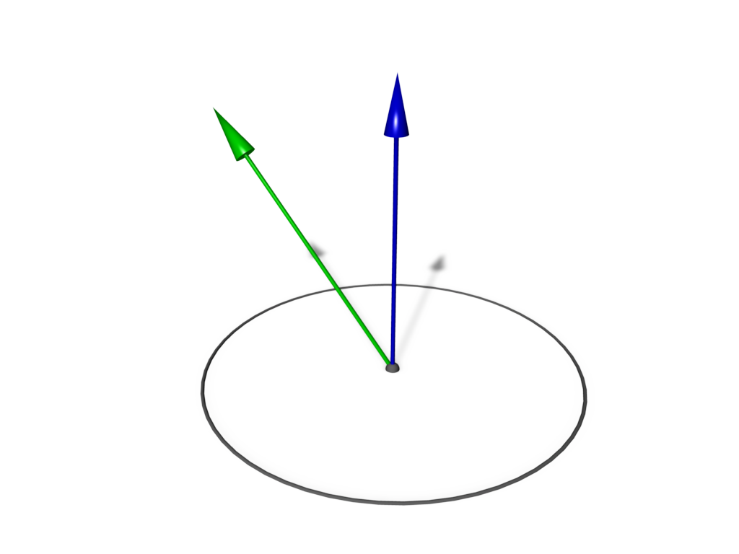
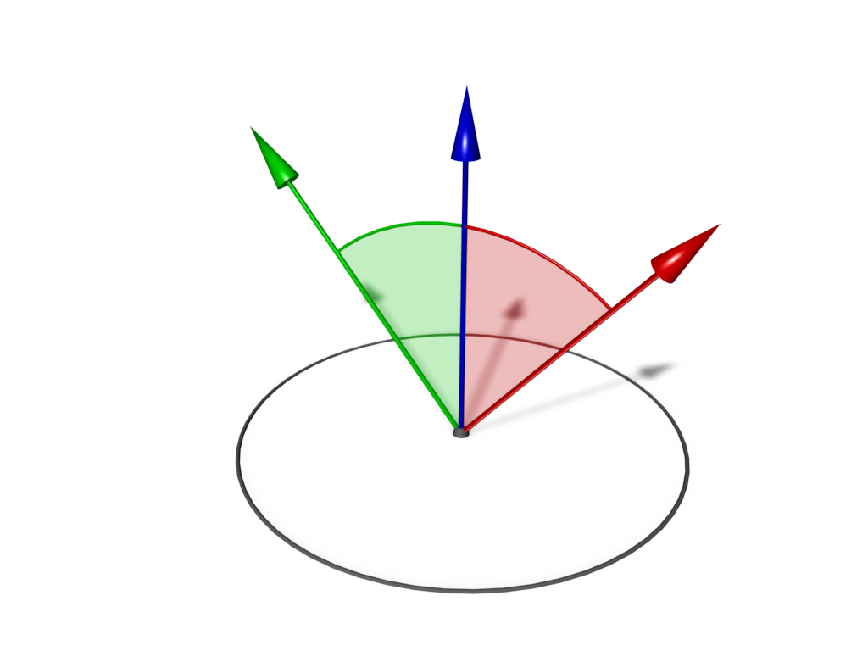
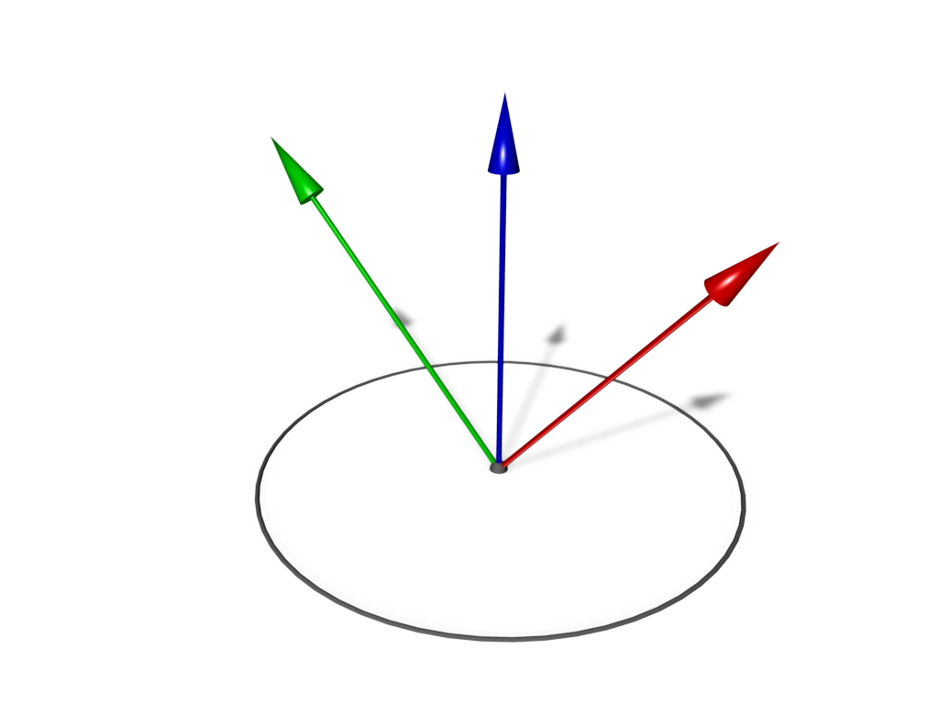
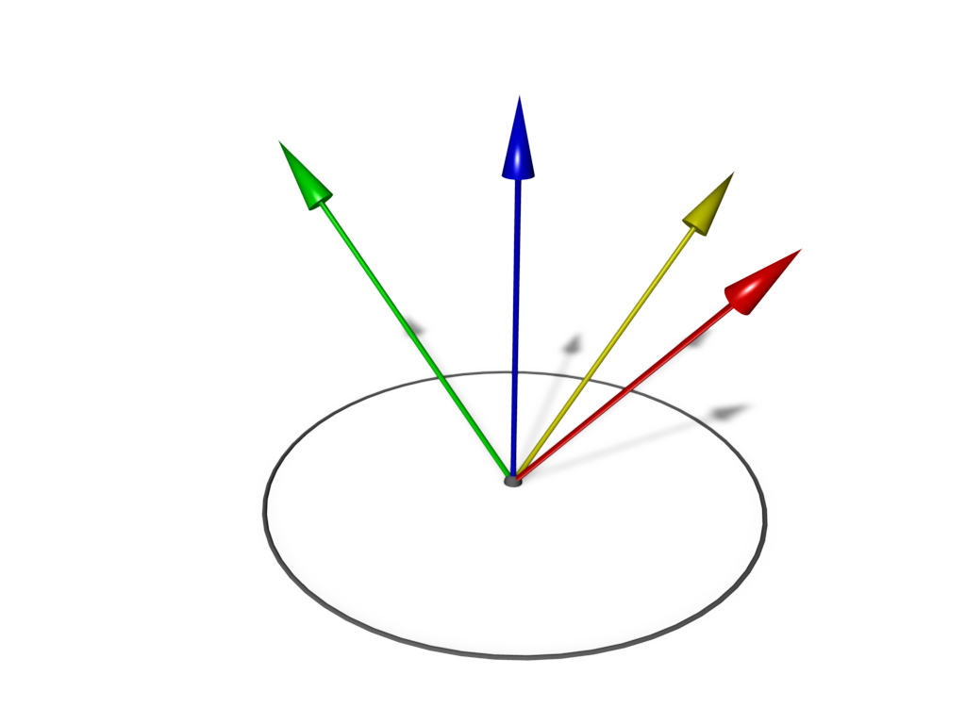
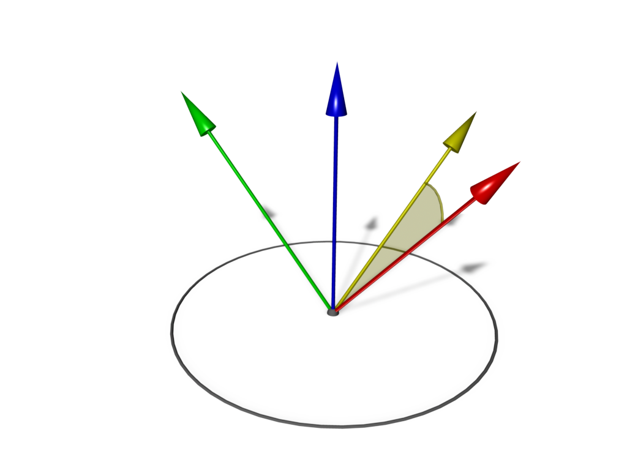
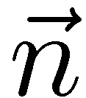
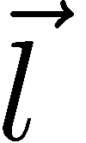
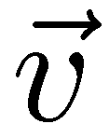
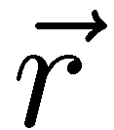
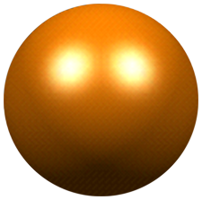
Single Scattering
Phong illumination with point light sources

Slide 9
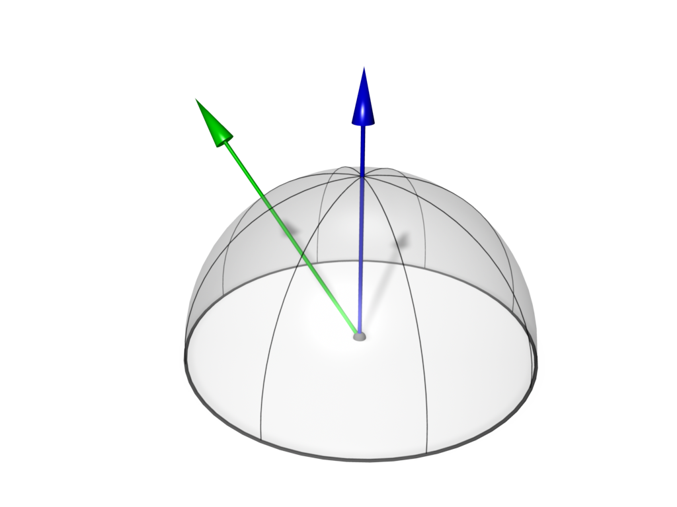
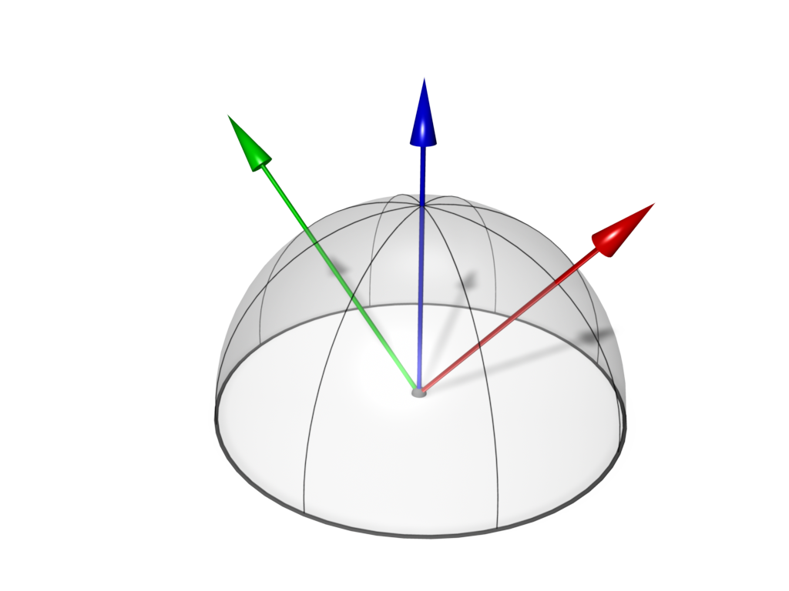
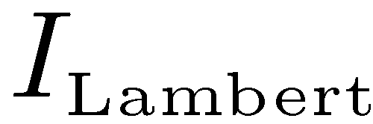
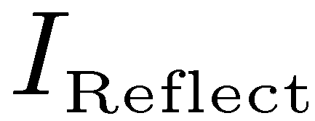
Single Scattering
Environment Light
Irradiance Map
Environment Map

Slide 10
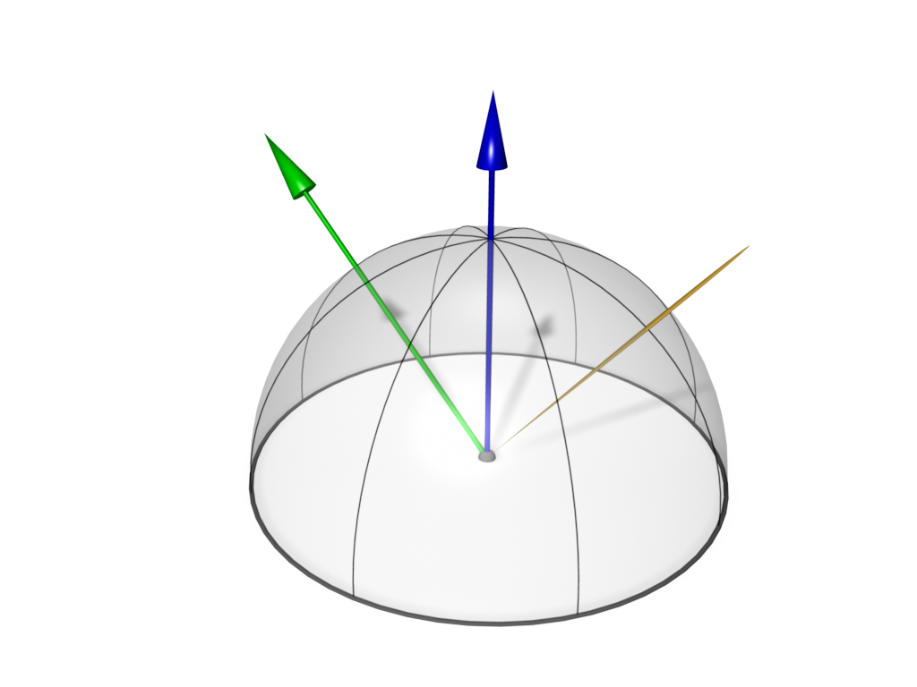
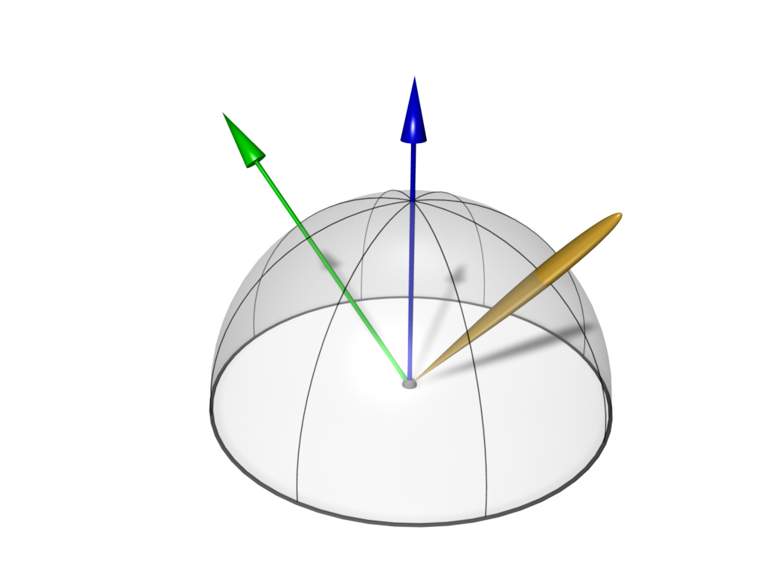
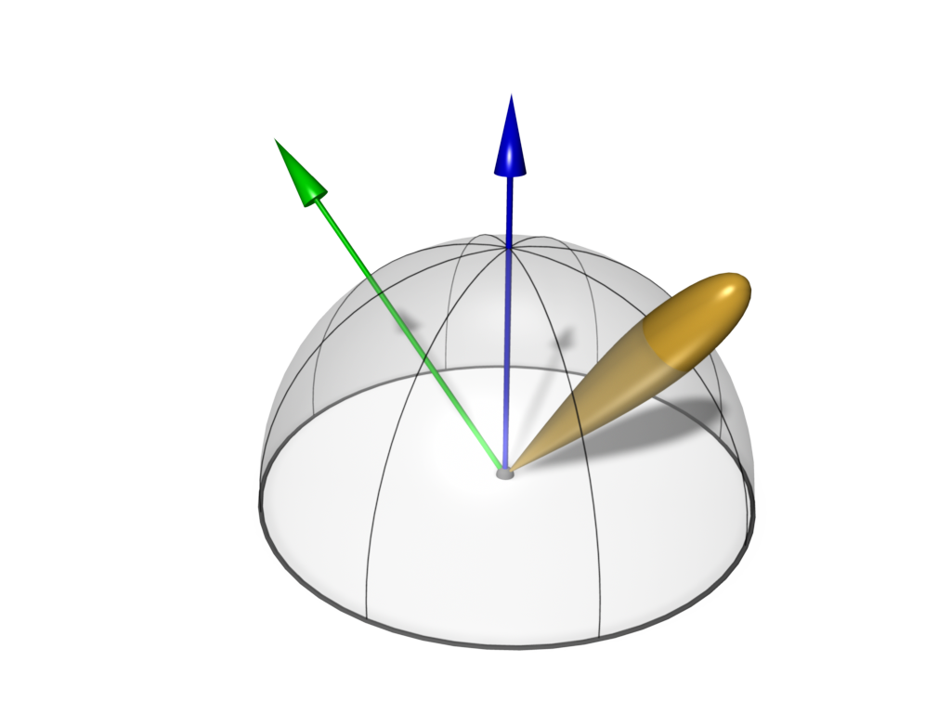
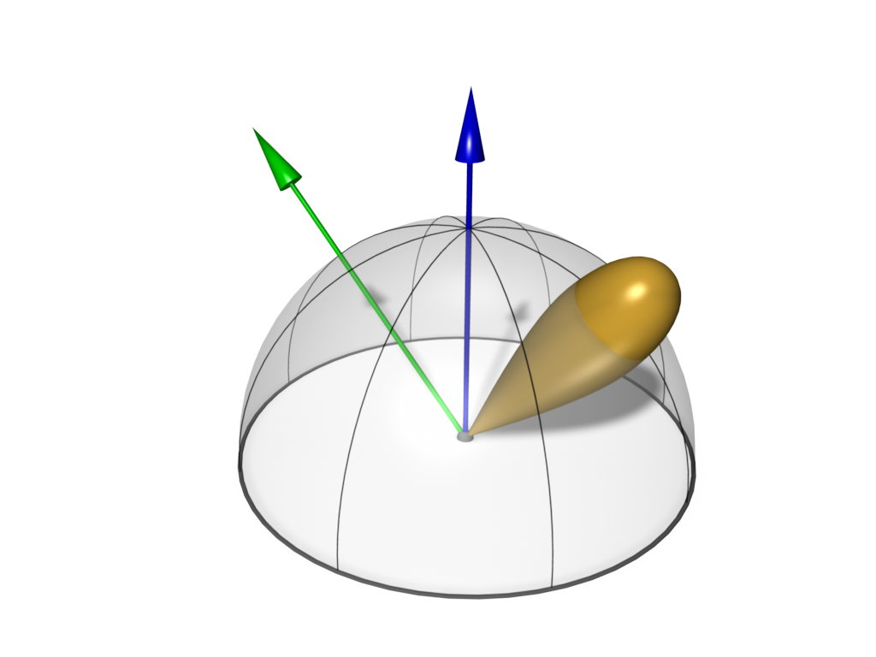
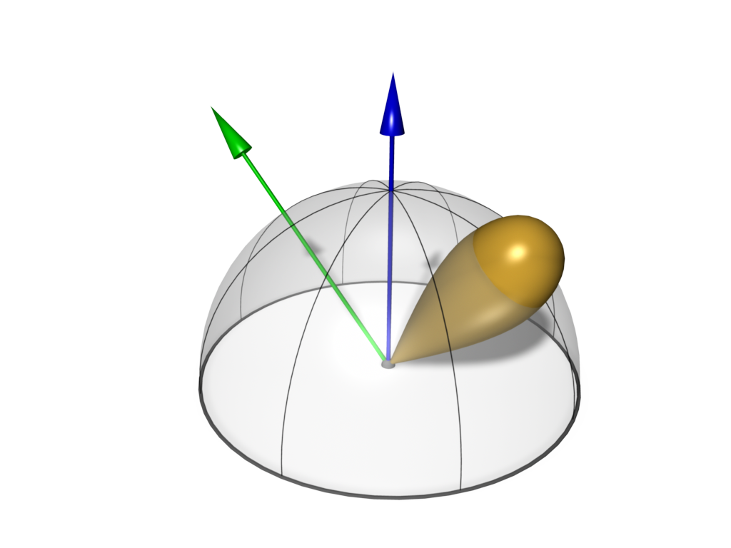
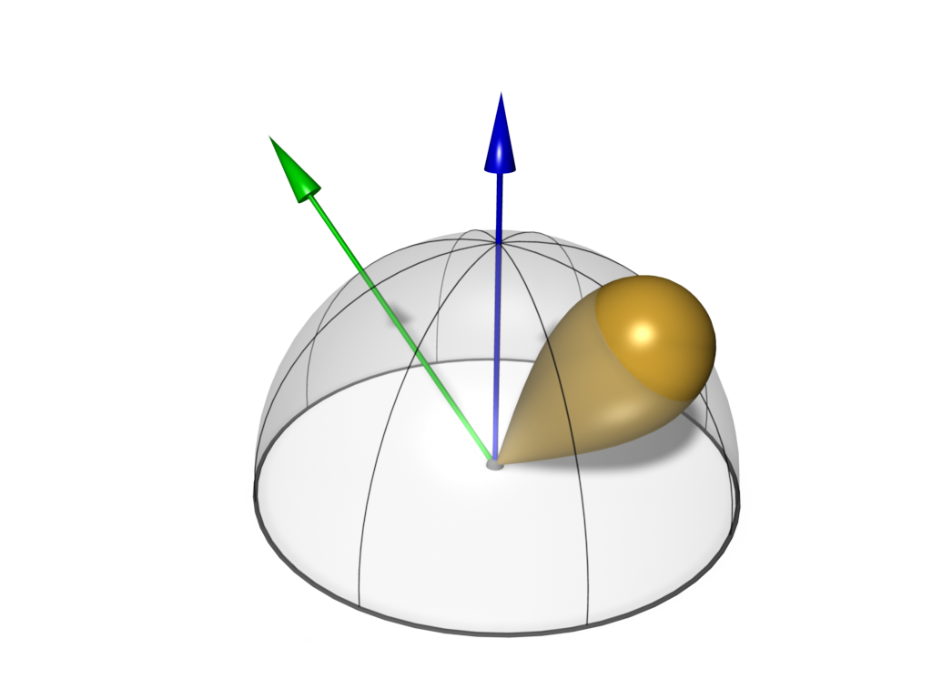
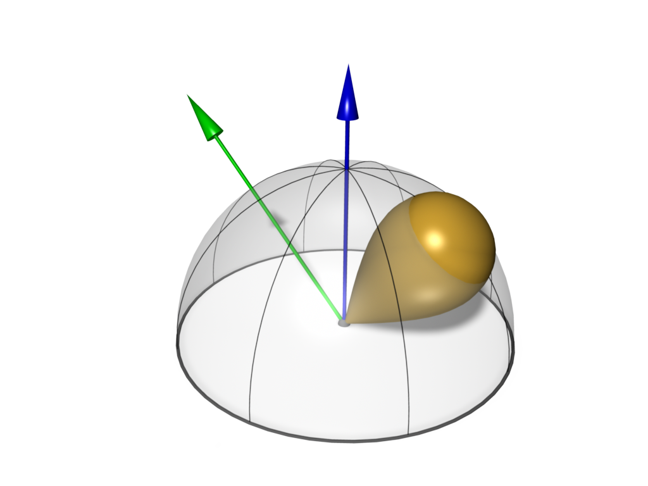
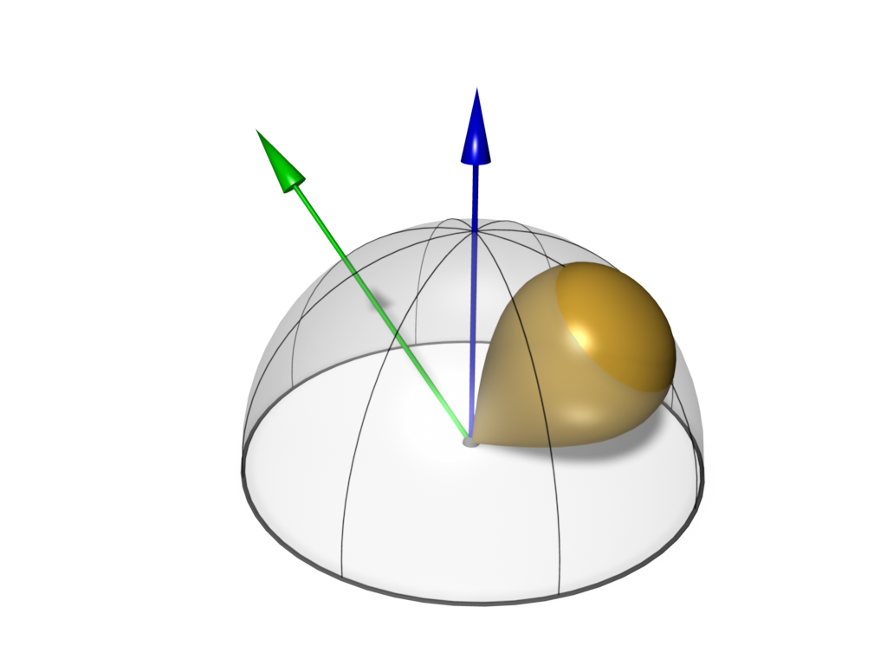
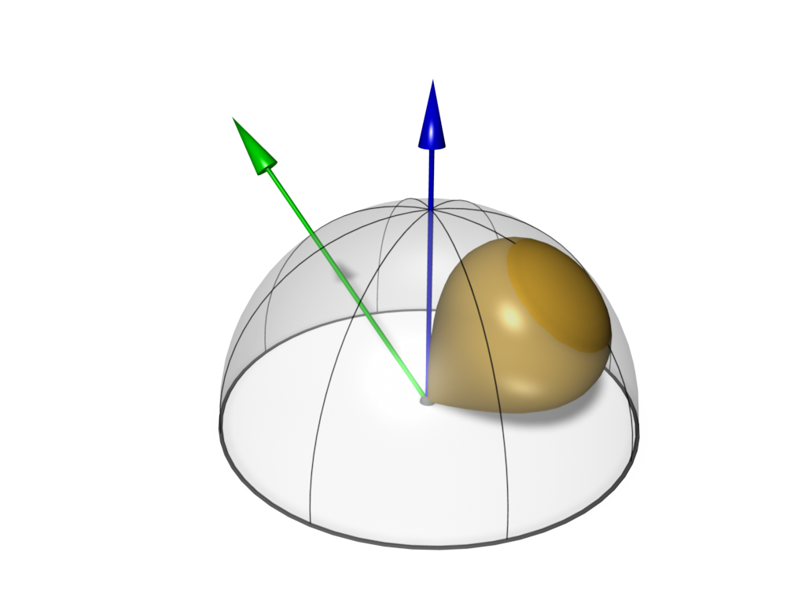
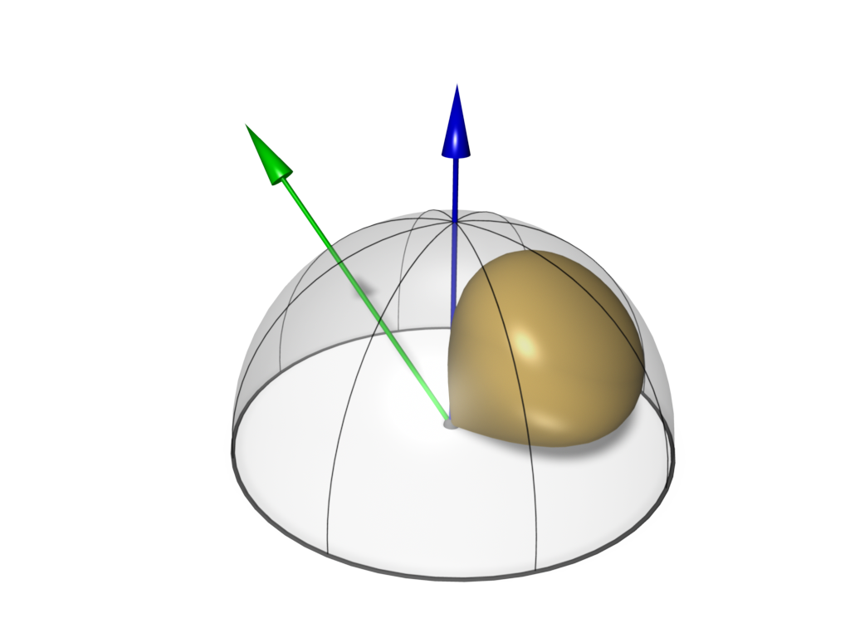
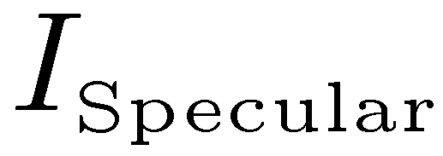
Single Scattering
Environment Light
Irradiance Map
Environment Map
Reflection Map

Slide 11
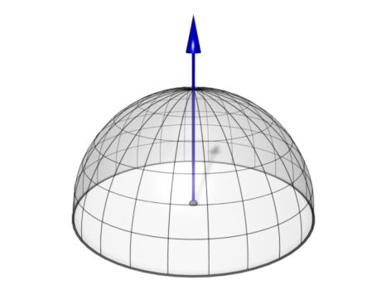
Math Notation
Surface Illumination
Hemisphere
BRDF
Elevation Angle
Volume Illumination
Sphere
Phase Function

Slide 12
Scattering Effects Monte-Carlo Methods

Slide 13
Math Notation
Mathematical Model integrates over the entire sphere/hemisphere
Integral must be solved for every intersection point
Fredholm Equation (cannot be solved analytically)

Slide 14
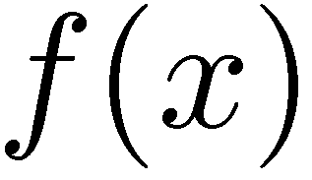
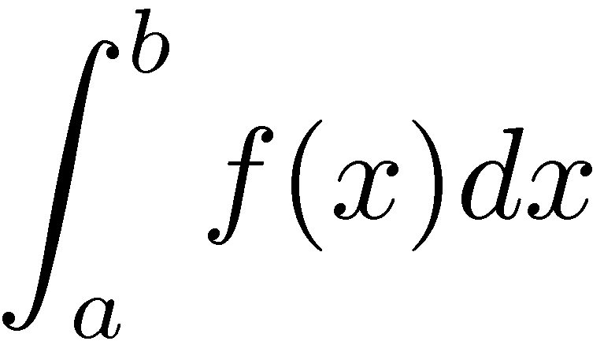
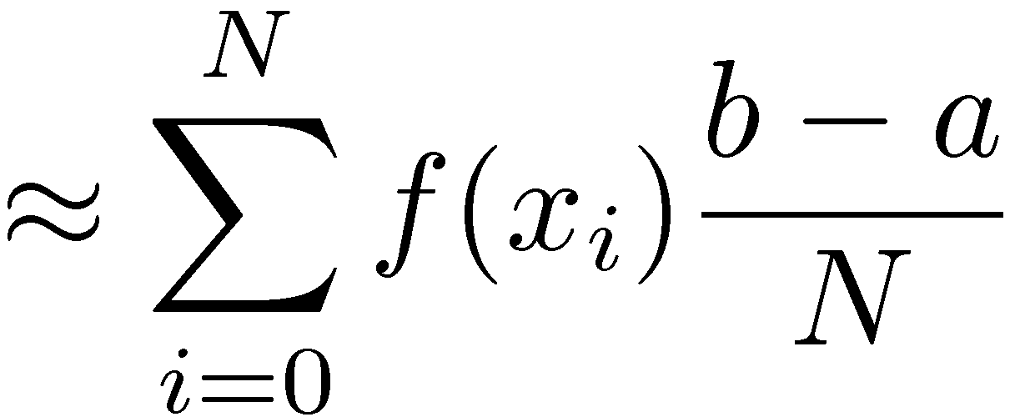
Numerical Integration
Equidistant Sampling
Approximation integral by a Riemann sum
Stochastic Sampling
Uniformly distributed samples
Approximation by sum

Slide 15
Stochastic Sampling
Cons:
Slower convergence than Riemann sum
Pros:
Better Scalability for multidimensional functions: increase number of samples in arbitrary steps
Noise instead of Aliasing
Independent of sampling grid: Clever placement of samples will improve the convergence!

Slide 16
Blind Monte-Carlo Sampling
Example: Filtering an Environment Map
Given an Environment Map
(i.e. photograph: fisheye or mirror ball)
Calculate an Irradiance Map
For each pixel of the irradiance map:
Determine n random directions on the hemisphere
Sample the Environment Map and
Average the results (incl. cos-term)
LDR Sample

Slide 17
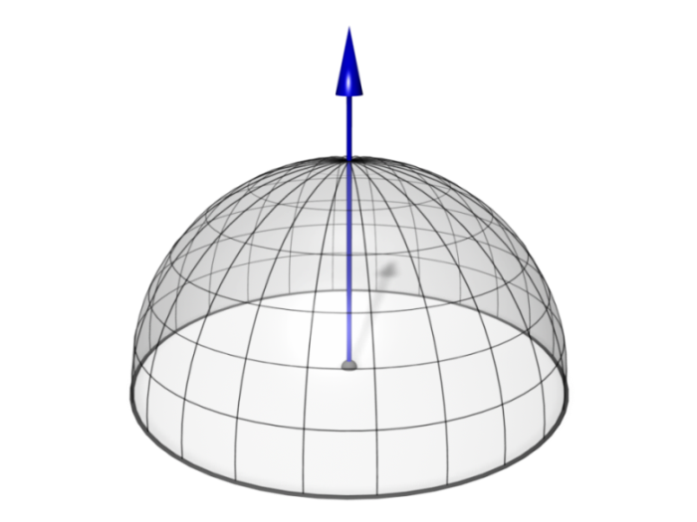
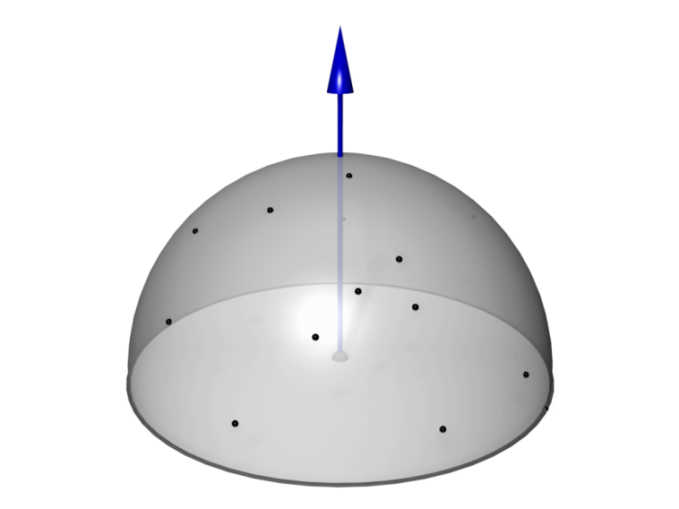
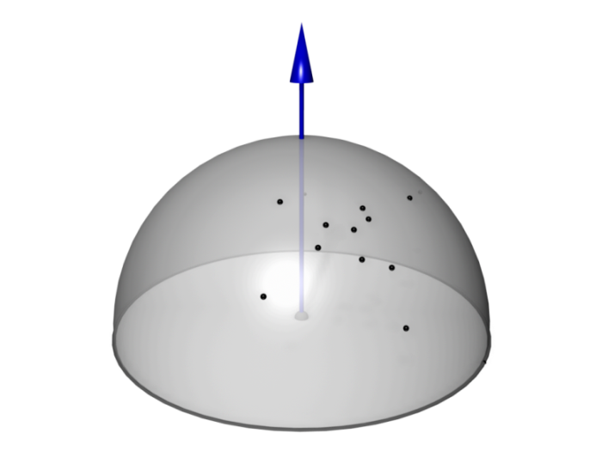
Rendering
Calculate the radiance from a point
depending on the incoming light on the sphere/hemisphere
depending on the phase function/BRDF
Deterministic
Uniform sampling of the sphere/hemisphere.
High computational load good approximation
Blind Monte-Carlo
Randomized sampling of the sphere/hemisphere.
Visually better images for fewer samples, slow convergence
Importance Sampling
Place samples where contribution is high
Faster!

Slide 18
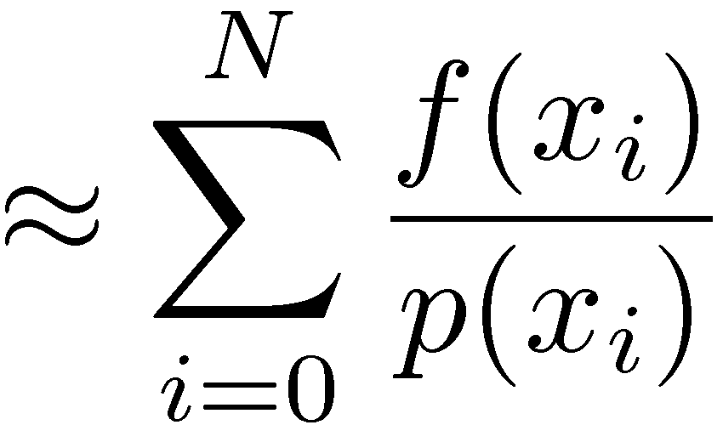
Importance Sampling
Stochastic Sampling
Non-uniformly distributed samples
Approximation by sum
Clever placement of samples
Many samples where function is high
Few samples where function is low
Probability Distribution Function (PDF)

Slide 19
Sampling a Specular Lobe
Simple Approach Specular term
Non-optimal, but easy to implement
Idea: uniform distribution of directions restricted to a cone
Precompute random unit vectors with uniform PDF
Randomly pick one vector
Negate vector, if
Blend with vector and normalize
Blend weight controls the size of the specular highlight and can be calculated from shininess

Slide 20
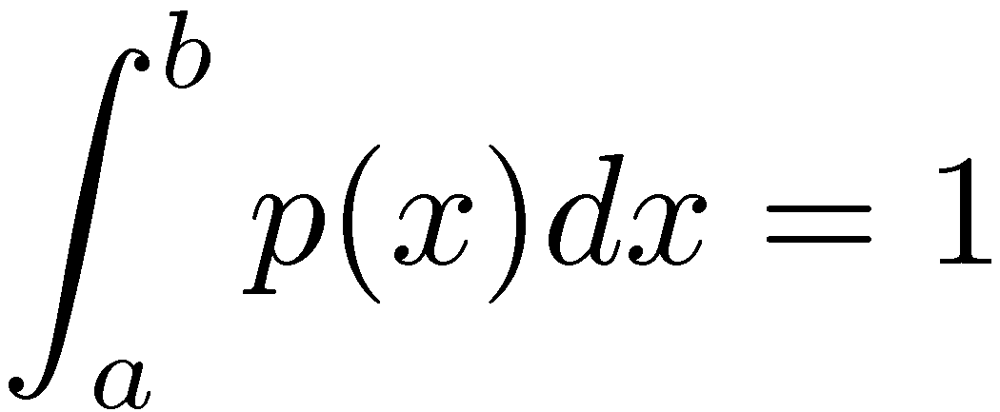
Stochastic Sampling
What is the ideal PDF for sampling a given function ?
Variance is minimal, if
must be chosen to normalize the distribution
Problem:
The ideal PDF requires knowing the integral beforehand!

Slide 21
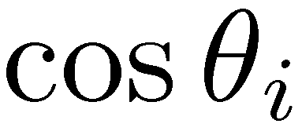
Stochastic Sampling
unknown
known
Although we do not know the integral completely, we still know parts of it

Slide 22
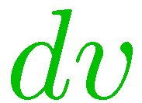
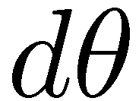
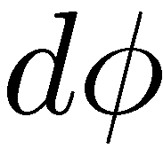
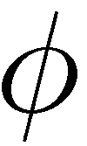
Solid Angle
Area (yellow):
Solid Angle:
Unit of solid angle: Steradian [sr]

Slide 23
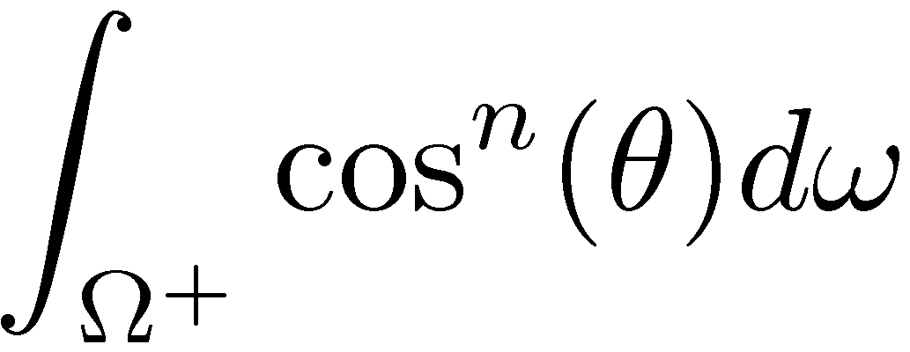
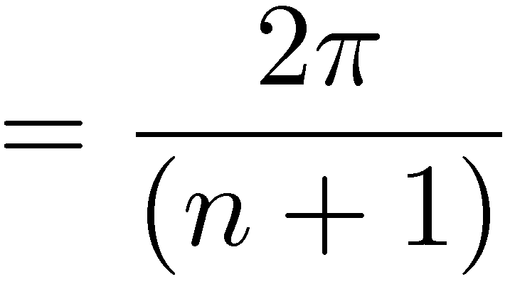
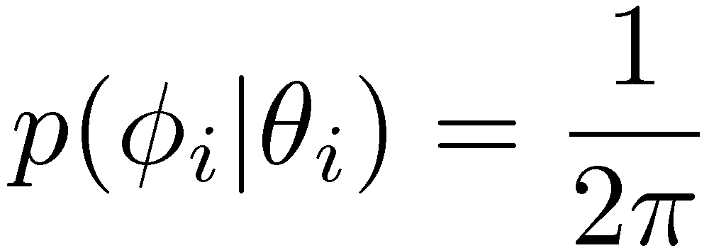
Sampling a Specular Lobe
Ideal Sampling
Convert to CDF and invert

Slide 24
Importance Sampling
Literature:

Slide 25
GPU Ray-Casting
Calculate First Intersection with Isosurface
Rasterize the front faces of the bounding box
For each fragment, cast a ray
Find first intersaction point with isosurface by sampling along the ray
interval bisection
Store the intersection point in render target 0
Estimate the gradient vector using central differences
Store the gradient vector in render target 1

Slide 26
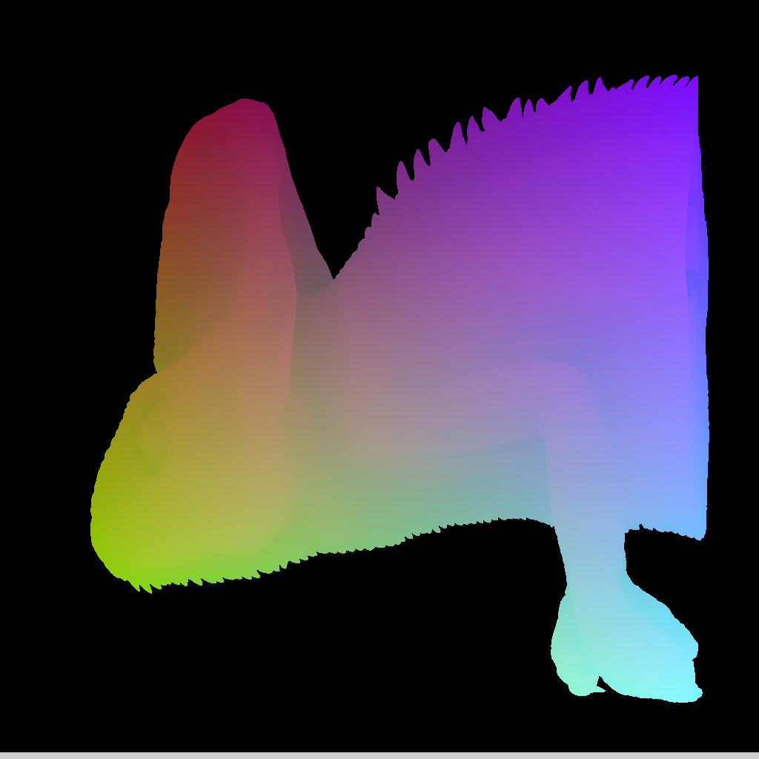
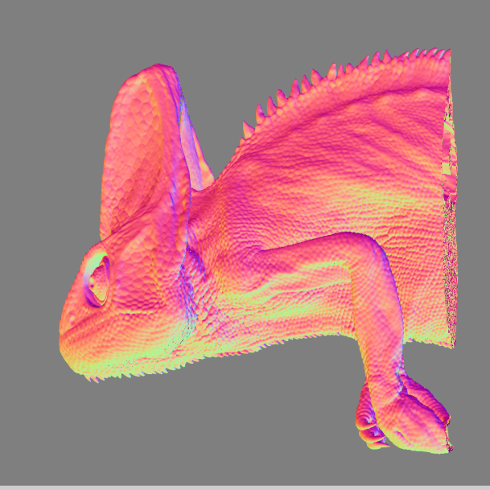
First Render Pass
MRT0: xyz-coordinates of first intersection point with isosurface
MRT1: xyz-components of gradient vector (color coded)

Slide 27
Deferred Shading
Single Scattering (no shadows)
Diffuse term:
Sample irradiance cube using gradient direction
Specular term:
Calculate random directions on the specular lobe
Sample environment cube
Weight each sample with its BRDF/phase function and its probability distribution

Slide 28
High Quality Isosurface
Single Scattering
Ambient Occlusion

Slide 29
Our First Implementation
Why not use a pre-filtered environment map?
You can, but
it only works for one specular exponent per object
Variable shininess may be used to visualize additional surface properties (e.g. gradient magnitude)

Slide 30
Single Scattering Example

Slide 31
Single Scattering Example

Slide 32
Multiple Scattering
Mathematical Model integrates over the entire sphere/hemisphere
Integral must be solved for every intersection point
Fredholm Equation (cannot be solved analytically)
Numerical Solution:
Number of rays grows exponentially
Much workload spent for little contribution

Slide 33
Multiple Scattering
Mathematical Model integrates over the entire sphere/hemisphere
Quantum Optics
Trace the path of single photons
Photons are scattered randomly
Probability of scattering direction given by BRDF/phase function
Monte Carlo path tracing

Slide 34
Phase Function Model
Scattering of light at every point inside the volume
Too expensive (extremely slow convergence)
Not practicable. Controlling the visual appearance is difficult
Idea: Restrict scattering events to a fixed number of isosurfaces only.
non-refractive
refractive

Slide 35
GPU Ray-Casting
Scattering Pass
Start at first isosurface and trace inwards
Account for absorption along the rays
Proceed until next isosurface
Calculate scattering event
Sample the environment on exit

Slide 36
GPU Ray-Casting
Scattering Pass
Simplifying Assumption:
Absorption on the „way in“ is same as on the „way out“
Abort the ray inside the volume square the absorption and sample irradiance map
Not very accurate but good visual results

Slide 37
Scattering Pass
preview in real-time
final version in ½-1 seconds

Slide 38
Final Composite
Multiply
Blend using Fresnel term

Slide 39
Path Tracing
Primary rays: 1 Secondary rays: 64
Primary rays: 8 Secondary rays: 8
Primary rays: 64 Secondary rays: 1

Slide 40
Examples
Different scattering cone angles for the „inward-looking“ (transmissive) Phong-lobe
refractive

Slide 41
Scattering Effects Light Map Approaches

Slide 42
3D Light Map
Direct light by shadow volume or deep shadow map
Consider the exchange of radiant energy between neighbouring voxels
Approximate by blur operation (like [Kniss, 2002])

Slide 43
Generate a 3D Light Map
Based on Shadow Volume
Calculate shadow volume for direct light as in
Blur the direct light slice by slice

Slide 44
Scattering 3D Light Map
Direct light
Direct plus indirect light

Slide 45
Calculate a 3D Light Map
Based on Deep Shadow Map
Resample the deep shadow map on a uniform voxel grid
Coarse grid resolution is sufficient due to the low-frequent nature of volumetric scattering

Slide 46
Scattering Deep Shadow Map
Direct light
Direct plus indirect light

Slide 47
Light Map Approaches
Shadow Volume Appraoch
Calculated in Model Space
Limited by Resolution of Shadow Volume
High Memory Requirements
Deep Shadow Map Appraoch
Calculated in Screen Space
Limited by Resolution of Shadow Volume
Reduced Memory Requirements
High Precision

Slide 48
High Dynamic Range
Direct light and shadows
Direct light, shadows and translucency

Slide 49
Summary
Scattering Effects
Single Scattering
Filtered Environment Maps
Monte-Carlo Integration
Multiple Scattering
Monte-Carlo Integration
3D Light Maps (Shadow Volume/Deep Shadow Map)

Slide 50
Acknowledgements
Images and Slides on Deep Shadow Maps: Andrea Kratz, Zuse Institute, Berlin Markus Hadwiger, VRVis, Vienna
Volume Data Sets:
Medical data sets courtesy of Agfa Vienna and Dept. Of Neurosurgery, Medical University Vienna
Chameleon, Cheetah, Bat, Pterosaur courtesy of UTCT data archive, University of Texas at Austin
Carp Data set courtesy of Univ. of Erlangen-Nuremberg

