Slide 1
Advanced Illumination Techniques for GPU-Based Volume Raycasting

Slide 2
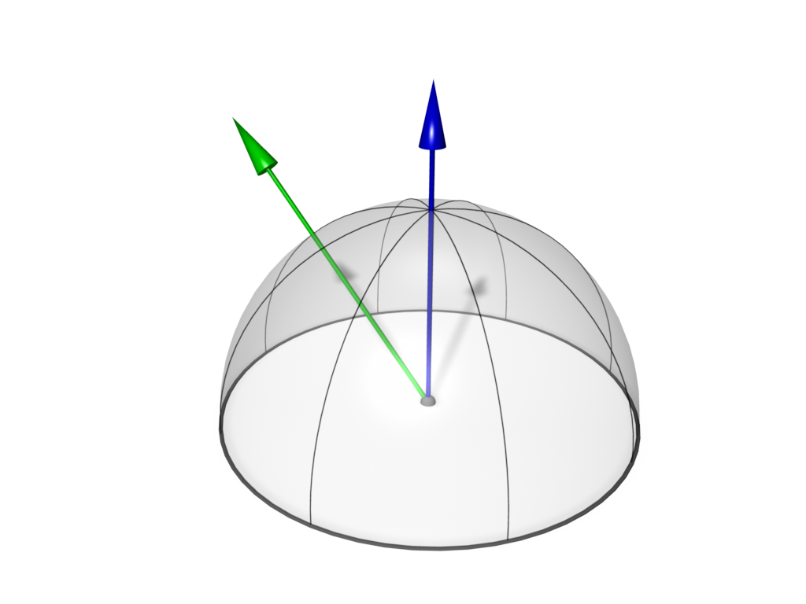
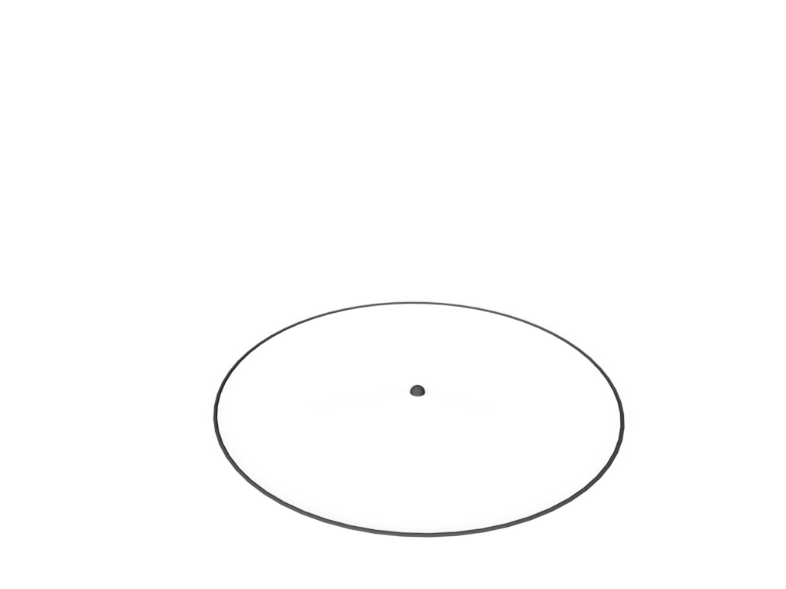
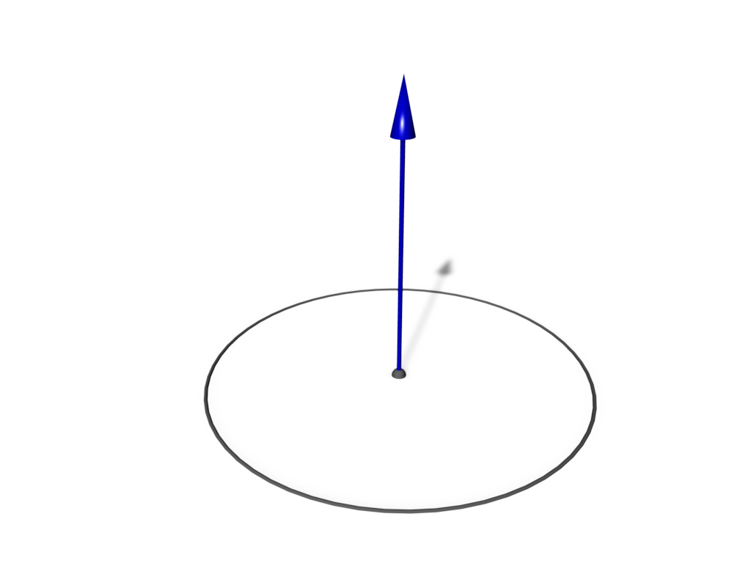
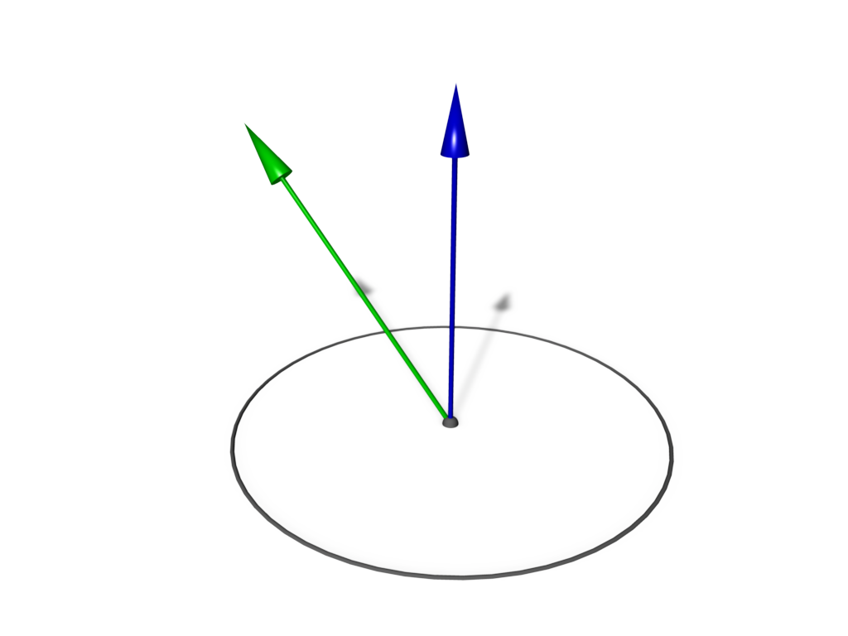
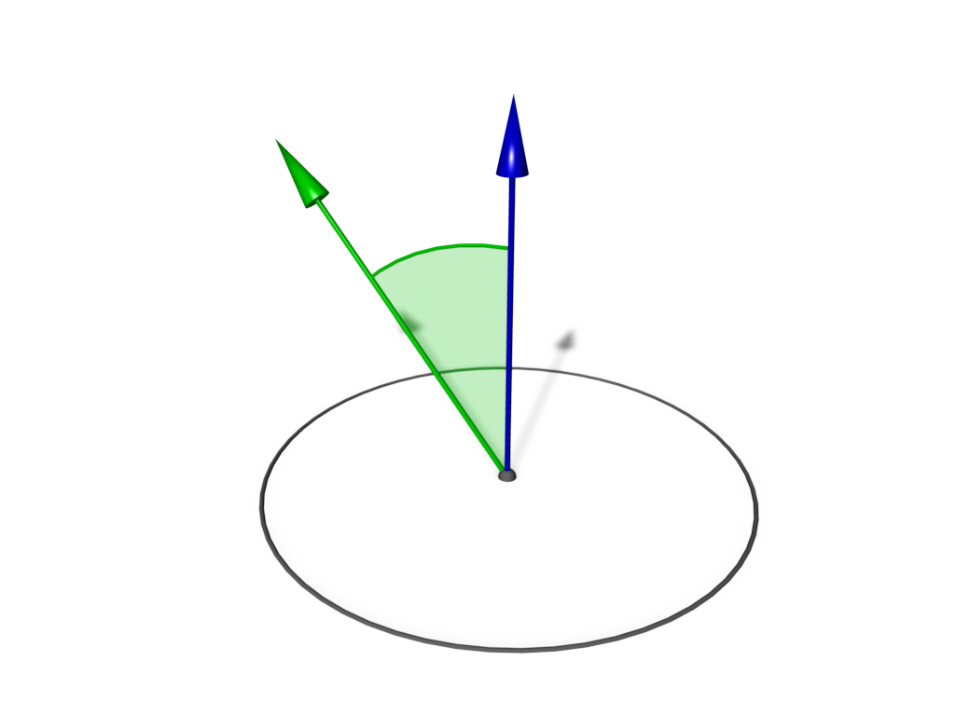
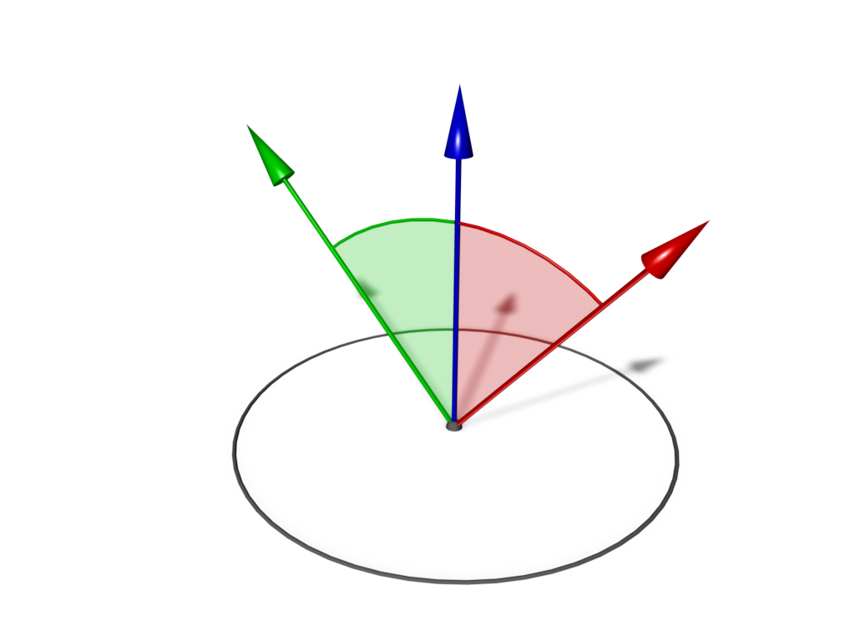
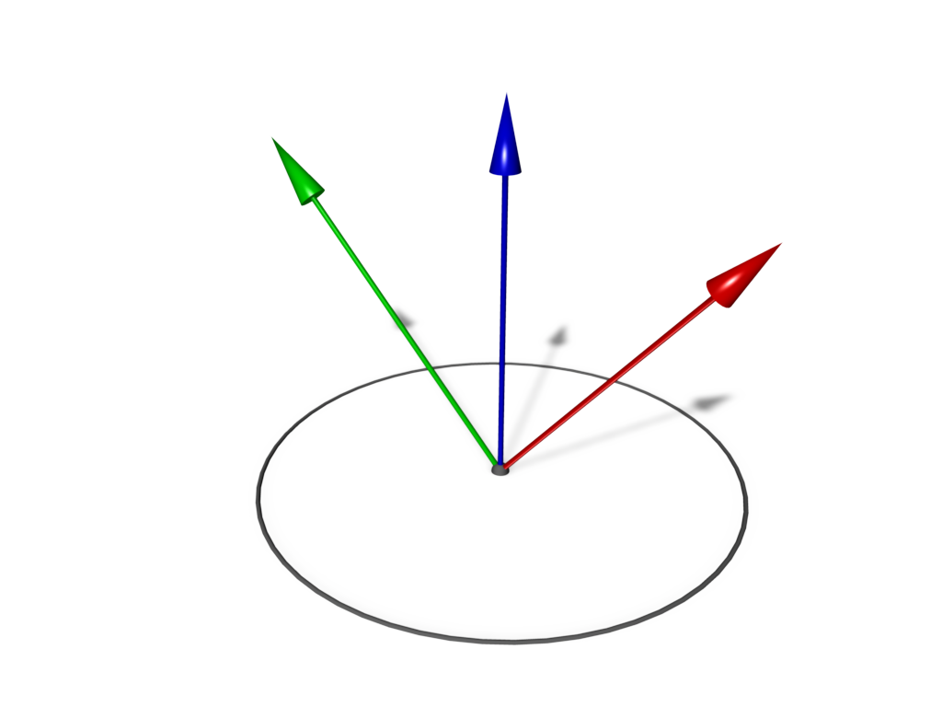
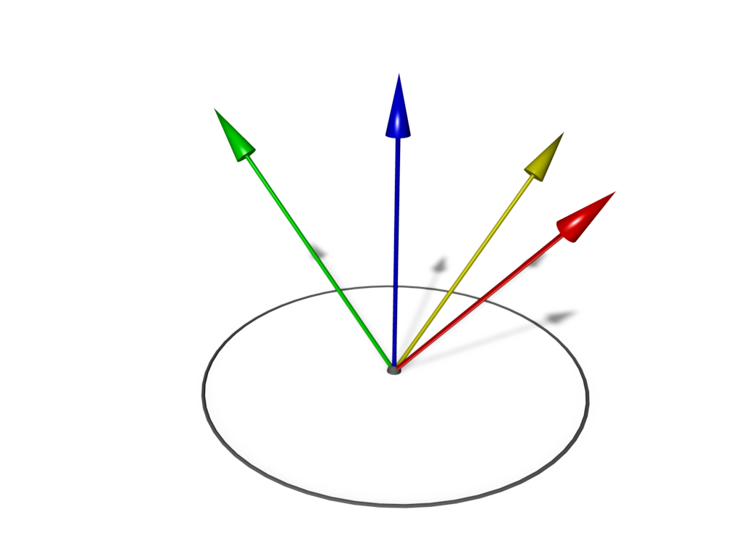
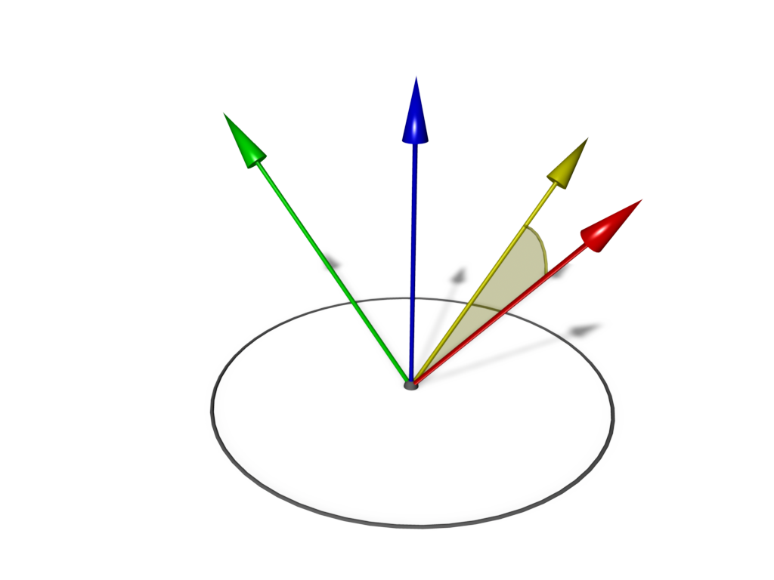

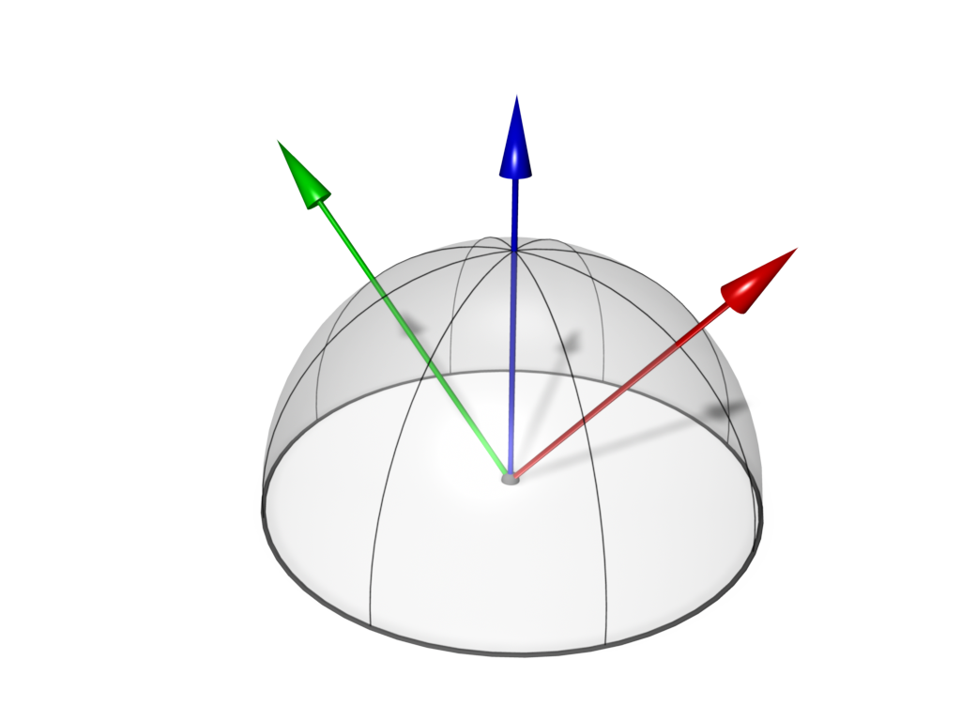
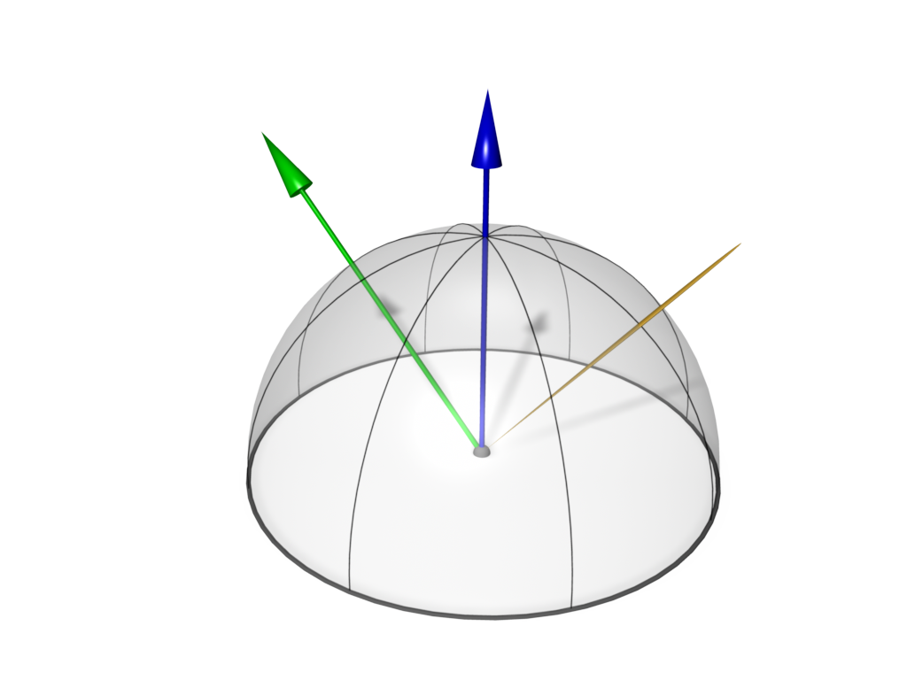
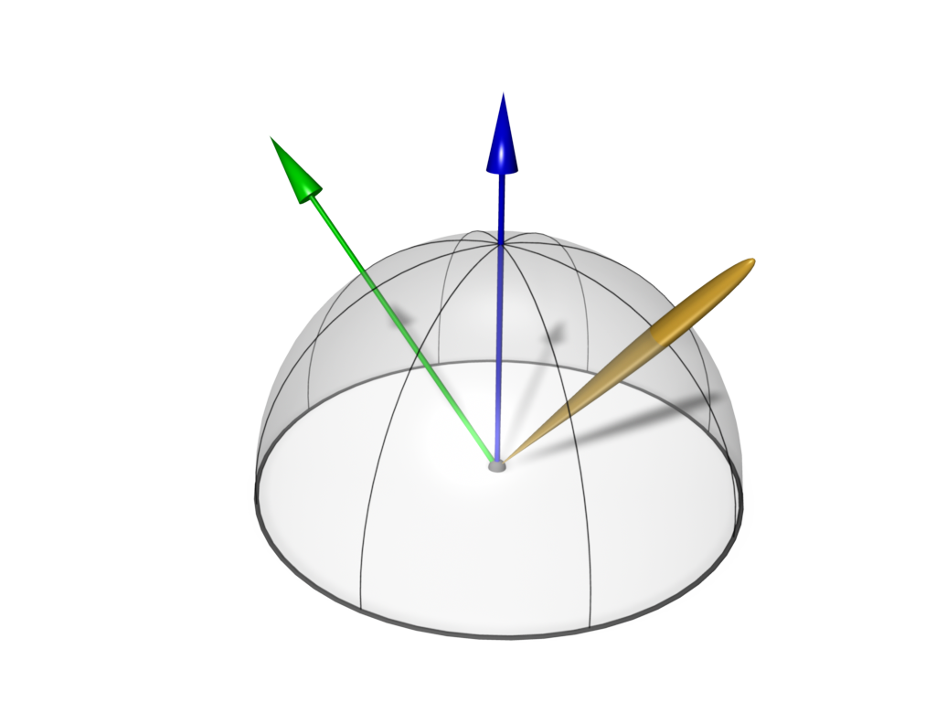

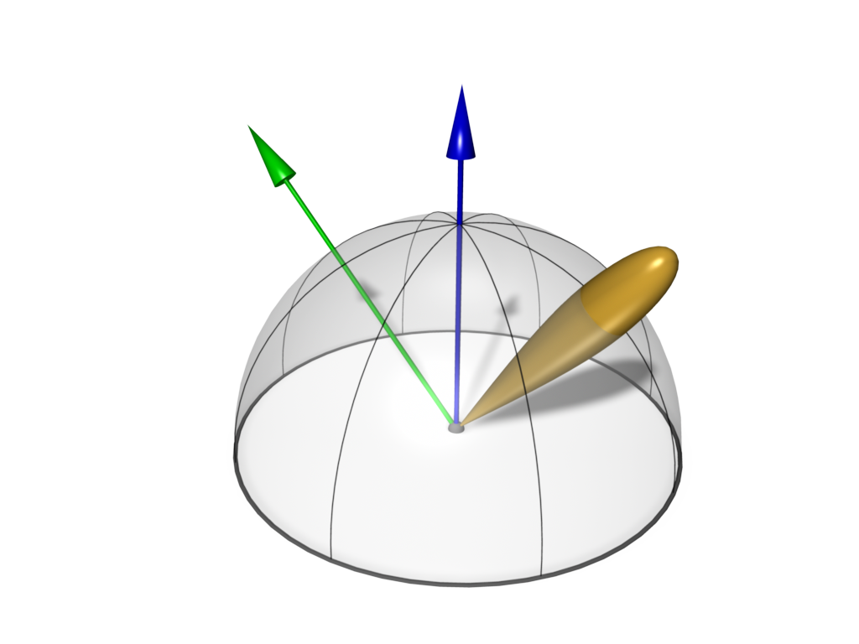

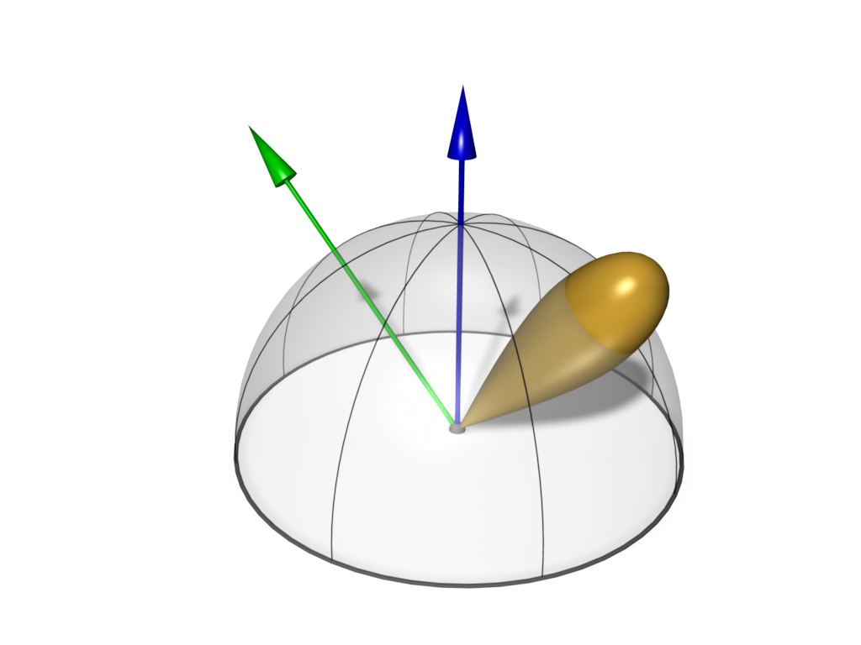
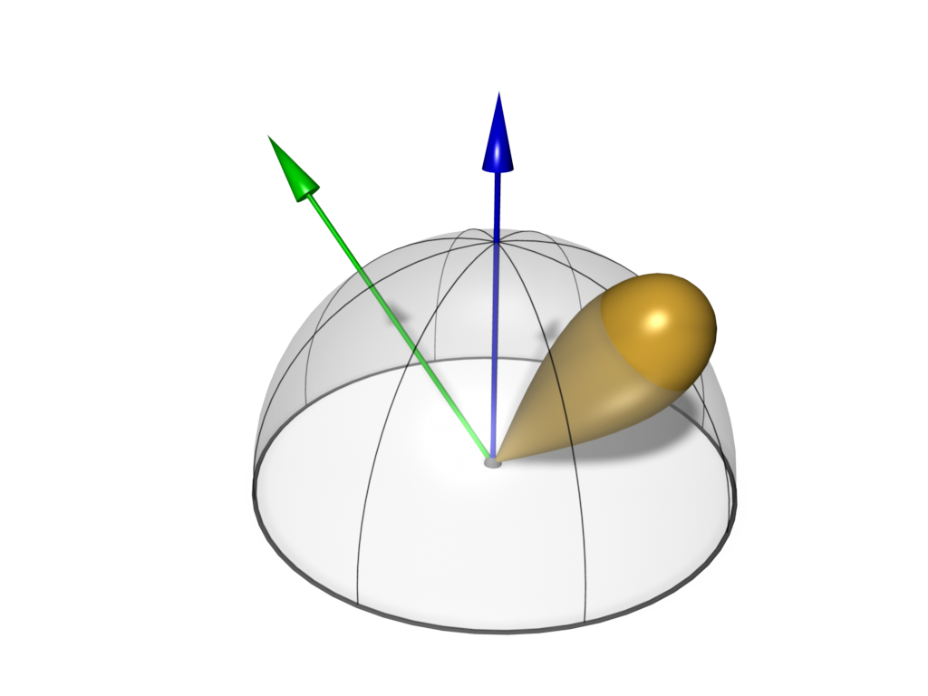
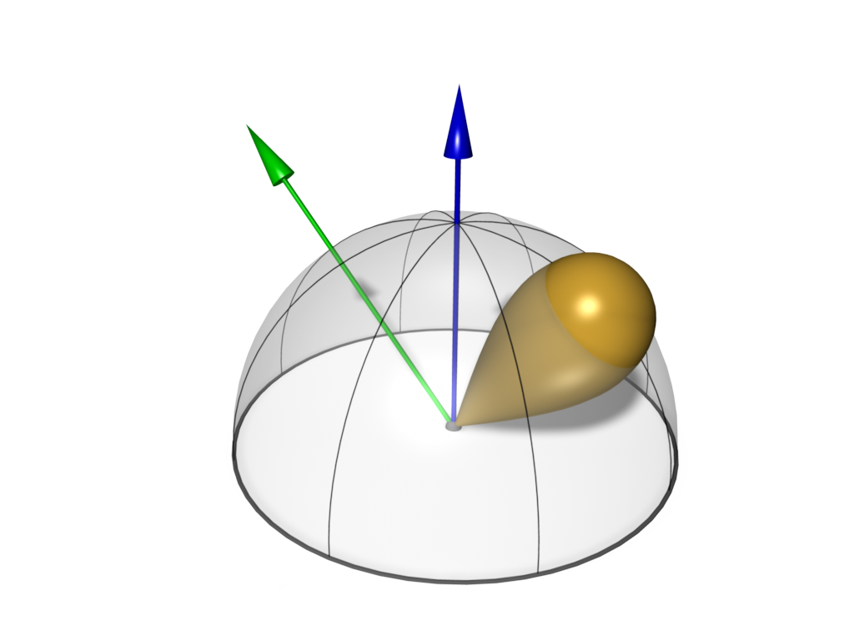
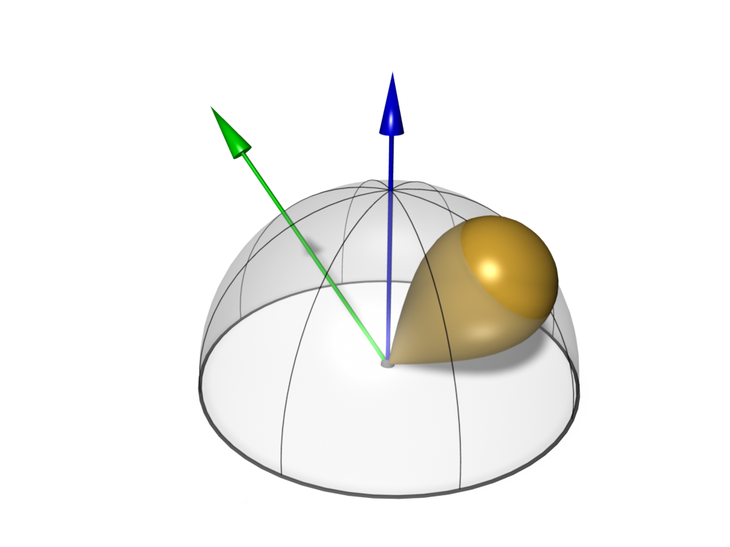
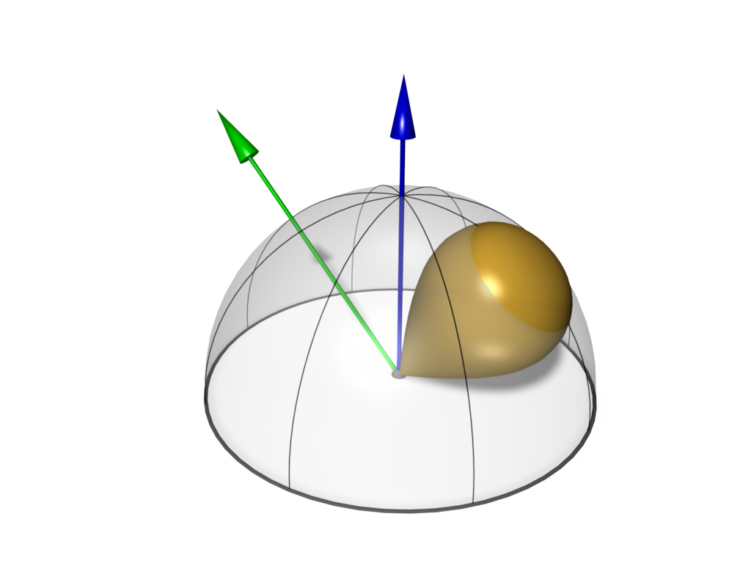
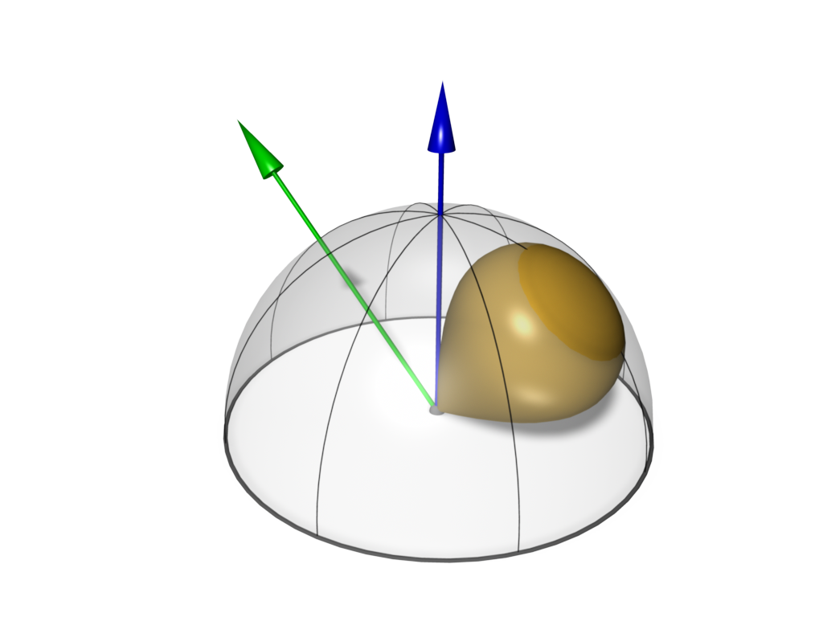
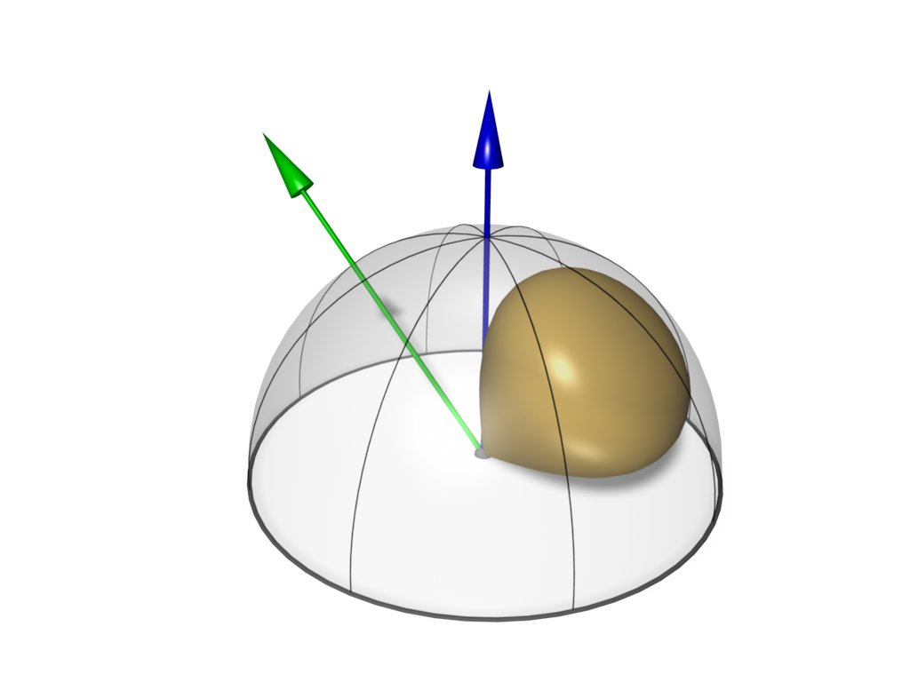
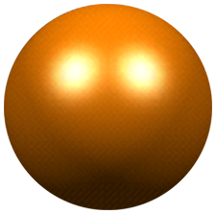
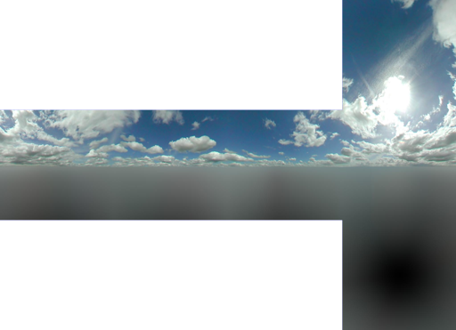



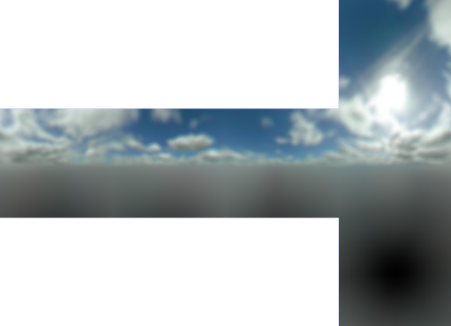

Local Illumination
BRDF: Perfekte Spiegelung
(z.B. Environment Map)
BRDF: Specular Reflection
(e.g. Phong Model)
Spekulare Reflexion
(z.B. Phong Modell)
Diffuse Reflexion
(z.B. Irradiance Map)
Perfekte Spiegelung
(z.B. Environment Map)

Slide 3
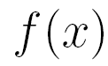
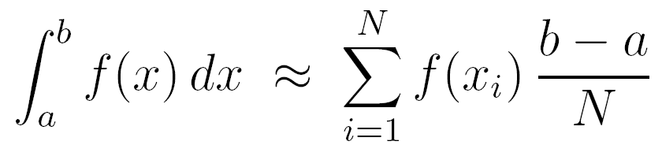

Numerical Integration
Deterministic Sampling
Approximate the integral by a Riemann-sum
Randomized Sampling
Uniformly distributed samples
Approximate by sum

Slide 4
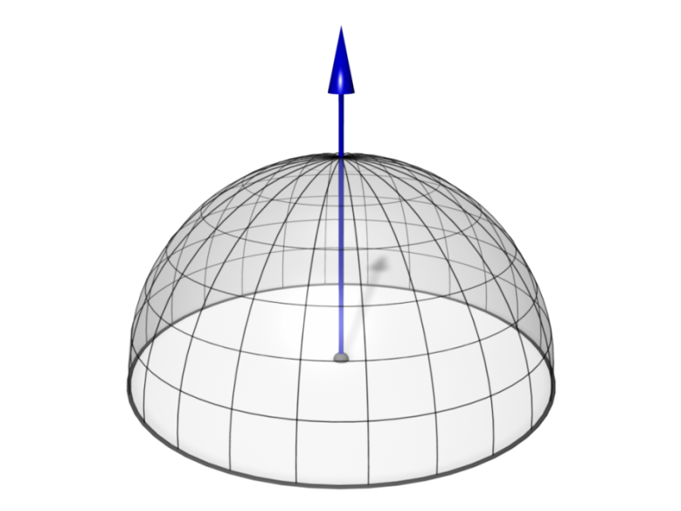
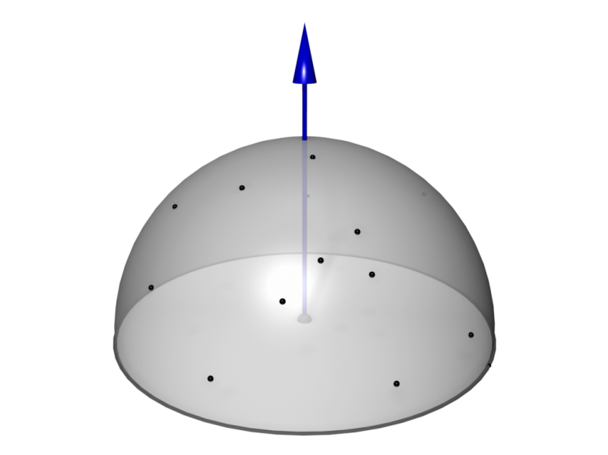
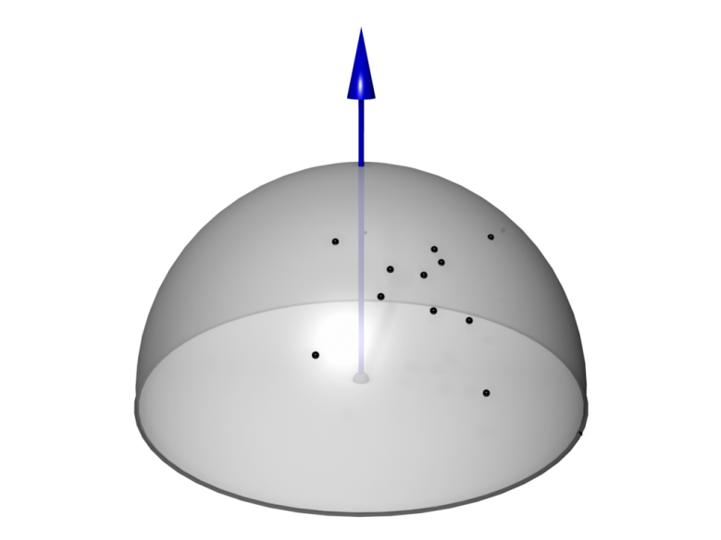
Rendering
Determine the radiance at a given point
  Depending on the incident light gathered over the hemisphere.
  Depending on the optical properties (reflectivity) at the point
Deterministic
High complexity,
good approximation
Blind Monte-Carlo
Better images with few samples,
slow convergence
Importance Sampling
Faster!

Slide 5
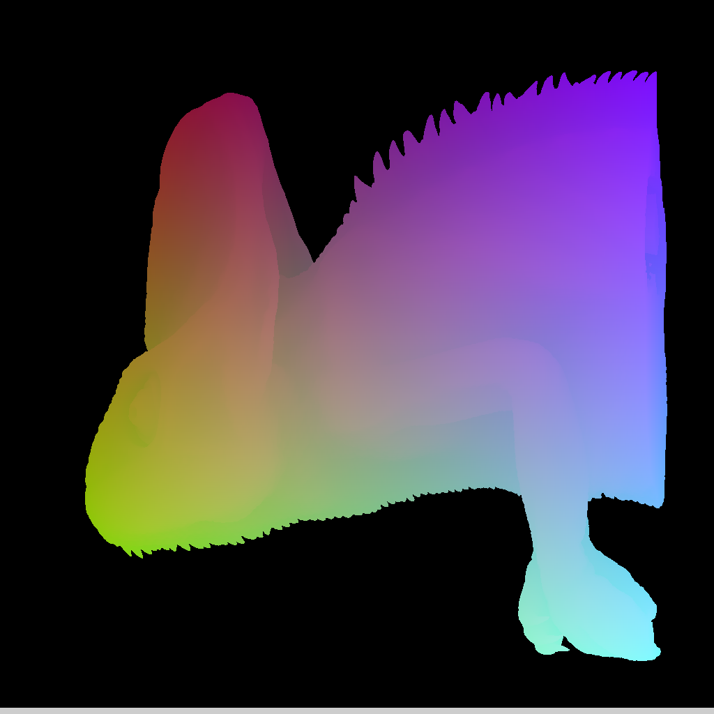
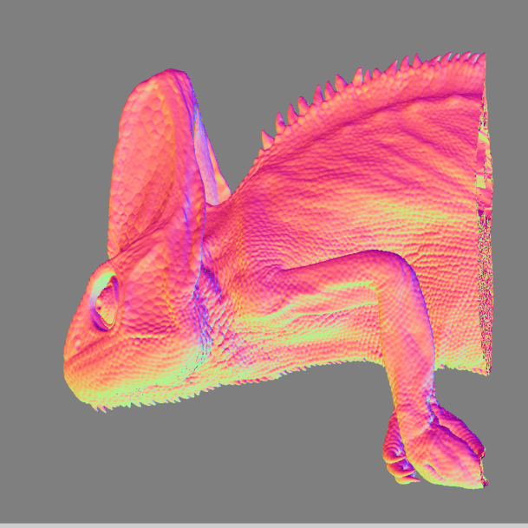
First Hit with Isosurface
MRT1: xyz-Coordinate of the first
intersection point (color coded)
MRT2: xyz-component of the
gradient vector (color coded)

Slide 6
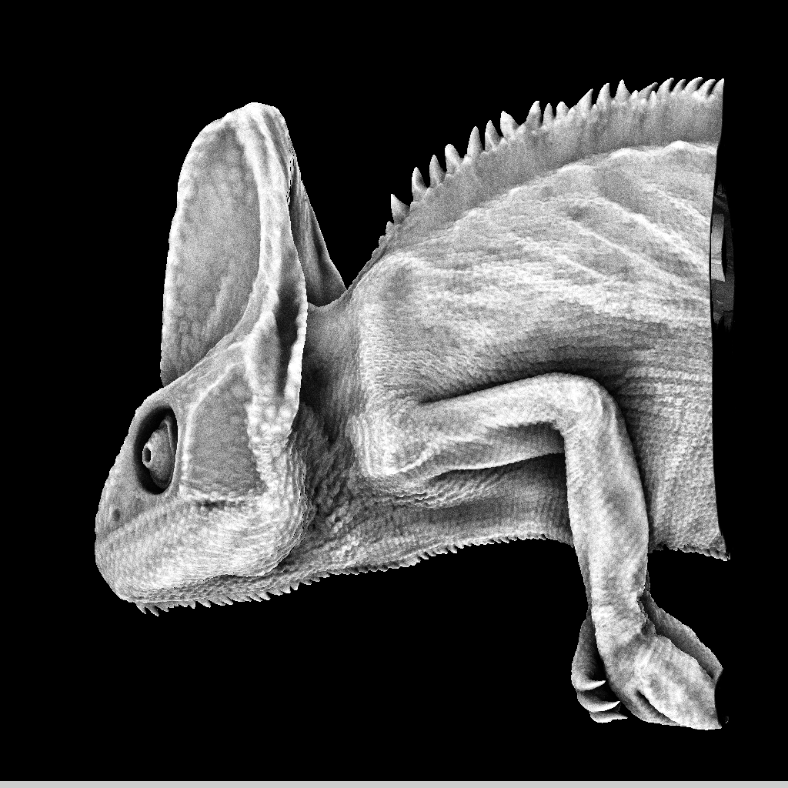
Ambient Occlusion Pass
Ambient Occlusion
Approximation
of soft shadows

Slide 7
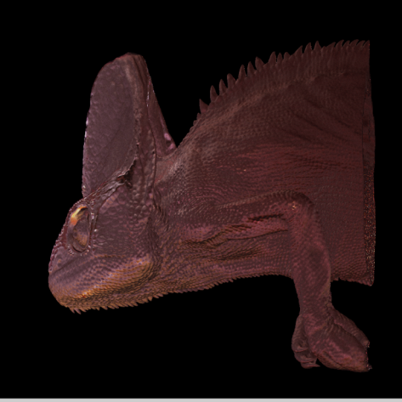
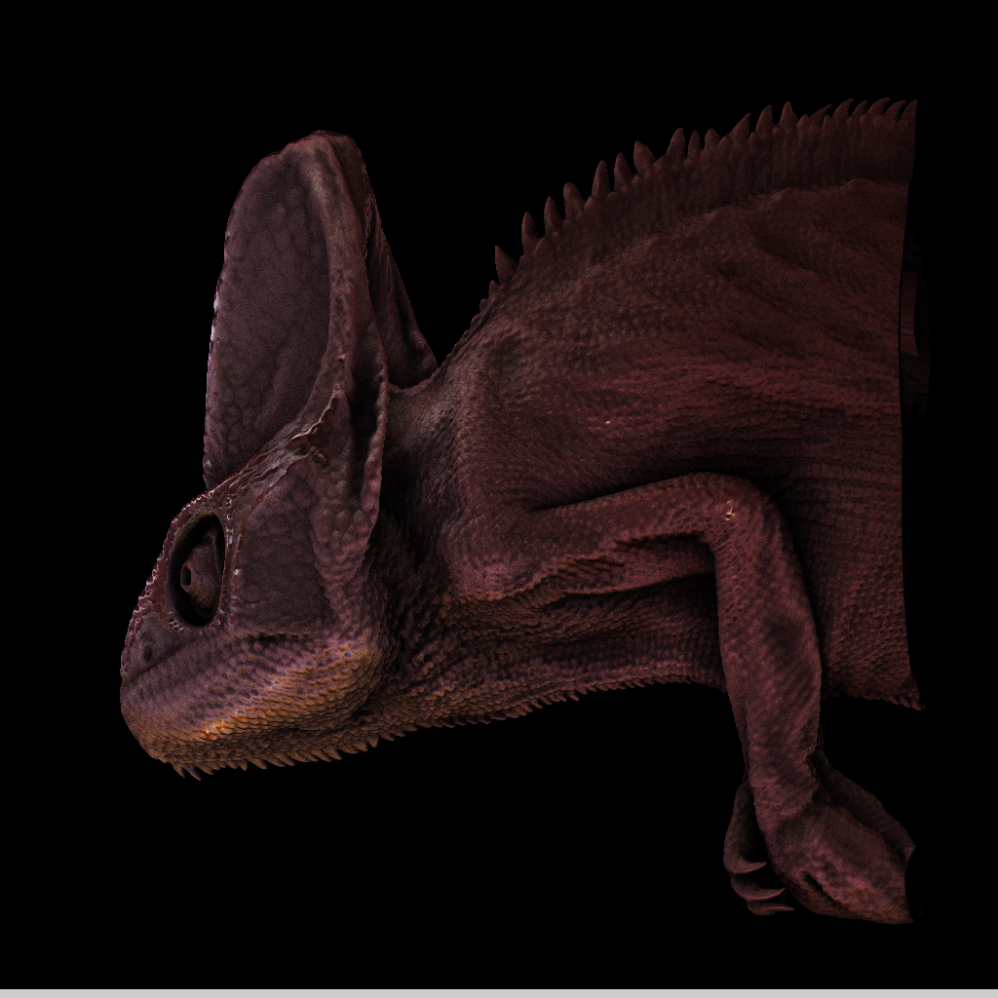

High Quality Isosurface
Local illumination
multiplied by ambient
occlusion

Slide 8
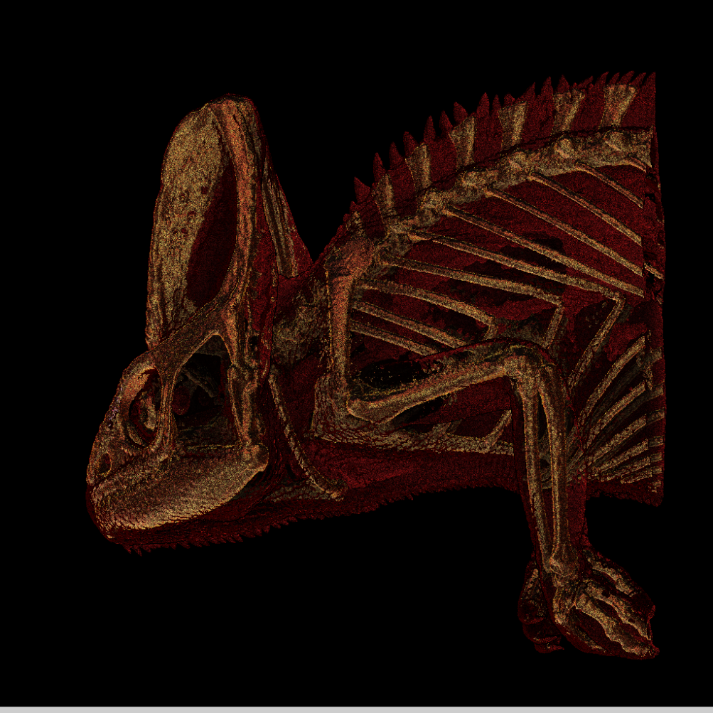

Scattering Pass
Preview in Echtzeit
Finale Version in ca. ½-1 Sekunde

Slide 9
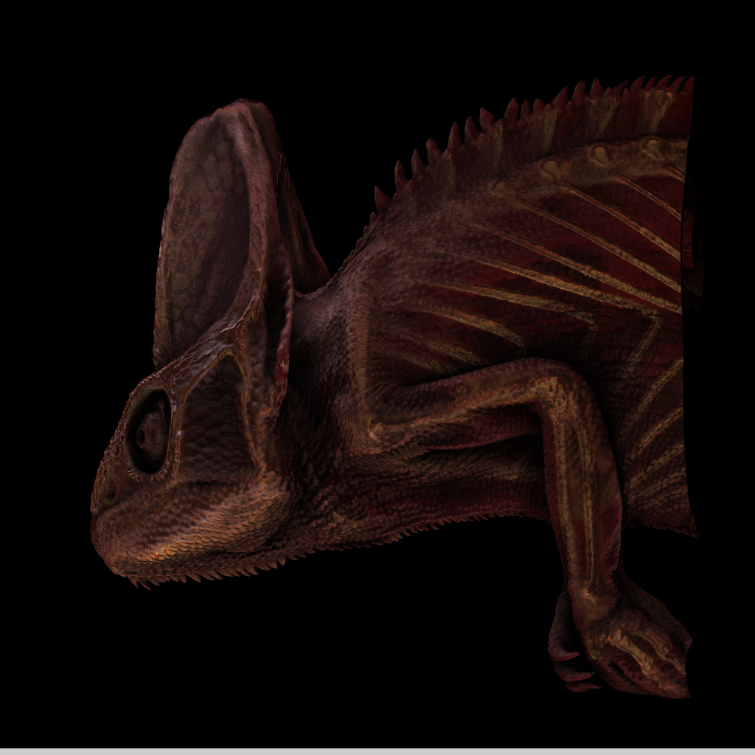



Final Composite
Multiply
Blend

Slide 10
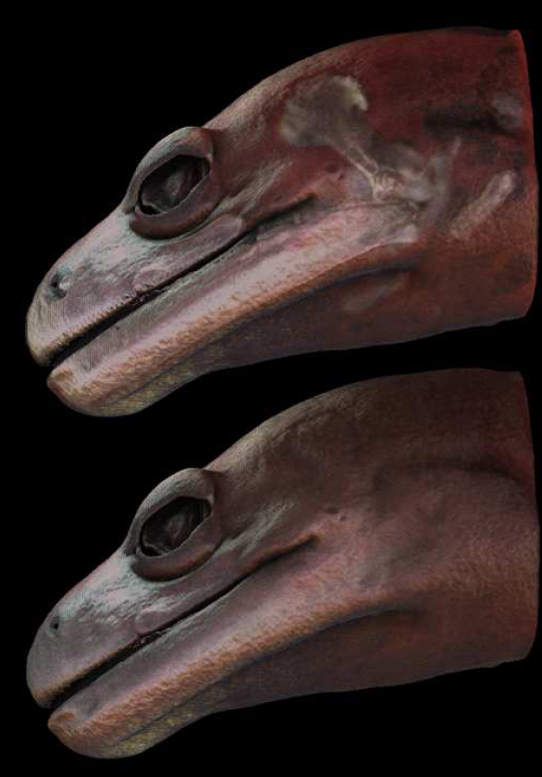
Examples
Different cone angles for
the transmissive term
(inward looking Phong lobe)

Slide 11
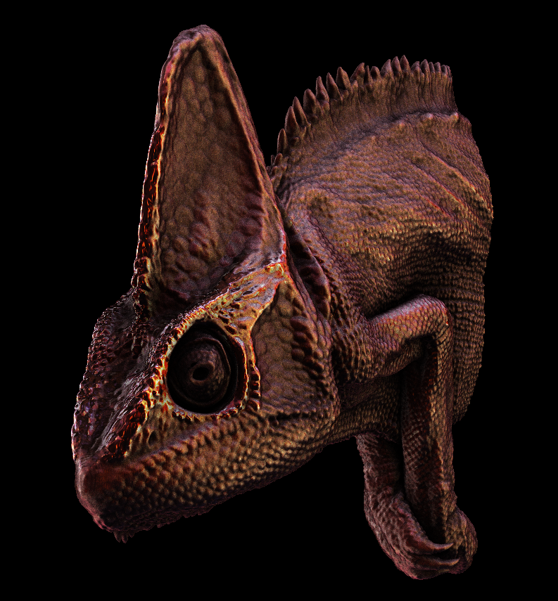
Example
Specular exponent
(shininess)
modulated by the
gradient magnitude
Higher gradient

Slide 12
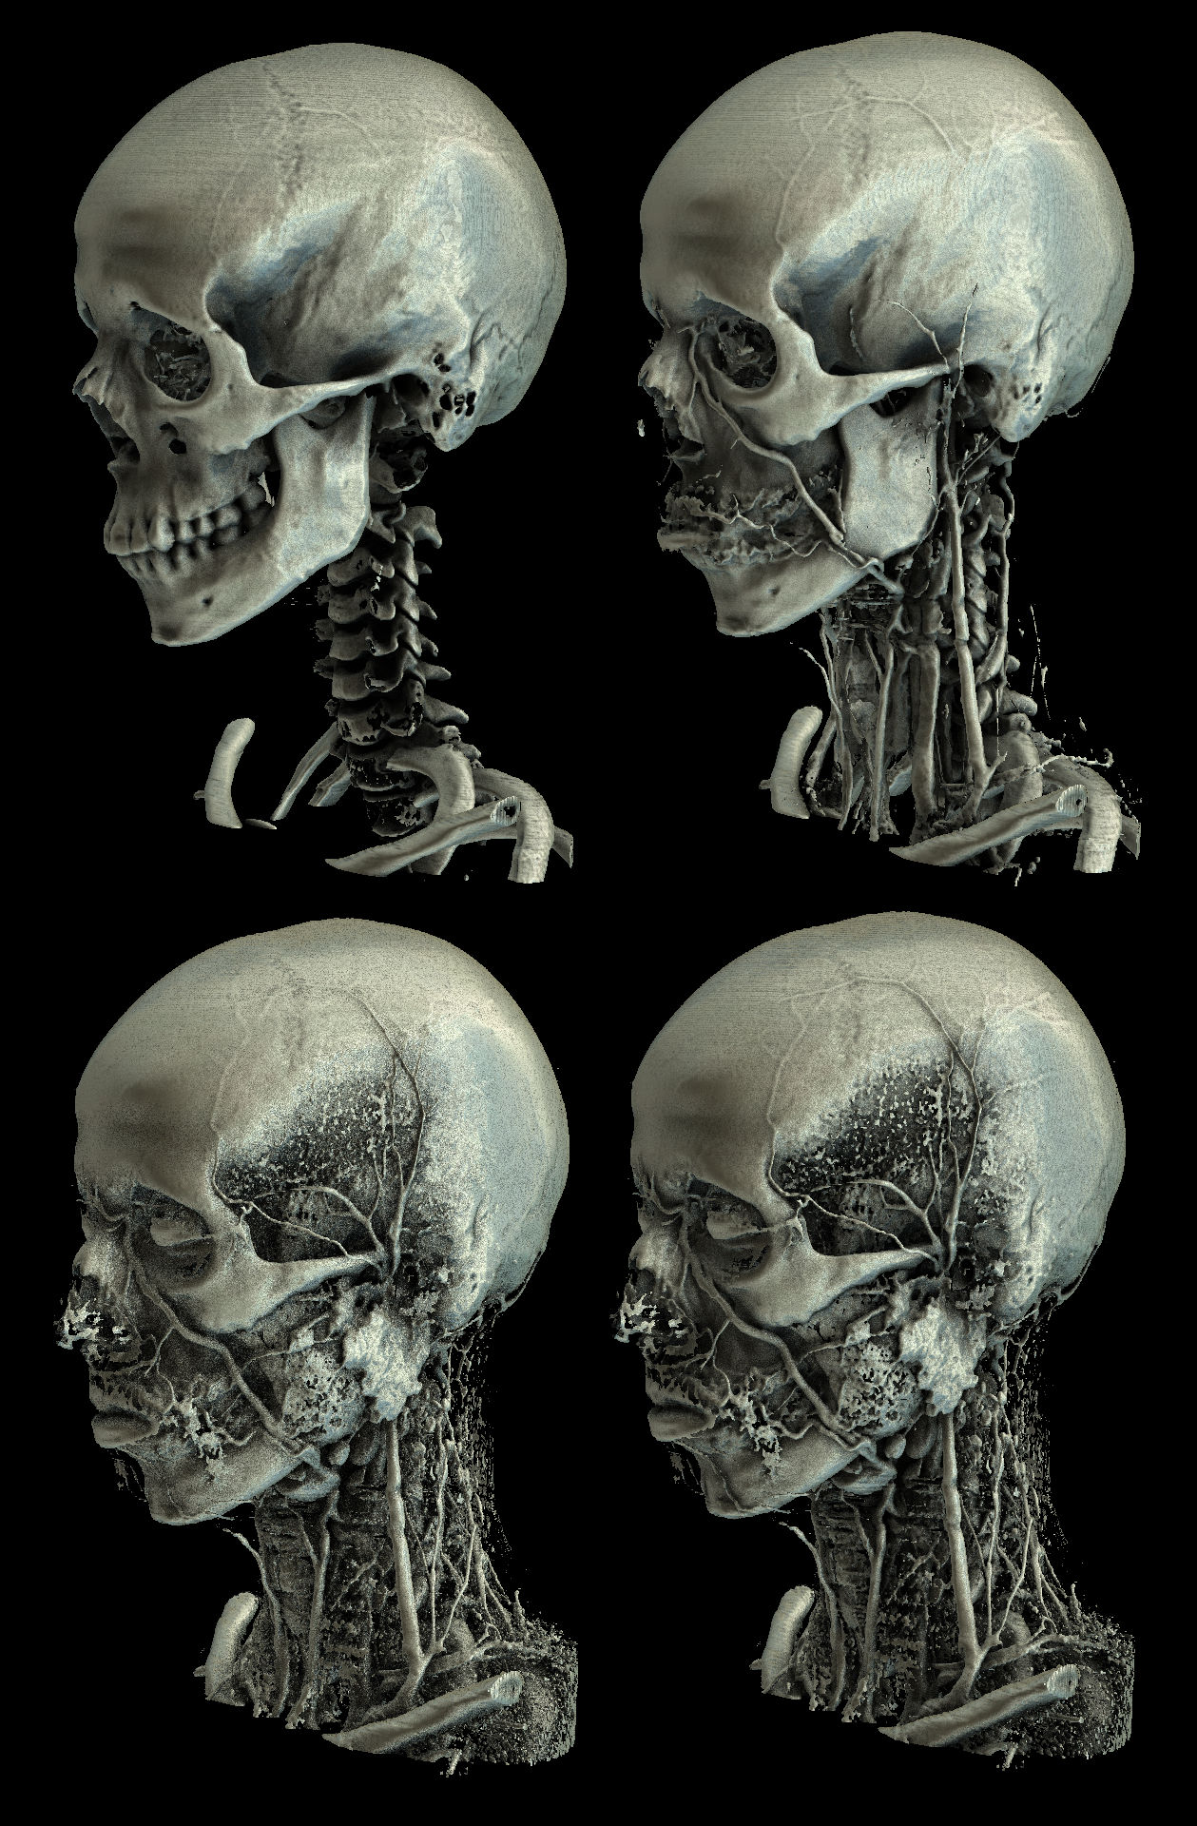
Beispiele

Slide 13
Examples

Slide 14
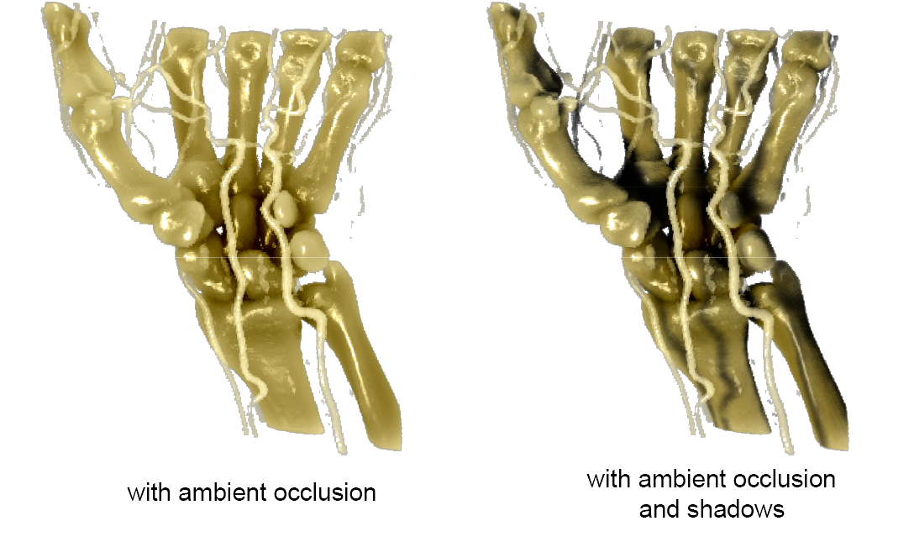
Interactive Volume Raytracing

Slide 15
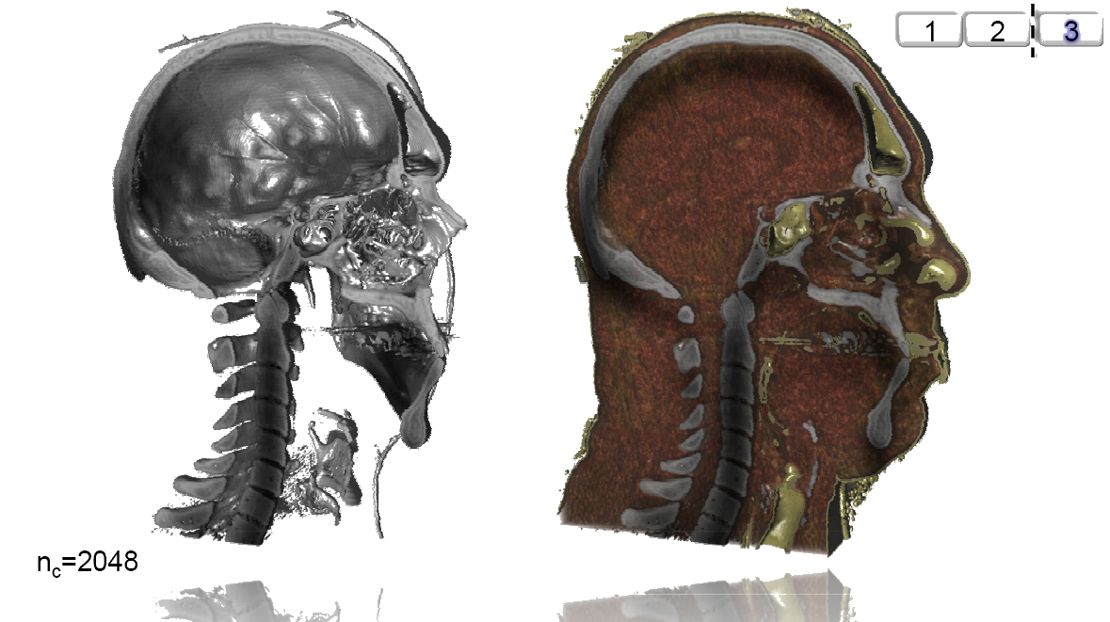
Application Example DVR

Slide 16
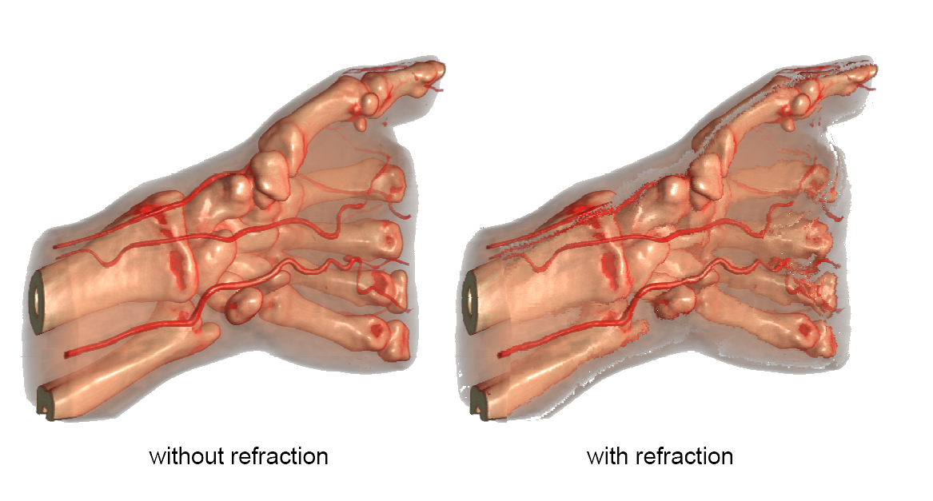
Refraction

Slide 17
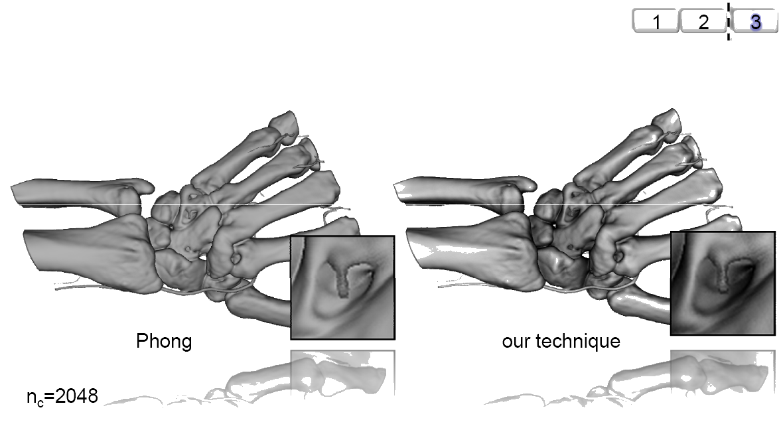
Example Isosurface Shading

Slide 18
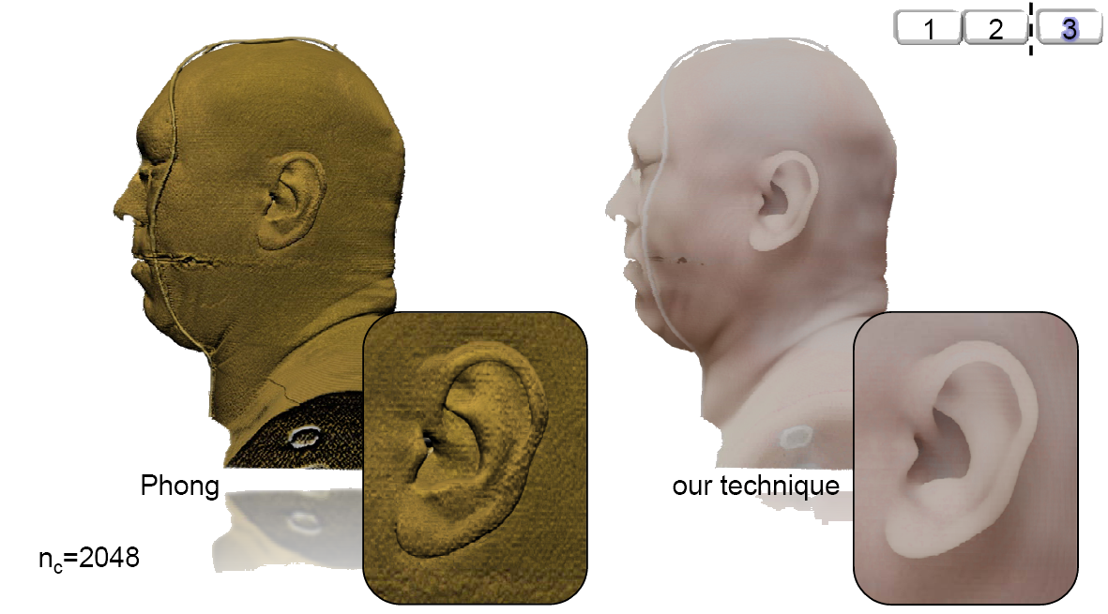
Application Example DVR

Slide 19
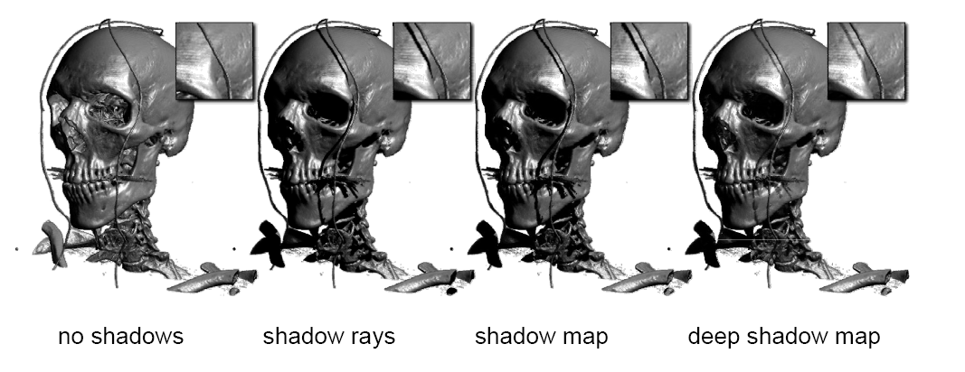
Shadow Techniques

Slide 20
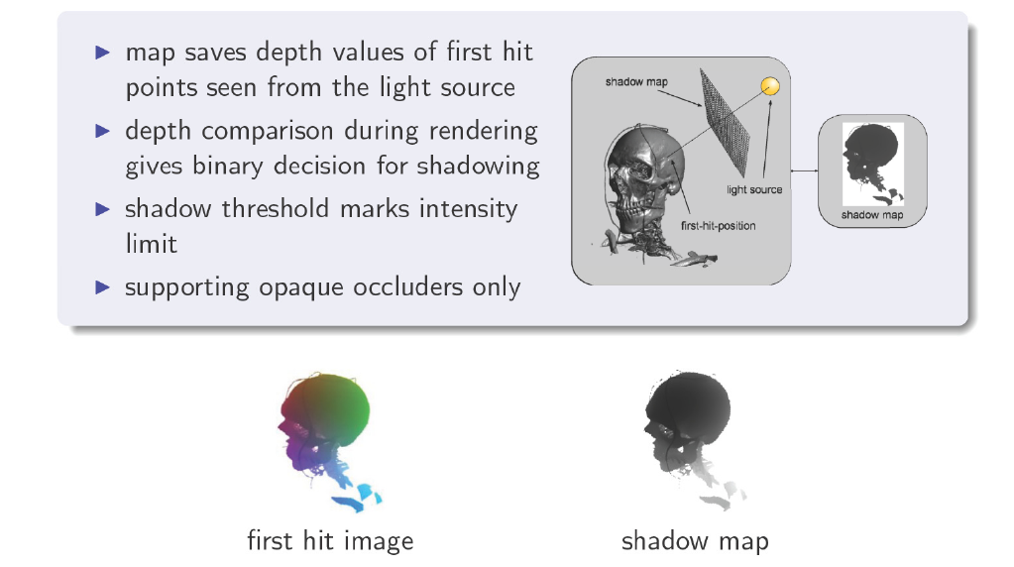
Shadow Maps

Slide 21
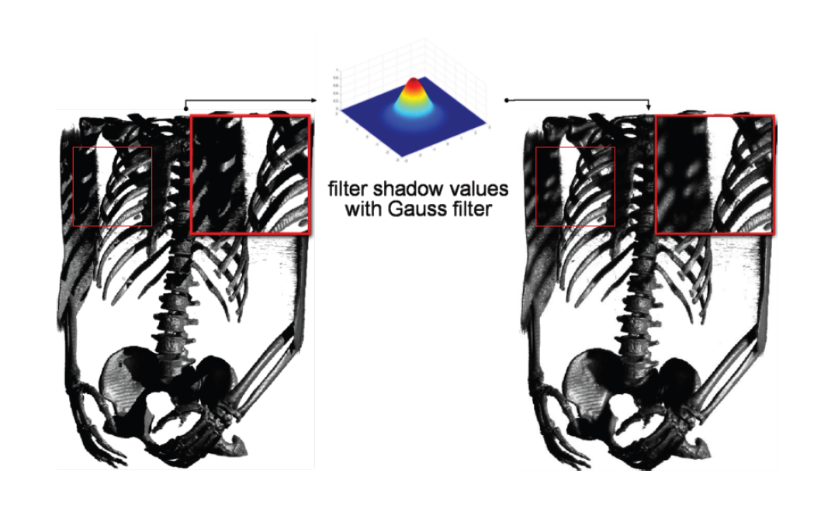
Shadow Mapping

Slide 22
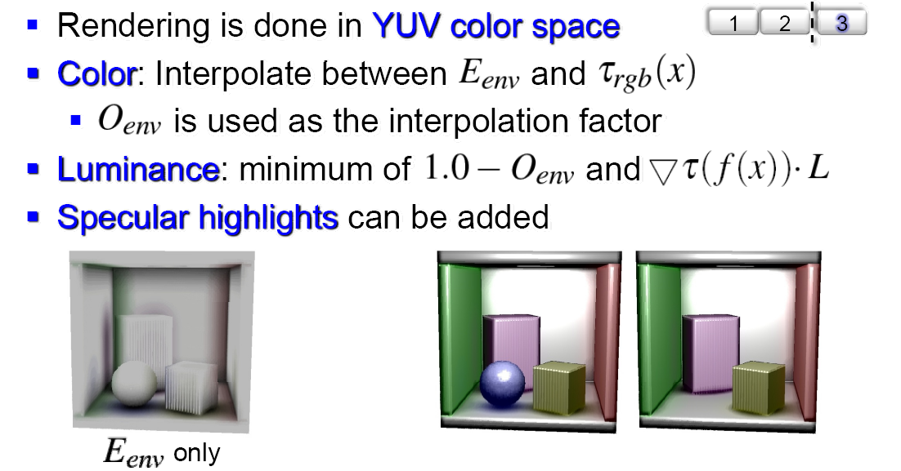
Rendering - DVR

Slide 23
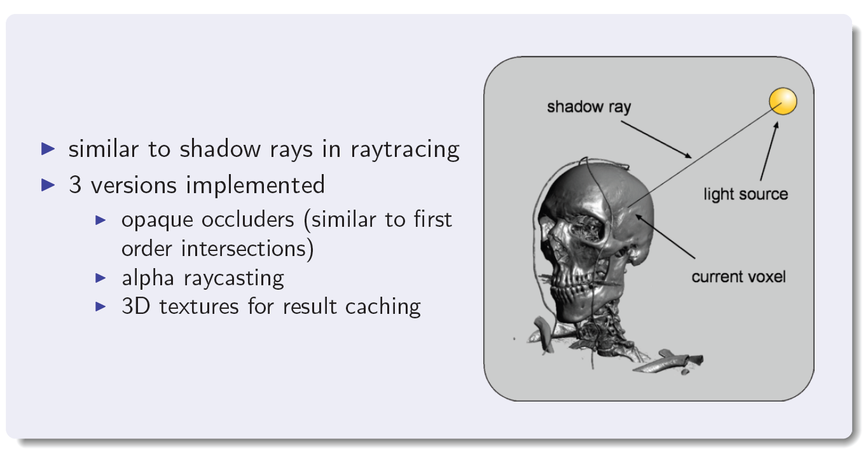
Shadow Rays

Slide 24
Multiresolution Volumes
Hierarchical and Flat Blocking Techniques
Hierarchical blocking
Constant data size, lower resolution blocks cover increasing spatial size
Level 1
Level 2
Level 0
Level 3
Flat blocking structure
Constant spatial size, lower resolution blocks have fewer samples
Level 0
Level 1
Level 2
Level 3

Slide 25
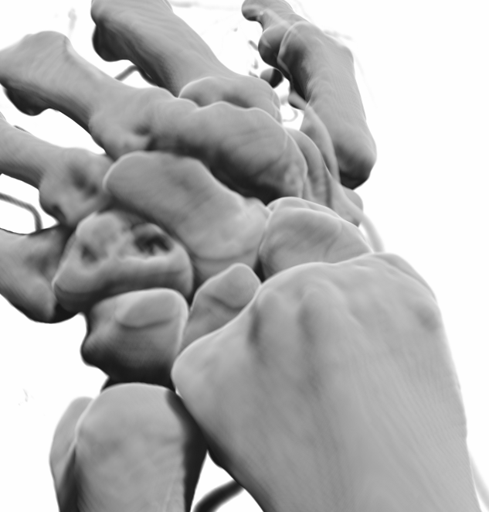
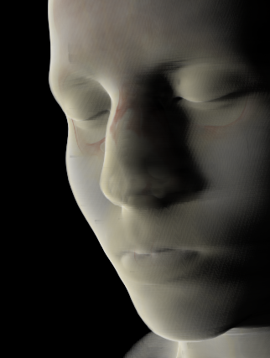
GPU Deep Shadow Maps

Slide 26
Deep Shadow Maps (2)
Geometry and volumes combine easily
Lokovic and Veach

Slide 27
Opaque Scene Geometry
Rasterize scene geometry into depth buffer
Volume ray-caster stops rays at these depths
Ray-cast on top of geometry or blend afterward

Slide 28

Opaque Scene Geometry
Back-project scene depth into volume space [0,1]
Use these volume space coordinates to stop rays
Works for arbitrarily complicated scenes

Slide 29



Viewpoint Inside the Volume
Two main possibilities
  Cap with geometry (clip near plane against frustum)
  Render near plane and use stencil/depth buffer

Slide 30
Integration with Shadow Volumes
Stencil-based shadow volumes care only for one scene depth per pixel
Soft shadow approaches depend even more on
rasterization
So: integration
extremely hard
Assarsson and Akenine-Möller, Siggraph 2003

Slide 31
Multiresolution Techniques
Out-of-core data management
Transfer function-based adaptive level-of-detail
Adaptive object-space sampling density
Continuous interblock interpolation between arbitrary resolutions

Slide 32








Virtual Autopsy

Slide 33


Local Ambient Occlusion
Sampling a limited sphere around each voxel
Uniform distribution of light sampling directions
Light contribution only at sphere surface
Sharp edges and ray directions are noticeable
8 directions used, radius of sphere about 16 voxels
Volumetric light creates smoother shadows
Light contribution at each sample point adjustable
Example to right shows equal contribution
Directions difficult to determine, smooth shadows
GPU-based approach utilizing Multiresolution
LOD volumes to speed up computation.
Images Courtesy of Frida Hernell, NVIS/CMIV, Linköping University

Slide 34
Emissive Materials
Emissive materials are easily incorporated into Local Ambient Occlusion
LAO and traditional absorption/reflection Volume Rendering (left)
Emissive materials spreads light in its neighborhood (middle)
Emission combined in LAO and Volume Rendering (right)
Images Courtesy of Frida Hernell, NVIS/CMIV, Linköping University

Slide 35

Local Ambient Occlusion
Diffuse Shading
Local Ambient Occlusion
Combining LAO and Diffuse
Ambient Occlusion and Emissive Materials (bullet fragments) used in Virtual Autopsy to facilitate finding small bullet fragments
LAO combined with diffuse shading to enhance high frequency details
Images Courtesy of Frida Hernell, NVIS/CMIV, Linköping University

Slide 36
Multiresolution Data
Final composition
Final composition
Level 3
Level 2
Level 1
Level 0
Data reduction 2.2:1
Data reduction 3.8:1
Hierarchical blocking
Flat blocking
Level 0
Level 1
Level 2
Level 3

Slide 37
Interblock Interpolation
1x1
2x2
8x8
8x8
1x1
1x1
4x4
8x8
Problem: The domain between block sample boundaries
Situation: A blocked multiresolution representation
Required: Smooth interpolation of samples between blocks

Slide 38




Interblock interpolation
A normalized sum, ϕ, of bounded block samples, ϕ_{b}
Notes:
Tri-linear interpolation – normalization is required

Slide 39
Adaptive Volume Sampling
Level 0
Level 1
Level 2
Level 3

