Slide 1
Integrating GPGPU Functionality into Scene Graphs
Jens Orthmann, Maik Keller, Andreas Kolb
Computer Graphics and Multimedia Systems
University of Siegen

Slide 2
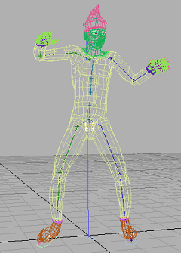
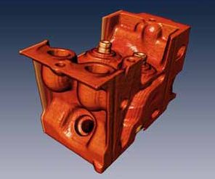
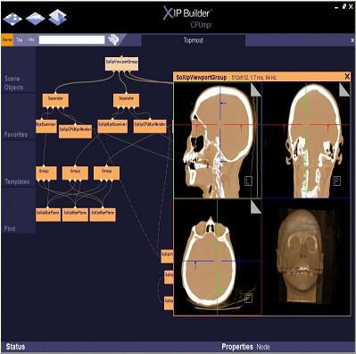
Motivation
Evolution of generic GPGPU languages
Heterogeneous architectures (OpenGL + CUDA)
Scene graphs are the most frequently used graphics architectures
General purpose functionality for scene graphs
( Physics, Simulations, Ray Tracing, Image Processing, Visualization )
NVSG by NVidia
VolumeViz by Mercury
XIP by Siemens

Slide 3
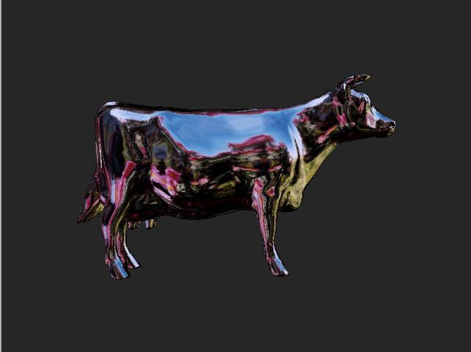
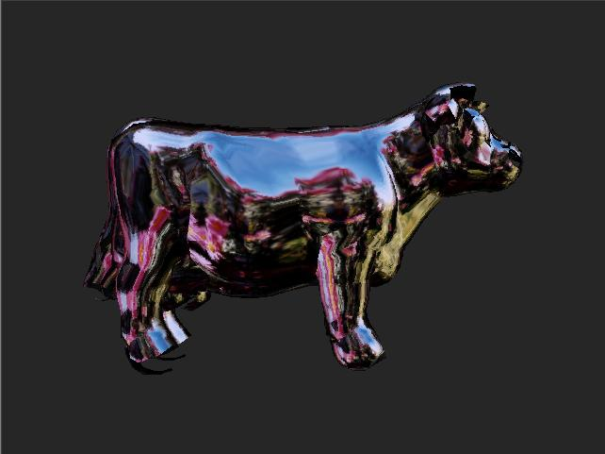
Contexts
A scene graph is populated with different kinds of rendering resources.
(textures, geometry, etc.)
Developers need to map these resources to the CUDA or OpenCL context
Interoperability should be invisible for developers.
The interface should be small.
Rendering
Computation

Slide 4
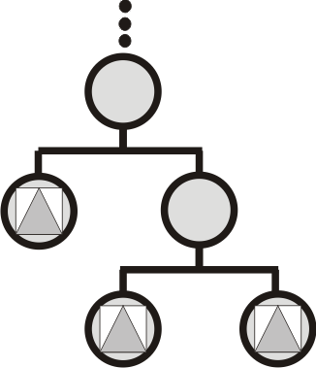
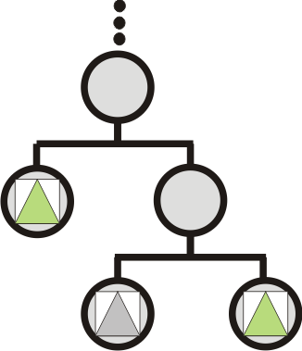
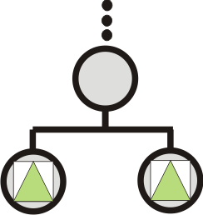
Graph Integration
How to integrate computations into the graph?
How to identify resources?
How to manage dynamic structures?
?

Slide 5
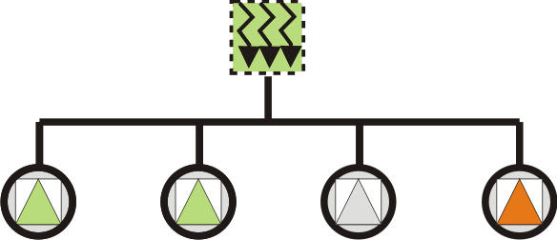
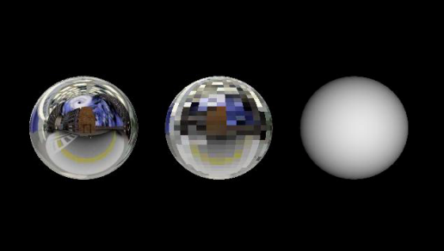
Approaches
Callback Approach
Engine Approach
Subtraversal Approach
Small Interface
Fixed References
No Intracommunication
Intracommunication
Multiple resources
Hidden dependencies
Fixed References
No references
Intracommunication
Multiple resources
Visible dependencies
Requires traversals
Naming scheme
’’Input’’
’’Input’’
’’Output’’

Slide 6
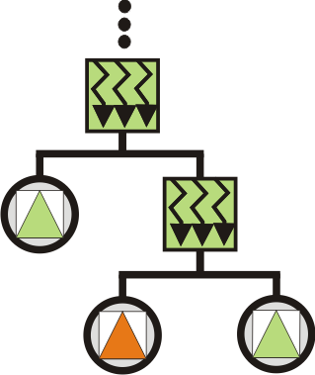
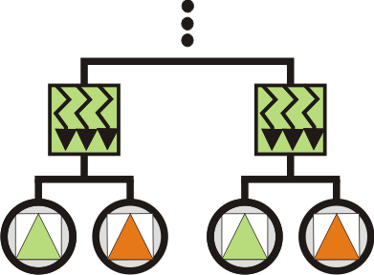
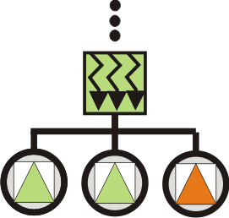
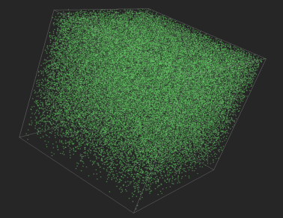
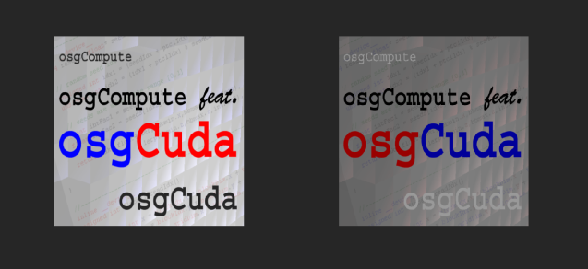
Subtraversal Approach
Single Context
Shared Context
Multiple Contexts

Slide 7
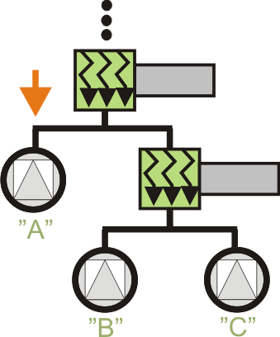
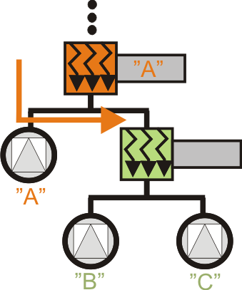
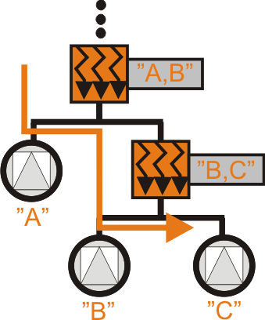
Resource Gathering
Resources are passed on to the computation modules
Exchange current computation context

Slide 8
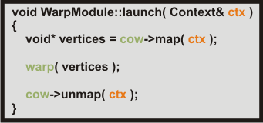
Graph Evaluation
Resources are mapped during the computation
Abstract view of resources within computations

Slide 9
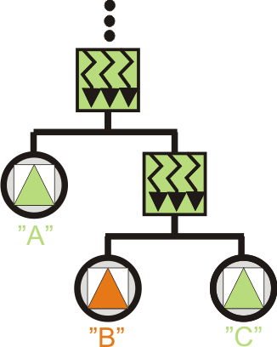
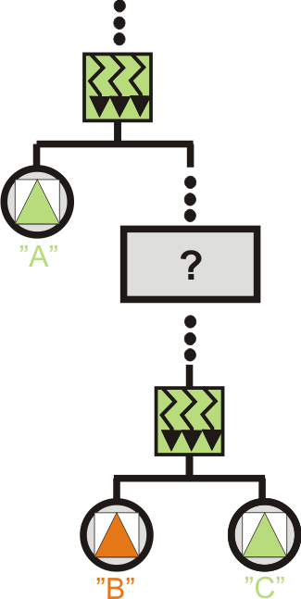
Resource Mapping
Intermixing rendering with computations
Memory mapping between contexts is expensive

Slide 10
Results
osgCompute:
CUDA (2.3) integration into OpenSceneGraph
Useable without the Scenegraph structure (similar to the Thrust API)
Support for all platforms: Linux, Mac, Windows
Framework, documentation and examples are available under the LGPL:
http://www.cg.informatik.uni-siegen.de/svt/osgcompute
Current Research:

Slide 11
Thank you for your attention!
This work is partially funded by the Siegener Graduate School “Development of Integral Heterosensor Architectures for the n-Dimensional (Bio)chemical Analysis”.
Thanks to Robert Osfield and Art Tevs for their support

