Slide 1
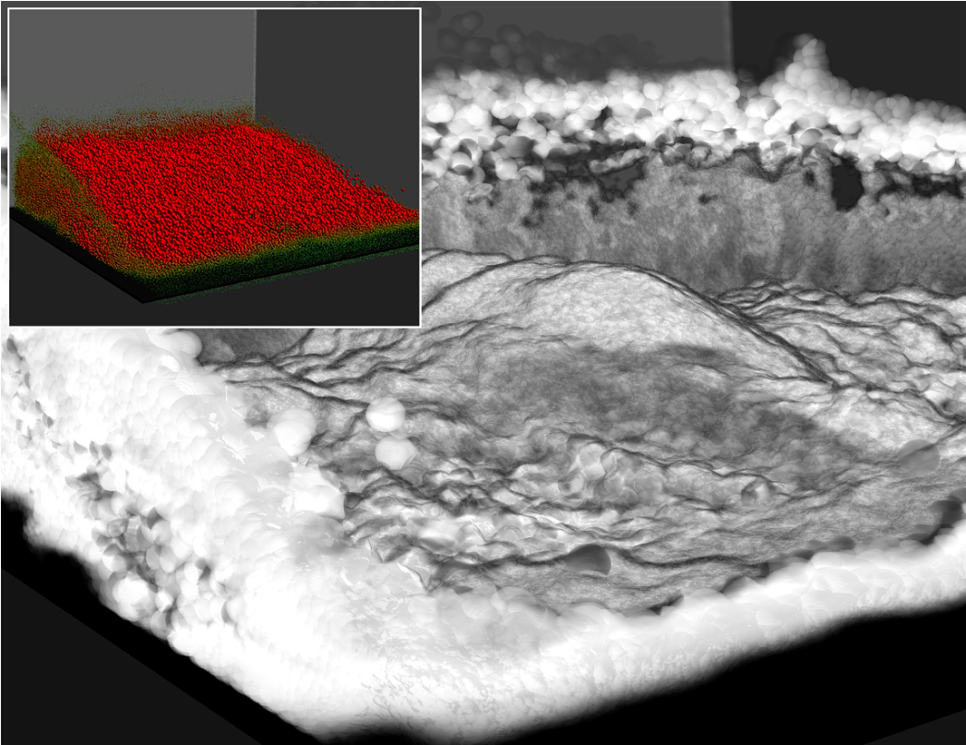
Topology-Caching for Dynamic Particle Volume Raycasting

Slide 2
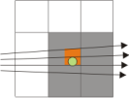
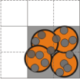
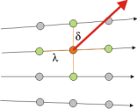
Outline
Motivation
Recent Techniques
GPU Raycasting System
  Node-Cache
  Influence-Cache
  Slab-Cache
Video & Results
Conclusion

Slide 3
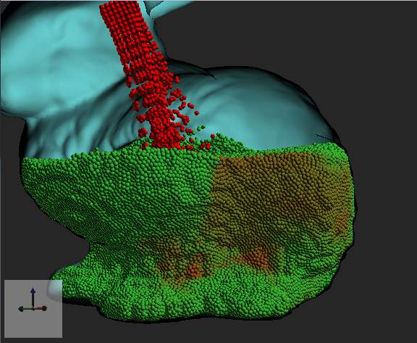
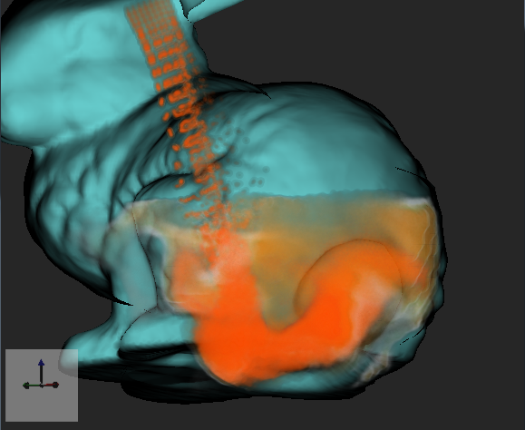
Motivation
Real-time particle-based flow simulations:
  Particles carry physical flow properties like density, concentration, etc.
  Rendering color-coded sprites is insufficient.

Slide 4
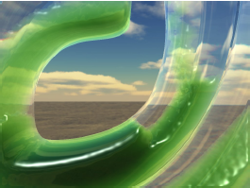
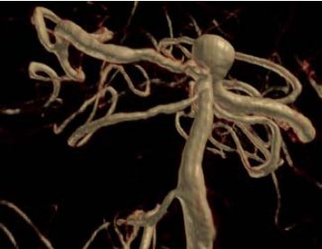
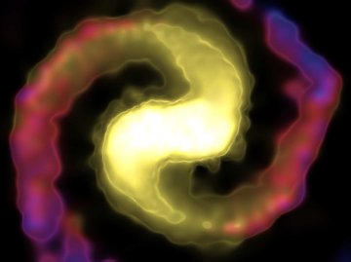


Recent Techniques
Image-based Rendering
Surface reconstruction
Fast: 64K around 55-20 fps
No Volume-Rendering
Splatting
Standard for particles
Fast: 200K around 43 fps
Blurred images
Texture-based Raycasting
High quality
Large datasets up to 42M
Requires pre-computation
W. van der Laan et. al., 2009:
“Screen Space Fluid Rendering
with Curvature Flow“
P. Schlegel et al., 2009:
“Layered Volume Splatting“
Fraedrich et. al., to appear:
“Efficient High-Quality Volume Rendering of SPH Data“

Slide 5
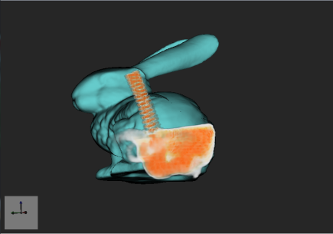
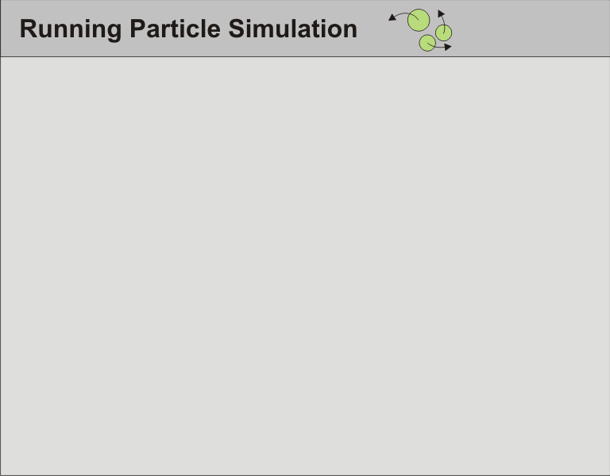
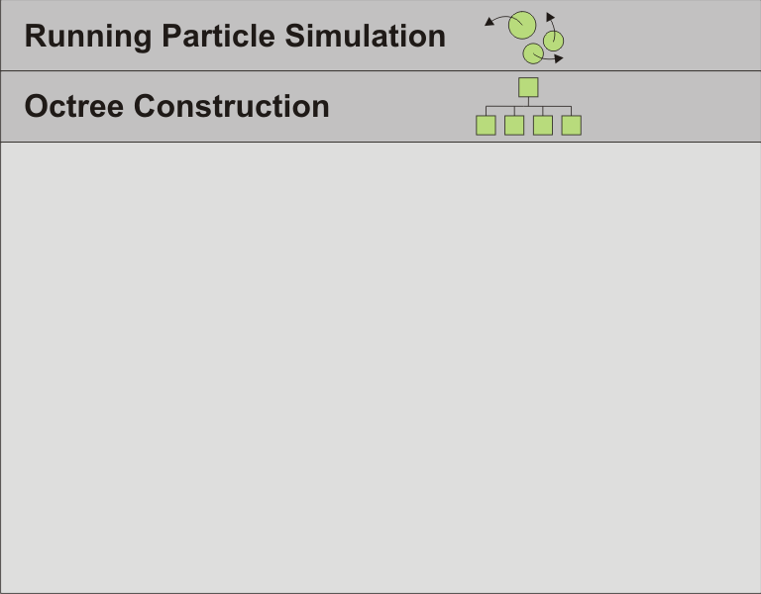
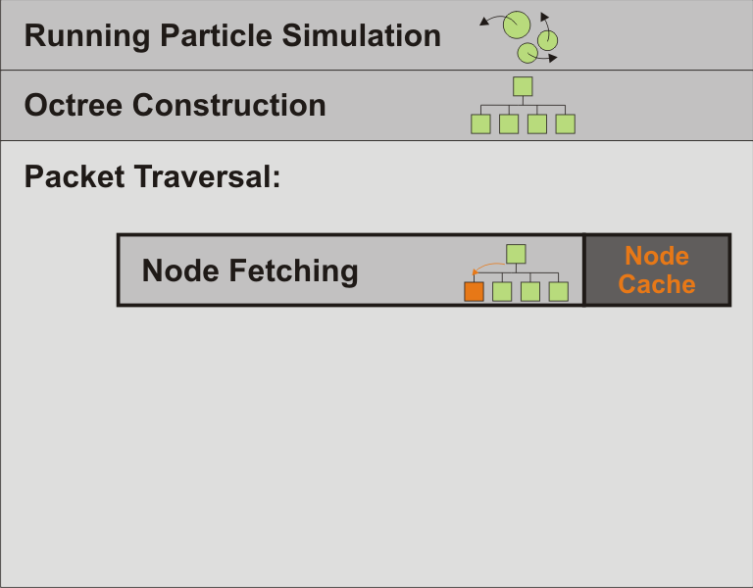
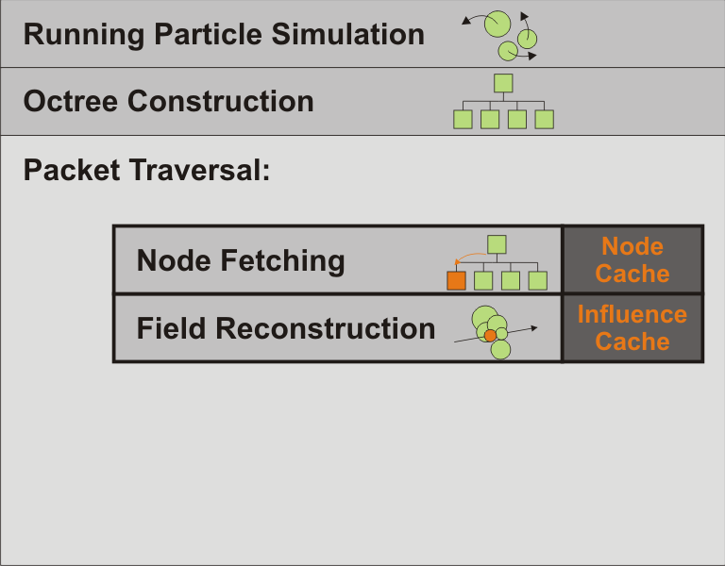
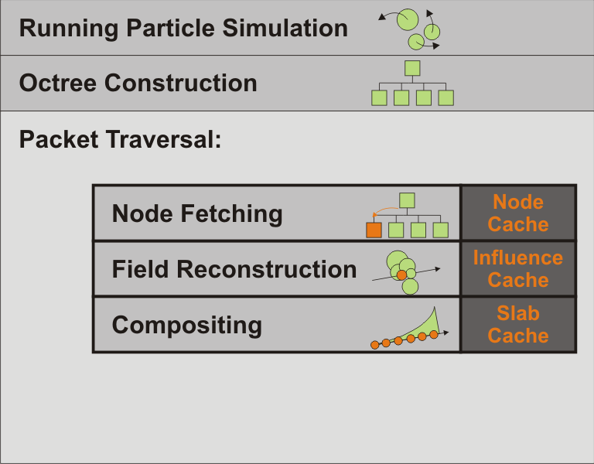
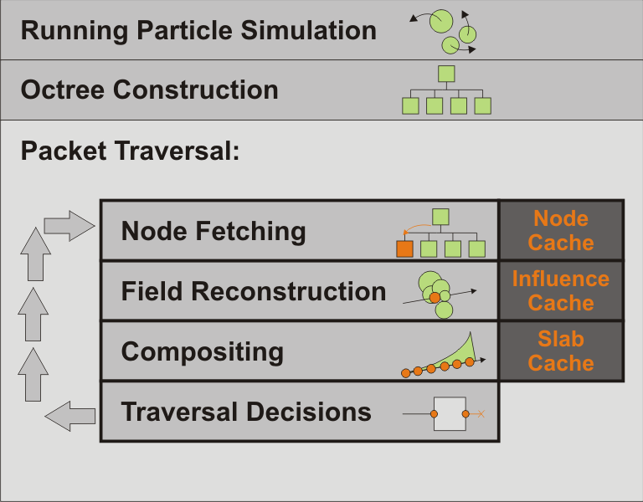
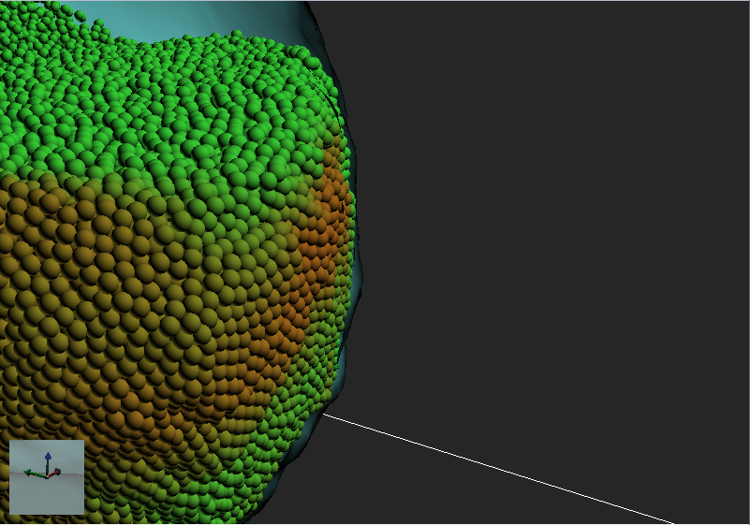
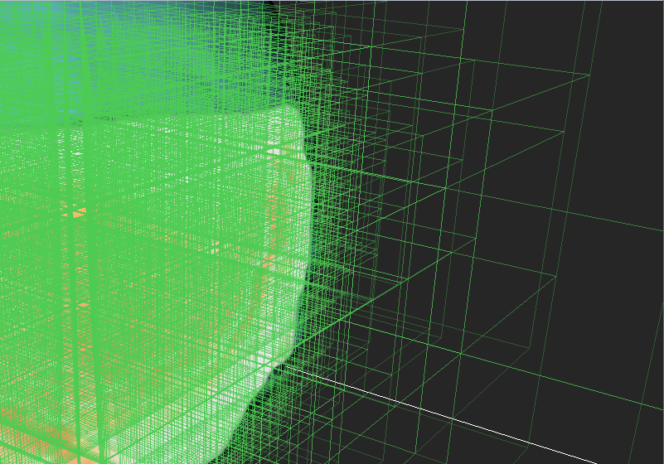
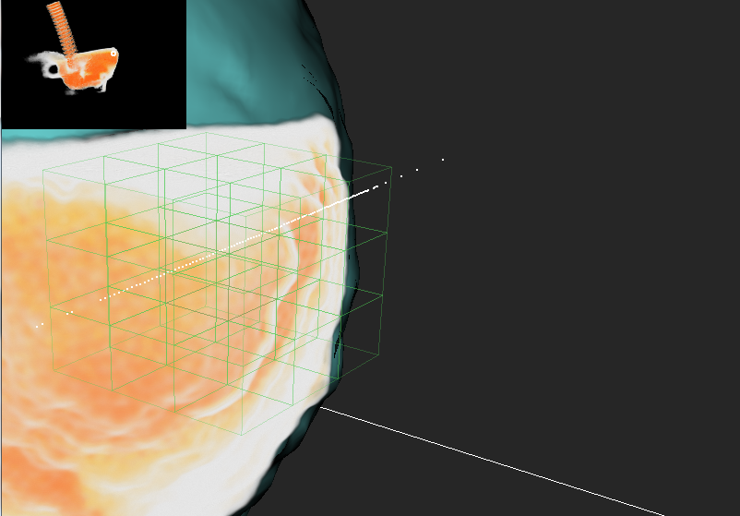
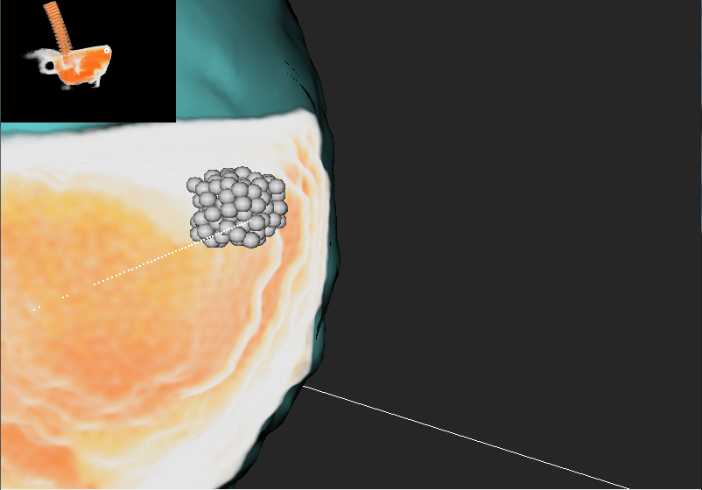
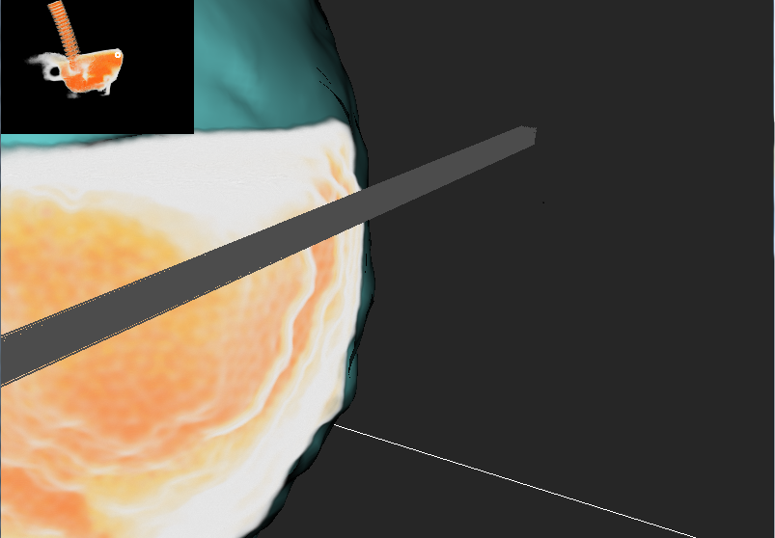
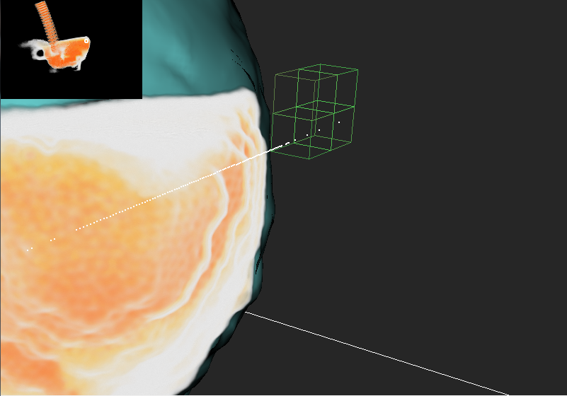
GPU Volume Raycasting
In each frame:
K. Zhou et al., 2010:
“Data Parallel Octrees
for Surface Reconstruction“
5

Slide 6
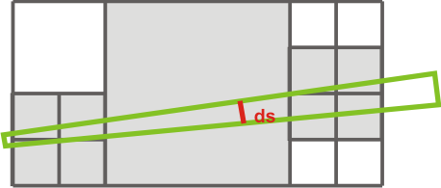
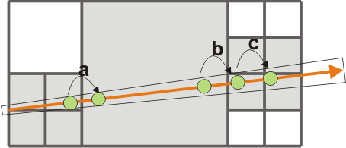
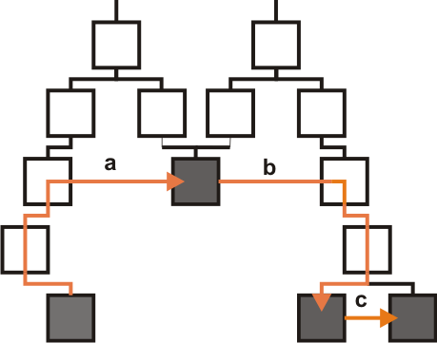
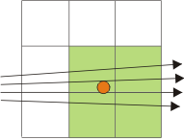
Tree Traversal: Node Cache
Assumption: the packet’s extend is smaller than the size of a node
Implication:
  Node pre-fetching
  Neighbor traversal
J .Wilhelms et al., 1992:
“Octrees for faster isosurface
generation“

Slide 7
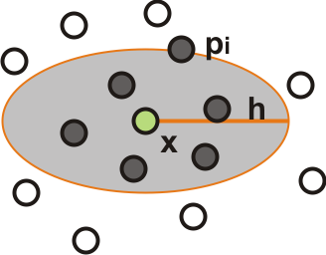


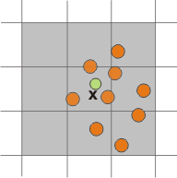
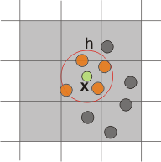
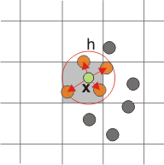

Sampling: Influence Cache
Assumption: field reconstruction works with particles in the local neighborhood:
Implication: redundant particle assignment.
P. Koumoutsakos et al., 2008:
“Flow Simulation using Particles“
G. Guennebaud et al., 2008:
“Dynamic Sampling and Rendering
of Algebraic Point Set Surfaces“

Slide 8
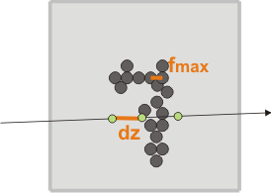

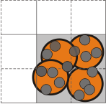
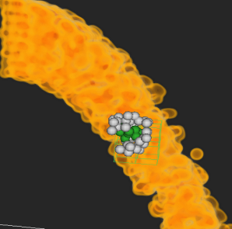
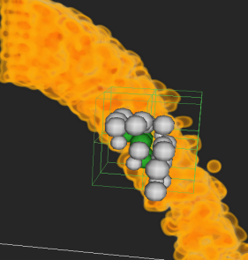
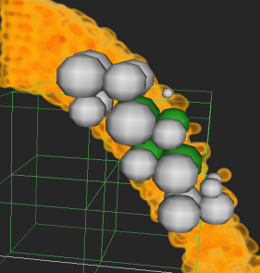

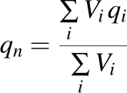
Sampling: Influence Cache
Problem: Undersampling at higher distances.
Solution: Buttom-up merging of particles.
M. Zwicker et al., 2003:
“EWA Splatting“
[Nyquist Theorem]
W. Hong et al., 2008:
“Adaptive particles for incompressible
fluid simulation“

Slide 9
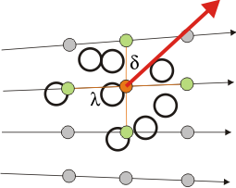
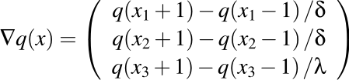
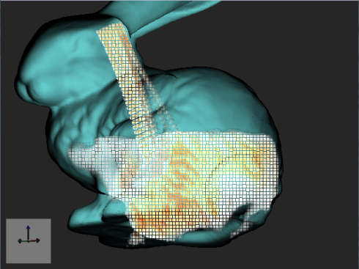
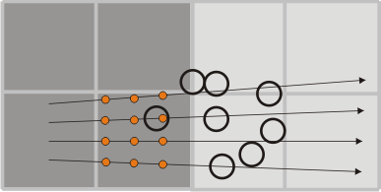
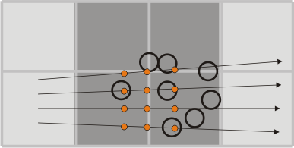
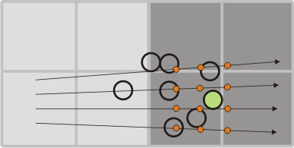
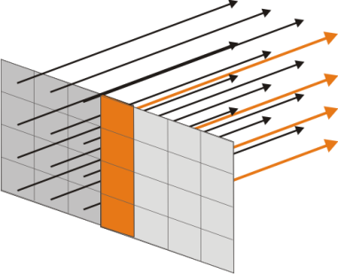
Compositing: Slab-Cache
Problem: same particles are sampled multiple times (gradients).
Solution:
  Slab-based front-to-back compositing
  Particles scatter to several slices at once
J. Mensmann et al., 2010:
“An advanced volume
raycasting technique
using GPU stream processing”

Slide 10
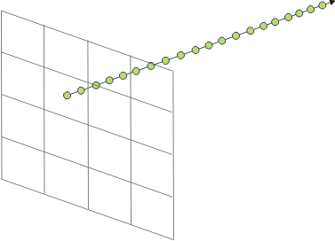
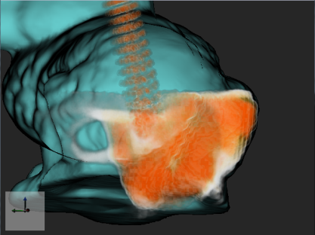
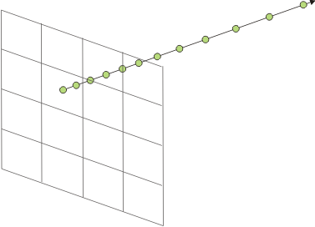
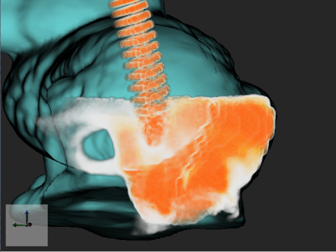


Compositing: Slab-Cache
[Recently] Observation: too many samples in distant regions
Solution: adaptive step size with opacity correction
Fraedrich et al., to appear:
“Efficient High-Quality Volume Rendering of SPH Data“

Slide 11
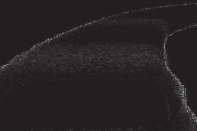

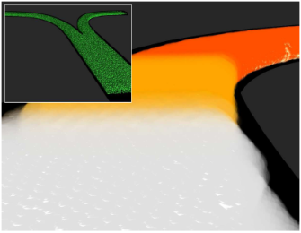
Results
Errors of the packet traversal:
  [Recently] Adaptive Steps, 8x8 Packets, CUDA on GTX 400 [unoptimized]:

Slide 12
Conclusion
Raycasting Pipeline: three optimization strategies
  [Per Slab] Node-Cache
  [Per Node] Influence-Cache
  [Per Slab] Slab-Cache
Future Work
  Optimization for GTX 400 (Occupancy)
  Automatic transfer-functions
  Splitting kernel into several distinct steps

Slide 13
Thank you
Thank you for your attention

