Slide 1
Medical Image Processing
Morphological Operations

Slide 2
Main thresholding methods
Introduction to the mathematical morphology in IP
Combined operations
Some examples and applications

Slide 3
Introduction to mathimatical morphology in IP
Some basic set operations on binary images
  Set translation:
  A_{z} = {b | b = a + z, aϵ A} = {(a_{x}+z_{x}, a_{y}+z_{y})|(a_{x}, a_{y}) ϵ A}, z=(z_{x}, z_{y})
  Set reflection
  A_{z} = {b | b = a + z, aϵ A}

Slide 4
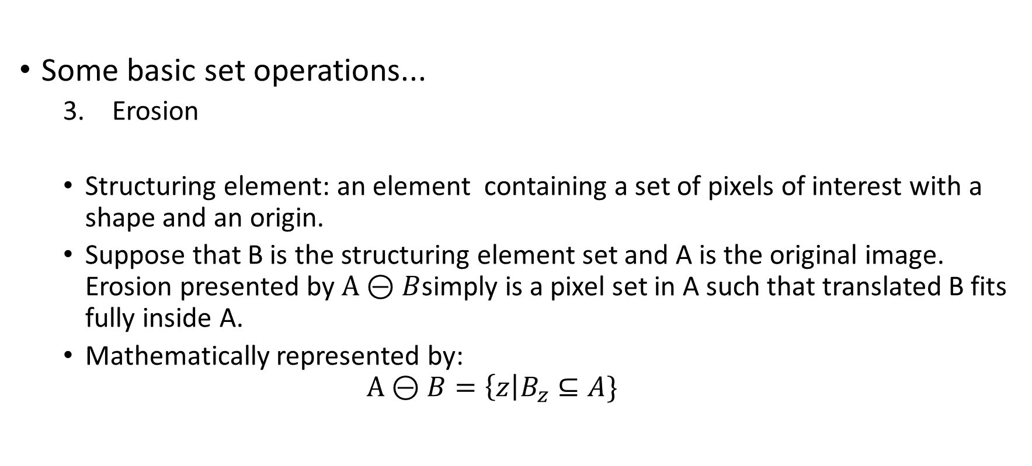
Introduction to mathimatical morphology in IP
Some basic set operations...
  Erosion
  Structuring element: an element containing a set of pixels of interest with a shape and an origin.
  Suppose that B is the structuring element set and A is the original image. Erosion presented by $A⊝B$simply is a pixel set in A such that translated B fits fully inside A.
  Mathematically represented by:
  $$A⊝B=\left\{z\right|B_{z}⊆A\}$$

Slide 5
Introduction to mathimatical morphology in IP
Some basic set operations
  Erosion (cont‘d) : an example: the result is in red
  B:
  A:

Slide 6
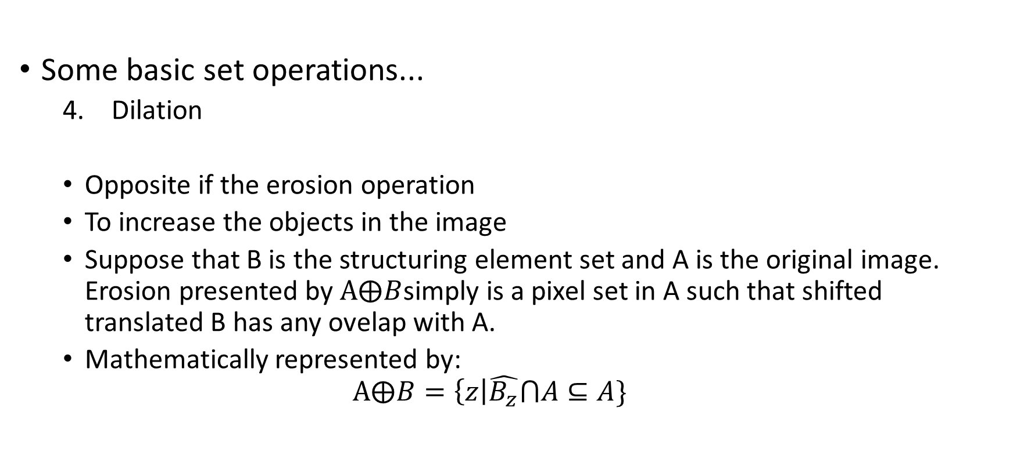
Introduction to mathimatical morphology in IP
Some basic set operations...
  Dilation
  Opposite if the erosion operation
  To increase the objects in the image
  Suppose that B is the structuring element set and A is the original image. Erosion presented by $A⨁B$simply is a pixel set in A such that shifted translated B has any ovelap with A.
  Mathematically represented by:
  $$A⨁B=\left\{z\right|\hat{B_{z}}⋂A⊆A\}$$

Slide 7
Introduction to mathimatical morphology in IP
Some basic set operations...
  Dilation (cont‘d): an example; the result after dilation is in black as below.
  B:
  A:

Slide 8
Introduction to mathimatical morphology in IP
  Some properties:
  Can be extended easly to the grayscale images
  Very useful applications appear in image segmentation
  More applications will appear by combination of the basic operations

Slide 9

Combined operations
  Operations:
  Opening: Erosion + Dilation
  Let B be the structuring element
  Let A be the original set
  $$A∘B=(A⊝B)⨁B$$

Slide 10

Combined operations
  Operations:
  Closing: Dilation + Erosion
  Let B be the structuring element
  Let A be the original set
  $$A⋅B=(A⨁B)⊝B$$

Slide 11
Combined operations (not limited to)
Extracting the outline of the foreground
Extracting the skeleton of the foreground
Removing spur pixels from the image
Thickening the objects of the image

Slide 12
Combined operations (examples)
Extracting the skleton of the image (original image in right):

Slide 13
Combined operations (examples)
Extracting the outline of the objects in image (original image in right):

Slide 14
Combined operations (examples)
Erosion with respect to the structuring element in shape of line (original image in right):

Slide 15
Combined operations (examples)
Erosion with a circle with radius 11 (original image in right):

Slide 16
Some Applications
Hole and region filling
Binary and watershed segmentation
Noise removal from a noisy image
Enhancing the segmentation tasks

