Slide 1
Medical Image Processing
Image thresholding methods

Slide 2
Main thresholding methods
Global thresholding
Local thresholding
Adaptive thresholding

Slide 3
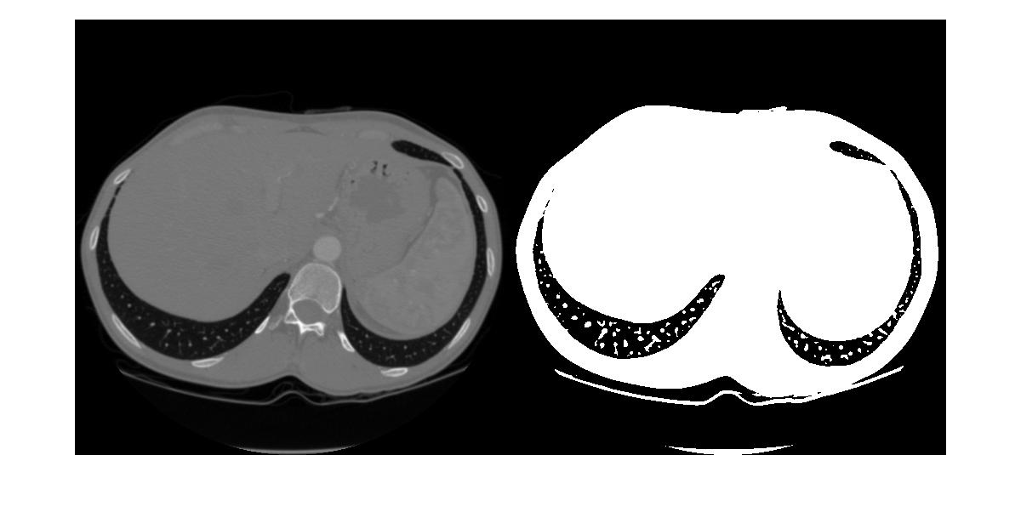
Global thresholding
A constant threhold is applied to the whole image pixels.
The image is devided into background and foreground

Slide 4
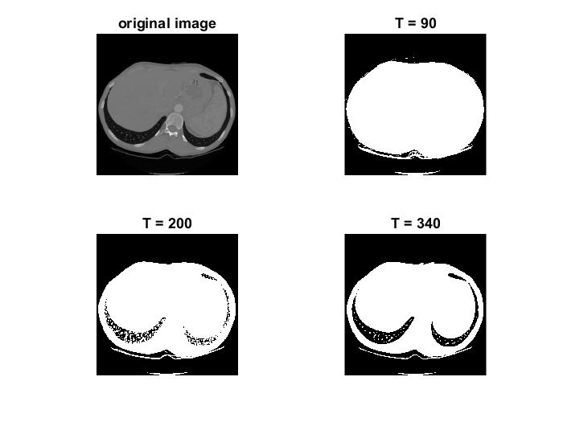
Global thresholding (example with different thresholds)

Slide 5
Problems with the global thresholding
Different objects appear in many different gray level.
Background might have high intensity variation.
So, Global Thresholding method is most useful when image contains a single object or objects with the same (almost) gray level also less noisy.
More technically Global Thresholding is useful when the image histogram can be separated in two regions clearly.

Slide 6
Otsu‘s thresholding method
It is the most commonly used global thresholding method.
Still the most common method for converting grayscale images to binary images.
It devides the image pixels into two classes foreground and background pixels based on minimizing inter class variance or equalently maximizing intra class variance.

Slide 7
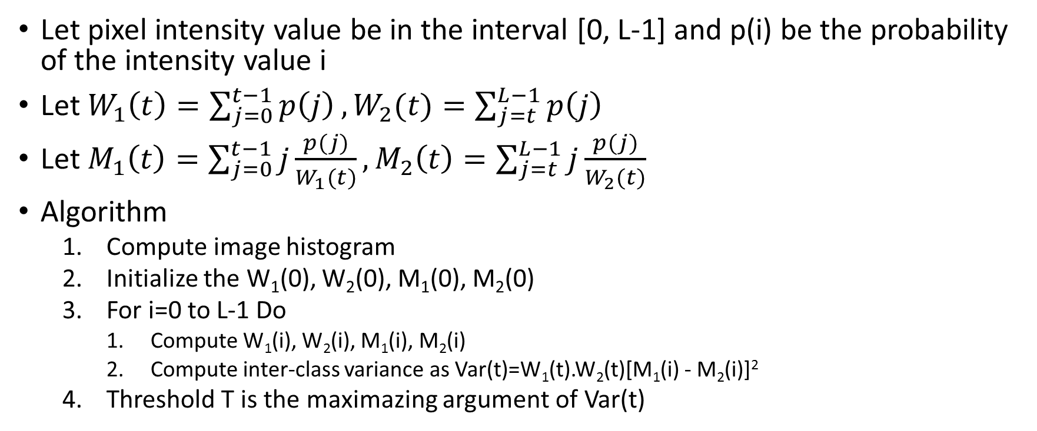
Otsu‘s thresholding method (Cont‘d)
Let pixel intensity value be in the interval [0, L-1] and p(i) be the probability of the intensity value i
Let $W_{1}\left(t\right)=\sum_{j=0}^{t−1}{p\left(j\right)},W_{2}(t)=\sum_{j=t}^{L−1}{p\left(j\right)}$
Let $M_{1}\left(t\right)=\sum_{j=0}^{t−1}{j\frac{p(j)}{W_{1}(t)},}M_{2}\left(t\right)=\sum_{j=t}^{L−1}{j\frac{p(j)}{W_{2}(t)}}$
Algorithm
  Compute image histogram
  Initialize the W₁(0), W₂(0), M₁(0), M₂(0)
  For i=0 to L-1 Do
    Compute W₁(i), W₂(i), M₁(i), M₂(i)
    Compute inter-class variance as Var(t)=W₁(t).W₂(t)[M₁(i) - M₂(i)]²
  Threshold T is the maximazing argument of Var(t)

Slide 8
Local thresholding
Deviding the image into some regions
Applying a global thresholding method in each region individually

Slide 9
Adaptive Thresholding
Threshold is set according to the neighbor pixels.
The basic statistical information of the image is used locally and globally.
Better results are gained comparing to global and local thresholding method and more details in the image are revealed.
Different appraoches exist for adaptivee thresholding dpending on the application.
Different settings exist for each approach depending on the image noise level, histogram,...

Slide 10
Adaptive thresholding (Niblack‘s method)
Set the window size (a moving rectangular window, e.g., [3 3])
For each pixel I_{ij} DO
  Caclulate local mean ml
  Calculate local standard of deviationsl
  Calculate the threshold T as T = m_{l} + k_{sl} (k= -0.2)
  Apply the threshold (I_{ij} = 0 if I_{ij} < T otherwise I_{ij} = 1)
Output the binary image I

Slide 11
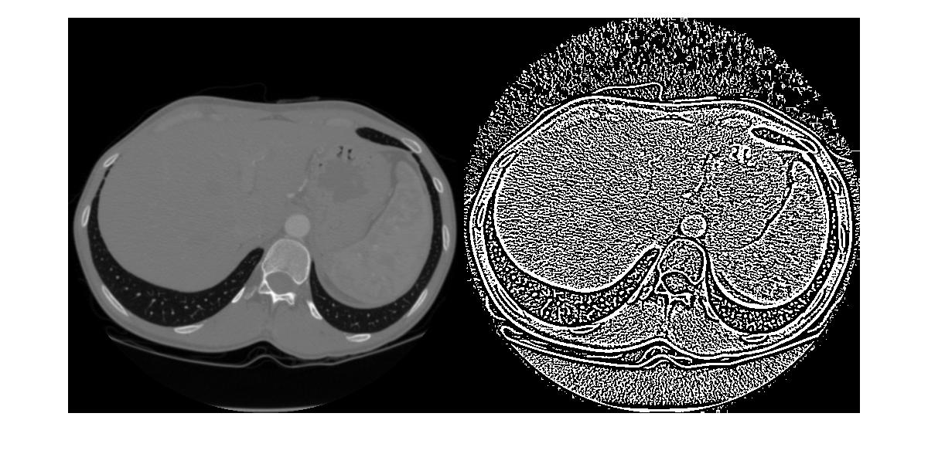
Adaptive thresholding (window size: [5 5]

Slide 12
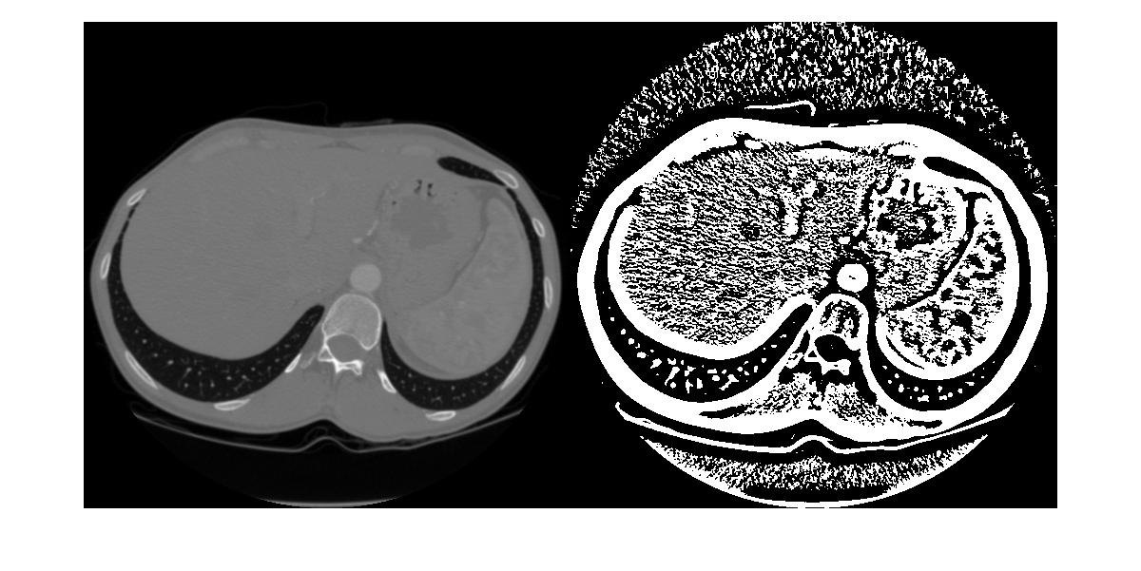
Adaptive thresholding (window size: [25 25]

Slide 13
An example on thresholding a CT image based on the relationship between HU and pixel intensity values
The mapping between HU and pixel values look likes:
HU=pixelValue*slope+intercept
Slope and intercept must be extracted from DICOM image file based on the DICOM header
After extracting the HU information of each pixel, the threshold is applied on the image based on information on the desired organ to be detected.

Slide 14
An example on thresholding a CT image....
I=dicomread('CT1.dcm'); % reading a CT image
Inf=dicominfo('CT1.dcm'); % extracting the DICOM
[group1, element1] = dicomlookup('RescaleSlope'); %Finding the group and element of component slope of the image
[group2, element2] = dicomlookup('RescaleIntercept'); %Finding the group and element of component intercept of the image
slope=Inf.(dicomlookup(40, 4179)); % extracting slope
intercept=Inf.(dicomlookup(40, 4178));%extracting intercept
HU=int16(I)*slope+intercept; %calculating the HU (Hounsfiled Unit) corresponding to each pixel value
Threshold= input(prompt); %setting the threshold from input
for i=1:size(I, 1) % applying the threshold
for j=1:size(I, 2)
if (HU(i, j)<T)
I(i, j)=1;
else
I(i, j)=0;
end
end
end

